Slide 1
SeatSync
Distributed ticket booking
A local demonstration of coordination and recovery
Distributed Computing 2026–27
01
Notes:
Introduce the problem: several entry servers can receive requests for the same seat. SeatSync makes the coordination visible. Run entirely locally with independent processes and separate databases. Course: Distributed Computing 2026–27.

Slide 2
The booking problem
12 requests
compete for one available seat
The system must serialize conflicting reservations and preserve confirmed bookings when a server process crashes.
Demonstration goal: one confirmed owner for each seat
02
Notes:
Use the last-seat example. If independent servers read availability and write without coordination, both may attempt to allocate the same seat. Our chosen mechanism is centralized mutual exclusion with an elected coordinator. This is a teaching workload, not a payment system.

Slide 3
Independent processes on one laptop
Component | Address | Responsibility
Browser and gateway | 127.0.0.1:18780 | Booking UI and process controls
Node 01 | 127.0.0.1:18791 | Entry server and replica
Node 02 | 127.0.0.1:18792 | Entry server and replica
Node 03 | 127.0.0.1:18793 | Initial coordinator and replica
Each replica owns a separate SQLite database. All booking messages travel over local HTTP RPC.
03
Notes:
Each node has its own operating-system process, HTTP endpoint, and SQLite file. The gateway routes browser requests and starts or kills processes, but nodes elect the coordinator themselves. Stable logical IDs map to addresses. Initial coordinator is Node 03. Source: app.py, node.py, common.py.

Slide 4
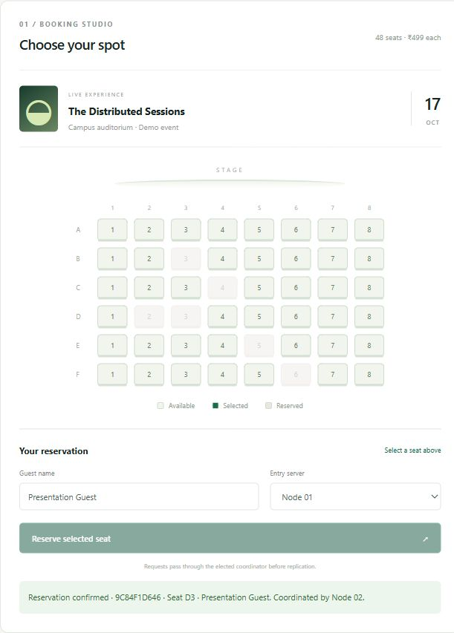
A reservation through the cluster
1 Select a seat
The client chooses an available seat and an entry server.
2 Request exclusive access
The entry node forwards to the elected coordinator.
3 Confirm durable copies
The coordinator records the reservation and waits for two replicas.
04
Notes:
Screenshot: actual local browser session. This screenshot shows a successful booking after failover, coordinated by Node 02. The browser can choose any live entry node. Explain the path from entry node to coordinator, durable replication, and response. Source: docs/screenshots/booking-detail.jpg and node.py.

Slide 5
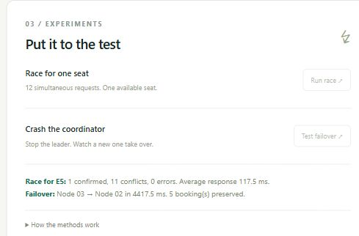
Centralized distributed mutual exclusion
One coordinator grants access
A mutex protects the seat check and the replicated reservation update.
One winner under contention
Later contenders see the reserved seat and receive a conflict response.
The critical section includes an intentional 55 ms teaching delay.
Actual local browser experiment
05
Notes:
Every node forwards booking requests to one elected coordinator. A mutex in that process serializes the critical section across those callers. This is the centralized algorithm, not Ricart–Agrawala. The race releases 12 concurrent requests through online nodes with a barrier. Screenshot: actual browser run. Source: node.py Node.book and app.py Cluster.race.

Slide 6
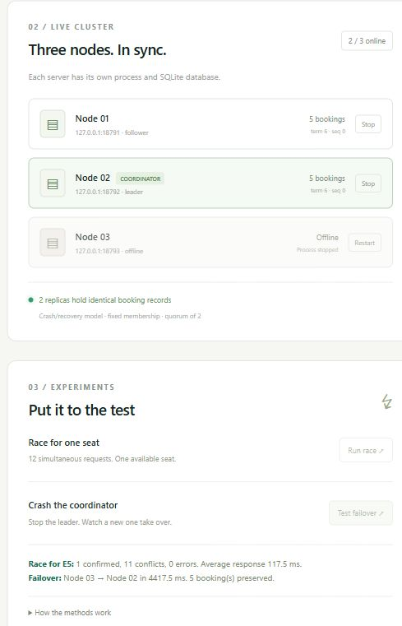
Bully election after a coordinator crash
Failure detection
A missing coordinator heartbeat triggers an election.
Election priority
Higher node IDs take priority. Node 02 wins while Node 03 is offline.
Recovery before promotion
The candidate reads replicas and requires a quorum before accepting writes.
06
Notes:
Actual browser screenshot: Node 03 process has stopped and Node 02 is coordinator. Followers detect failure through heartbeat timeouts. A candidate sends election requests to higher IDs. The highest reachable ID recovers state, replicates a new term to a quorum, and announces itself. Browser measurement and integration measurement come from different runs. Source: node.py Node.elect and Node.monitor.

Slide 7
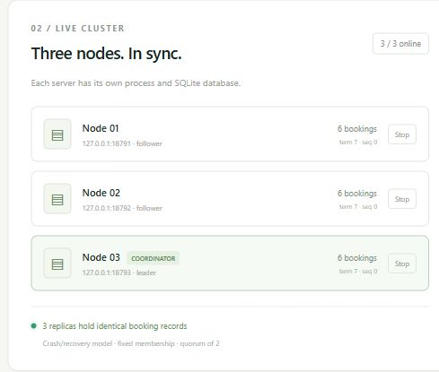
Replica recovery
A returning node starts from disk
Each replica reads its own persistent SQLite state.
Peers supply missing updates
Recovery selects the greatest observed term and sequence version.
The cluster converges
The higher ID regains coordination after state recovery. Reservation records match.
07
Notes:
Screenshot: actual Node 03 recovery after the browser failover experiment. Node 03 missed a booking while offline. On restart it loads its own database and reads peer snapshots. As the highest ID it recovers the newest version before reclaiming leadership. A returned lower-ID node receives state from the existing coordinator. Integration tests cover both cases. Source: node.py election and /election handler.

Slide 8
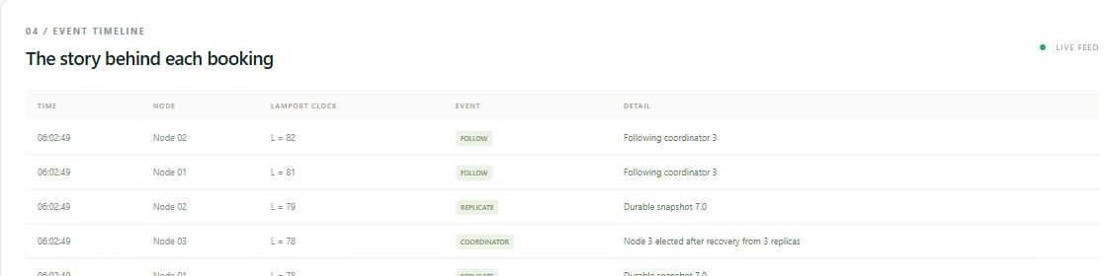
Logical events and message order
Outgoing message: increment local counter
Incoming message: max(local, received) + 1
The timeline exposes election, locking, replication, and booking events.
08
Notes:
Screenshot: actual event feed. Traced mutating RPCs carry a Lamport clock. Sending increments the counter. Receipt applies max(local, received) + 1. Local events also increment it. GET health and status probes are not part of this logical-clock example. The dashboard sorts by wall time on one laptop for readability. Lamport counters do not measure elapsed time and do not identify concurrency the way vector clocks do. Source: node.py and docs/screenshots/timeline.jpg.

Slide 9
Measured local results
Experiment | Observed result
Same-seat race | 12 requests, 1 success, 11 conflicts, 0 errors
Mean race response | 103.7 ms, measured end to end
Coordinator failover | 4430.6 ms, Node 03 to Node 02
Existing booking records | 2 preserved in the integration experiment
Recovery and persistence | Higher and lower ID recovery, full restart passed
One measured run on this laptop. 9 integration tests passed.
09
Notes:
Source: docs/test-results.json, a completed isolated integration-test run. Race mean 103.7 ms. Failover 4430.6 ms. These are one-run observations on this laptop. The 55 ms critical-section delay is intentional. Failover includes heartbeat timeout and supervisor polling. They are not universal performance claims. The separate browser screenshot uses another run and naturally differs. All nine integration test methods passed.

Slide 10
Failure model and limits
Supported experiment
Fixed membership, reliable loopback communication, and process crash/recovery.
Uncertain outcomes
A crash before the response may leave a reservation. Retry with the same request ID.
Production requirements
Partition-safe consensus and fencing, stronger recovery rules, authentication, and incremental logs.
10
Notes:
State these limits candidly. This project is not Raft or Paxos and does not establish partition-safe consensus. Bully election and quorum snapshots alone cannot prevent split brain under arbitrary network partitions, asymmetric reachability, or long scheduling pauses. A reservation may survive even if the reply is lost. Retrying with the same request ID is necessary. The gateway and laptop remain common points of failure. Source: README.md Recovery and assumptions.

Slide 11
Connection to the course
Course method | Project evidence
Client–server and RPC | Independent HTTP endpoints and forwarded booking requests
Centralized mutual exclusion | One elected coordinator serializes booking updates
Bully election | Highest reachable ID recovers and announces leadership
Fault tolerance and replication | Separate databases, quorum confirmation, restart recovery
Lamport clocks and naming | Logical event counters and stable node-to-address mapping
11
Notes:
Map the implementation to the provided Distributed Computing course policy. The policy is a syllabus, not proof of which lectures have occurred. We implement a selected combination rather than all topics. Naming is a static ID-to-address mapping, not DNS. Source: supplied Course Policy_DC_2026-27.docx instruction plan and lab list, plus local implementation.

Slide 12
Live demonstration
01 Book through Node 01
Show the receipt and matching replica records.
02 Race for another seat
Read the success, conflict, and error counts.
03 Crash and recover
Observe the election, make another booking, and restart Node 03.
Local address http://127.0.0.1:18780
12
Notes:
Suggested sequence takes about five minutes. Before presenting, ensure three nodes online, optionally reset the demo, and open http://127.0.0.1:18780. Book C4, race B3, crash coordinator, reserve another seat through a surviving node, restart Node 03, and export evidence. Show the current values rather than promising exact latency. Further narration and viva notes: docs/DEMO_SCRIPT.md.

