Slide 1

SPOTIFY DATA STUDY
Decoding Spotify
Popularity
What drives streams - and how to surface the next hit
Maisha Khatoon | Analyst
802 songs · 558 artists · 1930-2023

Slide 2
EXECUTIVE SUMMARY
Three findings that explain Spotify popularity
01
02
03
Playlists are everything
Cross-platform reach compounds
Audio features barely matter
Spotify playlist inclusion explains 59% of the variance in streams - more than every audio feature combined. Songs in the top playlist quartile see 10× the streams of the bottom quartile.
Songs present on all three major platforms (Spotify + Apple + Deezer) achieve 4.7× the median streams of single-platform tracks. Reach multiplies; it doesn't add.
Danceability, valence, energy - none correlate strongly with streams (all r < 0.13). The right placement matters more than the right sound.

Slide 3
DATASET
What we're working with
802
558
432B
308M
Songs analyzed
Unique artists
Total streams
Median streams
after cleaning & merge
solo + collaborations
cumulative
per song
141
675
9
2
Songs > 1B streams
Songs > 100M streams
Decades covered
Source sheets
the mega-hits
84% of dataset
1930 to 2023
Song_Deatils + Node_Deatils

Slide 4
STEP 1 · CLEANING
Challenges encountered in the raw data
Data Cleaning Summary (Business View)
Key Issues Identified & Resolved
Inconsistent IDs: Standardized formatting so datasets could merge correctly.
Duplicate Records: Removed overlapping entries to avoid double‑counting.
Mixed Data Types: Converted text‑based values into proper numeric formats.
Corrupted Row: Excluded one invalid record to prevent analysis errors.
Encoding Problems: Fixed broken characters in artist names.
Missing Values: Managed gaps in IDs and audio features during modeling.
Structural Differences: Aligned sheet structures to ensure a clean, reliable join.
Outcome
1,903 raw rows → 802 clean, analysis‑ready rows
Consistent, high‑quality dataset with no surprises during modeling

Slide 5
APPROACH
How the analysis was built
1
2
3
4
Clean
Explore
Model
Interpret
Normalize merge key, dedupe, fix encoding, coerce types, and build proper dates.
Distributions, correlations, year & artist breakdowns to surface candidate drivers.
Linear regression on log-streams for interpretation. Random forest for accuracy & non-linearity.
Translate feature importance into actionable recommendations for discovery & promotion.
Tools: Python (pandas, scikit-learn, matplotlib) · Excel · PowerPoint

Slide 6
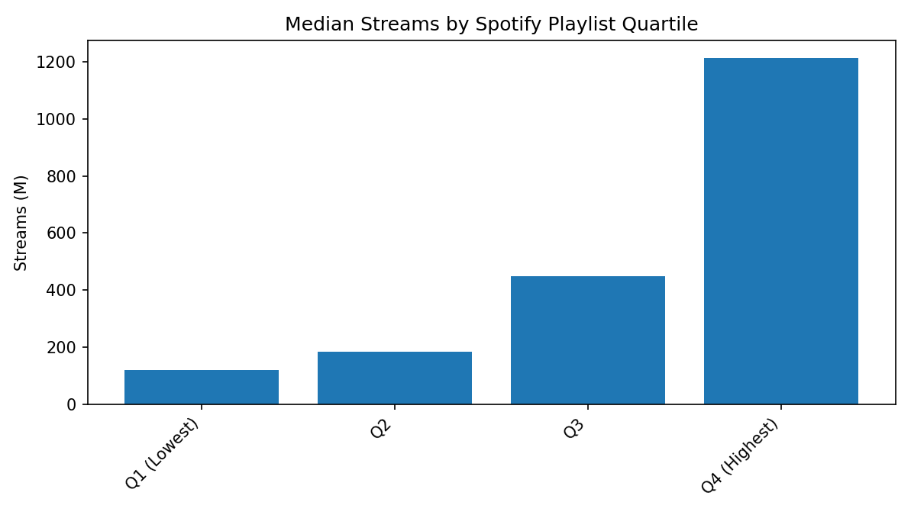
FINDING #1
Playlist inclusion is the dominant driver
THE 10× GAP
1,214M
median streams for songs in the top playlist quartile (Q4)
vs.
119M
for songs in the bottom quartile (Q1)
59% of random-forest feature importance comes from Spotify playlist count alone.
6 / 14

Slide 7
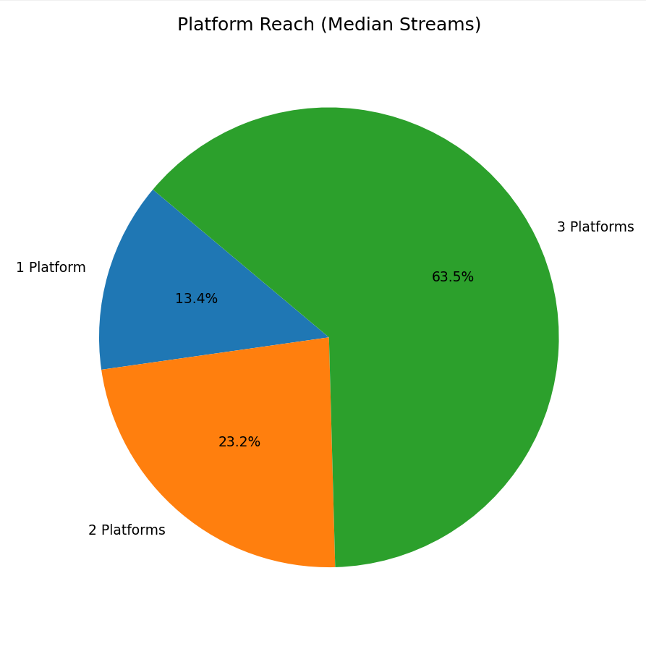
FINDING #2
Cross-platform presence compounds reach
4.7×
more streams for songs on all three platforms vs. just one
Spotify + Apple + Deezer
323M
Two platforms
118M
Single platform
68M
Reach multiplies, it doesn't add. Each additional platform roughly doubles median streams - suggesting non-overlapping audiences across services.
7 / 14

Slide 8
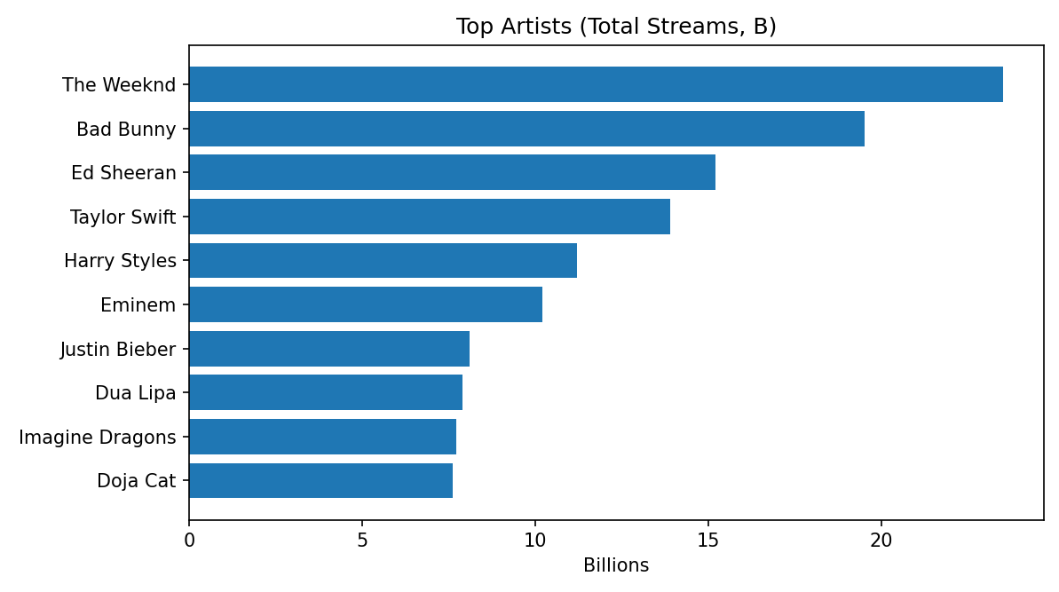
ARTIST INFLUENCE
Who moves the needle
Solo vs. collaboration
Median streams per song
Solo artist
350M
Collaboration
245M
Counter-intuitive.
Collabs underperform solo tracks at the median. Star power on one name beats split attention - though The Weeknd & Bad Bunny do appear on many top collabs.
9 / 14

Slide 9
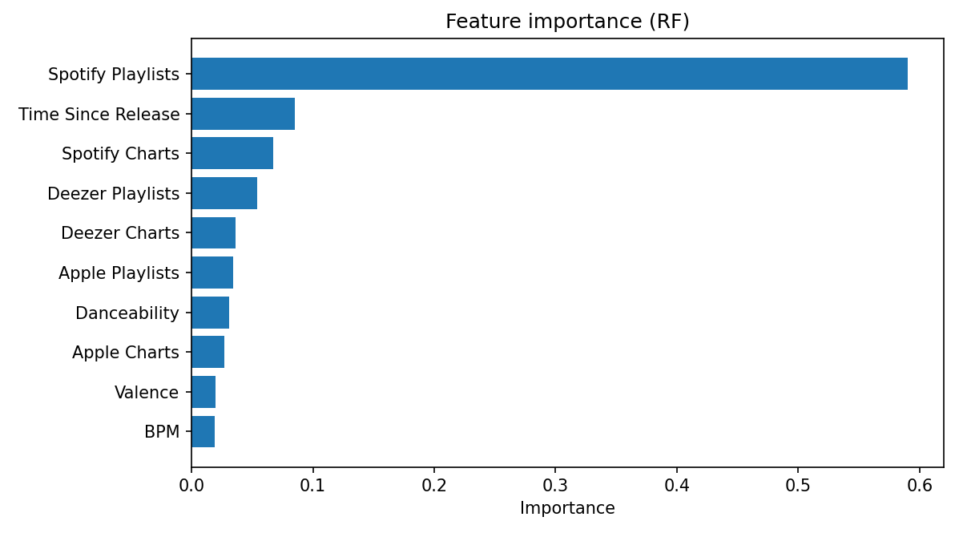
COUNTER-INTUITIVE FINDING
What the song sounds like barely matters
|r| < 0.13
for every audio feature
Why this matters
The popular intuition is that hits share a 'sound’ - danceable, upbeat, the right tempo. The data disagrees.
Distribution beats composition. The same song without playlist placement won't break out - regardless of how 'commercial' it sounds.
Combined RF importance of all 7 audio features: < 15%
10 / 14

Slide 10
APPLICATION
Which songs are trending right now?
Method: Rank songs released in the last 18 months by streams per day
# | Track | Artist | Streams / day | Total streams
1 | Flowers | Miley Cyrus | 3.72M | 1,317M
2 | Kill Bill | SZA | 2.99M | 1,163M
3 | Unholy (feat. Kim Petras) | Sam Smith, Kim Petras | 2.64M | 1,231M
4 | Ella Baila Sola | Eslabon Armado, Peso Pluma | 2.49M | 726M
5 | Anti-Hero | Taylor Swift | 2.29M | 1,000M
6 | I'm Good (Blue) | Bebe Rexha, David Guetta | 2.25M | 1,109M
7 | Creepin' | The Weeknd, 21 Savage, Metro B | 2.14M | 844M
8 | Shakira: Bzrp Music Sessions, Vol. | Shakira, Bizarrap | 2.03M | 722M
9 | TQG | Karol G, Shakira | 1.98M | 619M
10 | un x100to | Bad Bunny, Grupo Frontera | 1.95M | 506M
Recommendation: Spotify's 'trending' surface should rank by streams-per-day, not lifetime streams. Otherwise, old hits crowd out the songs people are actually discovering this week.
11 / 14

Slide 11
FINDING #3
Temporal trends: catalog effect & release timing
Catalog effect. 2017 songs have had 6+ years to accumulate streams; 2023 songs only months. Median drops sharply post-2020 - not a quality drop.
Release timing. January over-indexes (622M median - year-end carryover & resolution playlists). Jun & Feb-May lag. Aug-Sep are strong launch windows.
8 / 14

Slide 12
MODELLING APPROACH
Two models, two purposes
To understand what drives streams, two complementary models were trained on the cleaned dataset. Each answers a different question.
1
Linear Regression
2
Random Forest
Interpretable baseline on log₁₀(streams)
Non-linear ensemble · 300 trees · max depth 10
What it does
What it does
Fits a straight-line relationship between each feature and the log of streams. Features are standardized (z-scored) before fitting so coefficients are directly comparable.
Builds 300 decision trees on random feature subsets, then averages their predictions. Each split learns non-linear thresholds - e.g. "playlist count > 5,000 matters more than > 100".
Why we used it
VS
Why we used it
Coefficients tell us the direction and magnitude of each driver - e.g. "more Spotify playlist inclusions → higher streams" - in plain, explainable terms.
Feature importance scores reveal which variables the model leans on most - a sanity check on the linear regression, and a richer view of driver hierarchy.
Performance
Performance
R² = 0.644 on the held-out test set. Explains 64% of stream variance - a strong baseline for a noisy streaming dataset.
R² = 0.853 on the test set. Explains 85% of stream variance - significantly better than LR, confirming non-linear interactions are real.
Limitation
Limitation
Assumes linear relationships. Can't capture interaction effects (e.g. playlist count mattering more for newer songs).
Less interpretable. Can't easily say "a one-unit increase in X causes Y" - useful for importance ranking, not for explaining individual effects.
Together: LR explains the 'why' in plain language · RF confirms importance rankings with higher accuracy · Both agree Spotify playlists dominate
12 / 14

Slide 13
SO WHAT
Four actionable recommendations for Spotify
01
Treat playlist placement as the biggest driver of streams
02
Promote cross-platform, not just on-platform
About 60% of a song’s streaming performance comes from how many playlists it’s added to. Getting a spot on Spotify’s editorial or algorithmic playlists delivers far more impact than chart rankings or genre labels.
Tracks available on three streaming services get nearly 5× more streams than songs released on just one. Even though it seems counterintuitive, Spotify actually gains when artists are also active on Apple Music and Deezer - the data shows broader visibility boosts overall streaming performance
03
Use streams/day for 'trending', not lifetime totals
04
Don’t Treat Audio Fingerprinting as a Primary Predictor
Total stream counts naturally favor older songs, which hides what listeners are engaging with today. Using a velocity metric - streams divided by days since release - highlights the tracks gaining real momentum right now, such as Flowers, Kill Bill, and Unholy.
Audio features contribute very little to predicting a hit - less than 15% of model impact. They’re useful for matching songs by mood or similarity, but they shouldn’t be treated as strong predictors of streaming success on their own.
13 / 14

Slide 14
Thank you
Questions?
RECAP - THREE FINDINGS
59%
4.7×
< 15%
of stream variance explained by Spotify playlist count alone
more streams for songs on all three platforms vs. just one
of importance from audio features - distribution beats composition
Maisha Khatoon | Analyst

