Slide 1

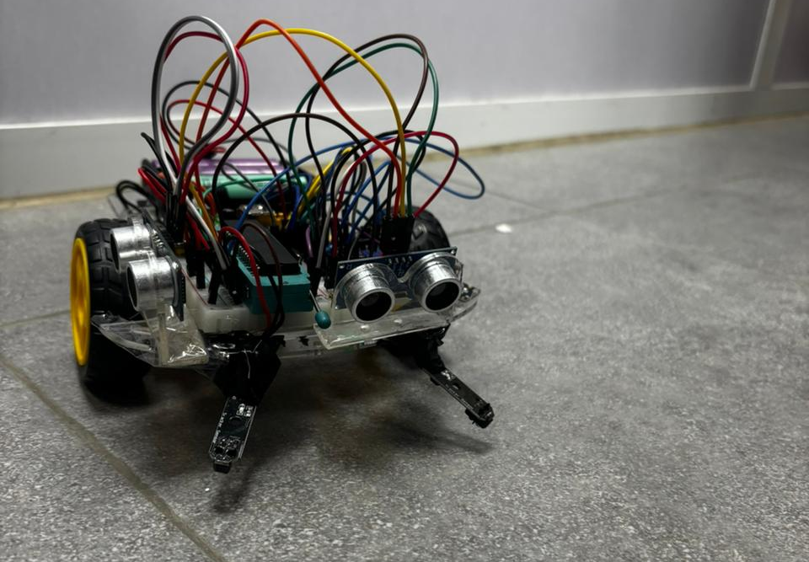
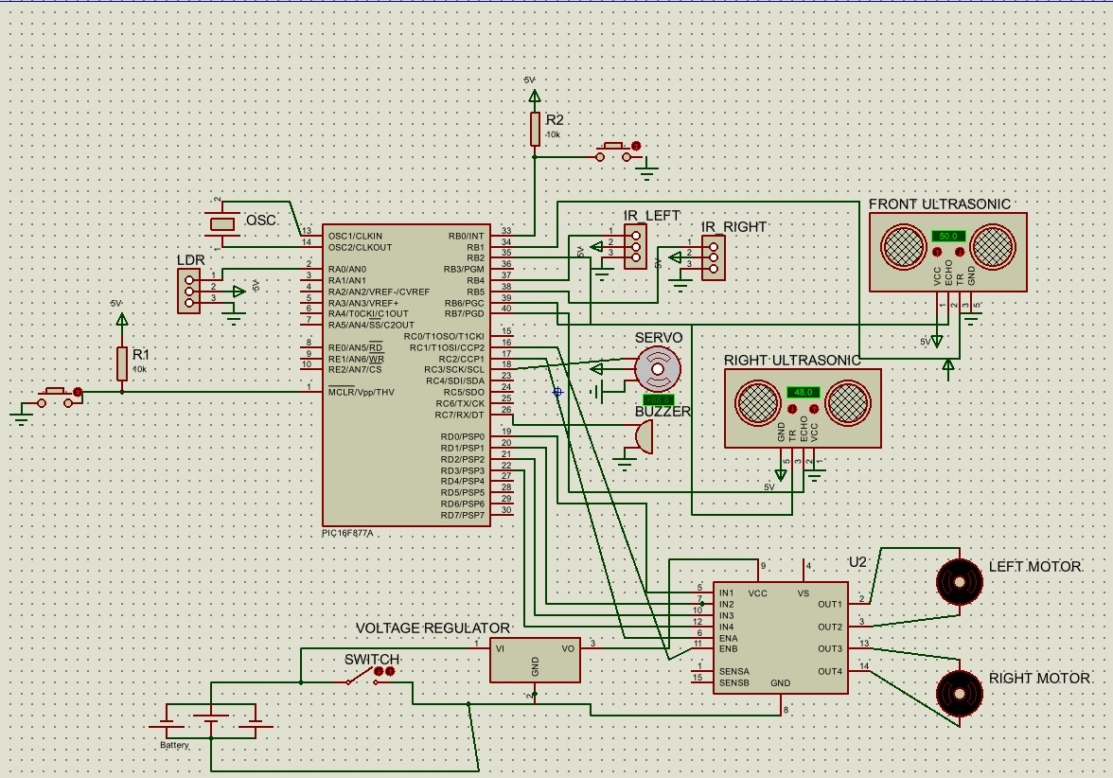
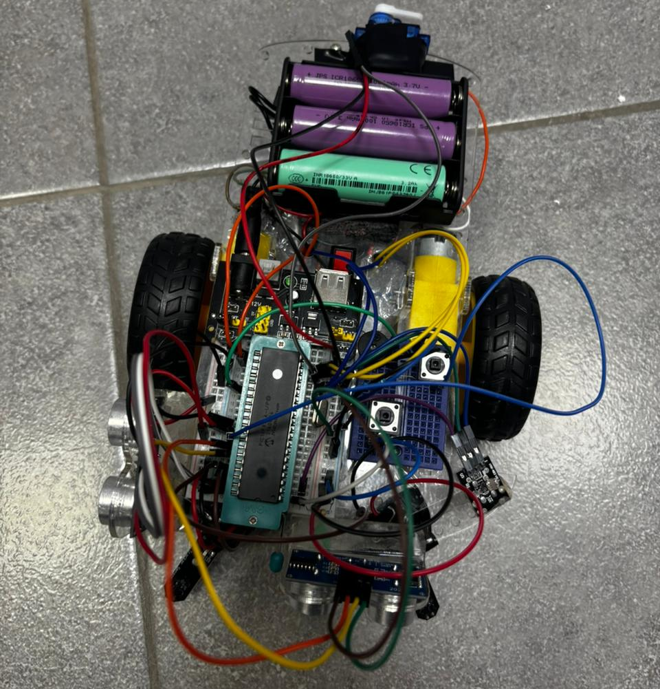
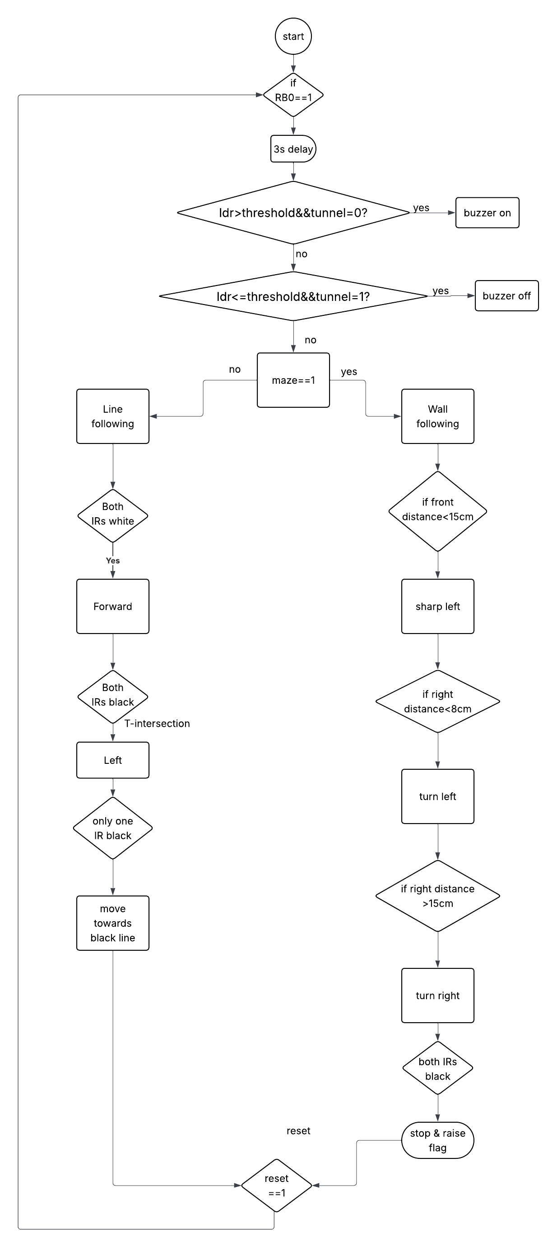
Autonomous Mobile Robot
Z. Abedrabbo, M. Arabiat,H. Labeeb
Supervisor: Dr. Belal Sababha
Embedded Systems Final Design Project, Spring 2026
King Abdullah II School of Engineering
Princess Sumaya University for Technology
Introduction
This projects aims to design an autonomous mobile robot that’s supposed to go through a track with multiple phases using PIC16F877A with different sensors for each phase and two brushless motors. The car must start at a black line following that terminates inside a tunnel, followed by a line following phase and finally a parking spot.
Results
After the external interrupts 3s delay caused by pressing the push button, motors keep moving the robot with the aid of IR sensors at the black line, balancing the robot also using hardware PWM to control thr motors’ speed and as soon as the robot enters the tunnel, the ldr causes an interrupt when it detects a voltage higher than its threshold value setting the buzzer on. The ultrasonic sensors keep the car calibrated in the wall following stage while avoiding any accidents. The robot finalizes its duties by parking at the end of the maze.
Figure 3 Final Design.
Figure 4: Final Design
Design
The autonomous mobile robot was designed using PIC16F877A microcontroller with a L298N H-bridge to operate both brushless dc motors, a voltage regulator to maintain a 5V supply to the circuit, 2 IR sensors for color detection in order to pass the line following stage, 3 Ultranonic sensors to measure distances required for line following, an LDR sensor that detects a difference in brightness when the robot enters the tunnel and fires a buzzer, a servo motor that rotates to raise a flag when the robot parks, 2 push buttons for a 3s delay and a restart. Figures shown below illustrate the Electrical and Software design used for the robot.
Figure 1 Electrical Design
Figure 2 Software Design
Conclusion
To sum up with, our main purpose was to successfully pass the track given, which was satisfied thanks to the digital and analog sensors used in our design that highly contributed in each stage required, and as soon as you become familiar with the sensors’ logic and functionalities, you can make anything work.

