Slide 1


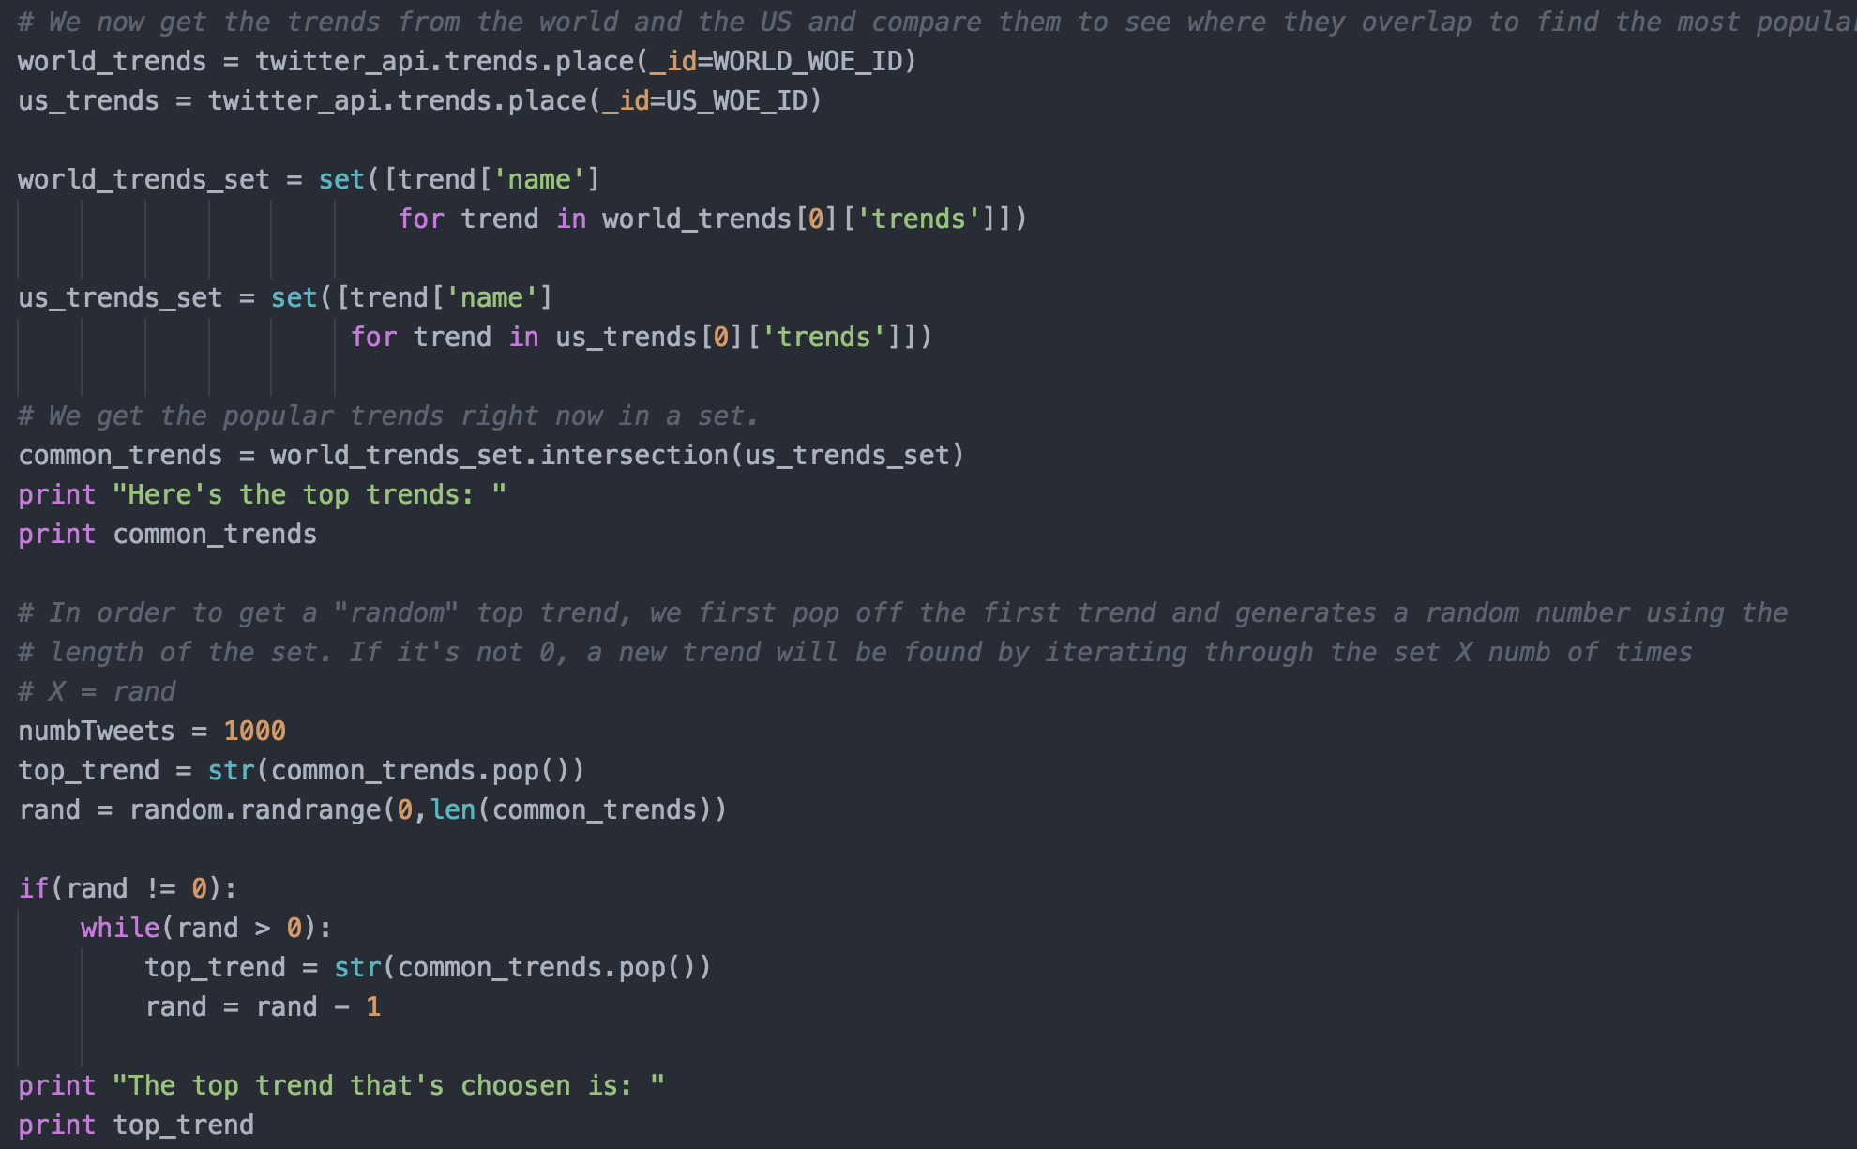
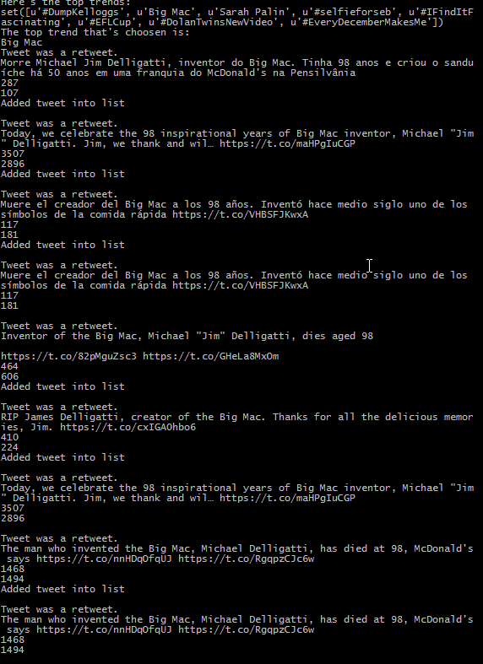
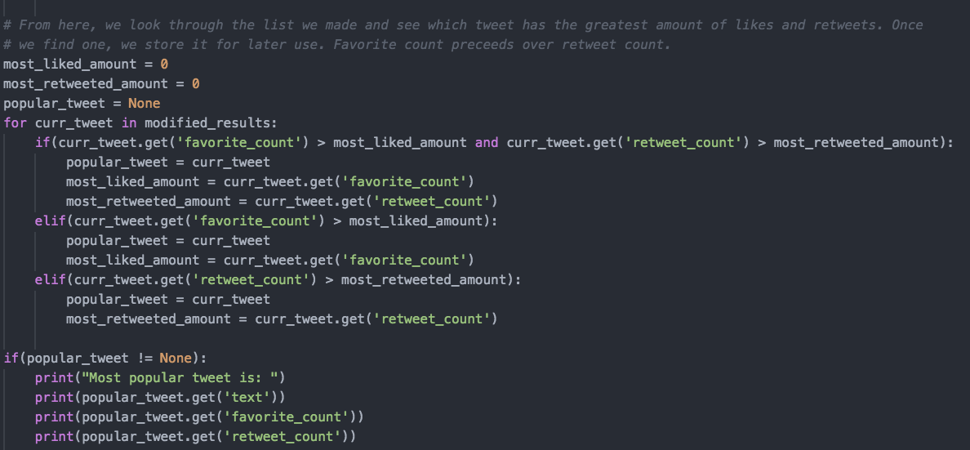
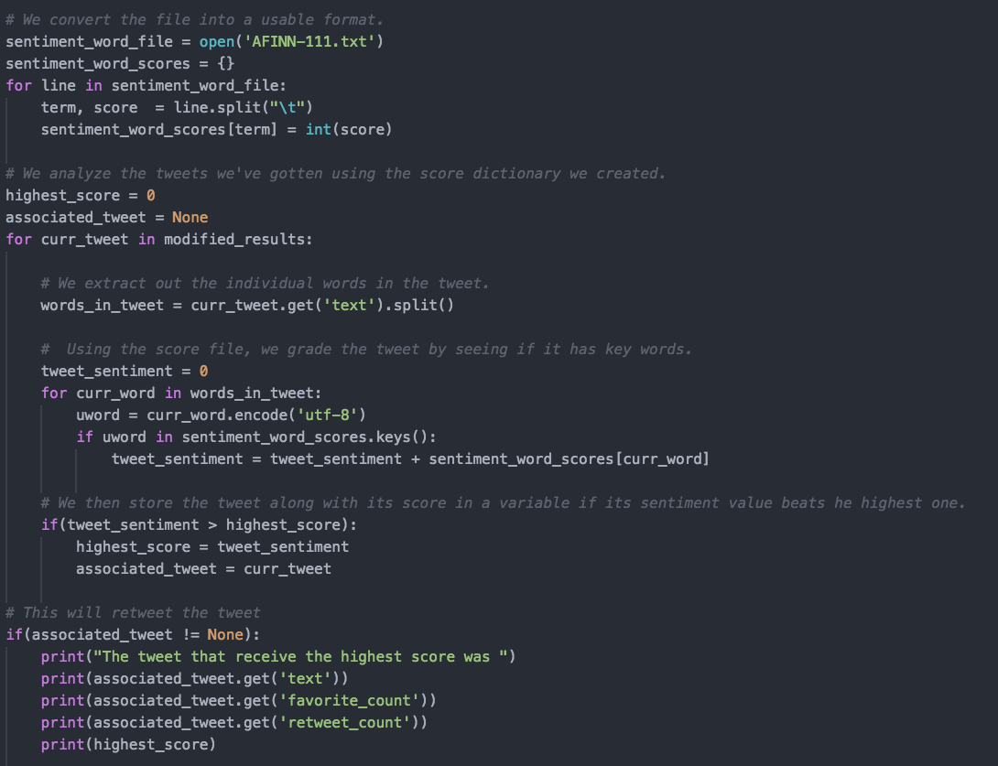
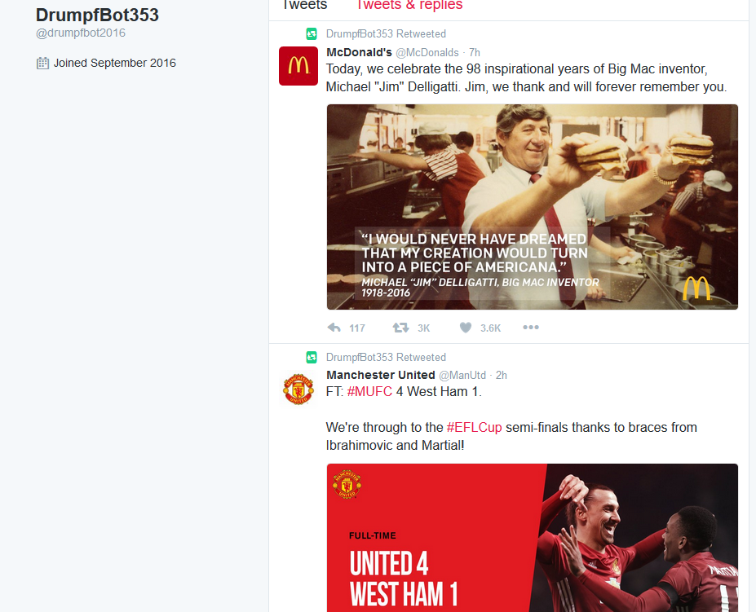
  DrumpfBot
Shiroma, Matthew, Britton, Ryan
CPSC 353, Data Communications/Computer Networks
Department of Computer Science, Chapman University, Orange, CA
Introduction
Social media is an important aspect in daily life. It allows for people to connect to each other virtually anywhere. Twitter is a growing medium that has convenient ways for top news and trends to spread across in hours. Our application, DrumpfBot, is a Twitter program that will search top trends on Twitter and periodically retweet tweets that have the highest sentiment score. This program will run in the background on another computer. The main goal of this application will allow people to have immediate knowledge of current events in the world without having to look for them themselves. We aim to streamline news to them through one popular social media.
Implementation and Challenges
As a starting basis, we used the code from our Sentiment Analysis programming assignment, since it was able to make a connection to Twitter and search through tweets by a specified user inputted keyword. It also analyzed the tweets found for specific words and assigned them an integer value, which rated how positive the tweet was. This foundation allowed us to spend more time on understanding the program as well as what Twitter API we are using.
One of our earlier challenges was finding out which API the Sentiment Analysis program was using. The functions that it used were all done in other APIs, except with different syntax. Once we took a closer look at our program as well as the official documentation on Twitter’s development page, the API we used was the Minimalistic Twitter API for Python. It contained convenient ways to access the Twitter stream through its Twitter class. We used this API because we had the Twitter developer documentation as well as having all of the methods we needed for our Twitter application.
Another challenge was using an open sourced API, since it is not affiliated with the official Python build. We documented each line of code in order to improve readability as well as to have a better understanding of what this function is doing. As of result, we came out of this with more confidence in exploring third part plugins.
Features
At the start of developing this application, we were aiming to have it take 1000 tweets, and analyze their sentiment scores. From there, we will find the ”hashtag” that is the most popular in all of these tweets. We will then find the tweet that had the highest sentiment score and retweet it out. This repeats for every 20 minutes as long as the program is running.
Once we started working and researching the Twitter API we are using, we had to revise our original plan. Thus, our program now takes a random top trend, uses that trend to search through Twitter, and performs a sentiment analysis on those tweets. The tweet with the highest score will then be retweeted.
The first feature that we finished was obtaining the top trends that the United States and the rest of the world share, randomly choosing one of those trends, and searching for tweets using that trend.
Conclusion
This project has been a great learning experience. We were able to apply many of the topics that we learned about in class including socket interfacing, socket addressing, and application programming interfaces. It was a fun challenge to figure out how to access and add to the Twitter stream in order to get our application to work properly.
With our application, not only were we able to track what the top trend is, we were also able to see how often the trends changed. The results were quicker than our original expectations. The sheer amount of people tweeting at all times of the day led to a big variance to what was the top trend at the time, which ranged from food to politics. There were also certain days when the trends seemed to change faster all day long instead of just certain hours of the day. This data would have to be looked over and done more frequently to get a precise idea as to why these things occurred.
Future Applications
Going forward, our program could be used by any number of researchers looking to track trends in order to see how the public changes from one trend to the next. Popular culture has always been an important part of social psychology, so our program could be of help to people within that field. We do not plan on modifying the program further in the near future, but if an opportunity presents itself, we will consider it.
Acknowledgments
We would like to acknowledge the Keck Research Program for their financial support. In addition, we would like to thank our professor, Dr. Fahy, who got us involved with this event, and taught us what he knows in his Data Communications/Computer Networks class.
Links and References
https://github.com/shiro105/DrumpfBot
https://twitter.com/drumpfbot2016
https://github.com/sixohsix/twitter
Figure 2. Code snippet of the first feature, which finds a random top trend.
The next feature was another challenge we faced, since we were unsure how we can implement the sentiment analysis we originally had into our program. We first compromised by having the most positive score be represented by the number of likes or retweets a tweet had. The more likes and retweets a tweet has, the larger the positive responses it got. However, when we understood how to implement the sentiment analysis, we decided to combine both concepts into one. As of result, our second feature has the original search filtered to contain tweets with a reasonable number of likes or retweets, which then the sentiment analysis calculates their scores. At the end of this, the tweet with the highest sentiment score will be the one that is retweeted by the program.
Figure 1. The program listing tweets out to standard output.
Figure 3. Code snippet of our second feature; finding tweets that have either 100 likes or retweets.
Our last feature will have the tweets we obtain from the last step to be periodically retweeted out by a Twitter account that’s affiliated with this program. We aim to have this occur every 20 minutes, since top trends often changes throughout the day.
One feature that was originally going to be a part of our application was removed later in the development. This was a UI that would allow for easier access to features of the application, but was deemed unnecessary once we decided to have it run constantly on a secondary computer. In addition, the program ran all at once, so there was no need to have a UI for a series of commands that only worked in succession. Due to this, we decided to keep the program running in the command window in order to leave a long list of tweets that had been read so that a user could come back later and see the entire process.
Figure 4. Another code snippet of our second feature; finding a tweet that has the highest sentiment analysis.
Figure 5. The DrumpfBot Twitter page.

