Slide 1
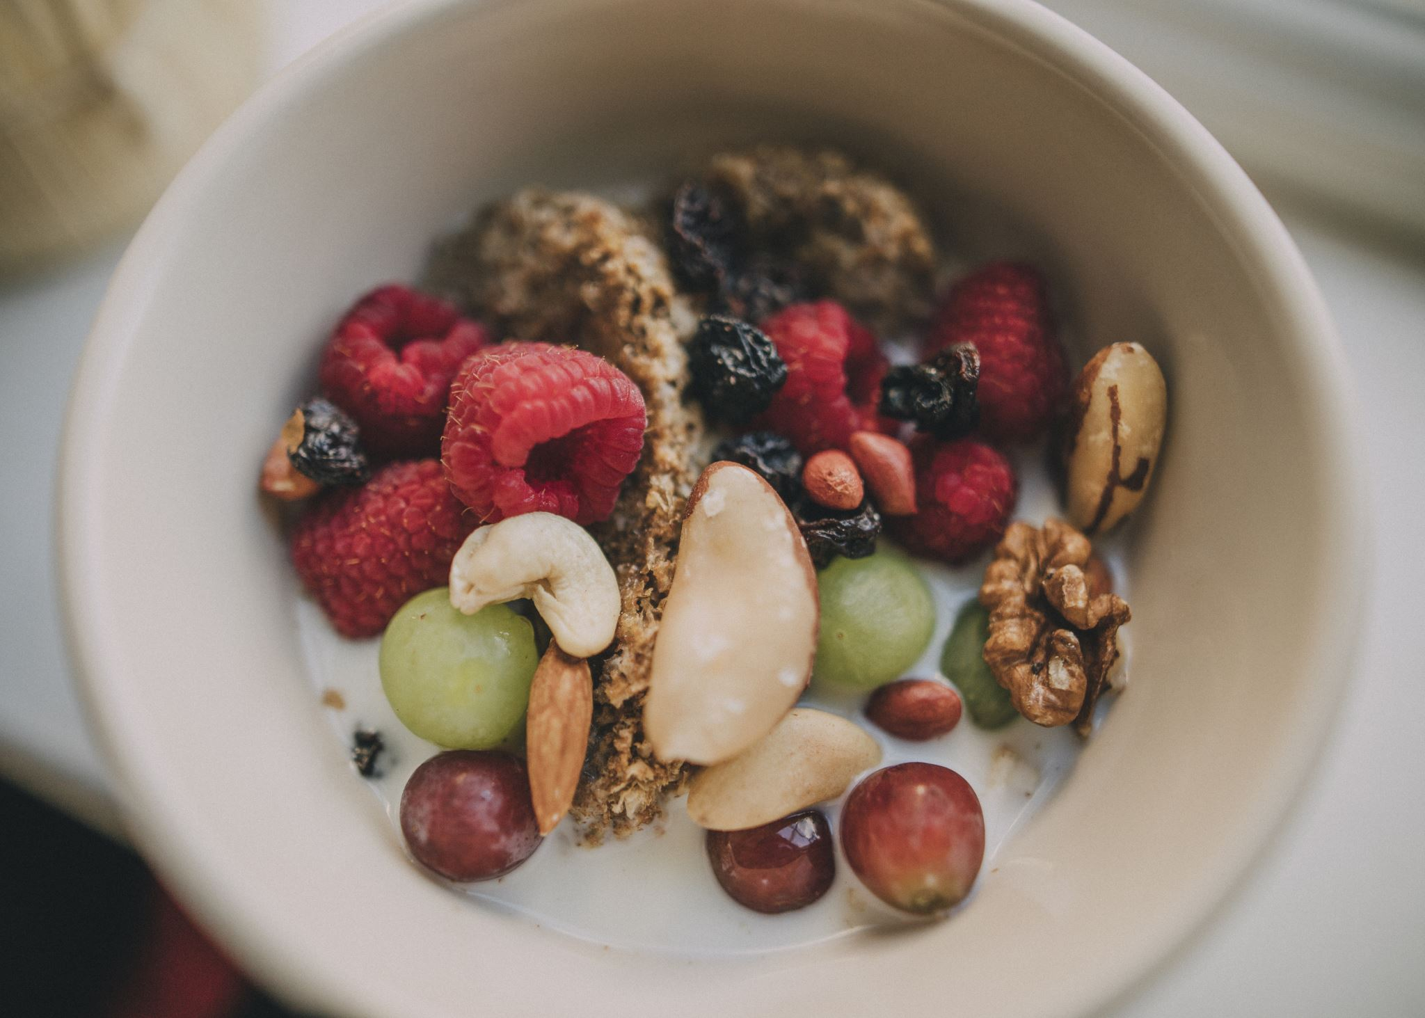
Fruit Classification

Slide 2
Contents
Keys for Designing CNN Architectures
My Attempts
Notes

Slide 3
Keys for Designing CNN Architectures
1. Start small.
- Smaller filter size to bigger.
- Smaller numbers of filters to bigger
2. Of size of images.
- Small size images:
- Filter sizes of 3, 5, 7
- MaxPooling of 2
- Stride of 2.
- Larger size images: to be shrinked.
- Padding = same if border’s of the image are important.
- Keep adding layers till overfiting.

Slide 4
My Attempts
1st. Too simple.
Conv2D(16, 3, padding='same', activation='relu', input_shape=(IMG_HEIGHT, IMG_WIDTH ,3)),
MaxPooling2D(),
Conv2D(32, 3, padding='same', activation='relu'),
MaxPooling2D(),
Conv2D(64, 3, padding='same', activation='relu'),
MaxPooling2D(),
Flatten(),
Dense(512, activation='relu'),
Dense(131, activation = 'softmax')

Slide 5
My Attempts
2nd. Too simple -> Adding layers till overfiting
Conv2D(32, (11, 11), padding='same', activation='relu', input_shape=(IMG_HEIGHT, IMG_WIDTH ,3)),
MaxPooling2D(),
Conv2D(64, (11, 11), padding='same', activation='relu'),
MaxPooling2D(),
Conv2D(128, (11, 11), padding='same', activation='relu'),
MaxPooling2D(),
Flatten(),
Dense(120, activation='relu'),
Dense(131, activation = 'softmax') # Output

Slide 6
My Attempts
3rd. Adding more layers
Conv2D(filters=16, kernel_size=2, activation='relu', padding='same', input_shape=(IMG_HEIGHT, IMG_WIDTH, 3)),
MaxPooling2D(pool_size=2),
Conv2D(filters=32, kernel_size=2, activation='relu', padding='same'),
MaxPooling2D(2),
Conv2D(filters=64, kernel_size=2, activation='relu', padding='same'),
MaxPooling2D(2),
Conv2D(filters=128, kernel_size=2, activation='relu', padding='same'),
MaxPooling2D(2),
Dropout(0.3),
Flatten(),
Dense(150, activation='relu'),
Dropout(0.4),
Dense(131, activation = 'softmax')

Slide 7
Notes Performance
Time Consume of Predictions.
- Handmade model:
- 1 - 5 millions parameters
- 8 seconds prediction.
- ResNet 152:
- 60 millions parameters.
- 2 minutes prediction.

Slide 8
Notes Errors
test = ImageDataGenerator.flow_from_directory(shuffe=True)
y_true = test.labels
--
y_pred = model.predict(test)
--
classification_report(y_true, y_pred)

