Slide 1


Keras
For building models

Slide 2


Contents
What is Keras
Why Keras
How to install
Get through
3 methods to describe models
Lots of layers to mix
Practice: Sequential methods
Tensorboard in Keras

Slide 3


What is Keras
Python commands
To manipulate platforms for machine learning
TensorFlow
Theano ..

Slide 4
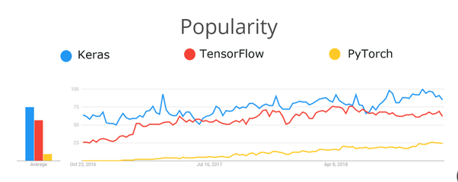
2. Why Keras
Pre-history of ML: handmade
Coding was hard
Code didn’t meet hardware
TensorFlow 1.0
Better hardware support
Not for human reading
Keras
Easy to learn
Great readable
More: Theano, CNTK
TensorFlow 2.0
Completely changes in workflow
tight integration of Keras

Slide 5

3. How to install
Running on CPU
One-line code
Running on GPU _ personal PC
Pretty DAMN!
Because of: NVIDIA driver - CUDA – cuDNN - TensorFlow – Ubuntu version -

Slide 6
4. Get through
1. Import
3. Describe model
4. Compile – confirm your architecture
5. Fit
import keras as K
import tensorflow as tf
import layers, models..
model = Sequential()
model.compile(loss=.. metrics=..)
model.fit(X_train, y_train, validation_data=)
2. Data Preprocessing

Slide 7
5. 3 methods to describe models
Sequential - best simple
Functional - best flexible
Model subclassing – no info
Layer VUI
Layer – VẺ
in
out
Out ..
Layer – CƯỜI

Slide 8
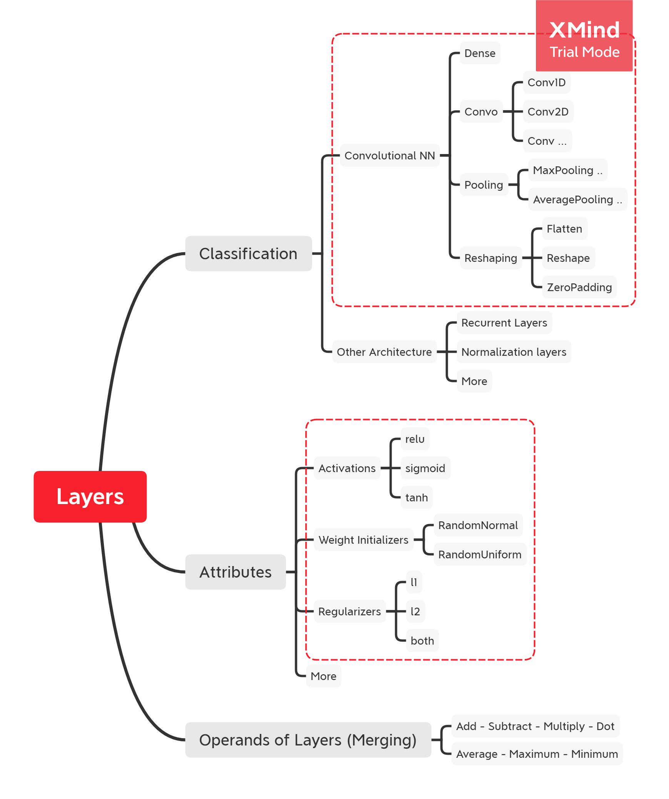
6. Layers

Slide 9
7. Practice: Sequential methods
>> notebook

Slide 10
8. Tensorboard in Keras
Tracking and visualizing
Viewing

