Slide 1
Tree-Based Model and ensemble method
Simple trees, Bagging, Random Forest

Slide 2
Introduction
Tree-based Model : construction of one tree (very interpretable but weak interpretation accuracy)
Ensemble Method : Combine several trees to improve the accuracy
- Bagging/Random Forest : contruct several indepedant trees then mean (reduce variance)
- Boosting : construct sequentially (correct the error of the previous one)

Slide 3
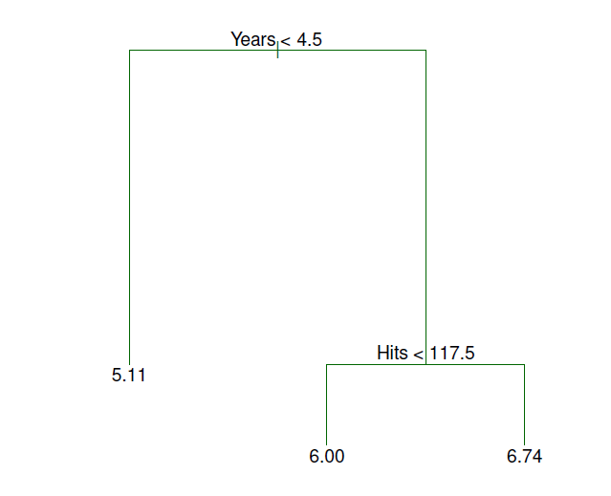
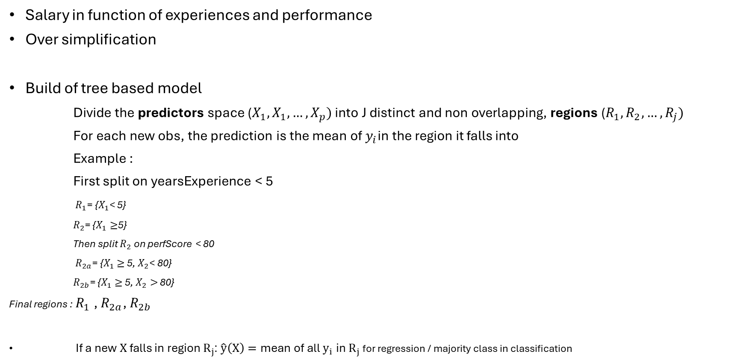
Tree based model
Salary in function of experiences and performance
Over simplification
Build of tree based model
Divide the predictors space ($X_{1},X_{1},…,X_{p})$ into J distinct and non overlapping, regions ($R_{1},R_{2},…,R_{j})$
For each new obs, the prediction is the mean of $y_{i}$in the region it falls into
Example :
First split on yearsExperience < 5
$R_{1}$= {$X_{1}$< 5}
$R_{2}$= {$X_{1}≥$5}
Then split $R_{2}$ on perfScore < 80
$R_{2a}$= {$X_{1}$ $≥$ 5, $X_{2}$< 80}
$R_{2b}$= {$X_{1}$ $≥$ 5, $X_{2}>$ 80}
Final regions : $R_{1}$, $R_{2a}$, $R_{2b}$
If a new $X$ falls in region $R_{j}$: $\hat{y}\left(X\right)=\text{mean} \text{of} \text{all} y_{i} \text{in} R_{j}$ for regression / majority class in classification

Slide 4

Predictor region spaces
High dimensional rectangles / boxes
Goal :
Find boxes $R_{1},R_{1},…,R_{j}$ that minimize the RSS given by
$$\sum_{j=1}^{J}{\sum_{i\text{∈ }R_{j}}{{\text{(}y_{i}\text{ − }\hat{y_{R_{j}}}\text{) }}^{2}}}$$
$\hat{y_{R_{j}}}$ : mean response for the training observations within the jth box

Slide 5
Technical details
Recursive Binary Splitting : at each step we choose the best variable and best threshold that reduce the RSS
Greedy / Top down : local better choice not global
Regression Criteria : RSS / Clasification Criteria Gini,entropia
Often the tree is too complex : Pruning / cross validation

Slide 6
Pruning / Cross Validation
To avoid overfitting (too big depth): Pruning (cut the tree too find a better bias/variance balance)
How : remove some of the leaves aand replace it by a leave that is an average of larger number observation
How to Prune Regression Trees, Clearly Explained!!!
Low depth tree : ++bias – variance / Low depth tree : --bias +variance
Pruing generate a sequence of candidate subtrees

Slide 7
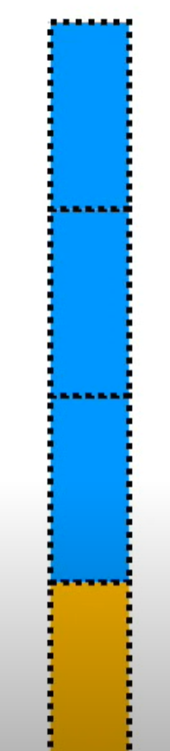
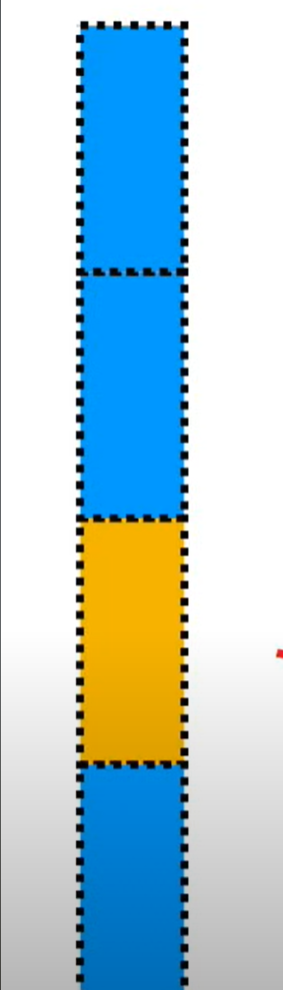
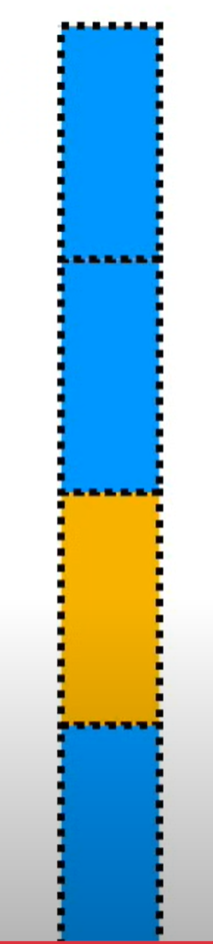
Cross validation
Method where we split the data into several parts, train the model on some parts and test it on the others
Then use CV to compare performance of each sub trees ( find the optimal depth/ size after pruning)
We keep the one that minimize the error
On construit d’abord un arbre trop grand, puis on le réduit (pruning). La cross-validation permet de choisir la taille optimale de l’arbre.

Slide 8
Ensemble method (Bagging Random Forest)
Even after pruning a simgle tree has high variance
To improve stability and accuracy we combine many simple trees together (weak learners)

Slide 9
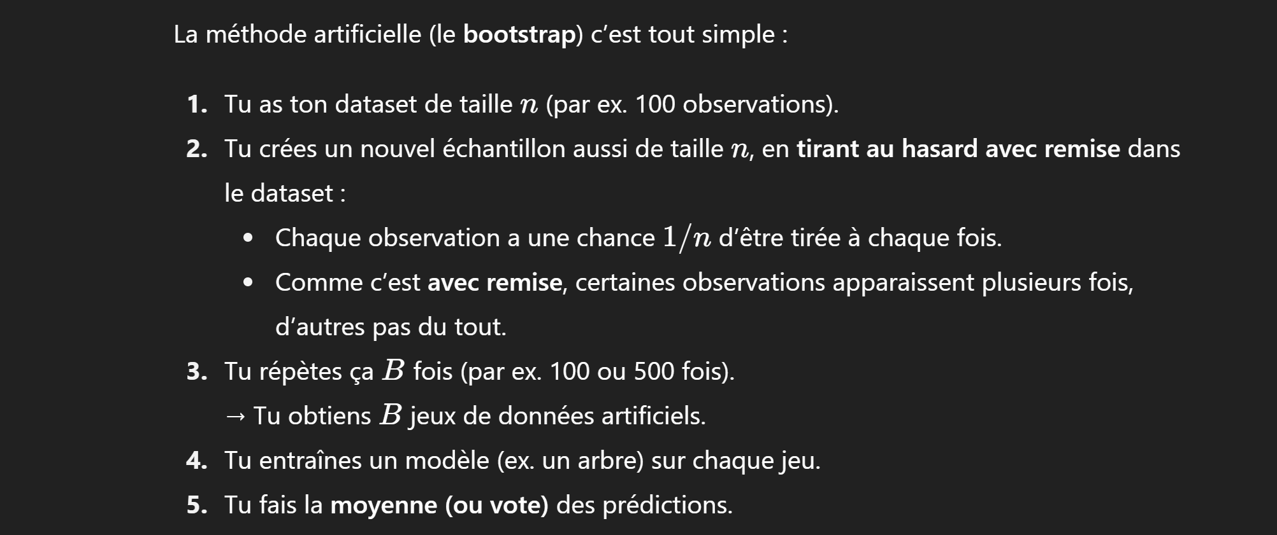
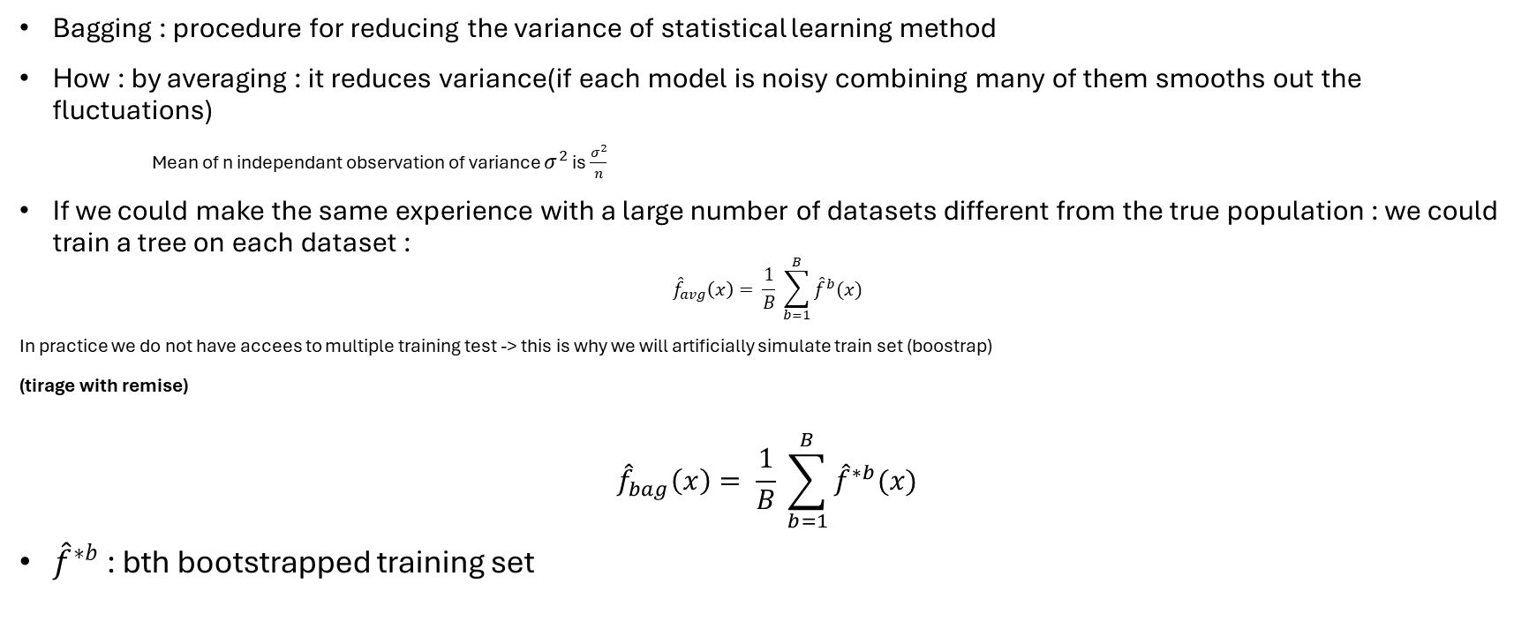
Bagging
Bagging : procedure for reducing the variance of statistical learning method
How : by averaging : it reduces variance(if each model is noisy combining many of them smooths out the fluctuations)
Mean of n independant observation of variance $σ^{2}$ is $\frac{σ^{2}}{n}$
If we could make the same experience with a large number of datasets different from the true population : we could train a tree on each dataset :
$${\hat{f}}_{avg}\left(x\right)= \frac{1}{B} \sum_{b=1}^{B}{{\hat{f}}^{b}(x)}$$
In practice we do not have accees to multiple training test -> this is why we will artificially simulate train set (boostrap)
(tirage with remise)
$${\hat{f}}_{bag}\left(x\right)= \frac{1}{B} \sum_{b=1}^{B}{{\hat{f}}^{∗b}(x)}$$
${\hat{f}}^{∗b}$: bth bootstrapped training set

Slide 10
Random Forest
Pb of bagging : if a variable is dominant all the subset will choose the same variable to start : trees are highly correlated
RF : Add random ; each time we see only a random subset of the variable

