Slide 1
Linear Regression
Simple and multiple

Slide 2
Introduction (Context, Motivation)
Simple Linear Regression
Supervised method (we have a dataset (X,Y))
Objective: to estimate a relationship f: X—>Y from the data in order to:
1) Predict new values of Y (Prediction)
(Example: predicting sales based on the TV, radio, and newspaper budget)
2)Understand the effect of each explanatory variable on Y (Inference)
(Example: measure the average impact of an additional €1000 on TV ad sales and test if this effect is significant)
Explanatory variable(s)
Target

Slide 3
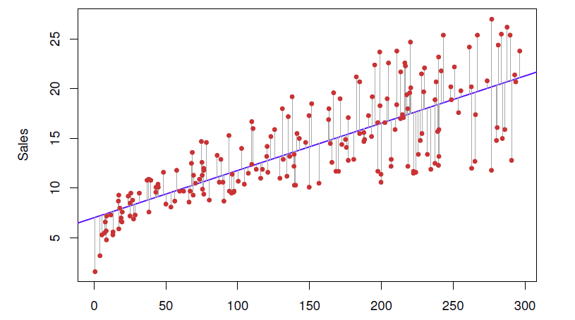
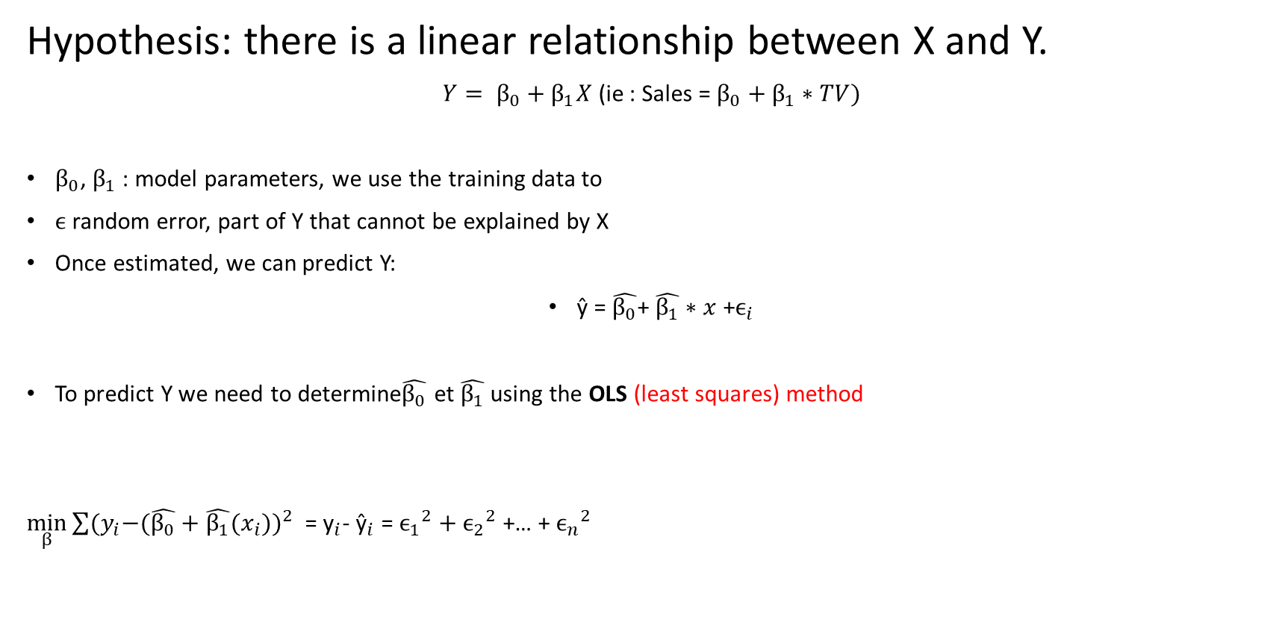
Simple Linear Regression
Hypothesis: there is a linear relationship between X and Y.
$Y= β_{0}+β_{1}X$ (ie : Sales = $β_{0}+β_{1}∗TV)$
$β_{0}$, $β_{1}$ : model parameters, we use the training data to
$ϵ$ random error, part of Y that cannot be explained by X
Once estimated, we can predict Y:
ŷ = $\hat{β_{0}}$+ $\hat{β_{1}}∗x$ +$ϵ_{i}$
To predict Y we need to determine$\hat{β_{0}}$ et $\hat{β_{1}}$using the OLS (least squares) method
$\min_{β}{{\sum{{(y}_{i}−(\hat{β_{0}}+\hat{β_{1}}{(x}_{i})})}^{2}}$ = ${\text{y}}_{i}$- ${\text{ŷ}}_{i}$ = ${ϵ_{1}}^{2}+$ ${ϵ_{2}}^{2}$ +… + ${ϵ_{n}}^{2}$
Intercept
Slope : average incrase in Y associated with one unit increase in X
Predictor, estimated value of y
Residual Sum Of Squares

Slide 4

Minimization problem
Simple Linear Regression
In order to minimize the function also called the cost function SSE:
SSE($β_{0},β_{1}$) = $\sum_{i=1}^{n}{{({\text{y}}_{i}\text{− }{\text{ŷ}}_{i})}^{2}}$ which is a convex function (global minimum) we
Calculate the derivatives in relation to $β_{0},β_{1}$ $\frac{dSSE}{dβ_{1}}$ = -2$\sum_{i=1}^{n}{{\text{x}}_{i}({\text{y}}_{i}\text{−}}$ ${(β}_{0}+β_{1}$ ${\text{x}}_{i})$) = 0
We are looking for the zeros of these functions ⬄ $\frac{dSSE}{dβ_{0}}$ = -2$\sum_{i=1}^{n}{({\text{y}}_{i}\text{−}}$ ${(β}_{0}+β_{1}$ ${\text{x}}_{i}$)) = 0
We have closed Formulas :
$\hat{β_{1}}$ = $\frac{\sum_{i=1}^{n}{\left({\text{x}}_{i} −\hat{x}\right)}({\text{y}}_{i} −\hat{y})}{\sum_{i=1}^{n}{{\left({\text{x}}_{i} −\hat{x}\right)}^{2}}}$ , $\hat{{ β}_{0}}$ = $\hat{y}$ - $\hat{β_{1}}$ $\hat{x}$

Slide 5

Model assumptions
Simple Linear Regression
E[$ϵ_{i}$] = 0 (no bias)
Var($ϵ_{i}$) = $σ^{2}$ (homoscedasticity)
$ϵ_{i}$ independant of each other
$ϵ_{i}$ ~ N(0, $σ^{2}$)
E[ε∣X] = 0, $ϵ_{i}$independance of ${\text{x}}_{i}$ from the error (essential for unbiased estimators) **
** Often criticized: if E[ε∣X] is different from 0, then part of the information contained in X is hidden in the error, the estimators are biased (for example, we forgot an explanatory variable).

Slide 6
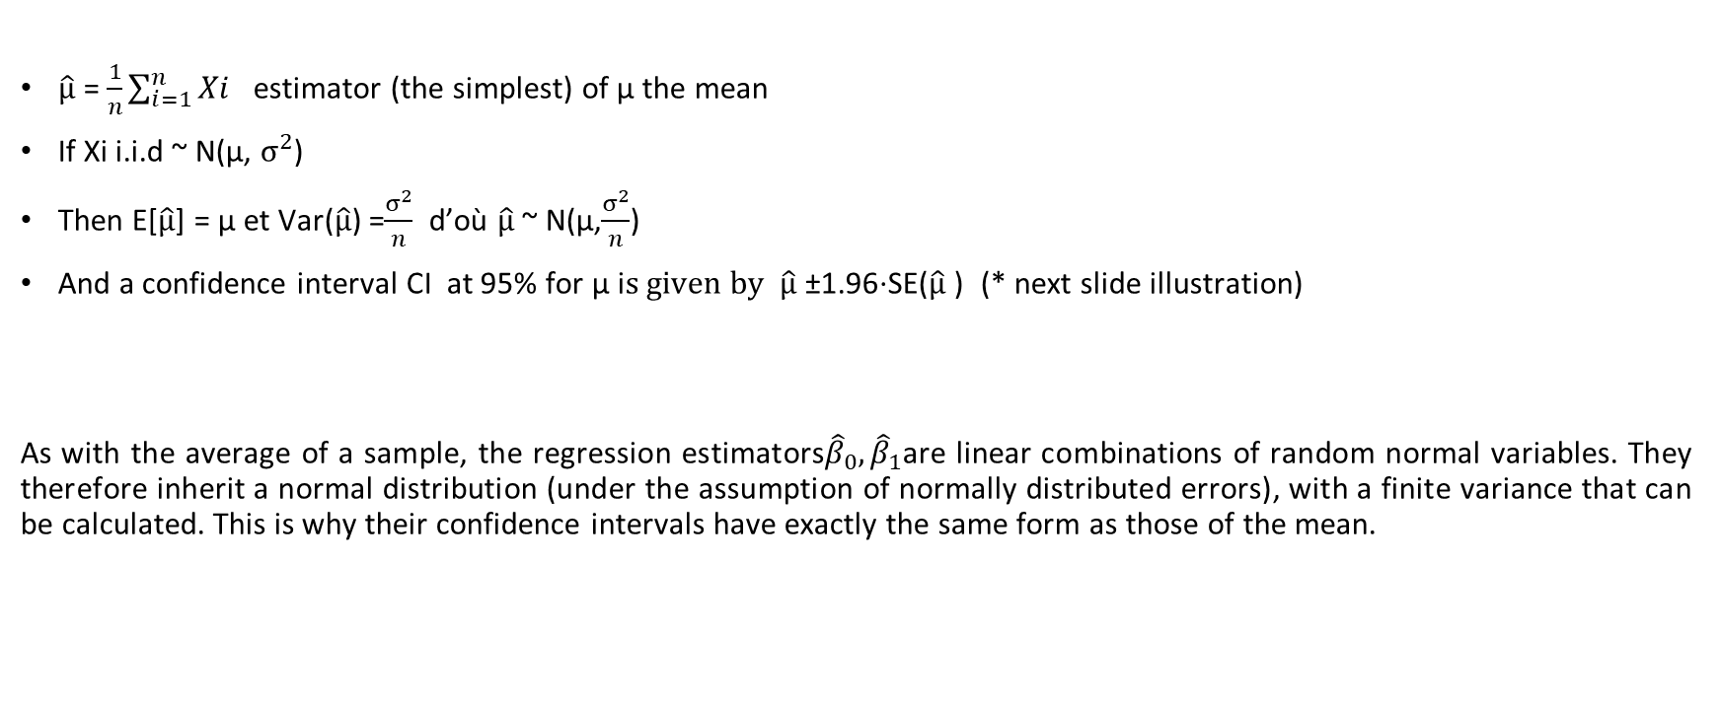
Statistical reminders
Simple Linear Regression
$\hat{µ}$ = $\frac{1}{n}\sum_{i=1}^{n}{Xi }$ estimator (the simplest) of µ the mean
If Xi i.i.d ~ N(µ, $σ^{2}$)
Then E[$\hat{µ}$] = µ et Var($\hat{µ}$) =$\frac{σ^{2}}{n}$ d’où $\hat{µ}$ ~ N(µ,$\frac{σ^{2}}{n}$)
And a confidence interval CI at 95% for µ i$s given by \hat{µ}$​±1.96⋅SE($\hat{µ}$​) (* next slide illustration)
As with the average of a sample, the regression estimators${\hat{β}}_{0},{\hat{β}}_{1}$are linear combinations of random normal variables. They therefore inherit a normal distribution (under the assumption of normally distributed errors), with a finite variance that can be calculated. This is why their confidence intervals have exactly the same form as those of the mean.

Slide 7

Illustration to understand the CI
Simple Linear Regression
Let µ (true mean) = 170 cm (height of students)
We take several samples of 25 students and calculate the mean (µ̂) of each sample.
Around each µ̂, we construct the 95% confidence interval.
Sample | Estimated mean $\hat{μ}$ | CI at 95 %
#1 | 168.5 | [166.0 ; 171.0]
#2 | 172.2 | [169.5 ; 174.9]
#3 | 169.0 | [166.5 ; 171.5]
#4 | 174.0 | [171.0 ; 177.0]
#5 | 165.5 | [163.0 ; 168.0] ❌

Slide 8
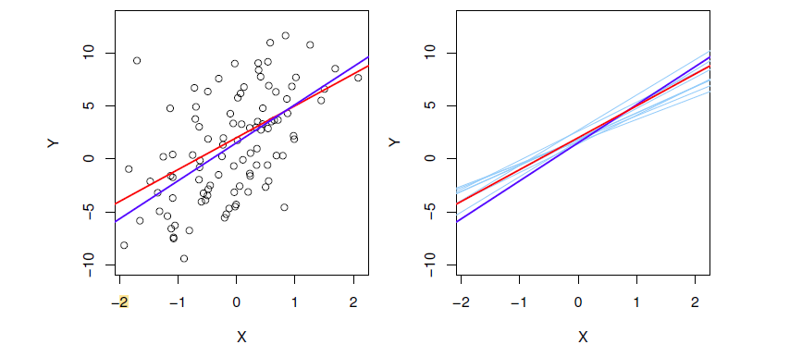

Uncertainty about the estimators
Simple Linear Regression
Each sample(x1​,y1​),…,(xn​,yn​), or dataset gives a different line
In red real line (if we had an infinite number of observations)
In dark blue least square line
In light blues: least square line across several subpopulations
OLS estimators are unbiased : E[$\hat{β_{j}}$] = $β_{j}$
${SE(\hat{β_{0}})}^{2}$= $σ^{2}[\frac{1}{n}$ + $\frac{\overline{x^{2}}}{\sum_{i=1}^{n}{{(x_{i}−\overline{x})}^{2}}}$] ${ SE(\hat{β_{1}})}^{2}$= $[\frac{σ^{2}}{\sum_{i=1}^{n}{{(x_{i}−\overline{x})}^{2}}}$]
(These formulas show that the more the x values are spread out, the better we estimate the slope)
With assumptions and stats :
RSE = $\sqrt{\frac{RSS}{n−2}}$ estimator of $σ^{2}$
CI : [$\hat{β_{0/1}}$-2 $SE\left(\hat{β_{0/1}}\right),$ $\hat{β_{0/1}}$-2 $SE\left(\hat{β_{0/1}}\right)$]

Slide 9

Hypothesis testing on the coefficients
Simple Linear Regression
Null hypothesis $H_{0}$ : There is no relationship btw X and Y ⬄ $β_{1}$ = 0
Alternative hypothesis $H_{a}$ : There is relationship btw X and Y ⬄ $β_{1}$ != 0
Question : When is it far enough from 0?
To quantify it we compute t-statistic t=$\frac{{\hat{β}}_{1}}{SE({\hat{β}}_{1})}$
P-value weak we reject $H_{0}$

Slide 10
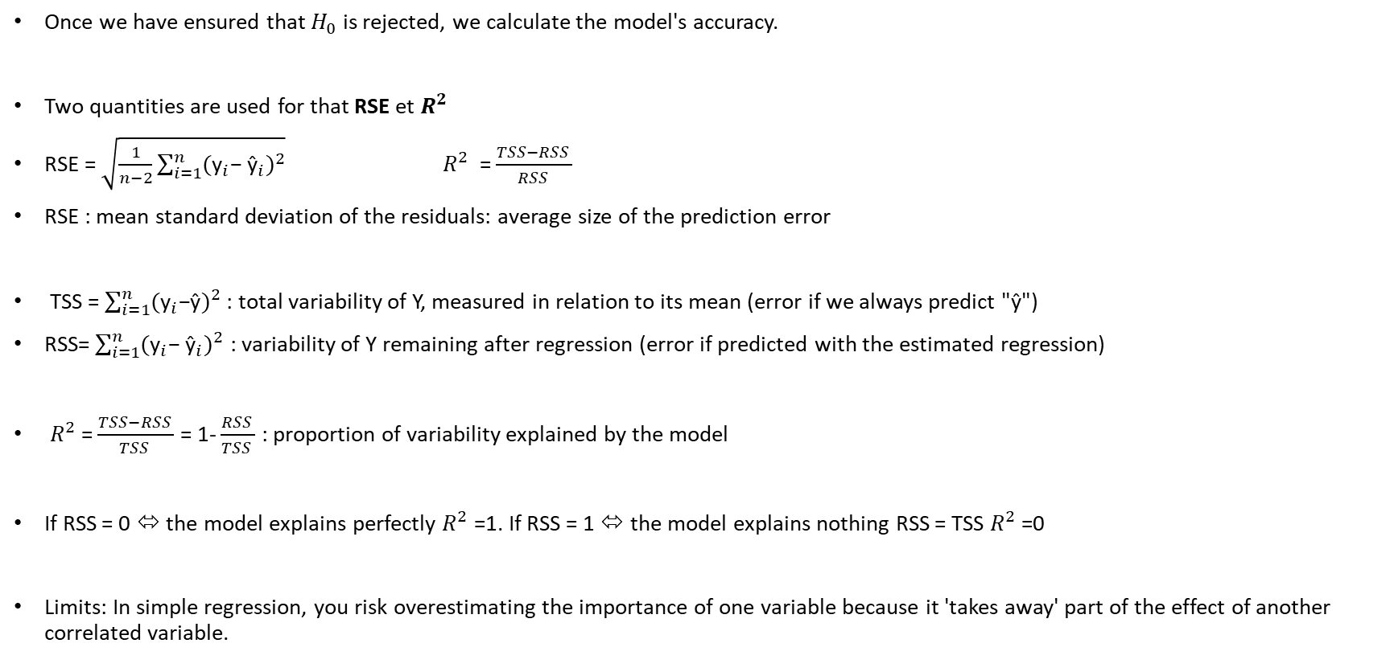
Accuracy of the model
Simple Linear Regression
Once we have ensured that $H_{0}$ is rejected, we calculate the model's accuracy.
Two quantities are used for that RSE et $R^{2}$
RSE = $\sqrt{\frac{1}{n−2}\sum_{i=1}^{n}{{({\text{y}}_{i}\text{− }{\text{ŷ}}_{i})}^{2}}}$ ${ R}^{2}$ = $\frac{TSS−RSS }{RSS }$
RSE : mean standard deviation of the residuals: average size of the prediction error
TSS = $\sum_{i=1}^{n}{{({\text{y}}_{i}\text{−}\text{ŷ})}^{2}}$ : total variability of Y, measured in relation to its mean (error if we always predict "ŷ")
RSS= $\sum_{i=1}^{n}{{({\text{y}}_{i}\text{− }{\text{ŷ}}_{i})}^{2}}$ : variability of Y remaining after regression (error if predicted with the estimated regression)
$R^{2}$ = $\frac{TSS−RSS }{TSS }$ = 1- $\frac{RSS }{TSS }$ : proportion of variability explained by the model
If RSS = 0 ⬄ the model explains perfectly $R^{2}$ =1. If RSS = 1 ⬄ the model explains nothing RSS = TSS $R^{2}$ =0
Limits: In simple regression, you risk overestimating the importance of one variable because it 'takes away' part of the effect of another correlated variable.

Slide 11
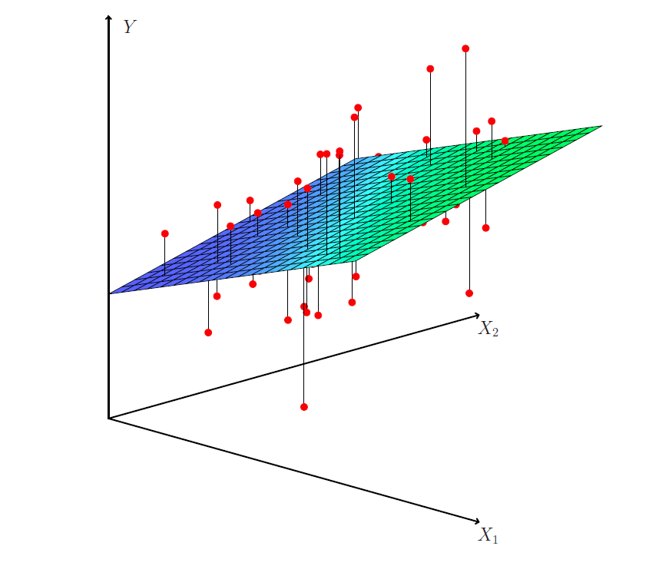

Multiple regression
Multiple Linear Regression
Idea: expand the analysis to several explanatory variables.
Give each predictor a different slope coefficient.
Y = $β_{0}+β_{1}X_{1}+β_{2}X_{2}+…+ β_{p}X_{p}+$ε
No more visualizable from 3 predictors
Maths part with matrix

Slide 12

Matrix model
Multiple Linear Regression
Y = X$β$ + ε
Let n be the number of observations, and p the number of explanatory variables.
Y vector of observations : Y=${ \text{y}}_{1}$
… vector of size n
${ y}_{n}$
X matrix of predictors X= 1 $x_{11}$ $x_{12}$ … $x_{1p}$
… matrix (n,p+1)
1 $x_{n1}$ $x_{n2}$ … $x_{np}$
$β$: vecteur des coefficients $β$ = ${ β}_{0}$
… vector of size p+1 What we are trying to estimate
${ β}_{p}$
ε: errors vector ε= ${ \text{ε}}_{i}$ vector of size n (Var(ε)= $σ^{2}$I​)
${ \text{ε}}_{n}$

Slide 13

Multiple Linear Regression
We want to find the matrix $\overline{β}$ that minimizes residual sum of squares
$\min_{β}$S($β)$=${\text{||}\text{y}\text{−}\text{X}β||}^{2}$ ⬄ ${\text{(}\text{y}\text{−}\text{X}β)}^{T}\text{(}\text{y}\text{−}\text{X}β)$ cause ${\text{||}v||}^{2}$ ⬄ $v^{T}v$
This is equivalent to find $β$ such that $\frac{d\text{S}\text{(}β)}{dβ}$ = 0 (**computations on the next slide )
$\frac{d\text{S}\text{(}β)}{dβ}$ =0 ⬄ $\hat{β}$ = ${{\text{(}\text{X}}^{T}X)}^{−1}$ ${\text{X}}^{T}$Y

Slide 14
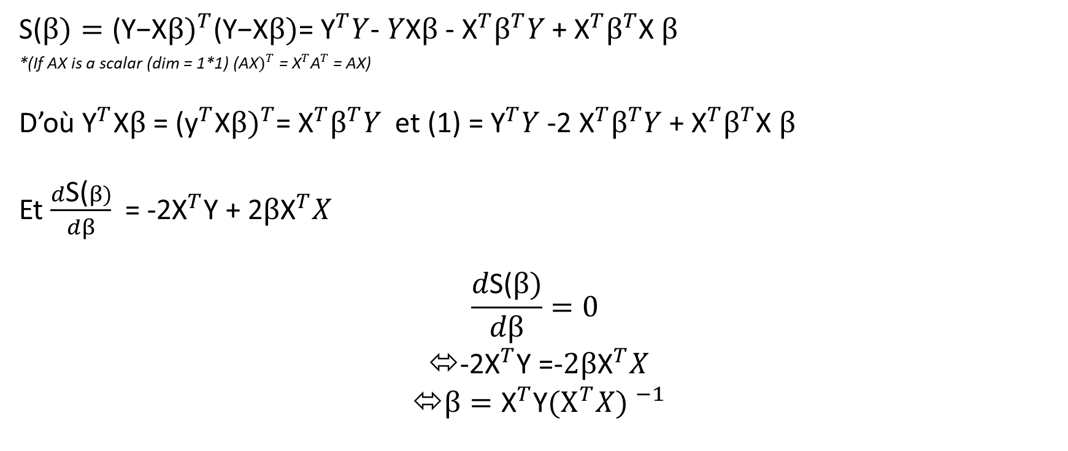
Calculations
Multiple Linear Regression
$\text{S}\text{(}β)={\text{(}\text{Y}\text{−}\text{X}β)}^{T}\text{(}\text{Y}\text{−}\text{X}β)$= ${\text{Y}}^{T}Y$- $Y\text{X}β$ - ${{\text{X}}^{T}β}^{T}Y$ + ${{\text{X}}^{T}β}^{T}$X $β$
*(If AX is a scalar (dim = 1*1) ${\text{(}\text{AX})}^{T}$ = ${\text{X}}^{T}{\text{A}}^{T}$ = AX)
D’où ${\text{Y}}^{T}\text{X}β$ = ${\text{(}{\text{y}}^{T}\text{X}β)}^{T}$= ${{\text{X}}^{T}β}^{T}Y$ et (1) = ${\text{Y}}^{T}Y$ -2 ${{\text{X}}^{T}β}^{T}Y$ + ${{\text{X}}^{T}β}^{T}$X $β$
Et $\frac{d\text{S}\text{(}β)}{dβ}$ = -2${\text{X}}^{T}\text{Y}$ + 2${β\text{X}}^{T}X$
$$\frac{d\text{S}\text{(}β)}{dβ}=0$$
-2${\text{X}}^{T}\text{Y}$ =-${2β\text{X}}^{T}X$
$β={\text{X}}^{T}\text{Y}{{(X}^{T}X) }^{−1}$

Slide 15

Hypotheses and global tests
Multiple Linear Regression
Null hypothesis $H_{0}$ : $β_{1}$= $β_{2}=β_{3}…$= 0
Alternative hypothesis $H_{a}$ : Au moins un $β_{j}$ != 0
Question : When is it far enough from 0 ?
To quantify it, we calculate the F-stat F=$\frac{(TSS−RSS)/p}{RSS/(n−p−1)}$
Interpretation : if F is large -> at least one prédictor explains Y

Slide 16
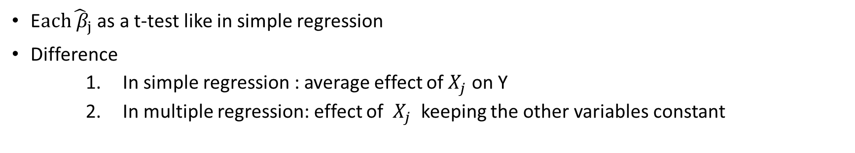
Partial effect and individuals p-values
Multiple Linear Regression
E$ach{\hat{ β}}_{j}$ as a t-test like in simple regression
Difference
In simple regression : average effect of $X_{j}$ on Y
In multiple regression: effect of $X_{j}$ keeping the other variables constant
A variable may appear significant in simple regression but become useless in multiple regression when it is correlated with another variable.

Slide 17
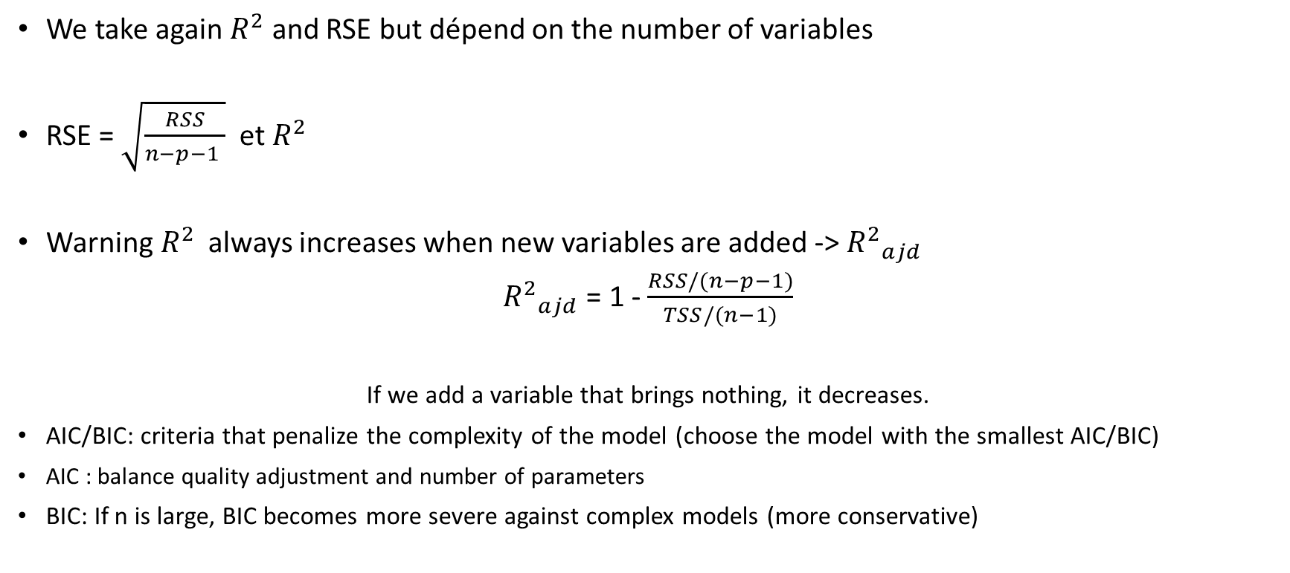
Fit quality
Multiple Linear Regression
We take again $R^{2}$ and RSE but dépend on the number of variables
RSE = $\sqrt{\frac{RSS}{n−p−1 }}$ et $R^{2}$
Warning$R^{2}$ always increases when new variables are added -> ${R^{2}}_{ajd}$
${R^{2}}_{ajd}$ = 1 - $\frac{RSS/(n−p−1)}{TSS/(n−1)}$
If we add a variable that brings nothing, it decreases.
AIC/BIC: criteria that penalize the complexity of the model (choose the model with the smallest AIC/BIC)
AIC : balance quality adjustment and number of parameters
BIC: If n is large, BIC becomes more severe against complex models (more conservative)

Slide 18
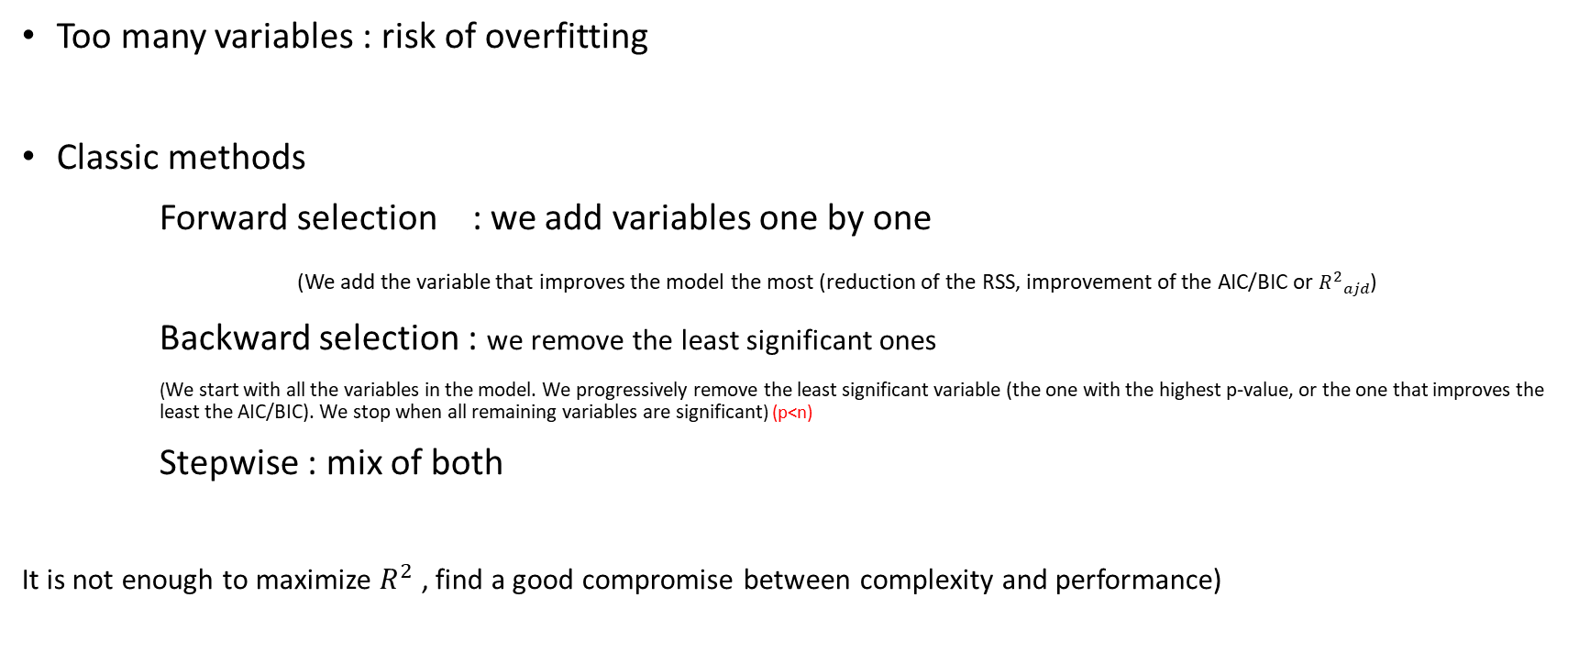
Selection of variables and overfitting
Multiple Linear Regression
Too many variables : risk of overfitting
Classic methods
Forward selection : we add variables one by one
(We add the variable that improves the model the most (reduction of the RSS, improvement of the AIC/BIC or ${R^{2}}_{ajd}$)
Backward selection : we remove the least significant ones
(We start with all the variables in the model. We progressively remove the least significant variable (the one with the highest p-value, or the one that improves the least the AIC/BIC). We stop when all remaining variables are significant) (p<n)
Stepwise : mix of both
It is not enough to maximize $R^{2}$ , find a good compromise between complexity and performance)

Slide 19
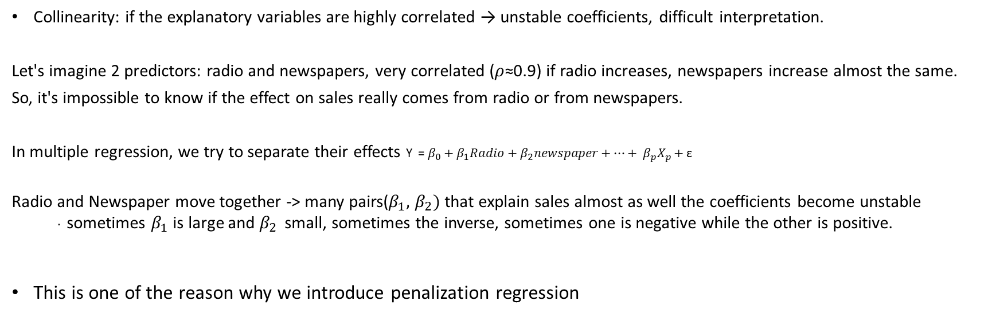
Collinearity problem
Multiple Linear Regression
Collinearity: if the explanatory variables are highly correlated → unstable coefficients, difficult interpretation.
Let's imagine 2 predictors: radio and newspapers, very correlated (𝜌≈0.9) if radio increases, newspapers increase almost the same.
So, it's impossible to know if the effect on sales really comes from radio or from newspapers.
In multiple regression, we try to separate their effects Y = $β_{0}+β_{1}Radio+β_{2}newspaper+…+ β_{p}X_{p}+$ε
Radio and Newspaper move together -> many pairs($β_{1},$ $β_{2})$ that explain sales almost as well the coefficients become unstable
· sometimes $β_{1}$​ is large and $β_{2 }$ small, sometimes the inverse, sometimes one is negative while the other is positive.
This is one of the reason why we introduce penalization regression

Slide 20
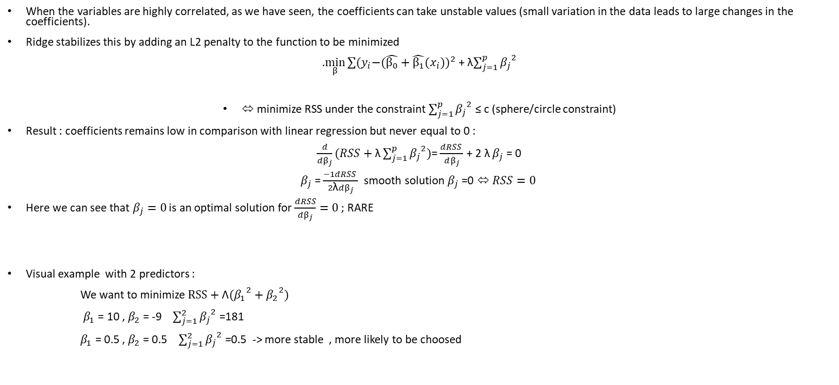
Extension (penalization regression) – Ridge
When the variables are highly correlated, as we have seen, the coefficients can take unstable values (small variation in the data leads to large changes in the coefficients).
Ridge stabilizes this by adding an L2 penalty to the function to be minimized
.$\min_{β}{{\sum{{(y}_{i}−(\hat{β_{0}}+\hat{β_{1}}{(x}_{i})})}^{2}}$ + λ$\sum_{j=1}^{p}{{β_{j}}^{2}}$
⬄ minimize RSS under the constraint $\sum_{j=1}^{p}{{β_{j}}^{2}}$ ≤ c (sphere/circle constraint)
Result : coefficients remains low in comparison with linear regression but never equal to 0 :
$\frac{d}{dβ_{j}}(RSS+\text{λ}\sum_{j=1}^{p}{{β_{j}}^{2}})$= $\frac{dRSS }{dβ_{j}}$ + 2 $\text{λ}$ $β_{j}$ = 0
$β_{j}$ = $\frac{−1dRSS }{2\text{λ}dβ_{j}}$ smooth solution $β_{j}$ =0 ⬄ $RSS=0$
Here we can see that $β_{j}=0$ is an optimal solution for $\frac{dRSS}{dβ_{j}}=$ $0$ ; RARE
Visual example with 2 predictors :
We want to minimize $RSS+{{\text{Λ}(β}_{1}}^{2}+{β_{2}}^{2})$
$β_{1}$ = 10 , $β_{2}$ = -9 $\sum_{j=1}^{2}{{β_{j}}^{2}}$ =181
$β_{1}$ = 0.5 , $β_{2}$ = 0.5 $\sum_{j=1}^{2}{{β_{j}}^{2}}$ =0.5 -> more stable , more likely to be choosed

Slide 21
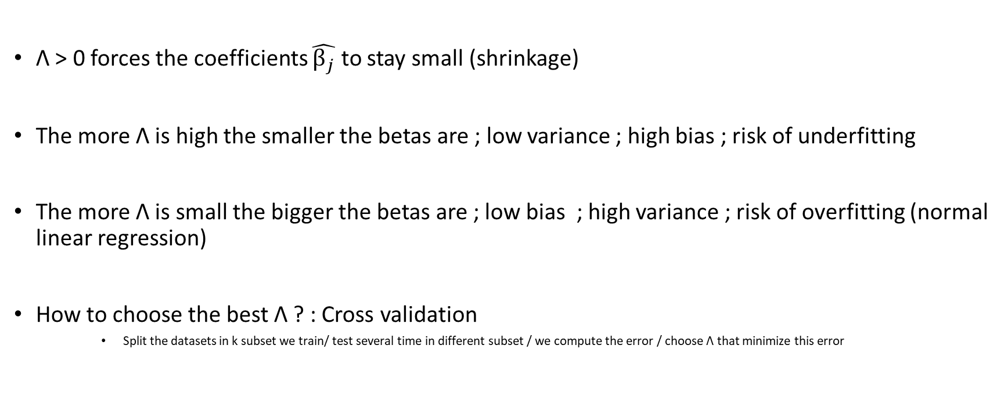
About Λ
Λ > 0 forces the coefficients $\hat{β_{j}}$ to stay small (shrinkage)
The more Λ is high the smaller the betas are ; low variance ; high bias ; risk of underfitting
The more Λ is small the bigger the betas are ; low bias ; high variance ; risk of overfitting (normal linear regression)
How to choose the best Λ ? : Cross validation
Split the datasets in k subset we train/ test several time in different subset / we compute the error / choose Λ that minimize this error

Slide 22
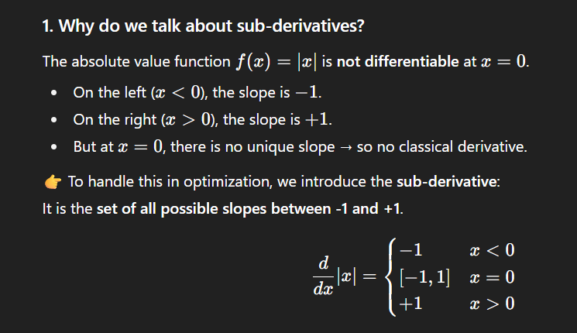
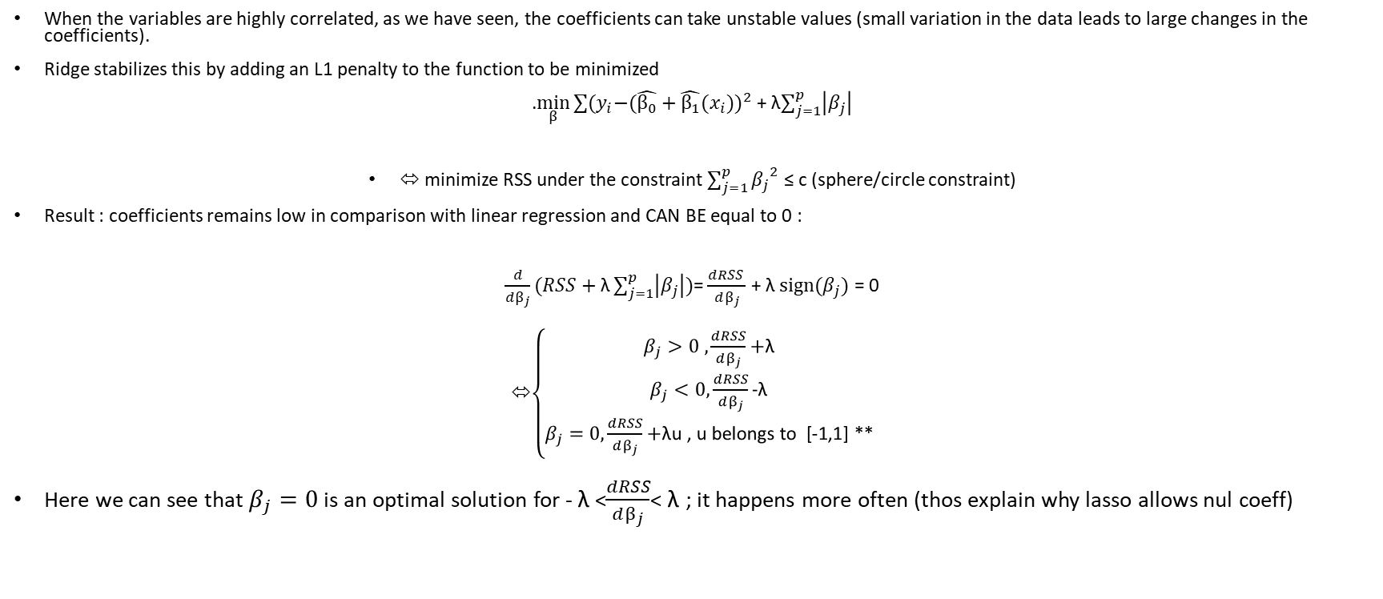
Extension (penalization regression) – Lasso
When the variables are highly correlated, as we have seen, the coefficients can take unstable values (small variation in the data leads to large changes in the coefficients).
Ridge stabilizes this by adding an L1 penalty to the function to be minimized
.$\min_{β}{{\sum{{(y}_{i}−(\hat{β_{0}}+\hat{β_{1}}{(x}_{i})})}^{2}}$ + λ$\sum_{j=1}^{p}{\left|β_{j}\right|}$
⬄ minimize RSS under the constraint $\sum_{j=1}^{p}{{β_{j}}^{2}}$ ≤ c (sphere/circle constraint)
Result : coefficients remains low in comparison with linear regression and CAN BE equal to 0 :
$\frac{d}{dβ_{j}}(RSS+\text{λ}\sum_{j=1}^{p}{\left|β_{j}\right|})$= $\frac{dRSS }{dβ_{j}}$ + λ $\text{s}\text{ign}\text{(}β_{j})$ = 0
⬄$\left\{\begin{aligned}β_{j}>0 ,\frac{dRSS}{dβ_{j}}\text{+}\text{λ} \\ β_{j}<0,\frac{dRSS}{dβ_{j}}\text{−}\text{λ} \\ β_{j}=0,\frac{dRSS}{dβ_{j}}\text{+}\text{λ}\text{u}\text{ , }\text{u} \text{belongs} \text{to}\text{ [}\text{−}\text{1,1}\text{] }\text{∗∗}\end{aligned}\right.$
Here we can see that $β_{j}=0$ is an optimal solution for - $\text{λ}$<$\frac{dRSS}{dβ_{j}}$< $\text{λ}$ ; it happens more often (thos explain why lasso allows nul coeff)

