Slide 1
Tree-Based Model and ensemble method
Simple trees, Bagging, Random Forest

Slide 2
Introduction
Tree-based Model : construction of one tree (very interpretable but weak interpretation accuracy)
Ensemble Method : Combine several trees to improve the accuracy
- Bagging/Random Forest : contruct several indepedant trees then mean (reduce variance)
- Boosting : construct sequentially (correct the error of the previous one)

Slide 3
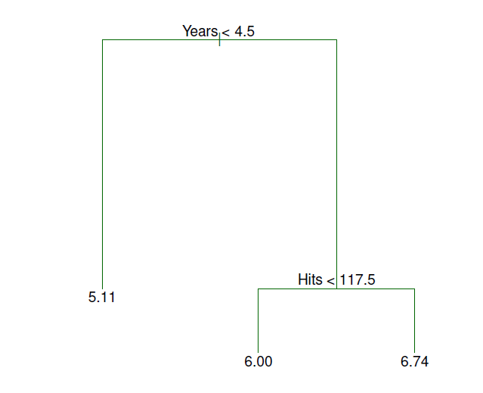
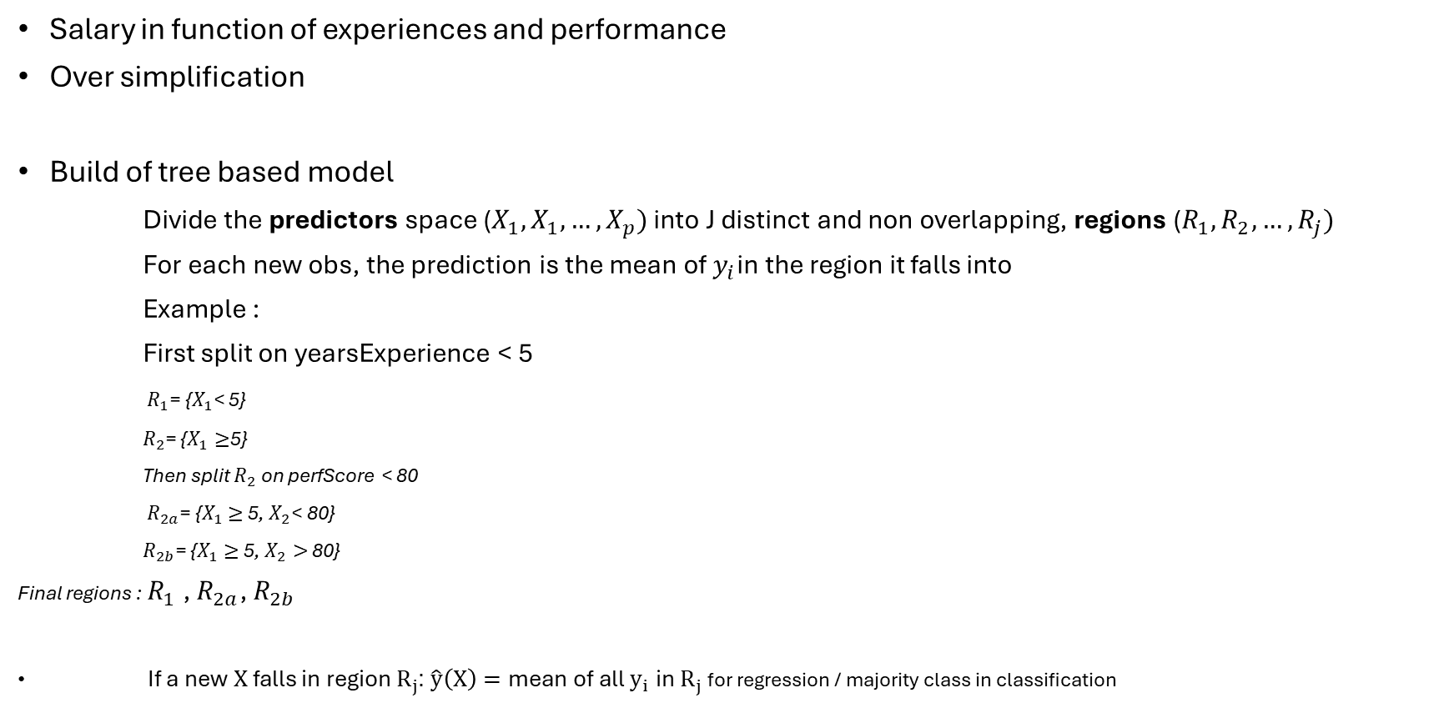
Tree based model
Salary in function of experiences and performance
Over simplification
Build of tree based model
Divide the predictors space ($X_{1},X_{1},…,X_{p})$ into J distinct and non overlapping, regions ($R_{1},R_{2},…,R_{j})$
For each new obs, the prediction is the mean of $y_{i}$in the region it falls into
Example :
First split on yearsExperience < 5
$R_{1}$= {$X_{1}$< 5}
$R_{2}$= {$X_{1}≥$5}
Then split $R_{2}$ on perfScore < 80
$R_{2a}$= {$X_{1}$ $≥$ 5, $X_{2}$< 80}
$R_{2b}$= {$X_{1}$ $≥$ 5, $X_{2}>$ 80}
Final regions : $R_{1}$, $R_{2a}$, $R_{2b}$
If a new $X$ falls in region $R_{j}$: $\hat{y}\left(X\right)=\text{mean} \text{of} \text{all} y_{i} \text{in} R_{j}$ for regression / majority class in classification

Slide 4

Predictor region spaces
High dimensional rectangles / boxes
Goal :
Find boxes $R_{1},R_{1},…,R_{j}$ that minimize the RSS given by
$$\sum_{j=1}^{J}{\sum_{i\text{∈ }R_{j}}{{\text{(}y_{i}\text{ − }\hat{y_{R_{j}}}\text{) }}^{2}}}$$
$\hat{y_{R_{j}}}$ : mean response for the training observations within the jth box

Slide 5
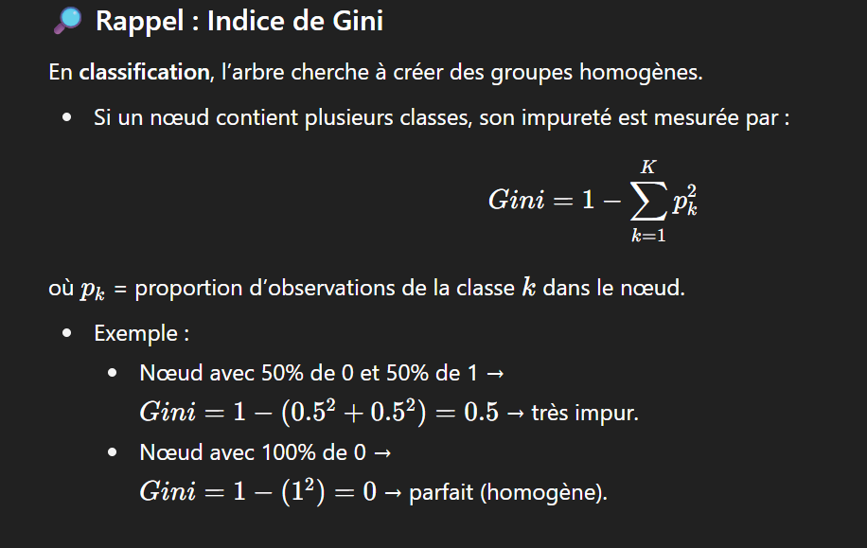
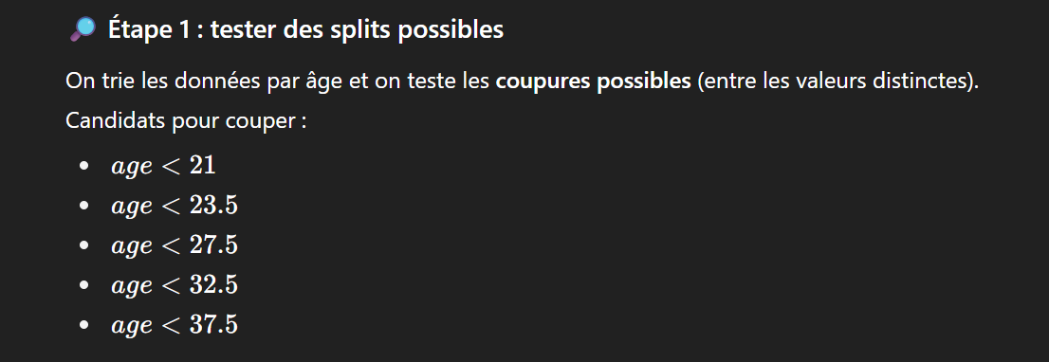
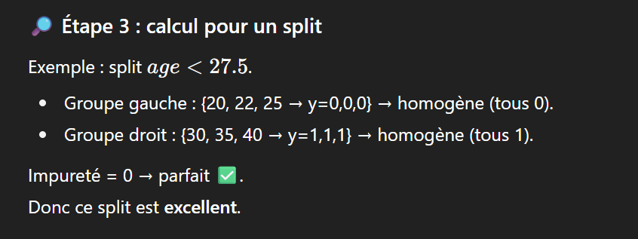
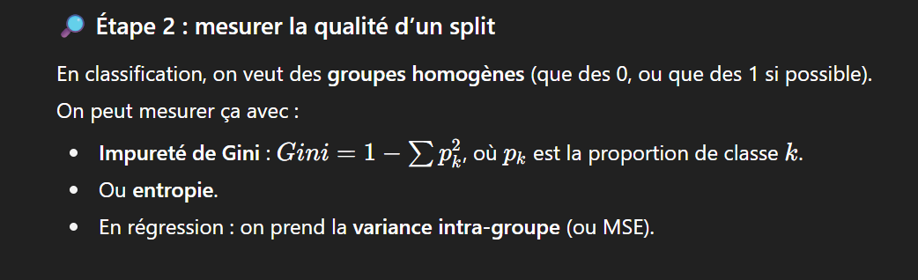
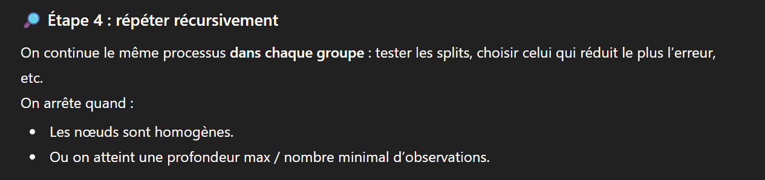
Construction de l’arbre (Exemple concret)
Âge | y
20 | 0
22 | 0
25 | 0
30 | 1
35 | 1
40 | 1
Plus gini proche de 1 mieux c’est
Nœuds homogènes = tous la même classe ou proche de y en regression

Slide 6
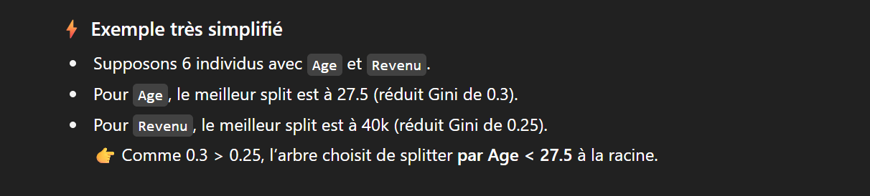
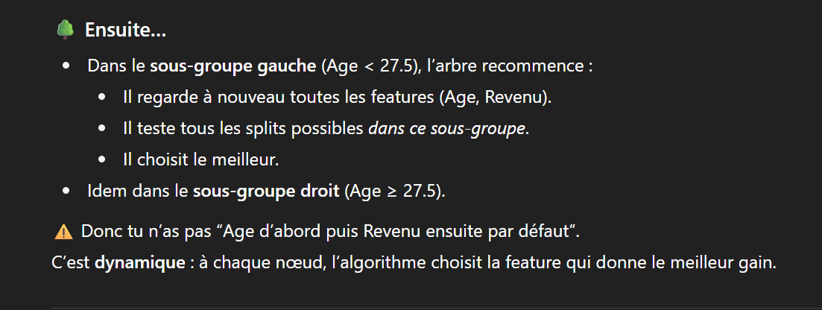
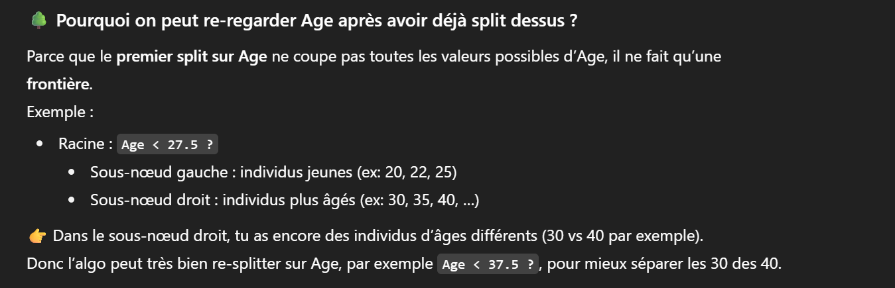

Slide 7
Technical details
Recursive Binary Splitting : at each step we choose the best variable and best threshold that reduce the RSS
Greedy / Top down : local better choice not global
Regression Criteria : RSS / Clasification Criteria Gini,entropia
Often the tree is too complex : Pruning / cross validation

Slide 8
Pruning / Cross Validation
To avoid overfitting (too big depth): Pruning (cut the tree too find a better bias/variance balance)
How : remove some of the leaves aand replace it by a leave that is an average of larger number observation
How to Prune Regression Trees, Clearly Explained!!!
Low depth tree : ++bias – variance / Low depth tree : --bias +variance
Pruning generate a sequence of candidate subtrees

Slide 9
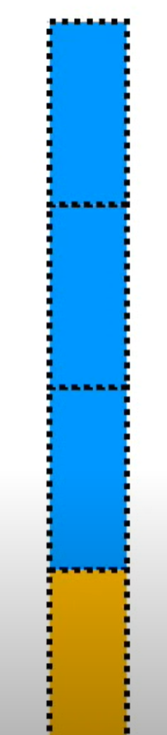
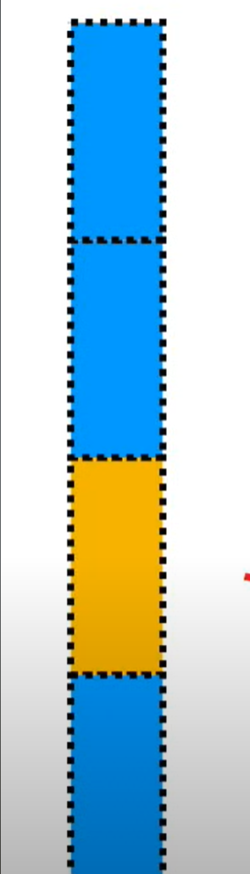
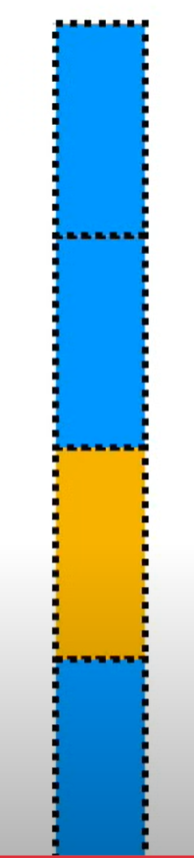
Cross validation
Method where we split the data into several parts, train the model on some parts and test it on the others
Then use CV to compare performance of each sub trees ( find the optimal depth/ size after pruning :hyperparameters)
We keep the one that minimize the error
On construit d’abord un arbre trop grand, puis on le réduit (pruning). La cross-validation permet de choisir la taille optimale de l’arbre. (CV permet de retrouver les valeurs optimales des hyperparamètres de manière plus efficaces)

Slide 10
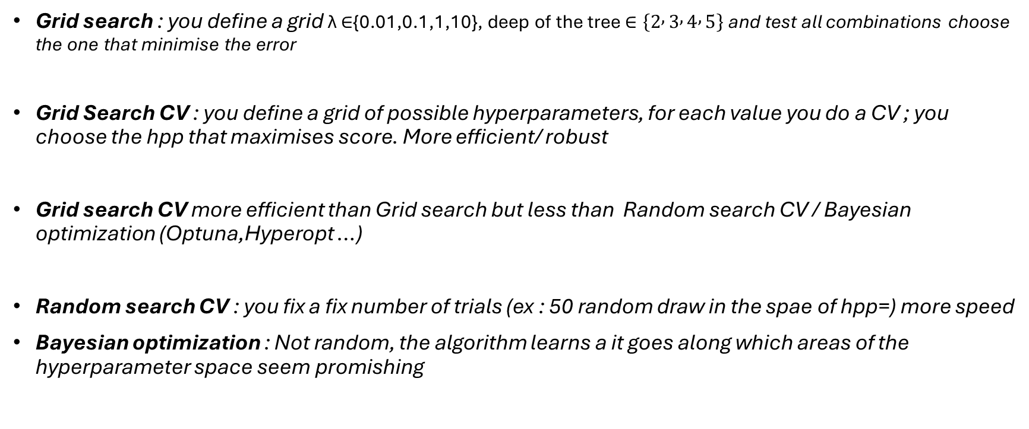
Method to find hyperparameters
Grid search : you define a grid λ ∈{0.01,0.1,1,10}, deep of the tree $∈\left\{2 , 3 , 4 , 5\right\}$ and test all combinations choose the one that minimise the error
Grid Search CV : you define a grid of possible hyperparameters, for each value you do a CV ; you choose the hpp that maximises score. More efficient/ robust
Grid search CV more efficient than Grid search but less than Random search CV / Bayesian optimization (Optuna,Hyperopt …)
Random search CV : you fix a fix number of trials (ex : 50 random draw in the spae of hpp=) more speed
Bayesian optimization : Not random, the algorithm learns a it goes along which areas of the hyperparameter space seem promishing

Slide 11
Ensemble method (Bagging Random Forest)
Even after pruning a simple tree has high variance
To improve stability and accuracy we combine many simple trees together (weak learners) :
Different methods exist : bagging, Random Forests, Boosting (Elyes)

Slide 12
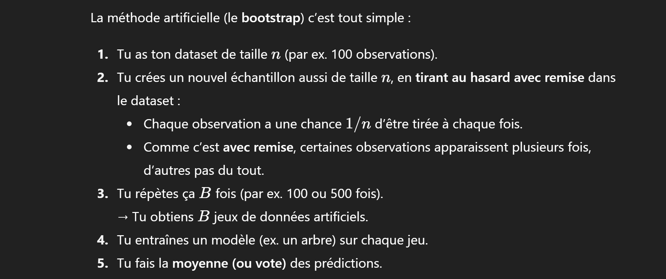
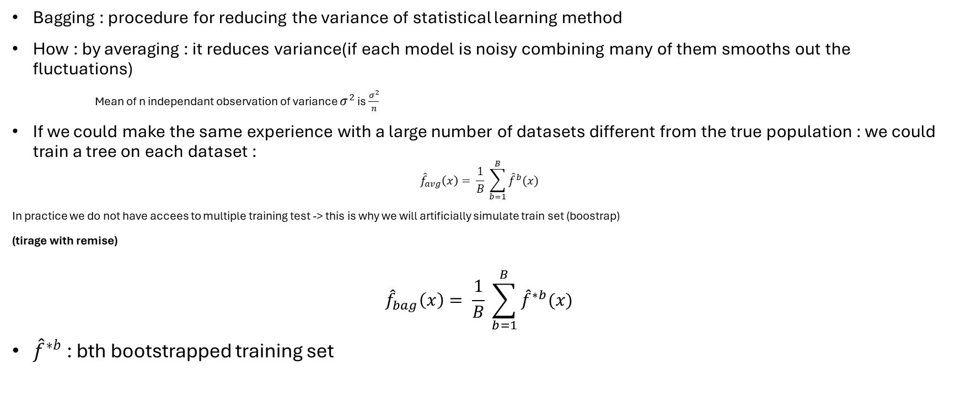
Bagging
Bagging : procedure for reducing the variance of statistical learning method
How : by averaging : it reduces variance(if each model is noisy combining many of them smooths out the fluctuations)
Mean of n independant observation of variance $σ^{2}$ is $\frac{σ^{2}}{n}$
If we could make the same experience with a large number of datasets different from the true population : we could train a tree on each dataset :
$${\hat{f}}_{avg}\left(x\right)= \frac{1}{B} \sum_{b=1}^{B}{{\hat{f}}^{b}(x)}$$
In practice we do not have accees to multiple training test -> this is why we will artificially simulate train set (boostrap)
(tirage with remise)
$${\hat{f}}_{bag}\left(x\right)= \frac{1}{B} \sum_{b=1}^{B}{{\hat{f}}^{∗b}(x)}$$
${\hat{f}}^{∗b}$: bth bootstrapped training set

Slide 13
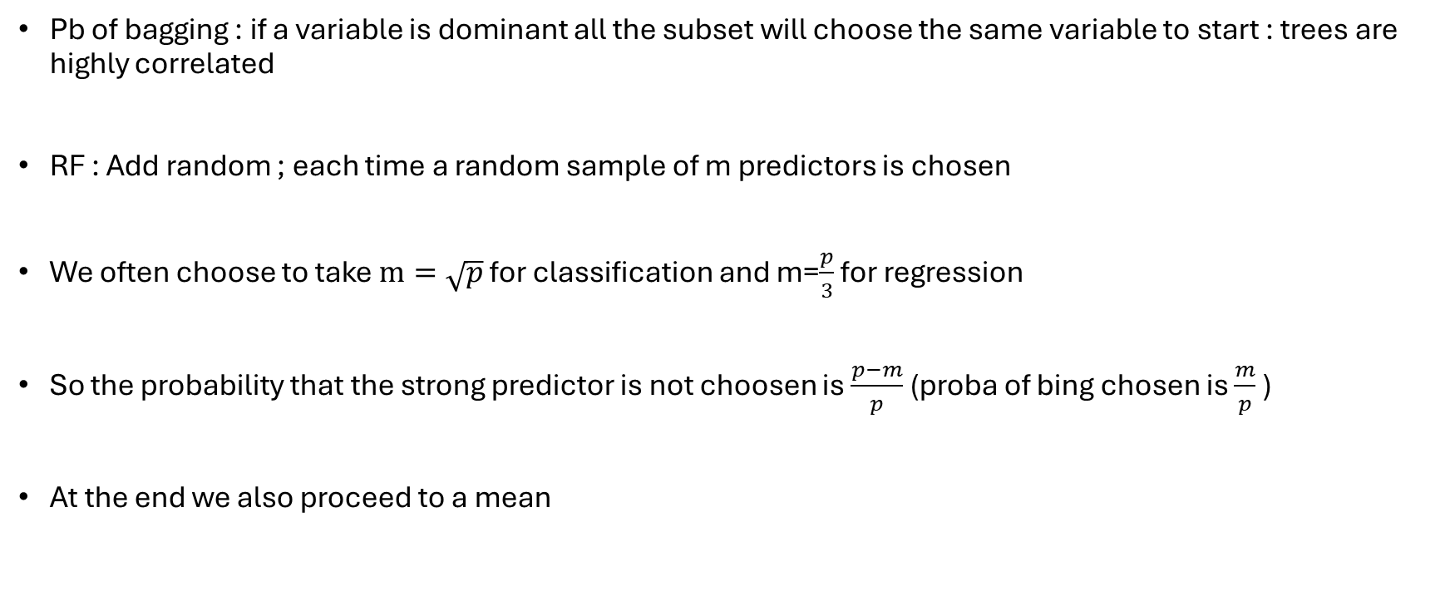
Random Forest
Pb of bagging : if a variable is dominant all the subset will choose the same variable to start : trees are highly correlated
RF : Add random ; each time a random sample of m predictors is chosen
We often choose to take $m=\sqrt{p}$ for classification and m=$\frac{p}{3}$ for regression
So the probability that the strong predictor is not choosen is $\frac{p−m}{p}$ (proba of bing chosen is $\frac{m}{p}$ )
At the end we also proceed to a mean

Slide 14
Understand bagging and RF through data
Exemple d’arbre trop sensible aux données d’entrées
Observation (individu) | Age (feature 1) | Revenu (feature 2) | Ville (feature 3) | y (cible)
1 | 25 25 | 30k | Paris | 0
2 | 40 | 70k | Lyon | 1
3 | 32 | 50k | Paris | 0
Bagging (random only on individuals): we drag individuals randomly with replacement. Example : Take I1 one time / I2 3 times (bootstrapped dataset) / all the features are always considered to build the tree and find better split
Random Forest : Same but at each nodes we only see Age/ Revenu or Ville/ Revenu information

