Slide 1

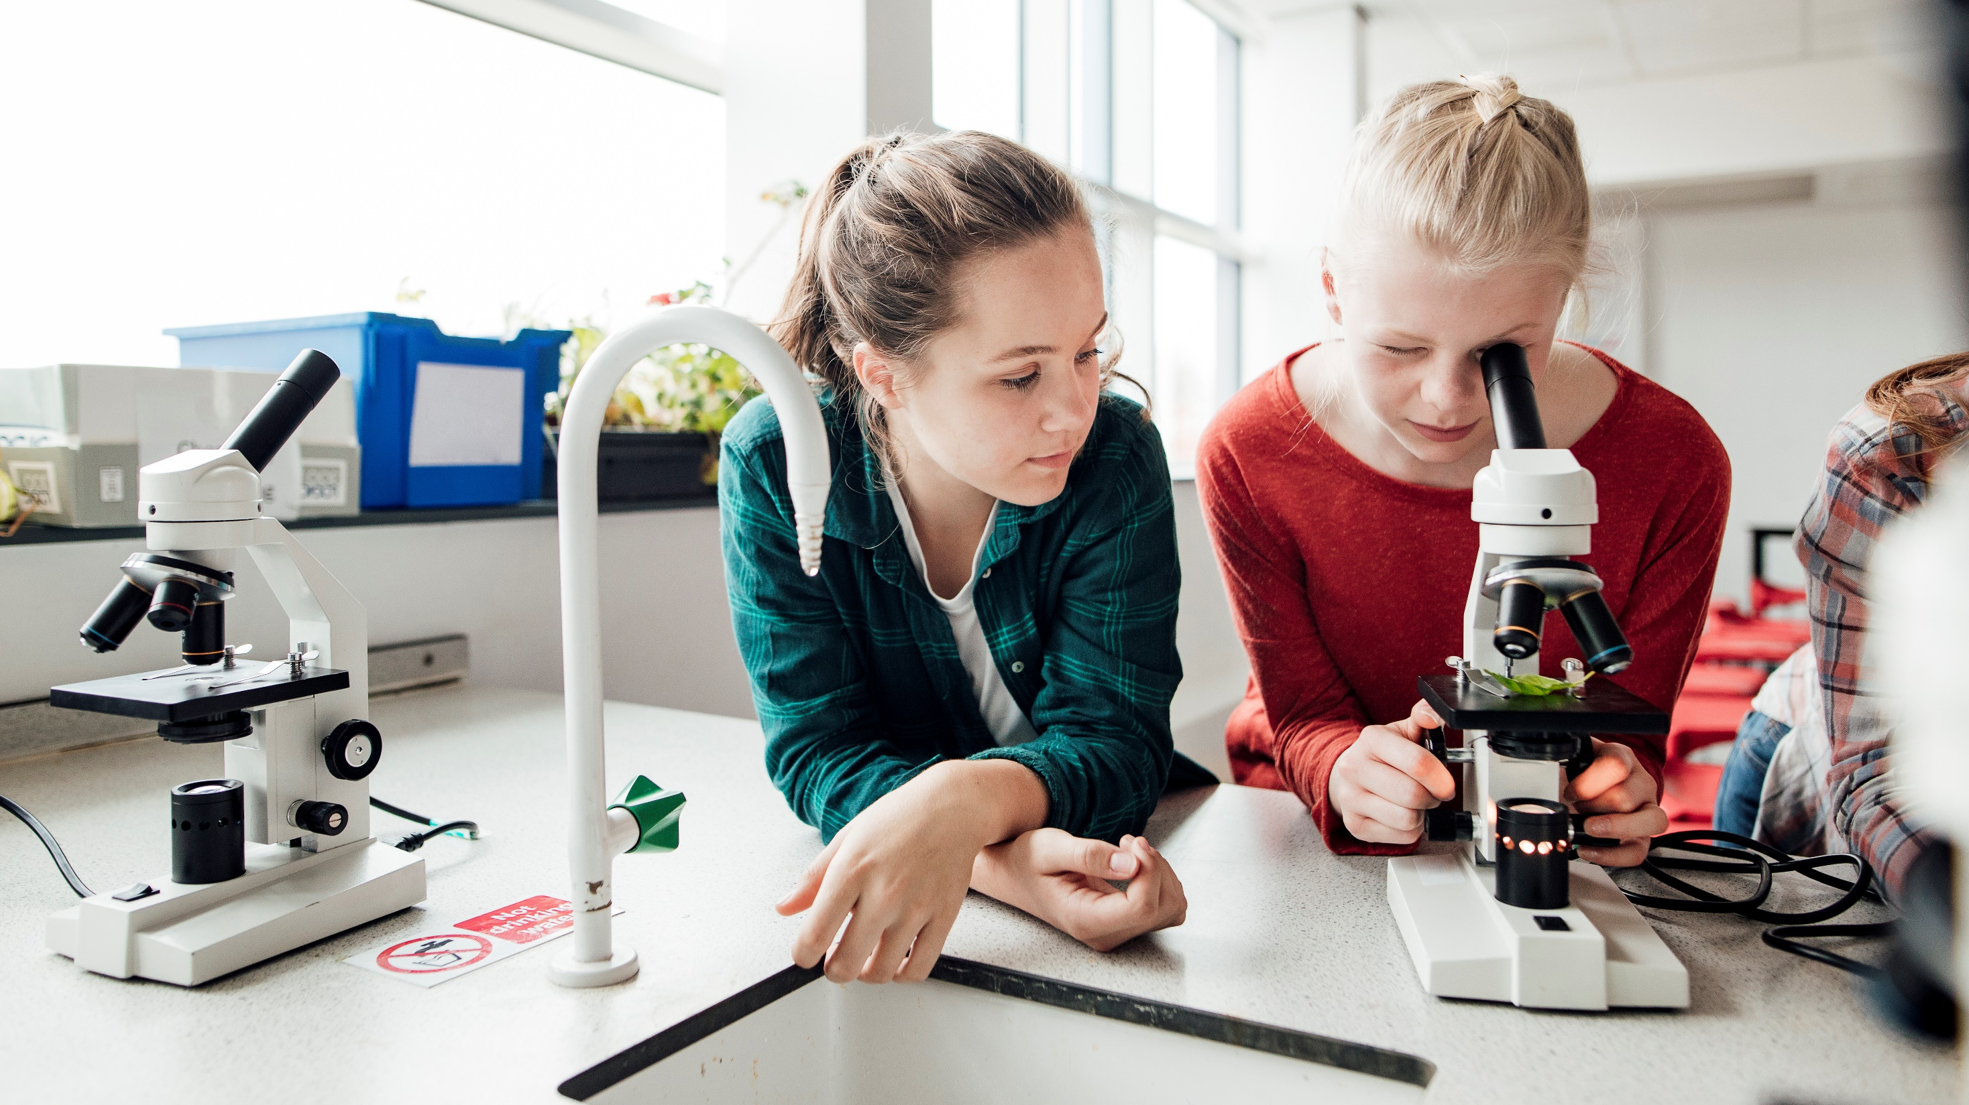
KNOW ABOUT OUR PROJECT -EDUCATION -(project name-Bytesbrain)

Slide 2
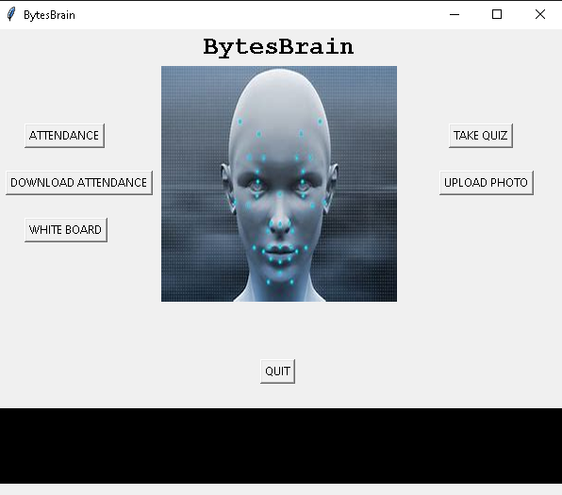
Problems BYTES BRAIN SOLVES
Transforming learning into Amazing e-learning Experiences
Lack Of Learner Motivation And Engagement
Adaptive learner models to accommodate different learner needs

Slide 3

How bytes brain works
PREREQUISITES
PYTHON INSTALLED
PYTHON PACKAGES LIKE TKINTER,FACE RECOGNITION,WEBBROWSER,SHUTIL,NUMPY,CV2 INSTALLED.
AND A PC WITH CAMERA.
THIS PROJECT IS (FACE RECOGNITION+ATTENDANCE +A WHITE BOARD CONTROLLED BY TEACHER’S HAND HAVING A COLOR MENTIONED IN THE PROGRAM) WITH A FUNCTIONALITY OF TAKING QUIZ OF THE CONCEPT BEING TAUGHT.

Slide 4
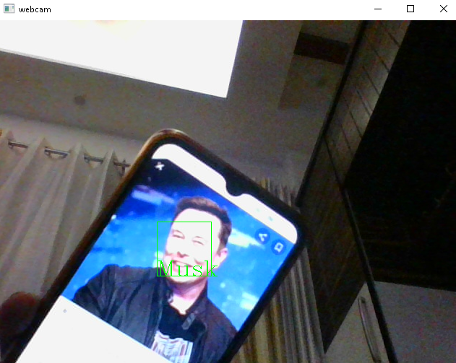
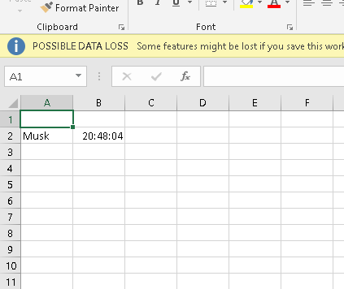
THIS OPTION WHEN CLICKED
OPENS CAMERA TO TAKE LIVE
FEED AND RECOGNIZES THE PERSONS WHOSE PICTURES ARE
UPLOADED IN THE APP
And CREATES A CSV(EXCEL) FILE WITH NAMES AND TIME WHEN THE FACE WAS RECOGNIZED.
(NO REPEATED ENTRY)
.
ELON MUSK PHOTO WAS SAVED THAT’S WHY HIS PHOTO FROM THE LIVE FEED WAS RECOGNIZED AND NAME AND TIME WAS SAVED IN THE EXCEL FILE AUTOMATICALLY.

Slide 5
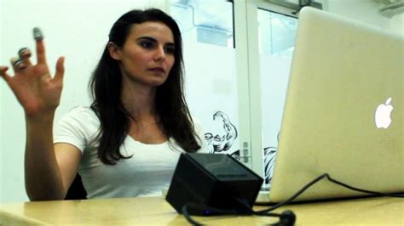
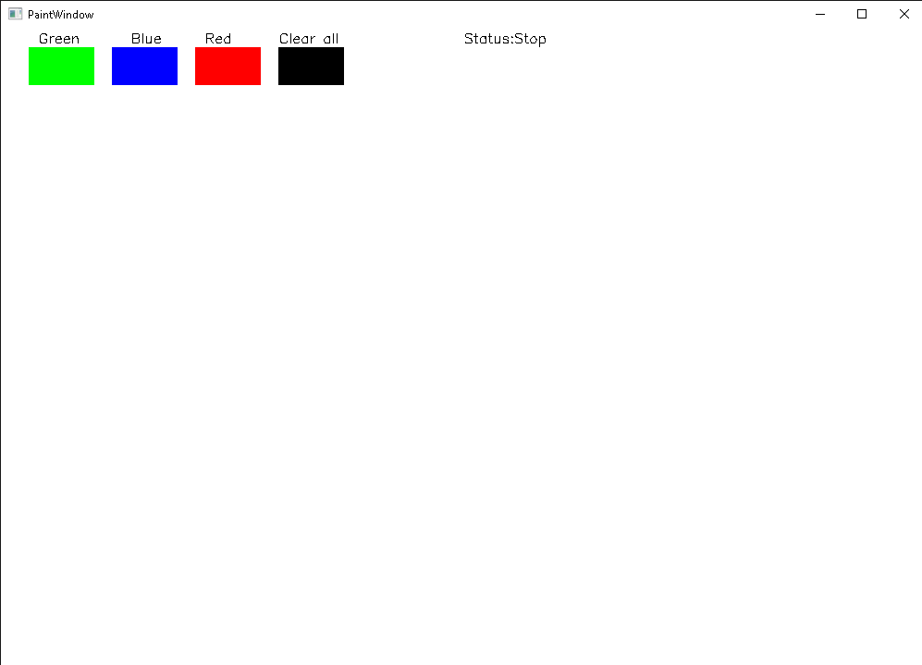
THIS OPTION WHEN CLICKED
OPENS A WHITE SCREEN(LIKE PAINT) AND PAINT CURSOR CAN BE CONTROLLED WITH FINGER GESTURE WITH A COLOR MENTIONED IN THE PROGRAM.SOME THING LIKE THE BELOW PICTURE.
OPENS A URL TO TAKE QUIZ OF ANY TOPIC.
PHOTOS OF PEOPLE TO BE RECOGNIZED IN LIVE FEED.
CONTROLLED BY HAND GESTURES.

Slide 6
impact
Improved Communication
Time Saving
Better Management
Better Retention
Better explanations of concept

Slide 7
conclusion
From our side we think we have created a application which takes attendance on the basis of face recognition and also have white board which works like the air canvas.
And we think it will help teachers in taking attendance automatically, explain concept with more clarity with our white board and the “take quiz” option will help in taking quizzes of the concepts being taught.

Slide 8
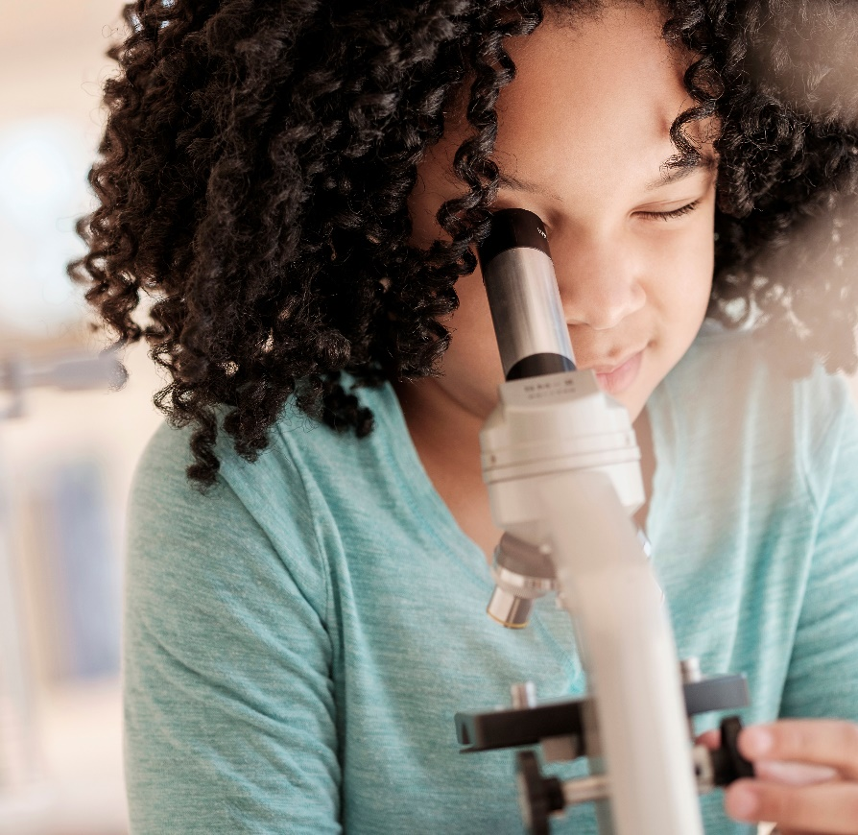



HOW BYTESBRAIN application DEVELOPED:
Research
Communication
Curiosity

Slide 9
Thank You
CREATORS:
NEEL KAMAL - neelpunia382@gmail.com
ASHISH NIRWAL - ashishnirwal2@gmail.com
Link : Bytesbrain.mp4 - Google Drive

