Slide 1
OUR
EDUCATION
SYSTEM
Karan Kumar Gupta (MAIT)
2nd year CSE

Slide 2
CONTENTS
Problem With Our Education system
Solution

Slide 3
PROBLEMS
Rattafying or the rote learning process
This Hinglish word easily define the state of Indian education system. Students in our education system are compelled to rote learn in order to score high marks. The system sadly does not focus on strengthening and clearing the concepts.

Slide 4
INSUFFICIENT INFRASTRUCTURE Poor infrastructure & lack of facilities are reasons for the low turnout of students in schools. Students, especially girls, do not prefer to go to schools.Basic necessities, such as clean and hygienic drinking water and separate toilets for boys and girls, are not available in many of the school, even in urban India

Slide 5
TEACHER SELECTION CRITERIA In most of our schools the teacher’s selection& recruitment process is non-merit based. They are selected as per the choice of selectors.Lack of proper academic qualifications and competency in pedagogy are another challenge.

Slide 6
NO EMPHASIS ON CREATIVITY our education system focuses on quantity rather than quality. Getting high marks by hook or crook is the only aim of the students; they are not bothered about conceptual understanding or developing critical and creative thinking. This restricts the growth of their mind. These are some issues, that our educational system is facing nowadays, which need to be resolved and removed from our system. If not completely, then at least some percentage of it can be removed by opening schools which focus on providing progressive quality education to students. If merit-based teacher selection, output-oriented study, concept clarity of students are treated as important factors, then we can think of bringing change in our education system. Opening schools where the focus is on providing an excellent education to students will ease the course of action. However, opening a school is not an easy job at all. You need many things like funds, land, getting approvals from authorities, designing architecture, expertise to create curriculum, etc. Not all these expert knowledge is available with a single person. School Consultancy service plays an important role in this tricky situation. Shri Educare is one such organization, which will help you in realizing the dream of opening such a school.

Slide 7
What is the
SOLUTION ?

Slide 8
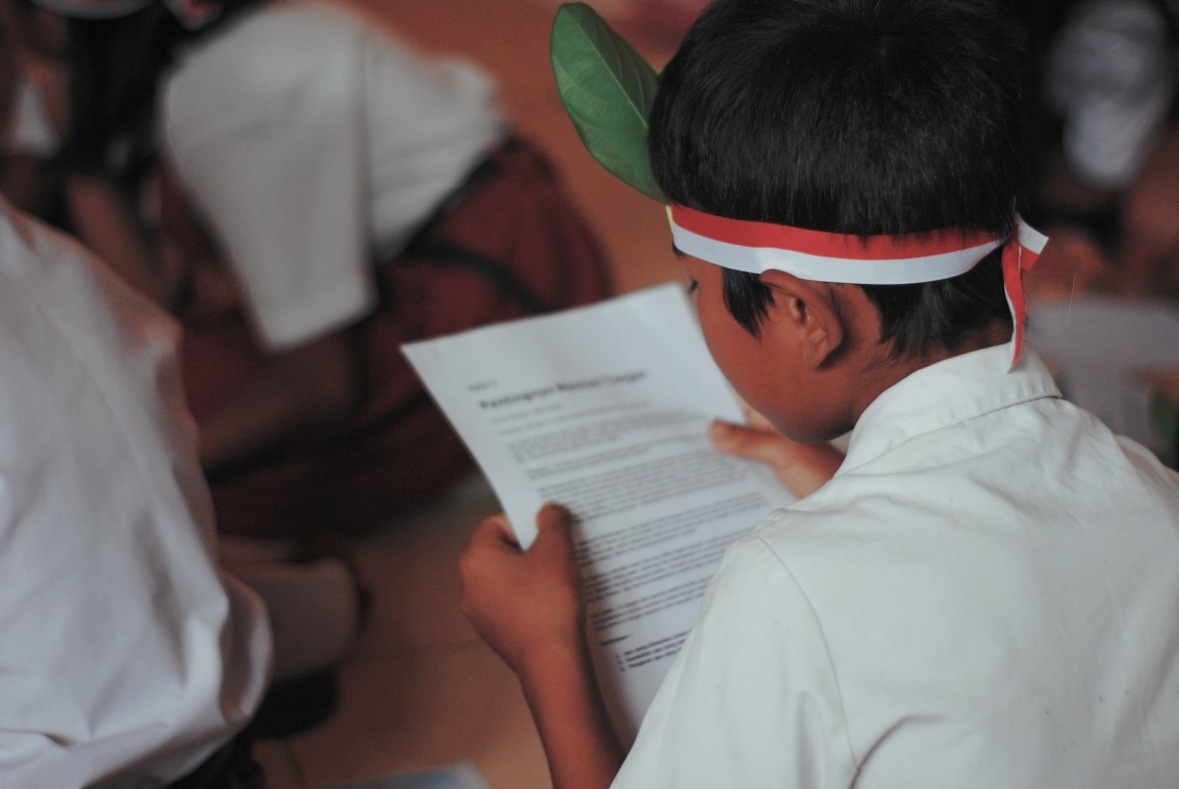
Rote learning

Slide 9
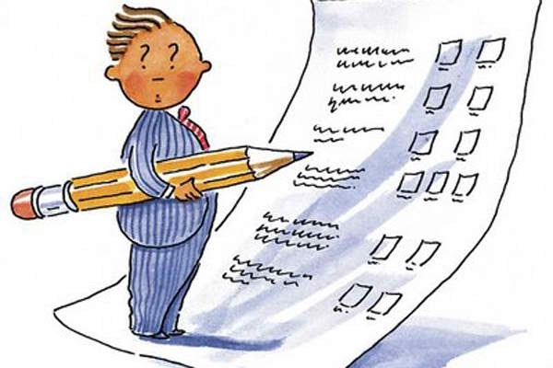
Evaluation system

Slide 10
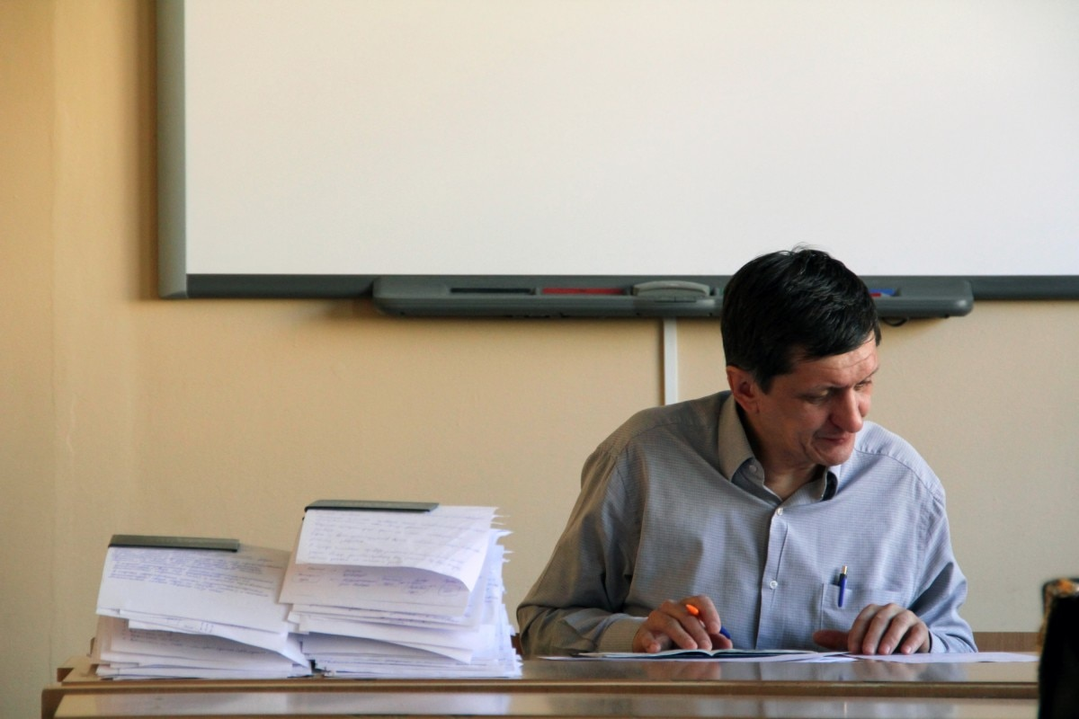
Better training of educators

Slide 11

Teach them the purpose of education

Slide 12
Thank You

