Slide 1

CODE INNOVATIVE HACKATHON - MAIT
Presentation By-
Team Galactus, Mait

Slide 2

1.Problem Statement
Health Tech
Create Solutions to deal with these two major challenges faced by the patients:
1. Enabling a patient-centered information exchange system.
2. Personal medical assistant.

Slide 3

3.Team
Team Name-Galactus
Participants
1.Shobhit Kumar
2. Sushant Kumar
3. Udit Takkar
4. Uday Mittal

Slide 4

4.Our idea to tackle the given problem statement
1. We are planning to create a web application that works like uber to connect patients suffering from illness to a nearby ambulance and driver registered on our platform so that they can quickly take the patients to the hospital.
2. Also, the application will have other sections that will act as a centralized system to provide real-time information about beds availability including ICU beds in the hospitals in the state of Delhi

Slide 5
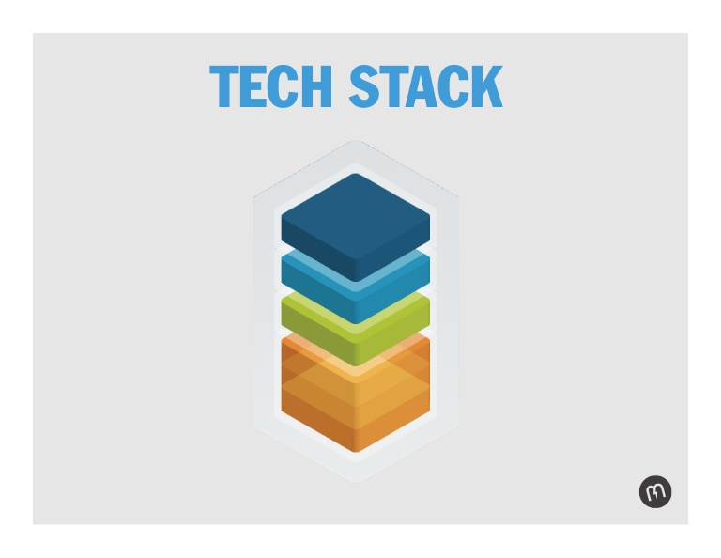
5.Tech Stack
Frontend: React
Backend: Node.js,Express.js
Database:MongoDB,mongoose
IDE: VS Code
API Testing & Documentation: Postman
Version Control: Git and GitHub
Hosting: Heroku
Mapbox API

Slide 6


6.How will the application help?
1. The web platform will connect patients to a nearby ambulance/driver registered on our platform so that they can quickly take the patients to the hospital without wasting precious time.
2. The application will provide real-time information about the beds available in hospitals. It will also contain a tweets section that will display tweets related to various medical resources.

Slide 7
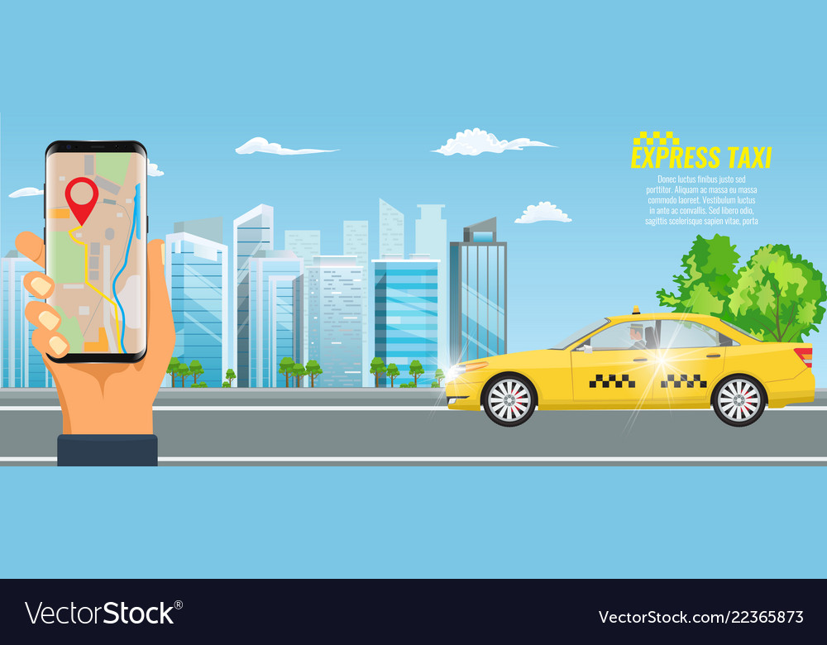
7.How will the application work?
1. Users can register to our platform by filling out their details.
2. Location:-This section would display all the markers of the driver’s location who are available on the map using the mapbox api.

Slide 8

Booking Section:-
In this section, the user would be required to enter his full address which would be the pickup location and then this address would be converted to coordinates using the Mapbox Geocoding API, and then from our database, we would search for all the available drivers and display them to the user in sorted order of their distance from the pickup location.
We would use a turf module to calculate the distance between the coordinates.
Then the user can confirm the booking by selecting the preferred driver.
Dashboard:-
After the Booking has been confirmed by the user the details and the route of the driver would be shown on the map to the user on the dashboard.

Slide 9
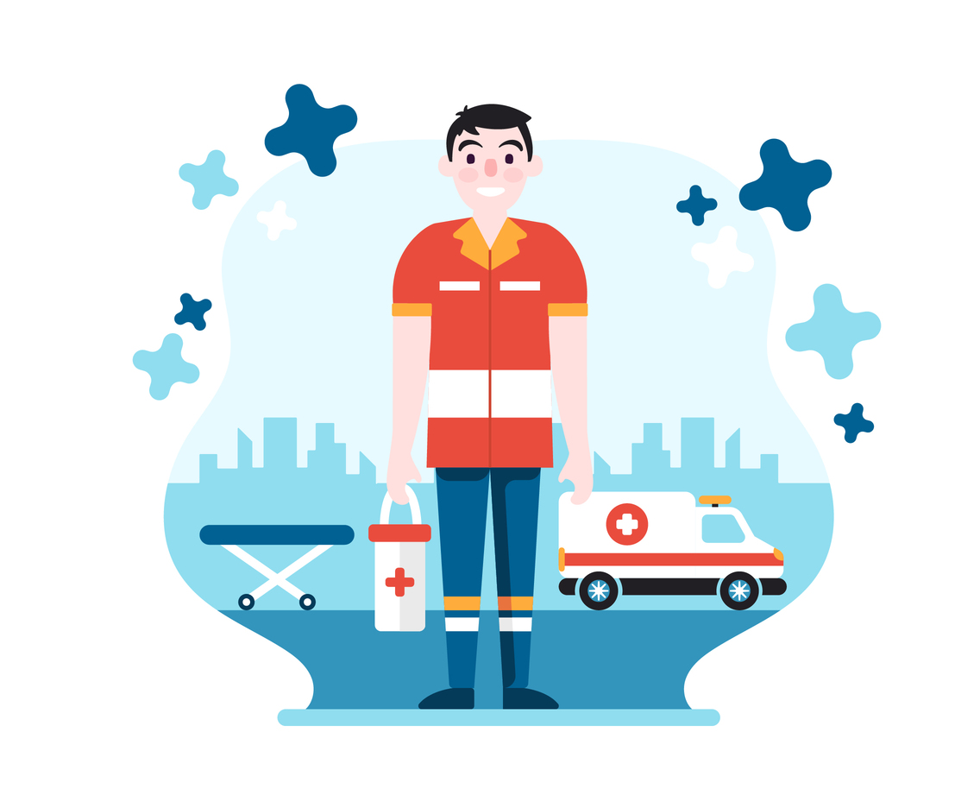
Drivers:-
Dashboard:-
A Driver could also register to our application by filling out his details and location and accept a booking from the users.
A Driver would have the option to mark his status as available when ready to accept bookings from the user.
When the user confirms the booking the driver would get all the details of the user i.e his name, distance, pickup location, and the direction and route to the pickup location would be displayed on the map using Mapbox API and Mapbox direction API.

Slide 10

Information Section:-
Information Section:- User can check the availability of beds in various hospitals around Delhi. For getting the information, we will use an API made available to the public by the Delhi Government

Slide 11

Tweets Section:-
Users can get verified leads of resources/beds and help from Twitter by typing their city.

Slide 12
Thank you !
Team Galactus
We would like to hear suggestions and improvments.

