Slide 1
What is TCP/IP?
❑ TCP/IP stands for Transmission Control Protocol/Internet
Protocol
➢ so named for two of its most important protocols
❑ Internet Protocol Suite
➢ (the phrase used in official Internet standard documents)
❑ one of the available network protocol* suites
➢ (*protocol – formal description of a set of rules and conventions that govern how devices on a network exchange information)
3

Slide 2
Why TCP/IP?
❑ The de facto standard for computer communications in today’s networked world
❑ The world’s most popular open system (nonproprietary)
➢ they can be used to communicate across any set of interconnected networks
➢ equally well suited for LAN and WAN communications
❑ The “engine” for the Internet!
4

Slide 3
TCP/IP and the Internet
❑ An internet under TCP/IP operates like a single network connecting many computers of various sizes and types
❑ The Internet is an interconnection of independent physical networks (e.g. LANs) linked together by internetworking devices (i.e routers/gateways)
❑ The main task of the Internet and its TCP/IP protocol suite is to provide services for users
5

Slide 4
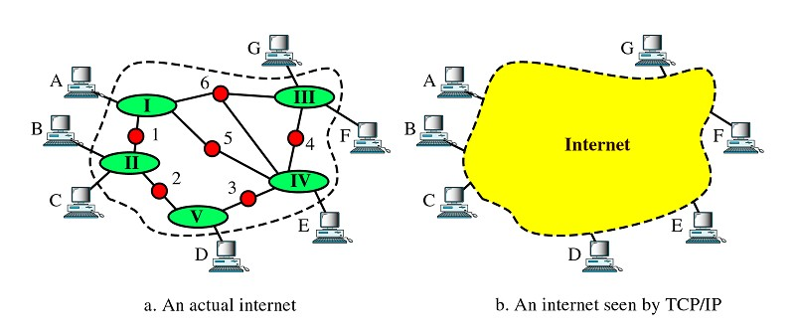
TCP/IP and the Internet
6

Slide 5
TCP/IP versus other Network
Protocols
❑ TCP/IP is not the only network protocol
❑ Other Protocols:
➢ NETBEUI – IBM PC/MS Windows
➢ IPX – Novell NetWare
➢ AppleTalk – Apple Macintosh
➢ SNA – IBM Mainframes
➢ DECnet – Digital Equipments
➢ etc.
7

Slide 6
OSI Reference Model and TCP/IP
❑ Like most network protocols, TCP/IP is a layered protocol
➢ each layer builds upon the layer below it, adding new functionality
❑ normally compared to Open Systems Interconnection (OSI)* reference model to better understand the functions of each layer
➢ (*OSI is a conceptual framework for communications between computer and network devices; defined by ISO)
8

Slide 7
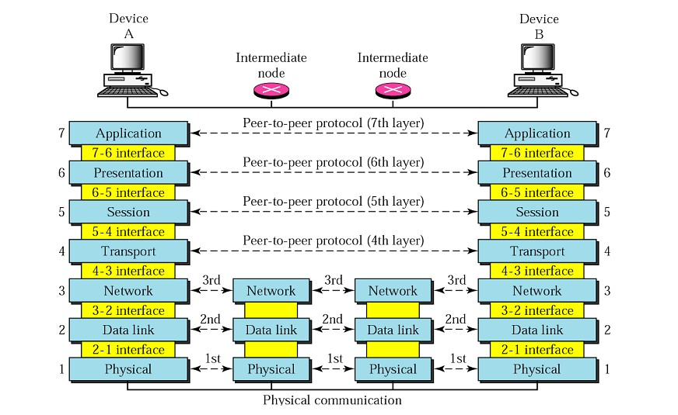
OSI Reference Model
9

Slide 8
OSI Model – Layered Architecture
❑ Each layer defines a family of functions (or services) distinct from those of the other layers
➢ modular, comprehensive, flexible
❑ The OSI model allows complete transparency between otherwise incompatible systems
❑ A mnemonic for remembering the layers
Please Do Not Touch Steve’s Pet Alligator
Physical, Data link, Network, Transport, Session, Presentation,
Application (1 to 7)
Pupils Should Treat Nice Lecturer Properly!
Application, Presentation, Session, Transport, Network, data Link,
Physical (7 to 1)
•
10

Slide 9
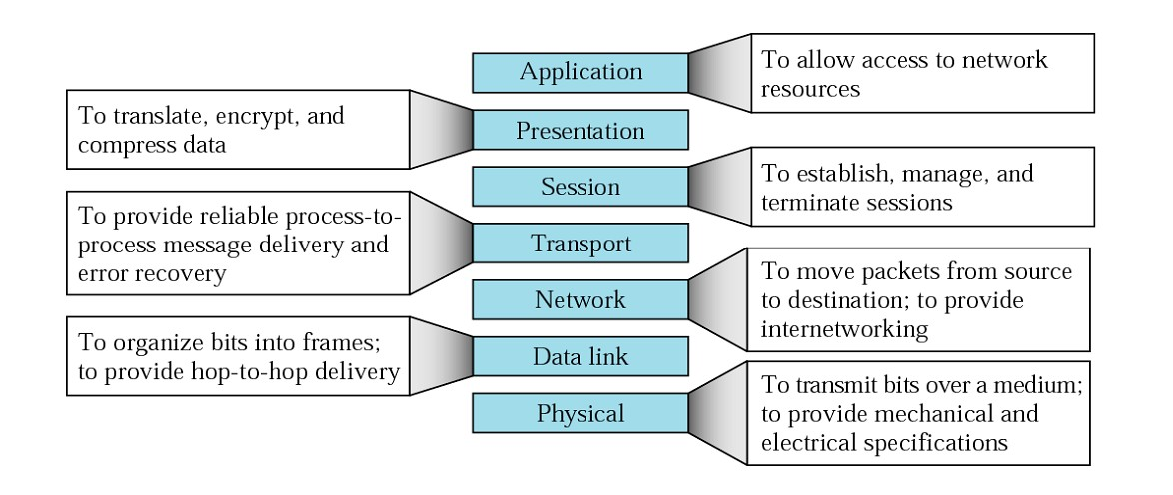
OSI Model – Summary of Layers
11

Slide 10
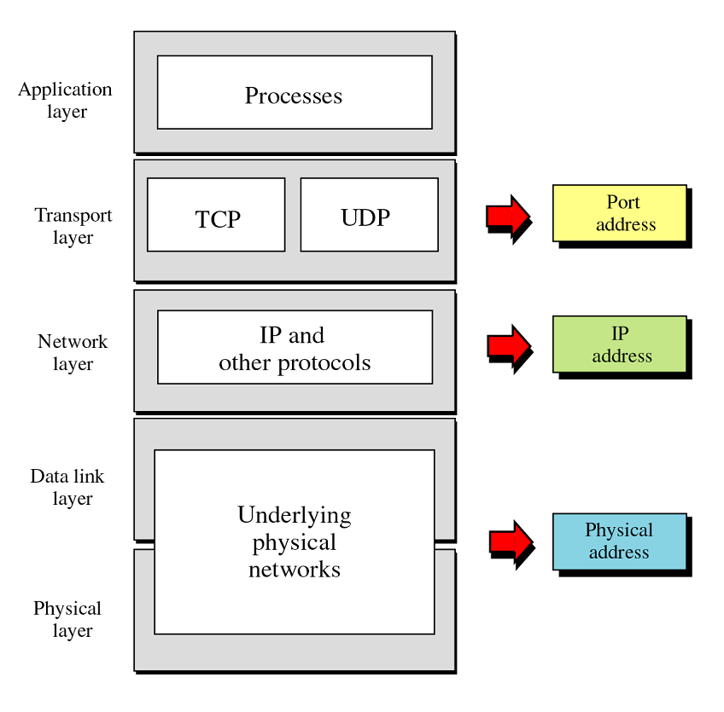
Relationship of Layers and
Addresses in TCP/IP
12

Slide 11
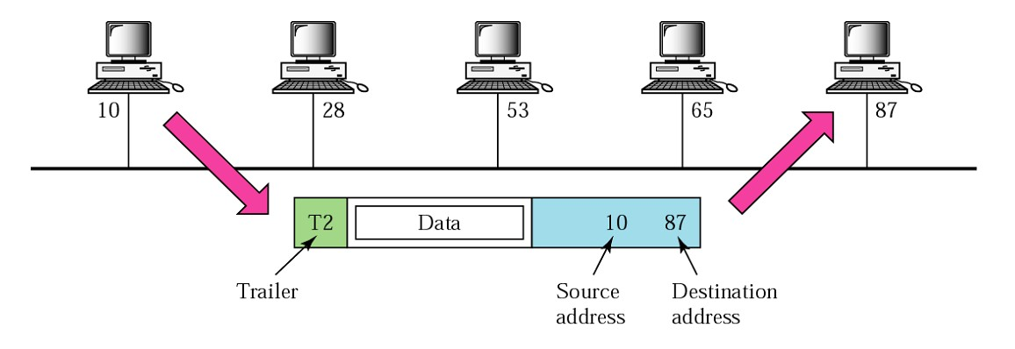
Physical Address
❑ Nodes are connected by a link; at the data link level the frame contains physical addresses
❑ Most LAN uses 48-bit (6 bytes) physical address,
➢ e.g. 07-01-02-01-2C-4B (written as 12 hexadecimal digit)
13

Slide 12
Internet Address
❑ Physical addresses are not adequate in an internetwork environment – a universal addressing system in which each host can be identified uniquely, regardless of the underlying physical network
❑ IP address (32 bits)
➢ e.g. 132.24.75.9 (written as four decimal number)
14

Slide 13
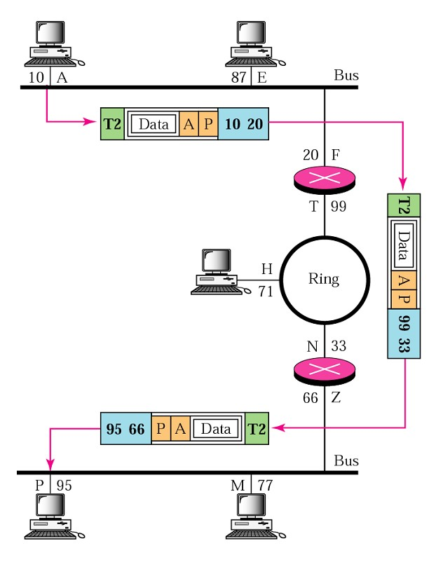
Internet Address
15

Slide 14
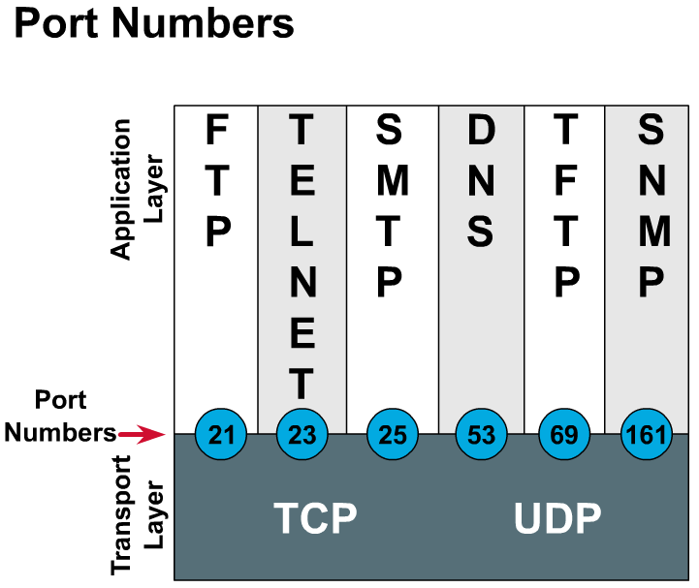
Port Address
❑ multiple processes may be
running at the same time
❑ port addresses differentiate the communicating processes
❑ in TCP/IP a port address is represented by one decimal number
➢ e.g. 80 (common port for HTTP)
16

Slide 15
IP Addressing (Internet Address)
❑ Static
❑ Dynamic
17

Slide 16
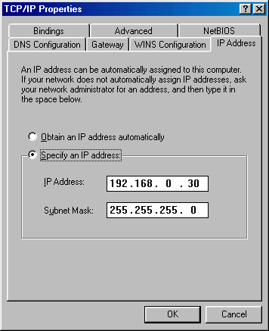
Static IP Addressing
❑ You have to go to each individual device
➢ Meticulous records must be kept
➢ No duplicate IP addresses
18

Slide 17
Dynamic Addressing
❑ Dynamic Host Configuration Protocol (DHCP)
➢ Successor to BOOTP
➢ Allows host to obtain an IP address quickly and dynamically
➢ Uses a defined range of IP address
❑ Reverse Address Resolution Protocol (RARP)
➢ Binds MAC addresses to IP addresses
❑ BOOTstrap Protocol (BOOTP)
➢ Uses UDP to carry messages
➢ Uses broadcast IP datagram
➢ MAC address pre-matched to IP address
➢ Can contain additional information (default gateway)
19

Slide 18
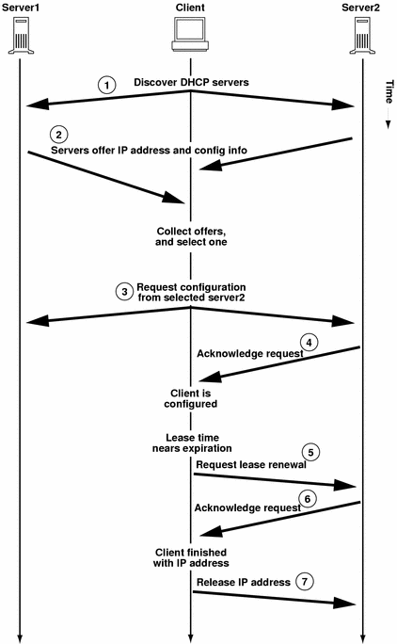
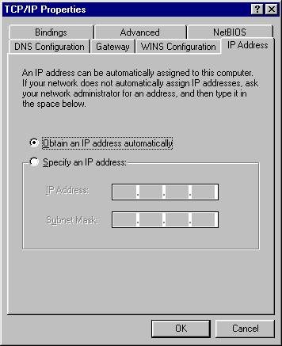
DHCP
20

Slide 19
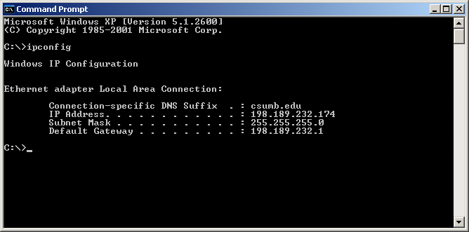
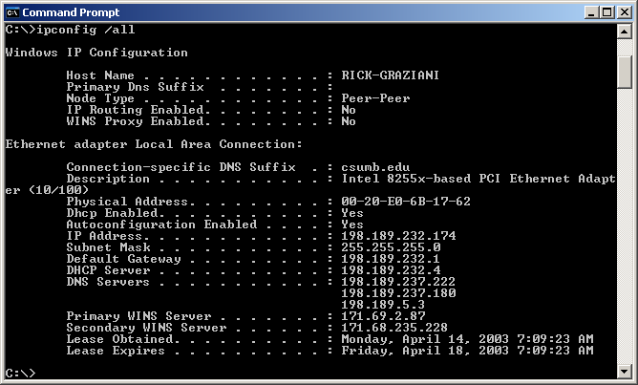
DHCP – Getting more than the IP Address
21

Slide 20

RARP
22

Slide 21

Dumb Terminals
23

Slide 22
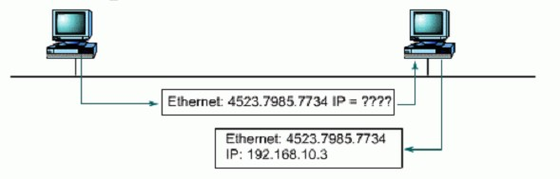
RARP reply
RARP Broadcast: I know
my MAC address, but what is my IP address?
RARP Server Unicast:
Here is your IP address.
24

Slide 23
BOOTP
❑ BOOTP (Bootstrap Protocol)
❑ Provides IP address, subnet mask, default gateway IP address and DNS IP address.
Disadvantage:
❑ BOOTP is not a dynamic configuration protocol (like DHCP).
❑ When a client requests an IP address the BOOTP server looks up its MAC address in a table to find the IP address.
❑ This binding is predetermined.
❑ What if the computer is moved to another subnet/network?
❑ Use DHCP!
25

Slide 24


ARP
26

Slide 25
ARP
Source host does not know the MAC address of the destination.
ARP request frame is a broadcast to all MAC address
All devices on the local segment will investigate the frame to check if their own IP address matches the destination IP address.
IP Header
Destination
192.168.1.100
Source
192.168.1.205
ME?
27

Slide 26
ARP
❑ If no – discard the packet
❑ If yes:
➢ Reads rest of packet
➢ Returns ARP reply
❑ ARP reply
➢ Supplies
MAC
address
of the
host.
no
no
Hey –my IP matches
Source: Arp Request
My
MAC
address
28

Slide 27

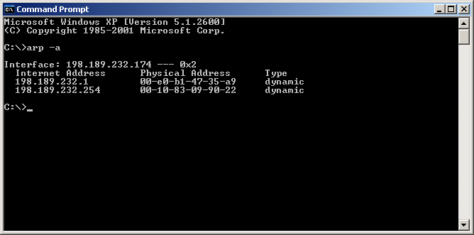
The ARP Table
29

Slide 28
Aging Out
❑ For Microsoft Windows hosts:
➢ Initial mappings have a 2-minute time-to-live.
➢ An entry that is used twice in 2 minutes is automatically given a 10- minute time-to-live.
❑ For Unix/Linux hosts:
➢ Initial mappings have a 20 minute time-to-live.
30

Slide 29
Compare ARP & RARP
Similarities
Both are concerned with mapping IP to MAC addresses
Both use same packet format
Both use broadcast addresses for their task.
Differences
➢ ARP - obtains MAC address of other clients by using an IP address while RARP – obtains its own (local host) IP address by using its own (local host’s) MAC address
➢ ARP packets are broadcast on local network by using broadcast MAC address (ff-ff-ff- ff-ff-ff) while RARP uses broadcast IP address (255.255.255.255) as well as broadcast MAC address (ff-ff-ff-ff-ff-ff)
➢ ARP table maintained by local host while RARP table maintained by RARP server
➢ ARP reply is used by local host to update its ARP table and to send packets to destination while RARP reply is used to configure the IP protocol of a local host.
31

Slide 30
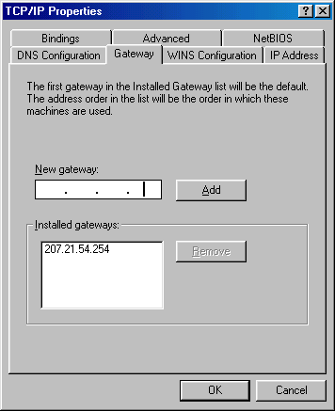
Using a default gateway
198.189.232.1
32

Slide 31
Domain Names and IP Addresses
❑ Many times we communicate with other hosts using domain
names such as www.nwu.edu.ng
❑ Hosts and routers route packets using IP addresses, NOT
domain names.
❑ The
❑ The
❑ The
host must translate the domain name to an IP address.
host will have the DNS Server do this translation for it. Domain Name System (abbreviated DNS) is an Internet
directory service.
❑ DNS is how domain names are translated into IP addresses, and DNS also controls email delivery.
❑ If your computer cannot access DNS, your web browser will not be able to find web sites, and you will not be able to receive or send email.
33

Slide 32
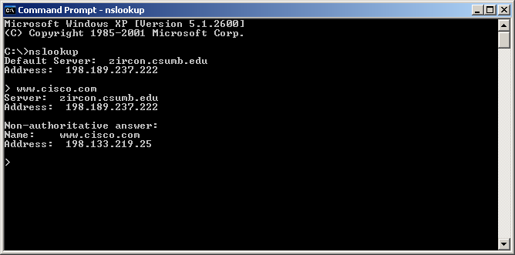
34

Slide 33
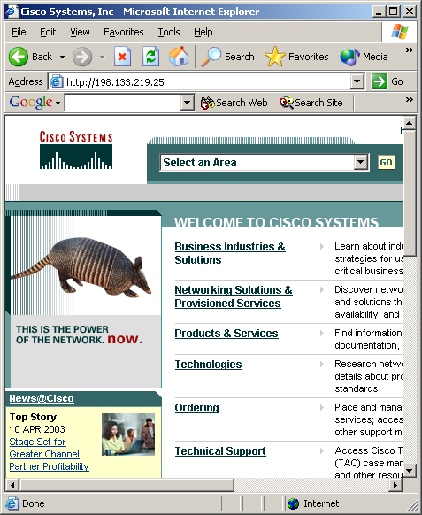

Domain Names and IP Addresses
We usually use domain names,
www.cisco.com, but the IP packets are sent using the IP address, 198.133.219.25.
198.133.219.25
35

Slide 34
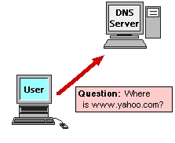
Exploring the Domain Name Space
How it works
❑ A DNS server is just a computer that's running DNS software.
❑ Since most servers are Unix machines, the most popular program is BIND (Berkeley Internet Name Domain), but you can find software for the Mac and the PC as well.
36

Slide 35
Exploring the Domain Name Space
❑ DNS software is generally
made up of two elements: the actual name server, and something called a resolver.
❑ The name server responds to browser requests by supplying name-to-address conversions.
❑ When it
answer, another
doesn't know the
the resolver will ask name server for the
information.
37

Slide 36
Exploring the Domain Name Space
❑ To see how it works, let's go
back to the domain-name- space inverted tree.
❑ When you type in a URL, your browser sends a request to
the closest name server.
❑ If that server has ever fielded a request for the same host name (within a time period
set by the administrator to prevent passing old information), it will locate the information in its cache and reply.
38

Slide 37
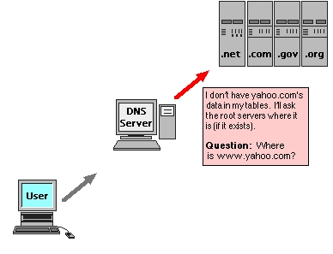
Exploring the Domain Name Space
❑ If the name server unfamiliar with the domain name, the resolver is attempt to solve the problem by asking further up the tree
❑ If that doesn't work, the second server will ask yet another - until it finds one that knows.
❑ (When a server can supply an answer without asking another, it's known as an authoritative server.)
39

Slide 38
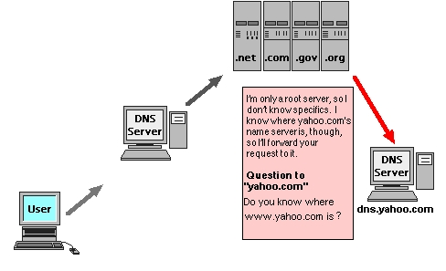
Exploring the Domain Name Space
❑ Once the information is located, it's passed back to your
browser.
❑ Usually this process occurs quickly, but occasionally it can take an excruciatingly long time (like 15 seconds).
40

Slide 39
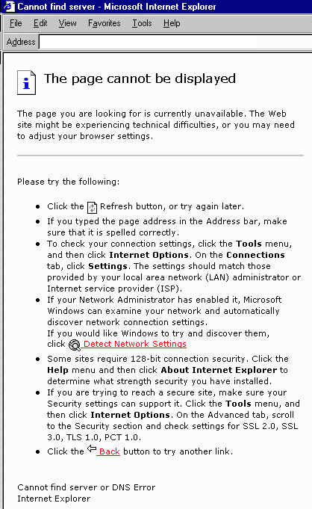
Exploring the Domain Name
Space
In the worst cases, you'll get a dialog box that says the domain name doesn't exist - even though you know it does.
This happens because the authoritative server is slow replying to the first, and your computer gets tired of waiting so it times-out (drops the connection).
But if you try again, there's a good chance it will work, because the authoritative server has had enough time to reply, and your name server has stored the information in its cache.
41

Slide 40

The End
42

