Slide 1
Cos 429: Face Detection (Part 2)
Viola-Jones and AdaBoost
Guest Instructor: Andras Ferencz
(Your Regular Instructor: Fei-Fei Li)
Thanks to Fei-Fei Li, Antonio Torralba, Paul Viola, David Lowe, Gabor Melli (by way of the Internet) for slides

Slide 2
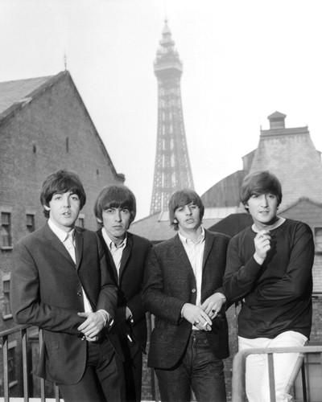
Face Detection

Slide 3
Face Detection

Slide 4
Sliding Windows
1. hypothesize:
try all possible rectangle locations, sizes
2. test:
classify if rectangle contains a face (and only the face)
Note: 1000's more false windows then true ones.

Slide 5























Classification (Discriminative)
Background
Faces
In some feature space

Slide 6
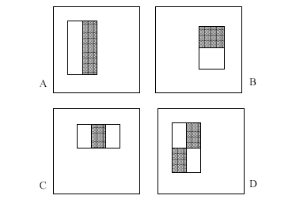
Image Features
4 Types of “Rectangle filters” (Similar to Haar wavelets
Papageorgiou, et al. )
Based on 24x24 grid:
160,000 features to choose from
g(x) =
sum(WhiteArea) - sum(BlackArea)
Notes:
For real problems results are only as good as the features used...
This is the main piece of ad-hoc (or domain) knowledge
Rather than the pixels, we have selected a very large set of simple functions
Sensitive to edges and other critcal features of the image
** At multiple scales
Since the final classifier is a perceptron it is important that the features be non-linear… otherwise the final classifier will be a simple perceptron.
We introduce a threshold to yield binary features

Slide 7
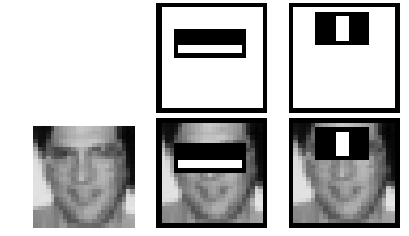
Image Features
F(x) = α₁ f₁(x) + α₂ f₂(x) + ...
1 if g_{i}(x) > θ_{i}
-1 otherwise
f_{i}(x) =
Need to: (1) Select Features i=1..n,
(2) Learn thresholds θ_{i} ,
(3) Learn weights α_{i}
Notes:
For real problems results are only as good as the features used...
This is the main piece of ad-hoc (or domain) knowledge
Rather than the pixels, we have selected a very large set of simple functions
Sensitive to edges and other critcal features of the image
** At multiple scales
Since the final classifier is a perceptron it is important that the features be non-linear… otherwise the final classifier will be a simple perceptron.
We introduce a threshold to yield binary features

Slide 8

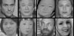
A Peak Ahead: the learned features

Slide 9
Why rectangle features? (1)
The Integral Image
The integral image computes a value at each pixel (x,y) that is the sum of the pixel values above and to the left of (x,y), inclusive.
This can quickly be computed in one pass through the image
(x,y)

Slide 10
Why rectangle features? (2)
Computing Sum within a Rectangle
Let A,B,C,D be the values of the integral image at the corners of a rectangle
Then the sum of original image values within the rectangle can be computed:
  sum = A – B – C + D
Only 3 additions are required for any size of rectangle!
  This is now used in many areas of computer vision
D
B
C
A

Slide 11
Boosting
How to select the best features?
How to learn the classification function?
F(x) = α₁ f₁(x) + α₂ f₂(x) + ....

Slide 12
Boosting
Defines a classifier using an additive model:
Strong
classifier
Weak classifier
Weight
Features
vector

Slide 13
Boosting
It is a sequential procedure:
x_{t=1}
x_{t}
Each data point has
a class label:
x_{t=2}
+1 ( )
y_{t} =
-1 ( )
and a weight:
w_{t} =1
Notes:
It is a sequential procedure that builds a complex classifier out of simpler ones by combining them additively.

Slide 14
Toy example
Weak learners from the family of lines
Each data point has
a class label:
+1 ( )
y_{t} =
-1 ( )
and a weight:
w_{t} =1
h => p(error) = 0.5 it is at chance

Slide 15
Toy example
Each data point has a class label:
+1 ( )
y_{t} =
-1 ( )
and a weight:
w_{t} =1
This one seems to be the best
This is a ‘weak classifier’: It performs slightly better than chance.

Slide 16
Toy example
Each data point has a class label:
+1 ( )
y_{t} =
-1 ( )
We update the
weights:
w_{t} w_{t} exp{-y_{t} H_{t}}
We set a new problem for which the previous weak classifier performs at chance again

Slide 17
Toy example
Each data point has a class label:
+1 ( )
y_{t} =
-1 ( )
We update the
weights:
w_{t} w_{t} exp{-y_{t} H_{t}}
We set a new problem for which the previous weak classifier performs at chance again

Slide 18
Toy example
Each data point has a class label:
+1 ( )
y_{t} =
-1 ( )
We update the
weights:
w_{t} w_{t} exp{-y_{t} H_{t}}
We set a new problem for which the previous weak classifier performs at chance again

Slide 19
Toy example
Each data point has a class label:
+1 ( )
y_{t} =
-1 ( )
We update the
weights:
w_{t} w_{t} exp{-y_{t} H_{t}}
We set a new problem for which the previous weak classifier performs at chance again

Slide 20
Toy example
f₁
f₂
f₄
f₃
The strong (non- linear) classifier is built as the combination of all the weak (linear) classifiers.

Slide 21

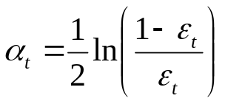
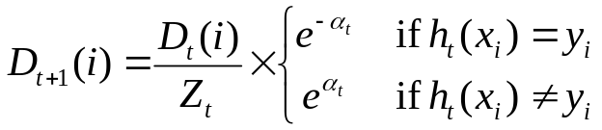
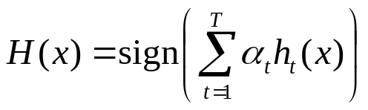
AdaBoost Algorithm
Given: m examples (x₁, y₁), …, (x_{m}, y_{m}) where x_{i}∈X, y_{i}∈Y={-1, +1}
Initialize D₁(i) = 1/m
The goodness of h_{t} is calculated over D_{t} and the bad guesses.
For t = 1 to T
1. Train learner h_{t} with min error
The weight Adapts. The bigger ε_{t} becomes the smaller α_{t} becomes.
2. Compute the hypothesis weight
3. For each example i = 1 to m
Boost example if incorrectly predicted.
Output
Z_{t} is a normalization factor.
Linear combination of models.

Slide 22
Boosting with Rectangle Features
For each round of boosting:
  Evaluate each rectangle filter on each example (compute g(x))
  Sort examples by filter values
  Select best threshold (θ) for each filter (one with lowest error)
  Select best filter/threshold combination from all candidate features (= Feature f(x))
  Compute weight (α) and incorporate feature into strong classifier
  F(x) F(x) + α f(x)
  Reweight examples

Slide 23
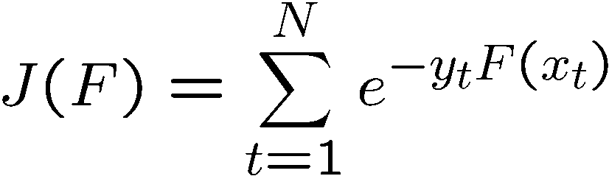
Boosting
Boosting fits the additive model
by minimizing the exponential loss
Training samples
The exponential loss is a differentiable upper bound to the misclassification error.

Slide 24
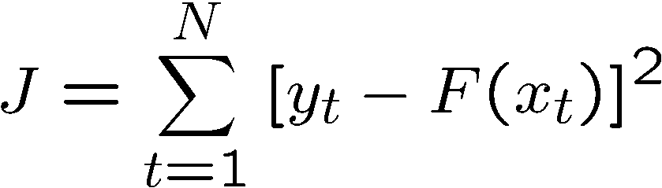
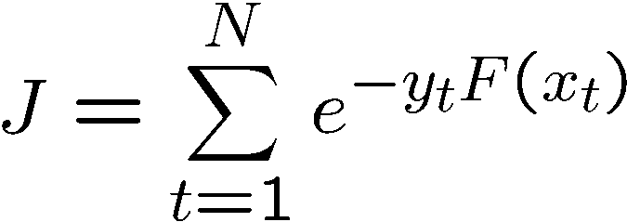
Exponential loss
Loss
Squared error
4
Misclassification error
3.5
Squared error
3
Exponential loss
2.5
2
1.5
Exponential loss
1
0.5
0
-1.5
-1
-0.5
0
0.5
1
1.5
2
yF(x) = margin

Slide 25
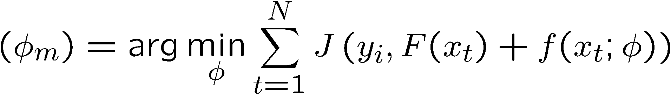
Boosting
Sequential procedure. At each step we add
to minimize the residual loss
Parameters
weak classifier
Desired output
input
For more details: Friedman, Hastie, Tibshirani. “Additive Logistic Regression: a Statistical View of Boosting” (1998)

Slide 26
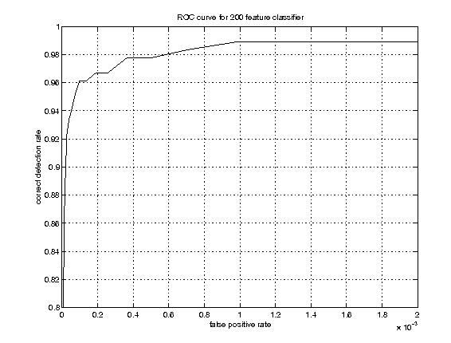




Example Classifier for Face Detection
A classifier with 200 rectangle features was learned using AdaBoost
95% correct detection on test set with 1 in 14084
false positives.
Not quite competitive...
ROC curve for 200 feature classifier

Slide 27
Building Fast Classifiers
Given a nested set of classifier hypothesis classes
Computational Risk Minimization
% False Pos
0
50
vs
false
neg
determined by
50 100
% Detection
T
T
T
IMAGE
SUB-WINDOW
T
Classifier 1
Classifier 2
Classifier 3
FACE
F
F
F
F
NON-FACE
NON-FACE
NON-FACE
NON-FACE
Notes:
In general simple classifiers, while they are more efficient, they are also weaker.
We could define a computational risk hierarchy (in analogy with structural risk minimization)…
A nested set of classifier classes
The training process is reminiscent of boosting…
- previous classifiers reweight the examples used to train subsequent classifiers
The goal of the training process is different
- instead of minimizing errors minimize false positives

Slide 28
Cascaded Classifier
IMAGE
SUB-WINDOW
50%
20%
2%
1 Feature
5 Features
20 Features
FACE
F
F
F
NON-FACE
NON-FACE
NON-FACE
A 1 feature classifier achieves 100% detection rate and about 50% false positive rate.
A 5 feature classifier achieves 100% detection rate and 40% false positive rate (20% cumulative)
  using data from previous stage.
A 20 feature classifier achieve 100% detection rate with 10% false positive rate (2% cumulative)

Slide 29
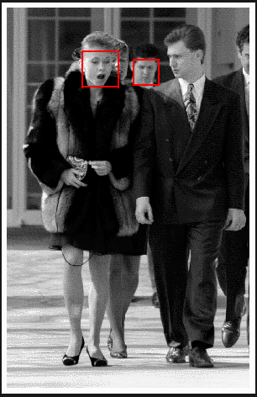
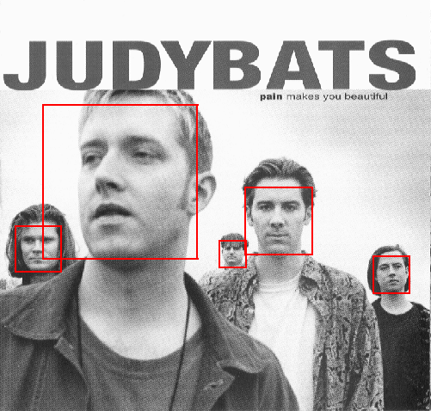
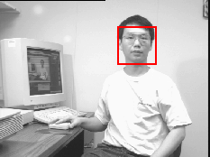
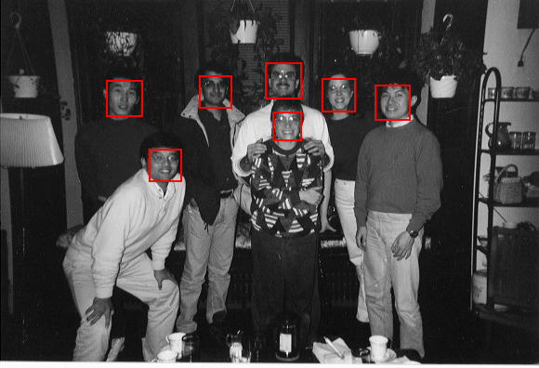
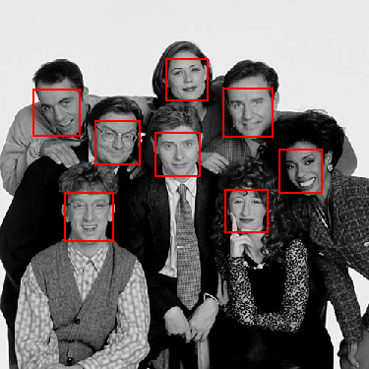
Output of Face Detector on Test Images

Slide 30
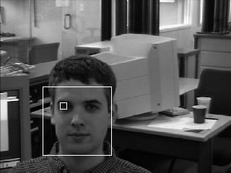
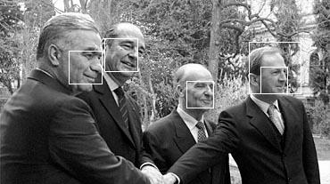
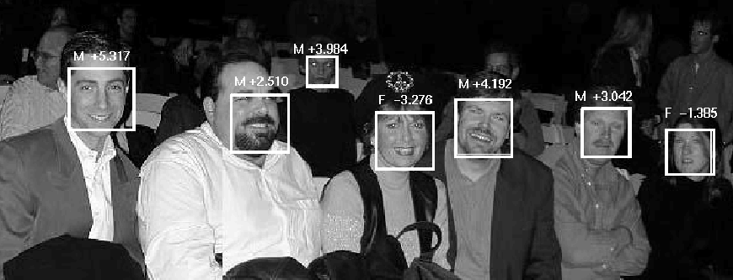
Solving other “Face” Tasks
Facial Feature Localization
Profile Detection
Demographic
Analysis

