Slide 1

Robust Real-time Face
Detection by Paul Viola and Michael Jones, 2002
Presentation by Baatarbek Ryskhan
IT-SoC Research Lab.
School of Engineering, Yonsei University
Batyrbek@yonsei.ac.kr
October, 2013

Slide 2
Contents :
Overview
Goals
Methods (Integral Image/AdaBoost/Cascade)
Example
Result
Back-Up Slides
Ending & Discussion

Slide 3
Overview
Robust – very high Detection Rate (True-Positive Rate) & very low False-Positive Rate… (always)
Real Time – For practical applications at least 2
frames per second must be processed.
Face Detection – not recognition. The goal is to distinguish faces from non-faces (face detection
is the first step in the identification process)

Slide 4
Three goals & a conclusion
Feature Computation : what features? And how can they be computed as quickly as possible
Feature Selection : select the most discriminating features
Real-timeliness : must focus on potentially positive areas (that contain faces)
Conclusion : presentation of results and discussion of detection issues.
How did Viola & Jones deal with these challenges?

Slide 5
Three solutions
Feature Computation
~The “Integral” image representation
Feature Selection
~The AdaBoost training algorithm
Real-timeliness ~A cascade of classifiers

Slide 6
Features
Overview | Integral Image | AdaBoost | Cascade
Can a simple feature (i.e. a value) indicate the existence of a face?
All faces share some similar properties
The eyes region is darker than the
upper-cheeks.
The nose bridge region is brighter
than the eyes.
That is useful domain knowledge
Need for encoding of Domain Knowledge:
Location - Size: eyes & nose bridge region
Value: darker / brighter

Slide 7
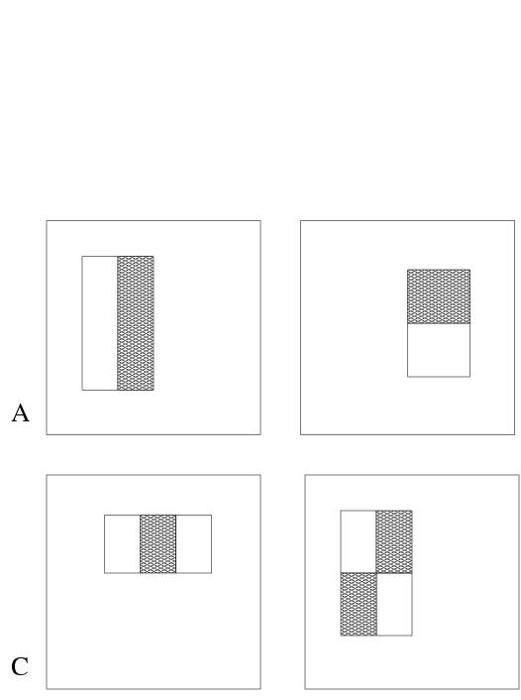
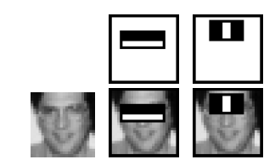
Overview | Integral Image | AdaBoost | Cascade
Rectangle features:
Value = ∑ (pixels in black area) - ∑ (pixels in white area)
Three types: two-, three-, four-rectangles, Viola&Jones used two-rectangle features
For example: the difference in brightness between the white &black rectangles over a specific area
Each feature is related to a special location in the sub-window
Each feature may have any size
Why not pixels instead of features?
Features encode domain knowledge
Feature based systems operate faster

Slide 8
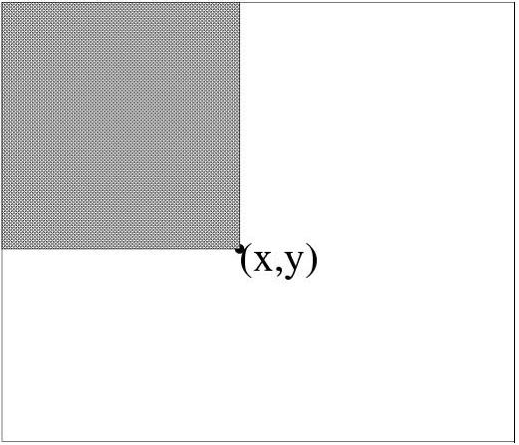
Integral Image Representation (also check back-up slide #1)
Overview | Integral Image | AdaBoost | Cascade
x
Given a detection resolution of 24x24
(smallest sub-window), the set of different rectangle features is ~160,000
Introducing Integral Image
Representation
Definition: The integral image at location (x,y), is the sum of the pixels above and to the left of (x,y), inclusive
The Integral image can be computed in a single pass and only once for each
sub-window
y

Slide 9

back-up slide #1
Overview | Integral Image | AdaBoost | Cascade
IMAGE
INTEGRAL IMAGE
0 | 1 | 1 | 1
1 | 2 | 2 | 3
1 | 2 | 1 | 1
1 | 3 | 1 | 0
0 | 1 | 2 | 3
1 | 4 | 7 | 11
2 | 7 | 11 | 16
3 | 11 | 16 | 21

Slide 10
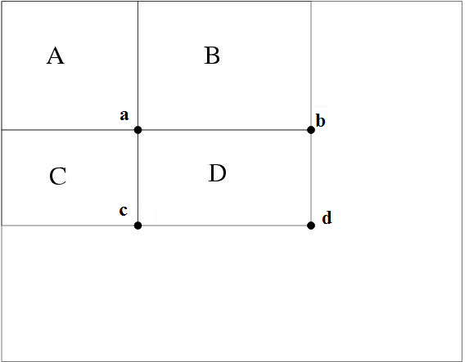
Rapid computation of rectangular features
Overview | Integral Image | AdaBoost | Cascade
Using the integral image representation we can compute the value of any rectangular sum (part of features) in constant time
For example the integral sum inside rectangle D can be computed as: ii(d) + ii(a) – ii(b) – ii(c)
two-, three-, and four-rectangular features can be computed with 6, 8 and 9 array references respectively.
As a result: feature computation
takes less time
ii(a) = A
ii(b) = A+B
ii(c) = A+C
ii(d) = A+B+C+D
D = ii(d)+ii(a)-ii(b)-ii(c)

Slide 11
Overview | Integral Image | AdaBoost | Cascade
Three goals
Feature Computation : features must be computed as quickly as possible
Feature Selection : select the most discriminating features
Real-timeliness : must focus on potentially positive
image areas (that contain faces)
How did Viola & Jones deal with these challenges?

Slide 12
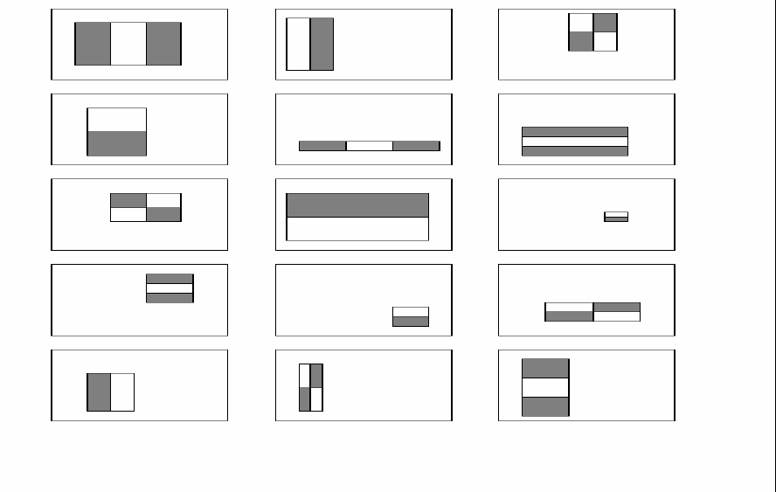


Feature selection
Overview | Integral Image | AdaBoost | Cascade
Problem: Too many features
In a sub-window (24x24) there are ~160,000 features (all possible combinations of orientation, location and scale of these feature types)
impractical to compute all of them (computationally expensive)
We have to select a subset of relevant features – which are informative - to model a face
Hypothesis: “A very small subset of features can be combined to form an effective classifier”
How? SOLUTION:
AdaBoost algorithm
Relevant feature
Irrelevant feature

Slide 13
AdaBoost
Overview | Integral Image | AdaBoost | Cascade
Stands for “Adaptive” boost
Constructs a “strong” classifier as a linear combination of weighted simple “weak” classifiers
Weak classifier
Strong
classifier
Image
Weight

Slide 14
AdaBoost - Characteristics
Overview | Integral Image | AdaBoost | Cascade
Features as weak classifiers
Each single rectangle feature may be regarded as a simple weak classifier
An iterative algorithm
AdaBoost performs a series of trials, each time selecting a new weak classifier
Weights are being applied over the set of the example images
During each iteration, each example/image receives a weight determining its importance

Slide 15
AdaBoost - Getting the idea…
Overview | Integral Image | AdaBoost | Cascade
Given: example images labeled +/-
Initially, all weights set equally
Repeat T times
Step 1: choose the most efficient weak classifier that will be a component of the final strong classifier (Problem! Remember the huge number of features…)
Step 2: Update the weights to emphasize the examples which were incorrectly classified
This makes the next weak classifier to focus on “harder” examples
Final (strong) classifier is a weighted combination of the T “weak” classifiers
Weighted according to their accuracy

Slide 16
AdaBoost – Feature Selection
Overview | Integral Image | AdaBoost | Cascade
Problem
On each round, large set of possible weak classifiers (each simple classifier consists of a single feature) – Which one to choose?
choose the most efficient (the one that best separates the examples – the lowest error)
choice of a classifier corresponds to choice of a feature
At the end, the ‘strong’ classifier consists of T features
Conclusion
AdaBoost searches for a small number of good classifiers – features (feature selection)
adaptively constructs a final strong classifier taking into account the failures of each one of the chosen weak classifiers (weight appliance)
AdaBoost is used to both select a small set of features and train a strong classifier

Slide 17
AdaBoost EXAMPLE adopted (from University of Edinburg/2009) Note: Prepared with figures adopted from “Robust real-time object detection” CRL 2001/01 and Edinburg 2009)

Slide 18
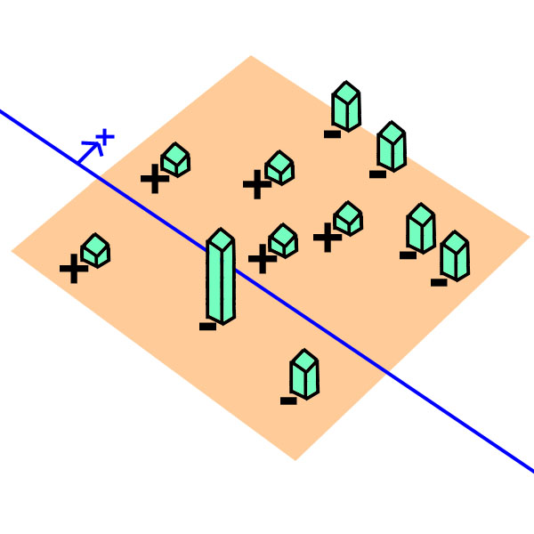
AdaBoost example:
Overview | Integral Image | AdaBoost | Cascade
AdaBoost starts with a uniform
distribution of “weights” over training examples.
Select the classifier with the lowest
weighted error (i.e. a “weak” classifier)
Increase the weights on the training examples that were misclassified.
(Repeat)
At the end, carefully make a linear combination of the weak classifiers obtained at all iterations.
Slide taken from a presentation by Qing Chen, Discover Lab, University of Ottawa

Slide 19
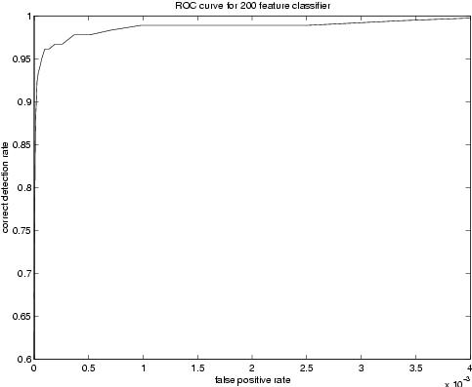
Now we have a good face detector
Overview | Integral Image | AdaBoost | Cascade
Thus, We can build a 200-featpicture classifier.
Experiments showed that a
200-feature classifier achieves:
95% detection rate
0.14x10⁻³ FP rate (1 in 14084)
Scans all sub-windows of a 384x288 pixel image in 0.7 seconds (on Intel PIII 700MHz)
The more the better (?)
Gain in classifier performance
Lose in CPU time
Verdict: good & fast, but not enough
Competitors achieve close to 1 in a 1.000.000 FP rate!
0.7 sec / frame IS NOT real-time.

Slide 20
Three goals
Overview | Integral Image | AdaBoost | Cascade
Feature Computation : features must be computed as quickly as possible
Feature Selection : select the most discriminating features
Real-timeliness : must focus on potentially positive image areas (that contain faces)
How did Viola & Jones deal with these challenges?

Slide 21
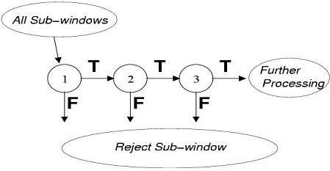
The attentional cascade
Overview | Integral Image | AdaBoost | Cascade
On average only 0.01% of all sub-windows are positive (are faces)
Status Quo: equal computation time is spent on all sub-windows
Must spend most time only on potentially positive sub-windows.
A simple 2-feature classifier can achieve almost 100% detection rate with 50% FP rate.
That classifier can act as a 1st layer of a series to filter out most negative windows
2nd layer with 10 features can tackle “harder” negative-windows which survived the 1st layer, and so on…
A cascade of gradually more complex classifiers achieves even better detection rates.
On average, much fewer features are computed per sub-window (i.e. speed x 10)

Slide 22
Training a cascade of classifiers
Overview | Integral Image | AdaBoost | Cascade
Keep in mind:
Competitors achieved 95% TP rate,10⁻⁶ FP rate
These are the goals. Final cascade must do better!
Given the goals, to design a cascade we must choose:
Number of layers in cascade (strong classifiers)
Number of features of each strong classifier (the ‘T’ in definition)
Threshold of each strong classifier (the in definition)
Optimization problem:
Can we find optimum combination?

Slide 23
A simple framework for cascade training
Overview | Integral Image | AdaBoost | Cascade
Viola & Jones suggested a heuristic algorithm for the cascade training: (pseudo-code at backup slide # 3)
does not guarantee optimality
but produces a “effective” cascade that meets previous goals
Manual Tweaking:
overall training outcome is highly depended on user’s choices
select f_{i} (Maximum Acceptable False Positive rate / layer)
select d_{i} (Minimum Acceptable True Positive rate / layer)
select F_{target} (Target Overall FP rate)
possible repeat trial & error process for a given training set
Until F_{target} is met:
Add new layer:
Until f_{i} , d_{i} rates are met for this layer
Increase feature number & train new strong classifier with AdaBoost
Determine rates of layer on validation set

Slide 24
backup slide #3
Overview | Integral Image | AdaBoost | Cascade

Slide 25
Three goals
Overview | Integral Image | AdaBoost | Cascade
Feature Computation : features must be computed as quickly as possible
Feature Selection : select the most discriminating features
Real-timeliness : must focus on potentially positive image areas (that contain faces)
How did Viola & Jones deal with these challenges?

Slide 26







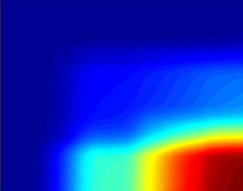

Training phase
Overview | Integral Image | AdaBoost | Cascade
Testing phase
Cascade trainer
Classifier cascade framework
Training
Set
(sub-windows)
Integral
Representation
Strong Classifier 1
(cascade stage 1)
Feature
computation
Strong Classifier 2
(cascade stage 2)
AdaBoost
Feature Selection
Strong Classifier N
(cascade stage N)
FACE IDENTIFIED

Slide 27
Therefore:
Extremely fast feature computation
Efficient feature selection
Scale and location invariant detector
Instead of scaling the image itself (e.g. pyramid-filters), we scale the features.
Such a generic detection scheme can be trained for detection of other types of objects (e.g. cars, hands)
Detector is most effective only on frontal images of faces
can hardly cope with 45º face rotation
Sensitive to lighting conditions
We might get multiple detections of the same face, due to overlapping sub-windows.

Slide 28
Results
(detailed results at back-up slide #4)

Slide 29
Results (Cont.)

Slide 30
backup slide #4
Viola & Jones prepared their final Detector cascade:
38 layers, 6060 total features included
1st classifier- layer, 2-features
50% FP rate, 99.9% TP rate
2nd classifier- layer, 10-features
20% FP rate, 99.9% TP rate
next 2 layers 25-features each, next 3 layers 50-features each
and so on…
Tested on the MIT+MCU test set
a 384x288 pixel image on an PC (dated 2001) took about 0.067 seconds
Detection rates for various numbers of false positives on the MIT+MCU test set containing 130 images and 507 faces (Viola & Jones 2002)

Slide 31
Thanks for your Attention! Q & A?

