Slide 1
Face Detection using the Viola-Jones Method
CS 175, Fall 2007
Padhraic Smyth
Department of Computer Science
University of California, Irvine

Slide 2
Outline
Viola Jones face detection algorithm
  State-of-the-art face detector
MATLAB code available for CS 175 for implementing this algorithm
  See viola_jones.zip, under projectcode on the class Web page

Slide 3
Viola-Jones Face Detection Algorithm
Overview :
  Viola Jones technique overview
  Features
  Integral Images
  Feature Extraction
  Weak Classifiers
  Boosting and classifier evaluation
  Cascade of boosted classifiers
  Example Results
Full details available in paper by Viola and Jones, International Journal of Computer Vision, 2004
Some of the following slides were adapted from a presentation by Nathan Faggian

Slide 4
Viola Jones Technique Overview
Three major contributions/phases of the algorithm :
  Feature extraction
  Classification using boosting
  Multi-scale detection algorithm
Feature extraction and feature evaluation.
  Rectangular features are used, with a new image representation their calculation is very fast.
Classifier training and feature selection using a slight variation of a method called AdaBoost.
A combination of simple classifiers is very effective

Slide 5
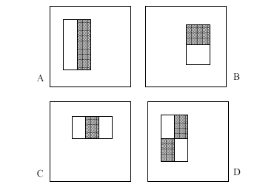
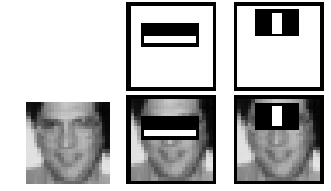
Features
Four basic types.
  They are easy to calculate.
  The white areas are subtracted from the black ones.
  A special representation of the sample called the integral image makes feature extraction faster.

Slide 6
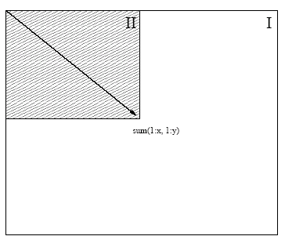
Integral images
Summed area tables
A representation that means any rectangle’s values can be calculated in four accesses of the integral image.

Slide 7
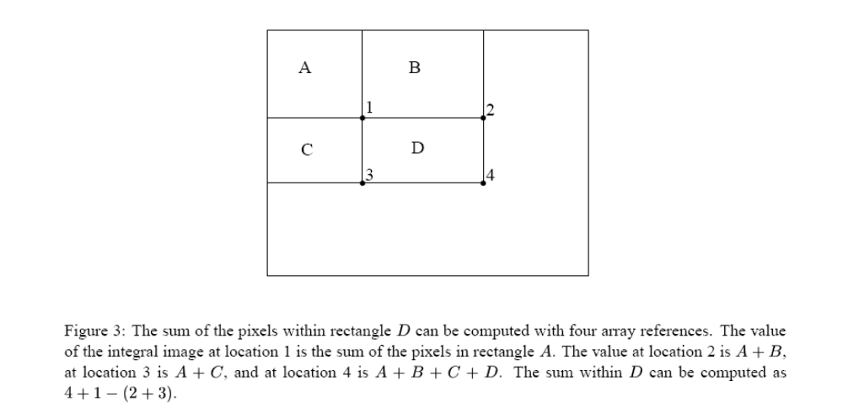
Fast Computation of Pixel Sums

Slide 8
Feature Extraction
Features are extracted from sub windows of a sample image.
  The base size for a sub window is 24 by 24 pixels.
  Each of the four feature types are scaled and shifted across all possible combinations
    In a 24 pixel by 24 pixel sub window there are ~160,000 possible features to be calculated.

Slide 9
Learning with many features
We have 160,000 features – how can we learn a classifier with only a few hundred training examples without overfitting?
Idea:
  Learn a single simple classifier
  Classify the data
  Look at where it makes errors
  Reweight the data so that the inputs where we made errors get higher weight in the learning process
  Now learn a 2nd simple classifier on the weighted data
  Combine the 1st and 2nd classifier and weight the data according to where they make errors
  Learn a 3rd classifier on the weighted data
  … and so on until we learn T simple classifiers
  Final classifier is the combination of all T classifiers
  This procedure is called “Boosting” – works very well in practice.

Slide 10
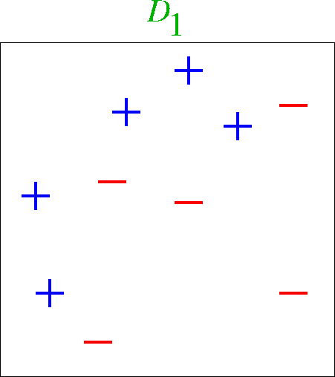
Boosting Example

Slide 11
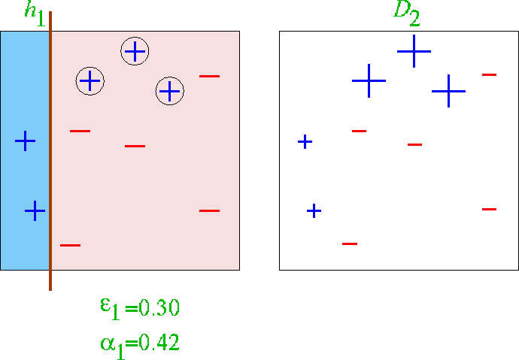
First classifier

Slide 12
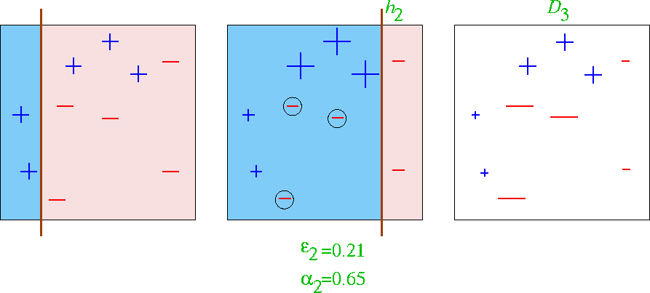
First 2 classifiers

Slide 13
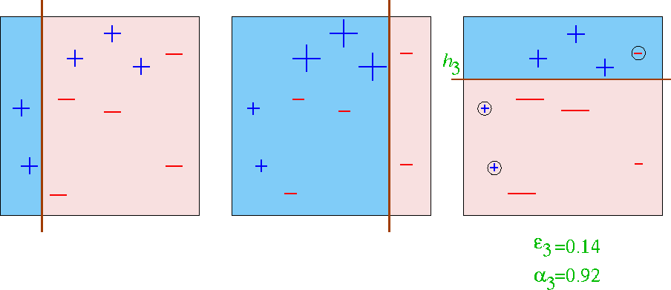
First 3 classifiers

Slide 14
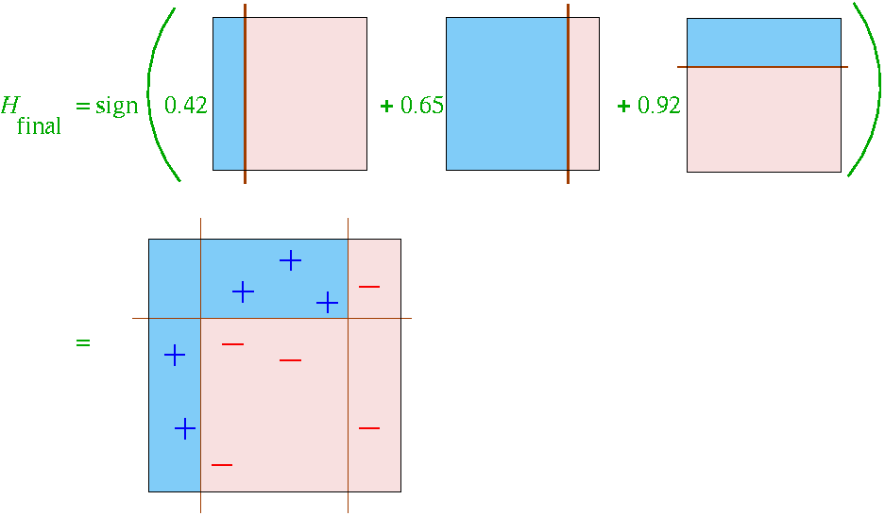
Final Classifier learned by Boosting

Slide 15
Recall: Perceptron Operation
Equations of “thresholded” operation:
  = 1 (if w₁x₁ +… w_{d} x_{d} + w_{d+1} > 0)
  o(x₁, x₂,…, x_{d-1}, x_{d})
  = -1 (otherwise)

Slide 16
Perceptron with just a Single Feature
Equations of “thresholded” operation:
Equivalent to x₁ > - w_{d+1} / w₁
i.e., equivalent to comparing the feature to a threshold
Learning = finding the best threshold for a single feature
Can be trained by gradient descent (or direct search)
  = 1 (if w₁x₁ + w_{d+1} > 0)
  o(x₁)
  = -1 (otherwise)

Slide 17
Final Classifier learned by Boosting

Slide 18
Boosting with Single Feature Perceptrons
Viola-Jones version of Boosting:
  “simple” (weak) classifier = single-feature perceptron
    see last slide
  With K features (e.g., K = 160,000) we have 160,000 different single-feature perceptrons
  At each stage of boosting
    given reweighted data from previous stage
    Train all K (160,000) single-feature perceptrons
    Select the single best classifier at this stage
    Combine it with the other previously selected classifiers
    Reweight the data
    Learn all K classifiers again, select the best, combine, reweight
    Repeat until you have T classifiers selected
  Hugely computationally intensive
    Learning K perceptrons T times
    E.g., K = 160,000 and T = 1000

Slide 19
How is classifier combining done?
At each stage we select the best classifier on the current iteration and combine it with the set of classifiers learned so far
How are the classifiers combined?
  Take the weight*feature for each classifier, sum these up, and compare to a threshold (very simple)
  Boosting algorithm automatically provides the appropriate weight for each classifier and the threshold
  This version of boosting is known as the AdaBoost algorithm
  Some nice mathematical theory shows that it is in fact a very powerful machine learning technique

Slide 20
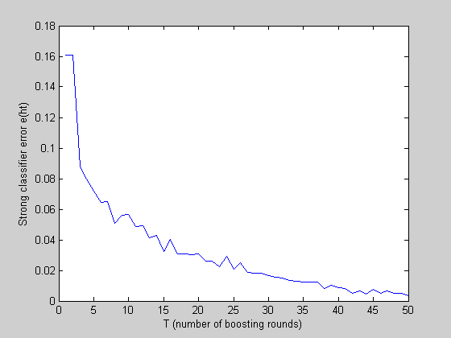
Reduction in Error as Boosting adds Classifiers

Slide 21
Useful Features Learned by Boosting

Slide 22
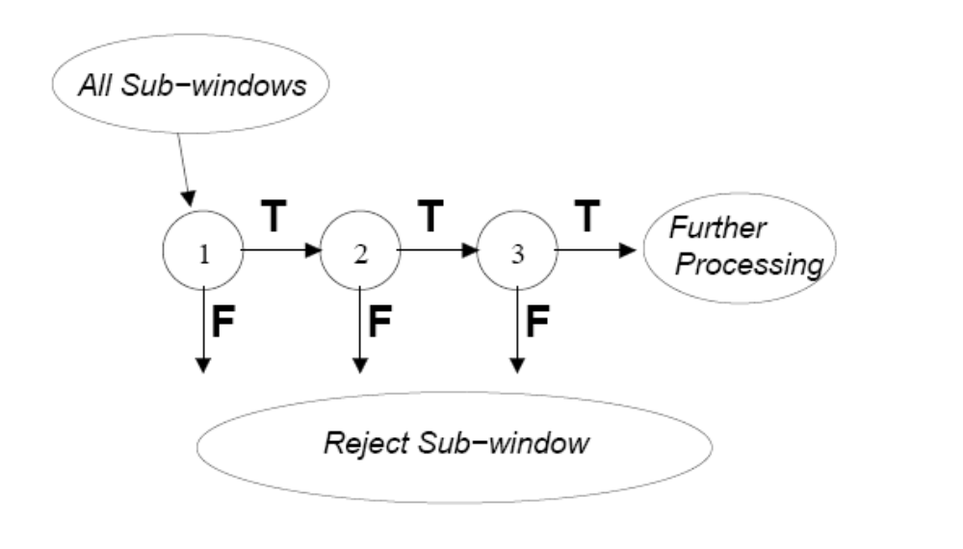
A Cascade of Classifiers

Slide 23
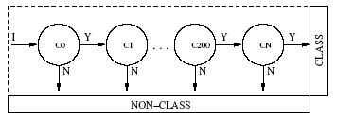
Cascade of Boosted Classifiers
Referred here as a degenerate decision tree.
  Very fast evaluation.
  Quick rejection of sub windows when testing.
Reduction of false positives.
  Each node is trained with the false positives of the prior.
AdaBoost can be used in conjunction with a simple bootstrapping process to drive detection error down.
  Viola and Jones present a method to do this, that iteratively builds boosted nodes, to a desired false positive rate.

Slide 24
Detection in Real Images
Basic classifier operates on 24 x 24 subwindows
Scaling:
  Scale the detector (rather than the images)
  Features can easily be evaluated at any scale
  Scale by factors of 1.25
Location:
  Move detector around the image (e.g., 1 pixel increments)
Final Detections
  A real face may result in multiple nearby detections
  Postprocess detected subwindows to combine overlapping detections into a single detection

Slide 25
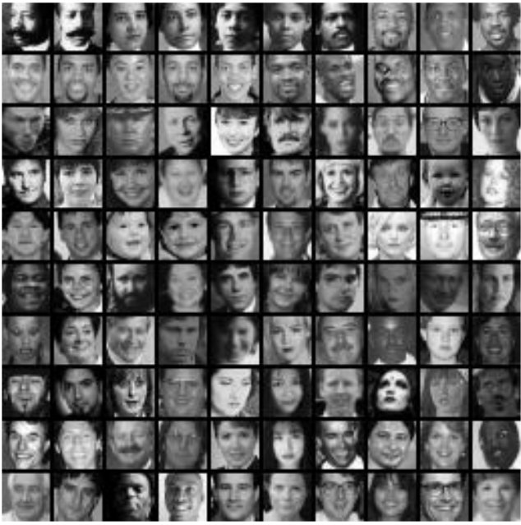
Training
In paper, 24x24 images of faces and non faces (positive and negative examples).

Slide 26
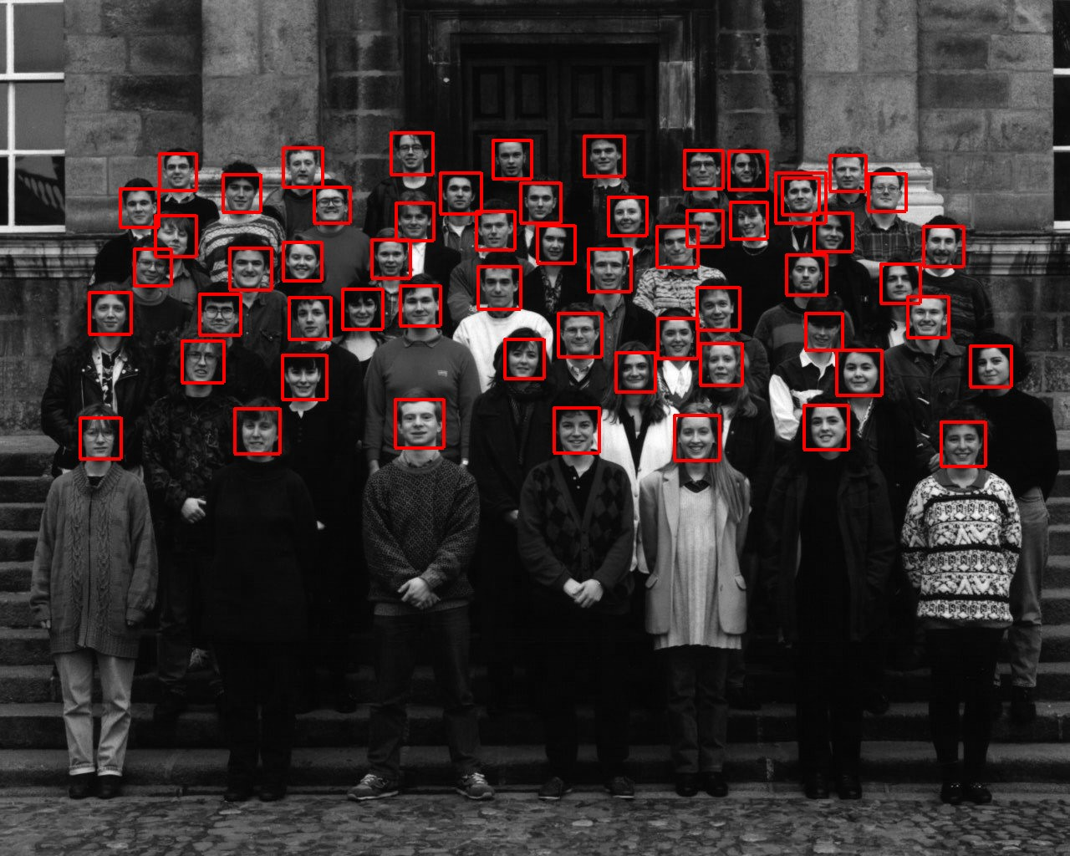
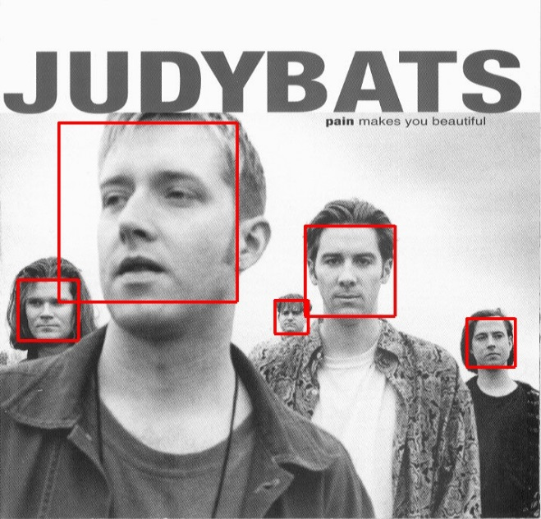
Sample results using the Viola-Jones Detector
Notice detection at multiple scales

Slide 27
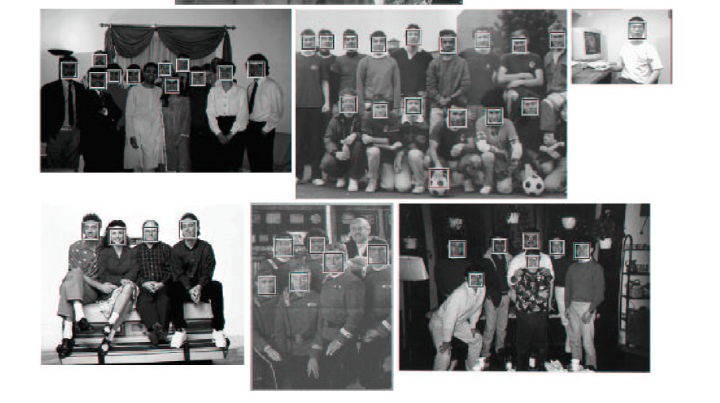
More Detection Examples

Slide 28
Practical implementation
Details discussed in Viola-Jones paper
Training time = weeks (with 5k faces and 9.5k non-faces)
Final detector has 38 layers in the cascade, 6060 features
700 Mhz processor:
  Can process a 384 x 288 image in 0.067 seconds (in 2003 when paper was written)

Slide 29
Code and Data for CS 175
In directory viola_jones.zip (under MATLAB code for Projects)
Code has been written by Nathan (TA)
  Current “release” is not complete – he will be updating it
  Please email Nathan for questions/help/discussion in using this code (nsutter@ics.uci.edu)
Major components:
  Feature extraction (written)
  Boosting algorithm (written)
  Cascade (not written – may not be necessary)
  Multi-scale multi-location detection (not written)

Slide 30
Code and Data for CS 175
Look at MATLAB directory on the Web page to see what functions and data are available

Slide 31
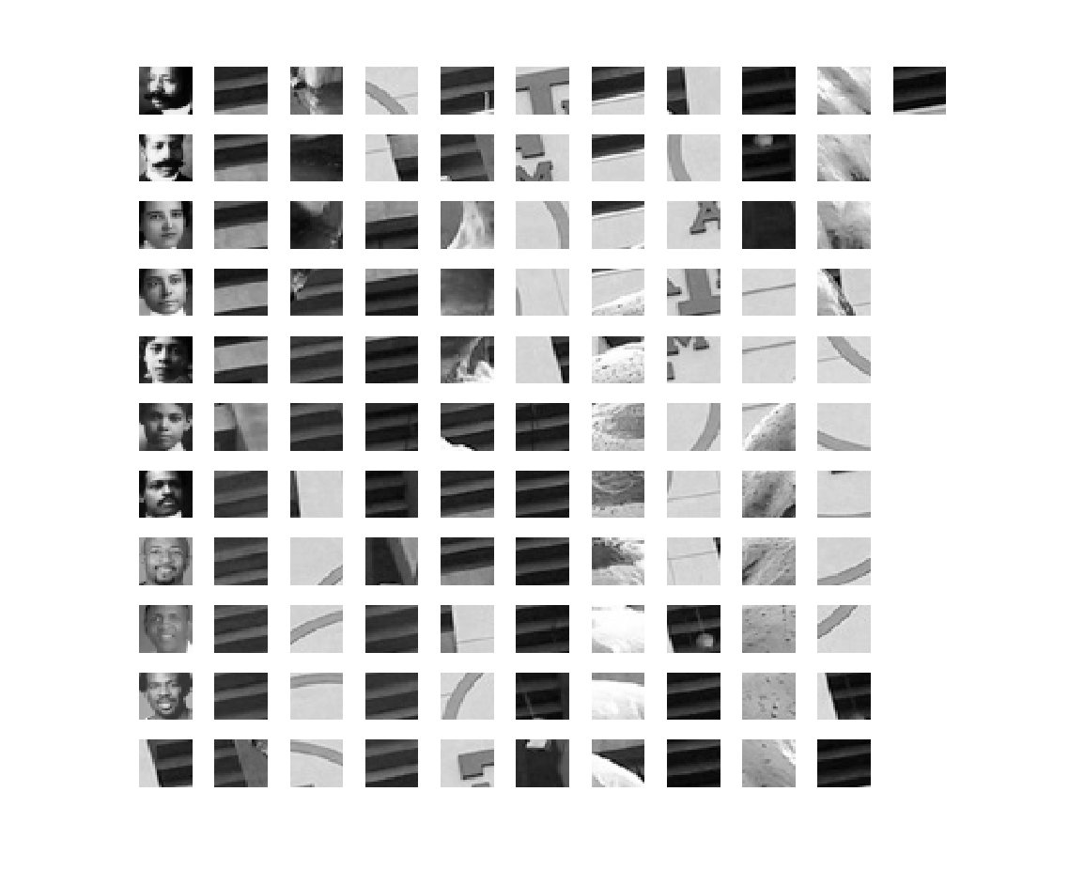
Small set of 111 Training Images

Slide 32
Summary
Viola-Jones face detection
  Features
  Integral Images
  Feature Extraction
  Weak Classifiers
  Boosting and classifier evaluation
  Cascade of boosted classifiers
  Example Results
MATLAB code available on the class Web site
  Will likely require some emails with Nathan to figure out how to use it
Work on your projects! Progress report due a week from Monday.

