Slide 1
ATT Auto Parts
Alican Özer - Thang Mai – Tam Tan

Slide 2
Agenda
Overview
Solution
System architecture
Demo
Notes:
BAU: business as usual
GroupM is the number one global media investment management group
Since 2011, NashTech have started with GroupM account for projects in Australia and Singapore. We have been providing system development, system maintenance and support on demands. Currently, we have 4 projects in GroupM account with total 10 headcounts. They are Red Flag Report, 6th Sense Dashboard, Autoscan and GCC Report. Each project has different characteristics, therefore we applied different methodology for management such as Scrum, Kanban and Scrumban.
In next coming sections, I will go through details of each projects, starting with Red Flag Report.

Slide 3

ATT Auto Parts
The need:
A website to sell auto parts
Scalable
Better performance
Centralized in AWS
Features:
Product List
Product Details
Support Users register & Login
Buy products and checkout
Notes:
GroupM Xaxis then would like to expand business to other markets, improve performance, centralize data in AWS for scalability , therefore we build the next generation for Red Flag Report, called 6th Sense dashboard. By doing this, we will help client to setup application to pull data from 12 markets with multiple data sources, such as APN, SF, TTD, Videology, DBM, … then create new 11 report templates on Tableau. We also will implement an web application dashboard to support multiple advanced features.

Slide 4







The Solution
We provided a new, end-to-end solution:
Analyze - Design – Code – Test - Deliver
Using Kanban
Resources:
3 head count
Management & Communication Tools
Github
Email
Fb messenger
The technologies used:
Notes:
Here are our solutions: we provide 5 head count working with latest technologies such as: .Net Core, asp.net core, AWS, Restful API, SOAP, FTP, docker and tableu. For management, we use Scrumban methodology, SVN, Trello, Email and Skype.

Slide 5
Product Architectural Overview

Slide 6
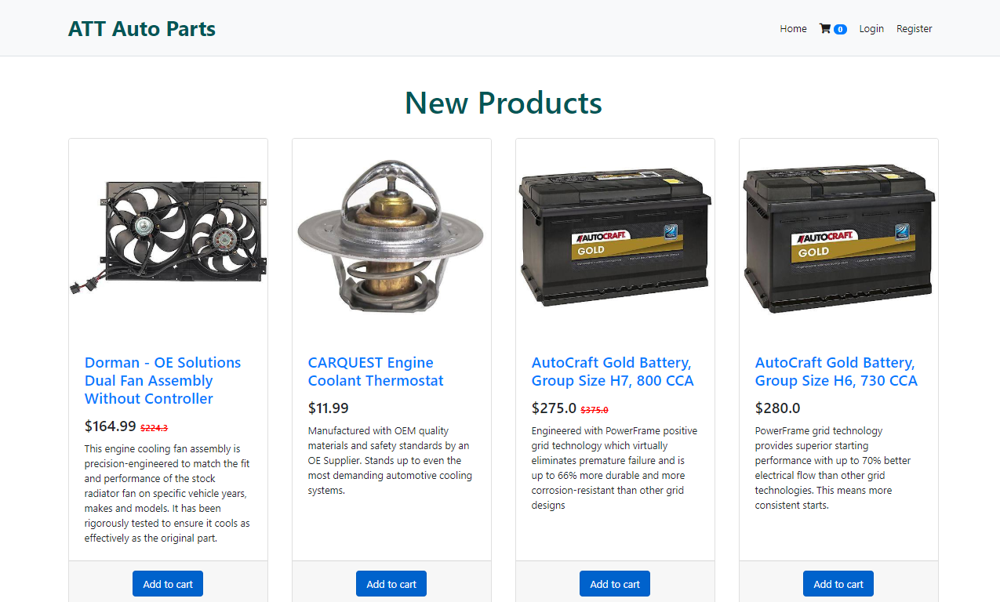
Screenshots

Slide 7
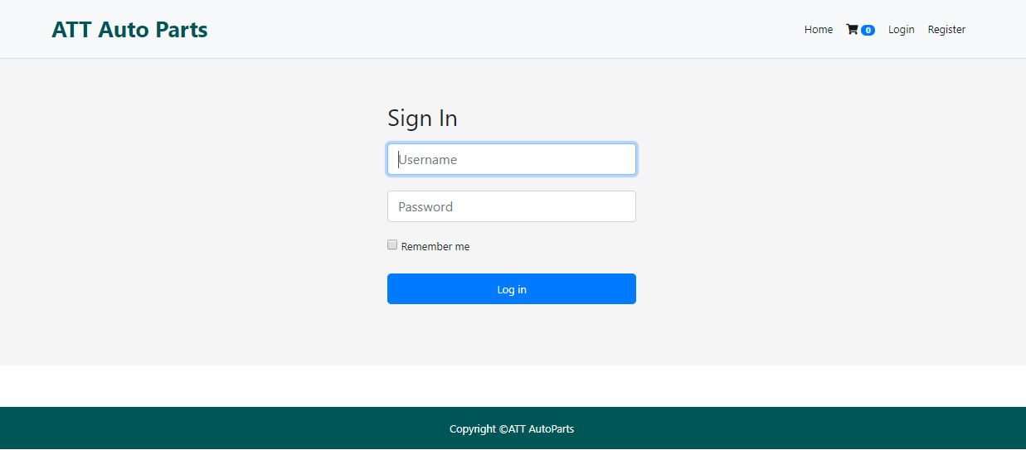
Screenshots

Slide 8
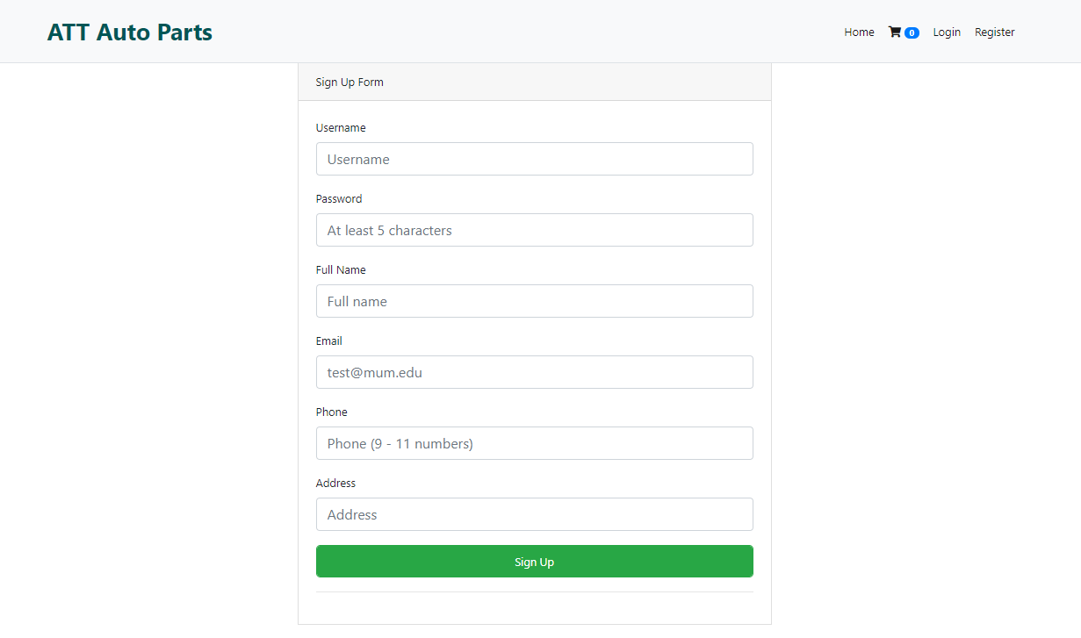
Screenshots

Slide 9
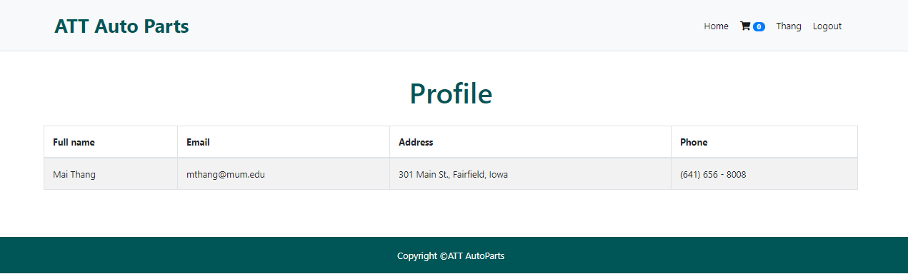
Screenshots

Slide 10
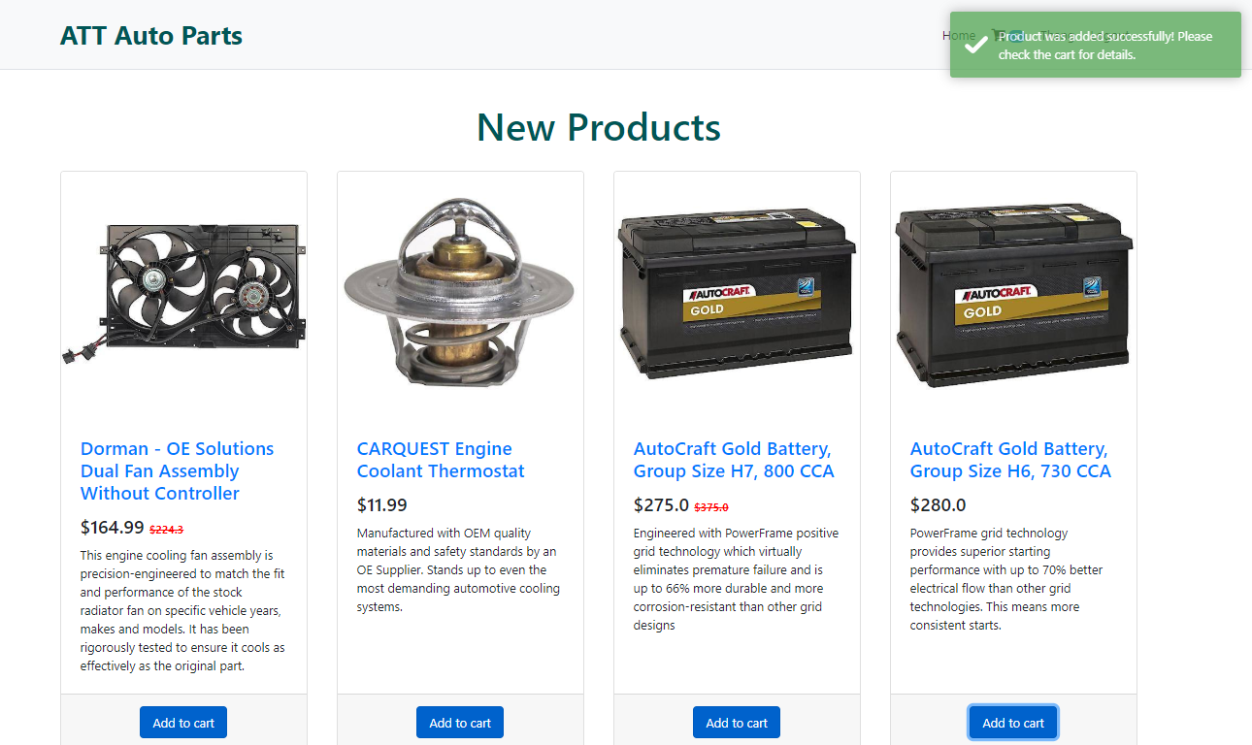
Screenshots

Slide 11
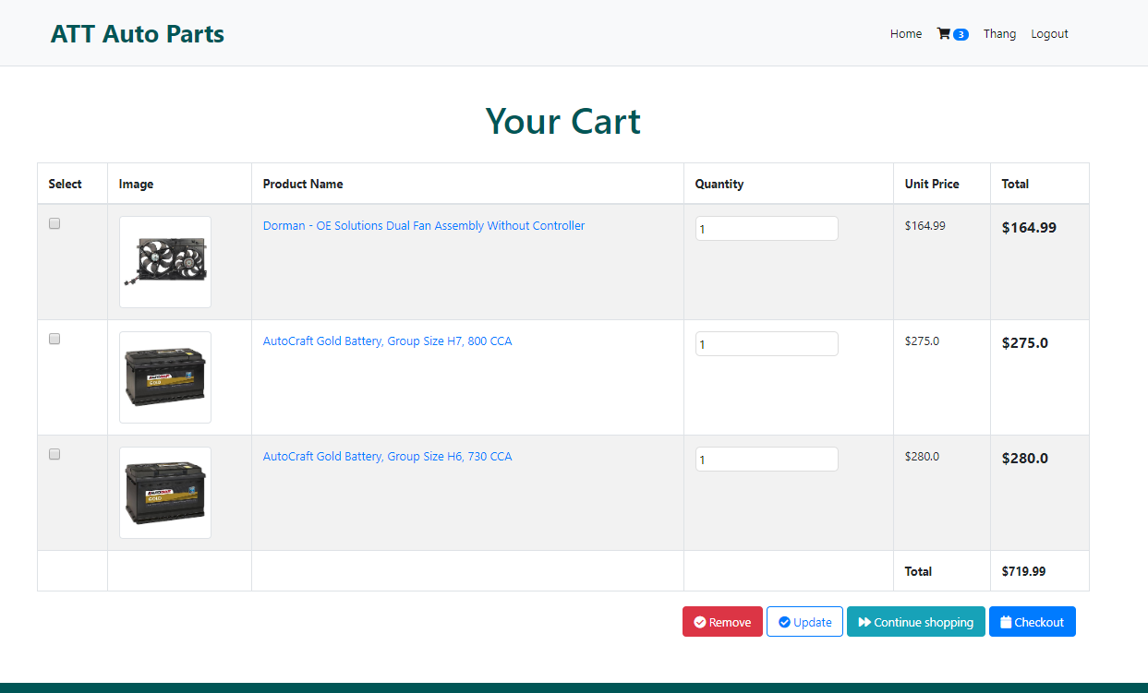
Screenshots

Slide 12
Screenshots – Mobile View

Slide 13

Notes:
Thank you very much for your time and please feel free to ask if any questions.

Slide 14
Notes:
Thank you

