Slide 1



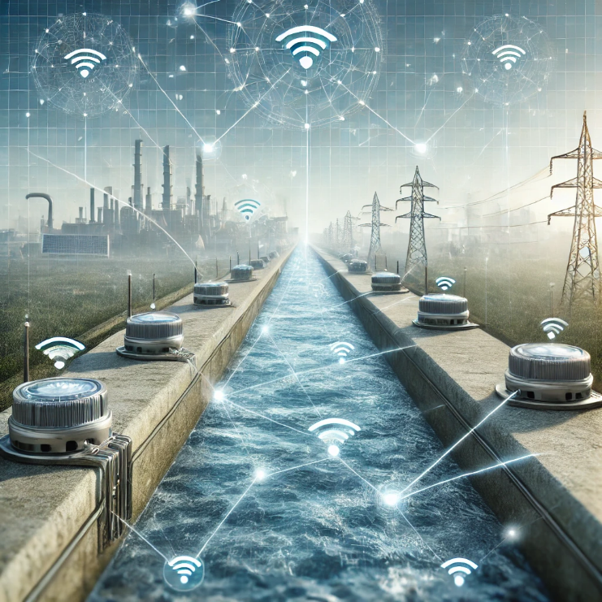
K.K.Wagh Polytechnic, Nashik Department Of Information Technology Academic Year 2024-25 Topic : “Water Canal Distribution System Using IoT ”
Name Of Student :
Maithili .S. Jadhav
Name Of Guide :
Mrs. M. P. Nawarkar

Slide 2


Introduction of project
1
Description of The Project
2
CONTENTS
problem & solution
3
conclusion
4

Slide 3
Project analysis slide 3
Introduction Of
Project
Problem Statement :
Background :
IoT Advantage :
Water management is crucial for agriculture and urban supply, requiring efficient distribution systems.
IoT enables automation, real-time monitoring, and precise control of water flow, enhancing efficiency.
Traditional water canal systems face issues like manual operation, water wastage, and inefficiency.
:
Email & Web Address
Email & Web Address
Email & Web Address
Email & Web Address
Type Of Product :
Type Of Product :
Name :
:
Type Of Product :
Service Industry
Service Industry
Service Industry
hmbyte.com
hr@hmbyte.com
Service Industry
hmbyte.com
hr@hmbyte.com
hmbyte.com
hr@hmbyte.com
Humming Byte Technologies
2021
hmbyte.com
hr@hmbyte.com
Project Scope :
Objective:
This project focuses on designing an IoT-based system to automate and optimize water distribution in canal networks.
Type Of Control :
Type Of Company :
Type Of Company :
Type Of Company :
Ensure minimal water wastage and effective resource management through smart technologies.
Private
Small Scale
Small Scale
Small Scale

Slide 4
Problem
Manual Operation: Most canal systems still rely on manual controls, leading to delays and inefficiencies.
Water Wastage: Uncontrolled water flow often results in excessive water loss, impacting resource availability.
Inconsistent Monitoring: Limited or no real-time monitoring means issues like leaks or blockages are detected
late
Resource Inefficiency: ineffective management leads to uneven water distribution, affecting agricultural
productivity
Solution
Real-time Monitoring: Use sensors to collect data on water levels, flow rate, and potential issues, which can be moniterd remotely.
Smart Decision-Making: Integrate data analytics and algorithms for adaptive control, optimizing water distribution based on current needs.
Automated Control System: Implement IoT-based actuators and sensors to regulate water flow automatically.
Remote Management: Enable operators to control and monitor the system via mobile apps or web interfaces, reducing the need for physical presence.

Slide 5

Project analysis slide 6
Description Of The
Project
The IoT-based water canal distribution system automates water management using integrated sensors, controllers, and communication technologies. Sensors measure water levels and flow rates, while controllers process this data to operate actuators that regulate water flow. Data is transmitted wirelessly to a centralized dashboard, allowing real-time monitoring and control. The system supports remote management, enabling operators to oversee and adjust operations through a user-friendly interface. Cloud integration ensures data storage, advanced analysis, and predictive insights. Key features include automated flow control, instant alerts for issues, and reduced need for manual intervention, enhancing efficiency and resource management.

Slide 6
Need of project
Need:
Water Management Issues.
Manual Monitoring.
Resource Wastage.
Benefits:
Improved Efficiency.
Real time Monitoring
Remote Access

Slide 7
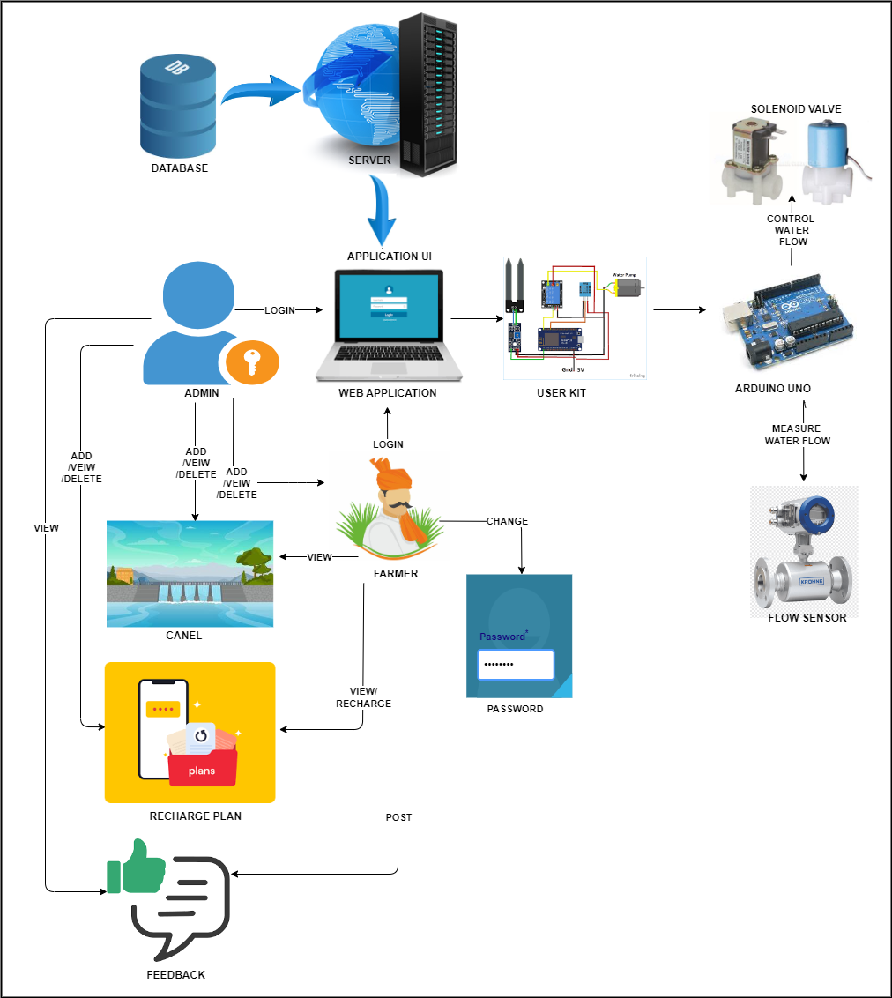
Project analysis slide 7
System Architecture

Slide 8

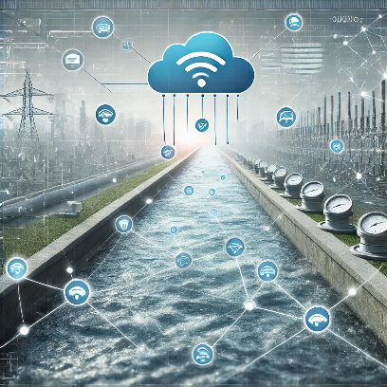
Project analysis slide 2
Future scope
Scalability
User Feedback Mechanism
Future
Advanced Data Analytics
Enhanced Security Features
Regulatory compliance
Integration with Other IoT Systems

Slide 9
Conclusion
Reduced Waste: Optimizes water distribution, minimizing losses.
Cost Savings: Lowers operational and labor costs through automation.
Enhanced Efficiency: Automates water control, improving system responsiveness.
Future Potential: Scalability and integration with AI/analytics for further improvements.
Sustainability: Promotes efficient, long-term water management for agricultural and urban use.

Slide 10
Thank You

