Slide 1
Data Analytics Project
Customized Anime Recommendations for Users
Presented by: Maithreyee B Bharadwaj
Email: maithreyee95@gmail.com
Date: 25 July 2023

Slide 2
Problem Statement
I am a junior data analyst working for a company called Myanime, a website which contains a variety of animes. My manager asked me to give recommendations to users based on what they have watched and new users the top animes based on a variety of criteria. My job is to figure out a data driven strategy to give recommendations.

Slide 3
Q. What is an anime?
Anime (アニメ) is a Japanese term for hand-drawn or computer animation. The word is the abbreviated pronunciation of "animation" in Japanese, where this term references all animation. Outside Japan, anime is used to refer specifically to animation from Japan or as a Japanese-disseminated animation style.

Slide 4
Exploring the database
Exploration of the database was split into three parts
Cleaning the database
Analysing the database
Visualizations

Slide 5
Cleaning the database
The database has three excel files which are called anime, reviews and profile.
Each file has almost 30,000-40,000 records.
I had to check if I could automatically import the data into mysql workbench using the import wizard.
Here is where I ran into a lot of issues and with which I understood why cleaning of the database is so important.
The major issues I faced were :
5.1. Special characters: If the excel file has a lot of special characters it does not get imported. Even importing manually by creating a table and importing the csv, the records get dropped. Here the excel had to be cleaned by replacing special characters with a blank space.
5.2. I had to be very careful of the data types which was used to define the variables while creating tables.
5.3 #Name? is an error when the names have an = or @ so such values had to be changed by replacing them with an underscore(_) as these records were getting dropped while importing.

Slide 6
Analysis
The database consists of three tables
Table | Rows | Columns
Anime | 16,217 | 9
Review | 192,117 | 10
Profile | 81,727 | 3
Anime: This table consists of the anime name, id, genre, no of episodes, the dates from which it aired on television, the no of people who have watched the anime, popularity, score and the rank of each anime
Review: This table consists of the anime id, user id of the users who have scored a particular anime, score, and score on various categories which are story, sound, animation, characters, enjoyment
Profile: This table consists of the user id, the gender of each user and their favourite animes.

Slide 7
Visualization
Since our website provides a variety of animes, we have to customize the animes based on user preferences. I have grouped the anime based on some of the choices we are going to give our users.
The categories are as follows:
User based Categories | Anime based Categories
1. Popularity | 1.Story
2. Score | 2.Animation
3. Gender | 3. Enjoyment
4. Genre | 4.Characters
 | 5. Sound

Slide 8
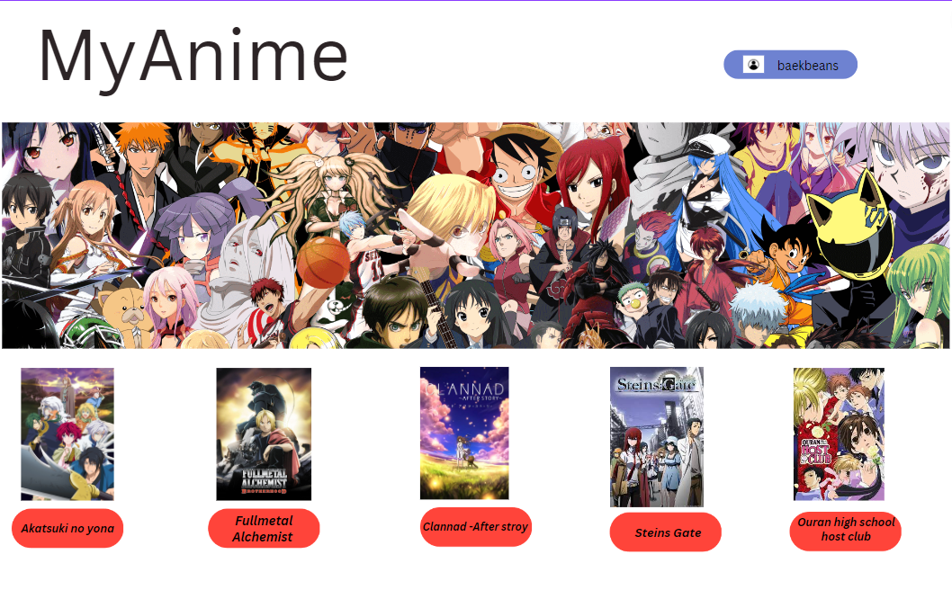
MyAnime user page
This is the web page when a user logins into his/her account.
As an example, I have taken a female user.
These are the anime recommendations based on the results obtained through analysis of the database.
Let me show you my analysis next.

Slide 9
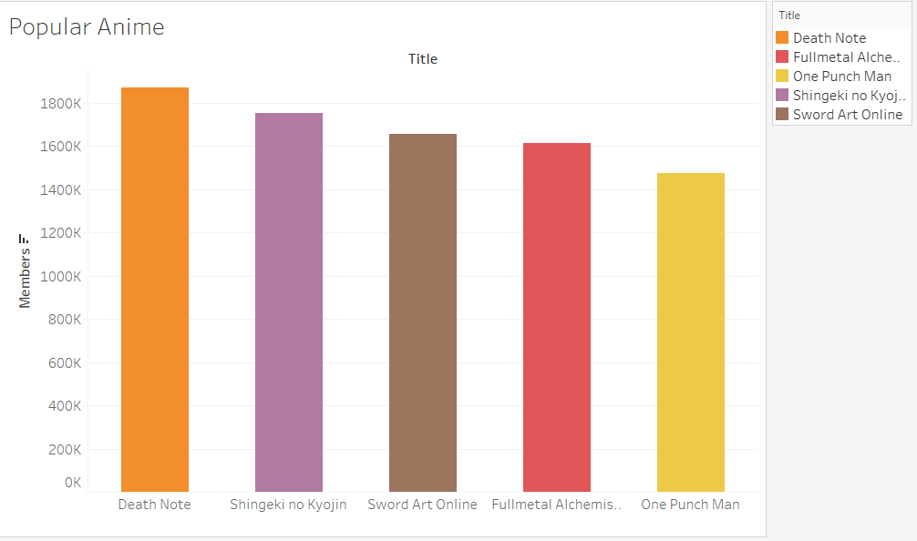
I. User based categories
1.Popularity
Here the popularity of the anime is based on the number of users who have watched these animes
Anime | Users watched
Death Note | 1,871,043
Shingeki no Kyojin | 1,754,979
Sword Art Online | 1,657,823
Fullmetal alchemist :Brotherhood | 1,615,084
One Punch Man | 1,475,219

Slide 10
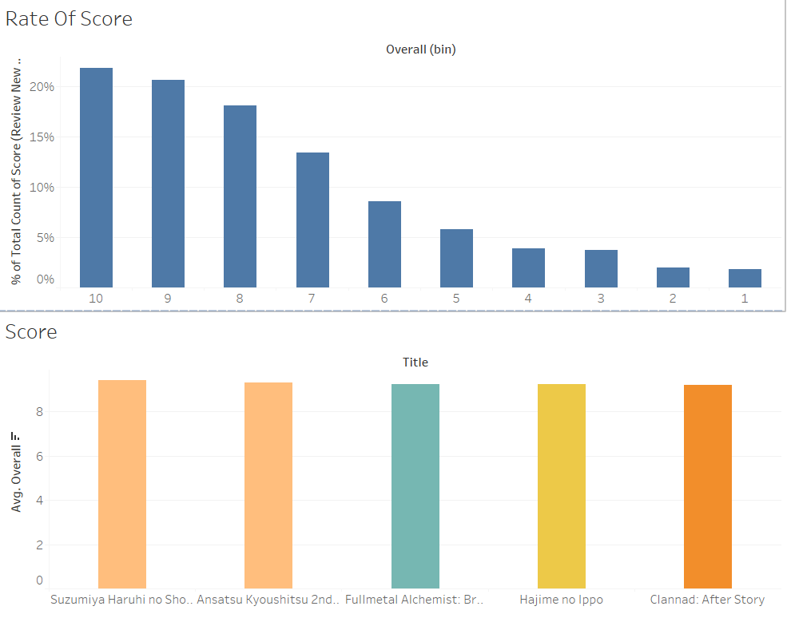
2.Score
The graph on the left hand side shows the percentage of scores for various anime.
It can be observed that 22% of the anime having a score of 10.
The percentage of each score gradually decreases.
Further analysis have to be done to get more users to rate an anime.
In order to get the top 5 animes with highest average score, it has to be rated by at least 100 users.

Slide 11
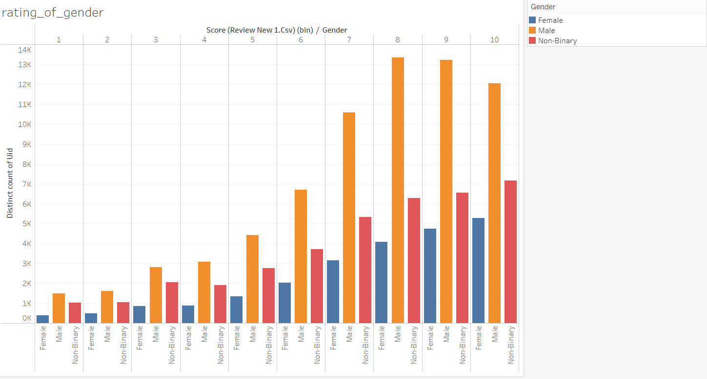
3. Gender
The three values under gender include:
Male
Female
Non-Binary
Below is a graph showing how each gender rates an anime.
Insight:-It turns out that male users are more consistent in rating an anime than female users.

Slide 12
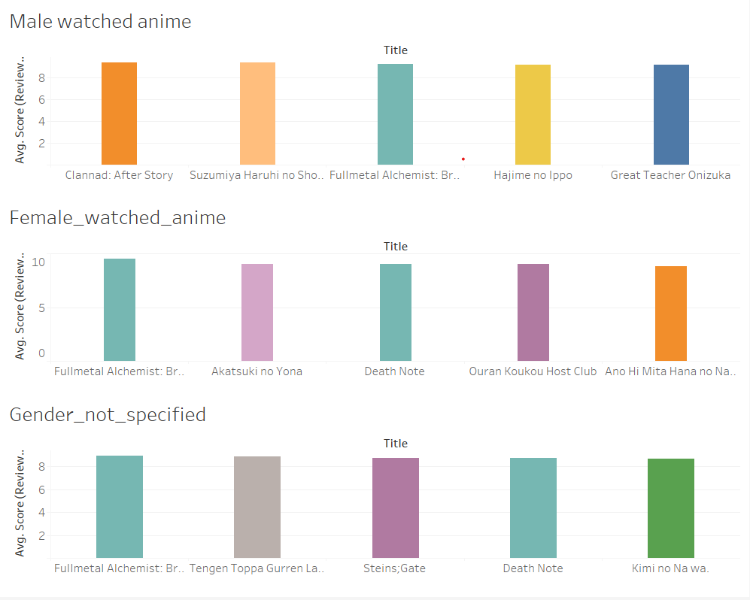
These graphs show the top 5 most watched animes among the various genders.
The X-axis = Anime Title
The Y-axis = Avg Score
Condition -The number of users who have watched a particular anime and given a score should be more than 100.
Reason- To prevent animes which are watched by just 1 or 2 users and have been given the highest scores.

Slide 13
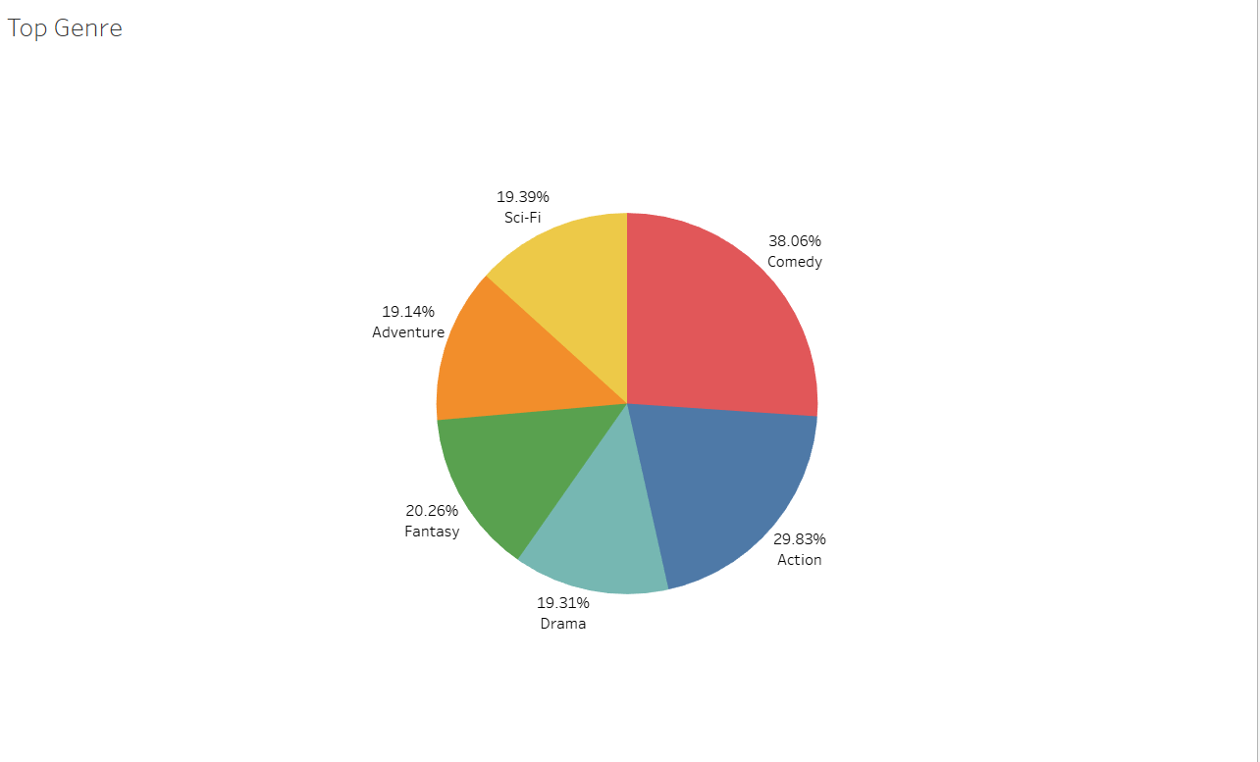
4.Genre
The top most watched genre are
Comedy
Action
Fantasy
Sci-Fi
Drama
Adventure

Slide 14
The top 3 animes from each genre
Here is a table which contains the top three animes from each genre.
An anime is picked for a particular genre if more than 100 users have watched it and have given a score.
In this way an anime which has been watched by just one user and has been given the highest score does not get included.
Genre | Anime 1 | Anime 2 | Anime 3
Comedy | Suzumiya Haruhi no shoushitsu | Ansatsu Kyoushitsu 2nd Season | Fullmetal alchemist : Brotherhood
Action | Ansatsu Kyoushitsu 2nd Season | Fullmetal alchemist :Brotherhood | Gintama
Fantasy | Fullmetal alchemist :Brotherhood | Fullmetal alchemist | Ookami to Koushinryou
Sci-Fi | Suzumiya Haruhi no shoushitsu | Gintama | Steins Gate
Drama | Fullmetal alchemist :Brotherhood | Hajime no Ippo | Clannad After story
Adventure | Fullmetal alchemist :Brotherhood | Sen to chihiro no kamikakushi | Sora yori mo tooi Basho

Slide 15
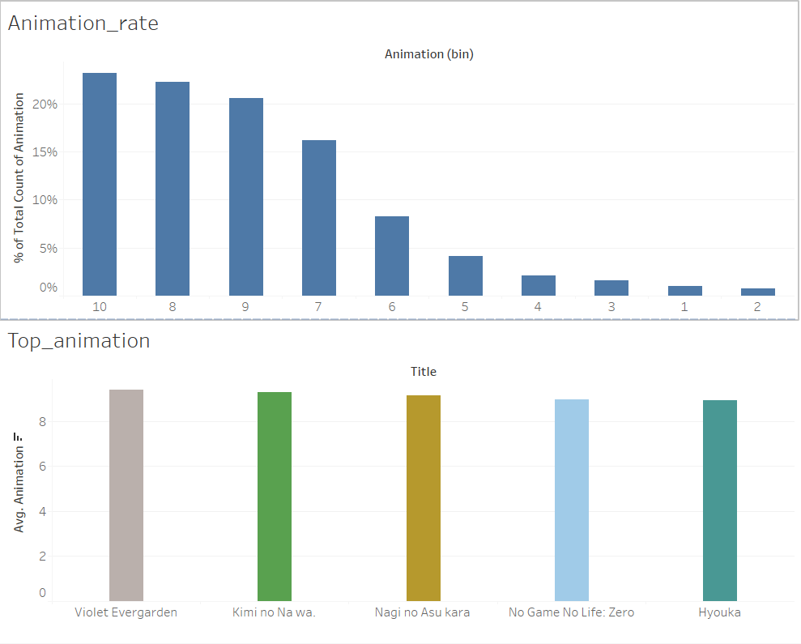
II.Anime based categories
1.Animation
Here the percentage of users who have given a rating of 10 is 23%.
22% have given a rating of 8.
Anything below six should not be considered.
The top 5 animes with high average score in the category ‘’animation”.
The condition is that the animes should have been watched by at least 100 users.

Slide 16
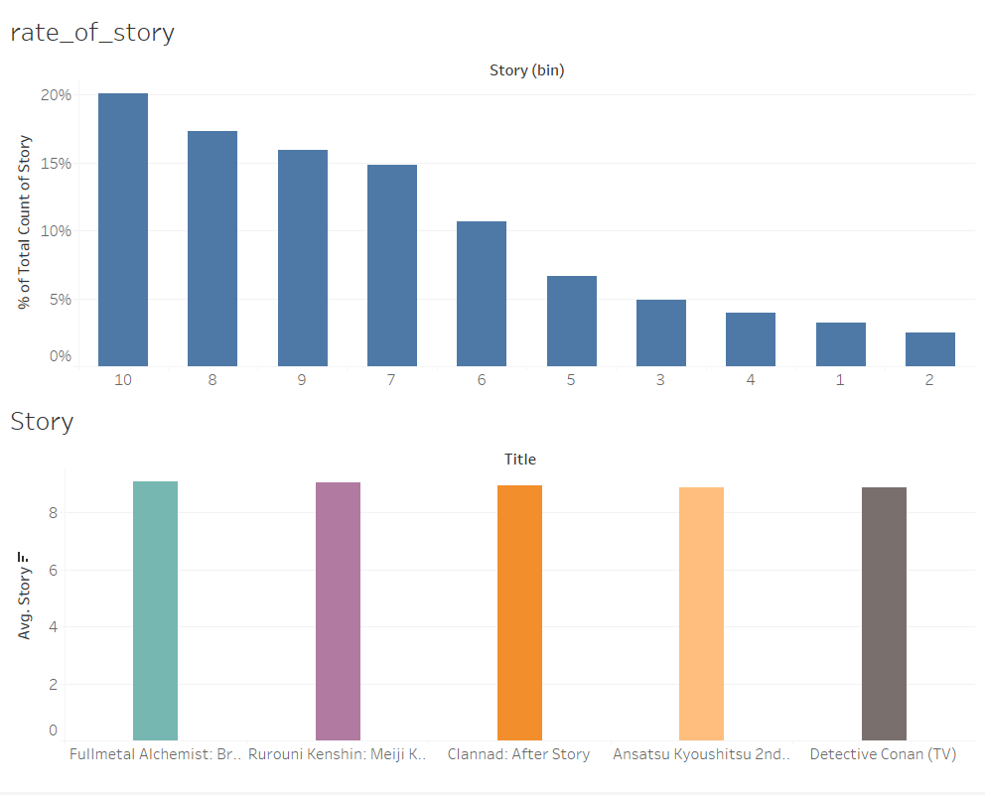
2.Story
Here the percentage of users who have given a rating of 10 is 20%.
17.5 % have given a rating of 8.
Anything below six should not be considered.
It can be observed that users care more about animation than story (look at the decreasing trend in rating)
The top 5 animes with high average score under the category ‘‘story’’.
Here again the condition by which these animes are top 5 is that they should have been watched by at least 100 users.

Slide 17
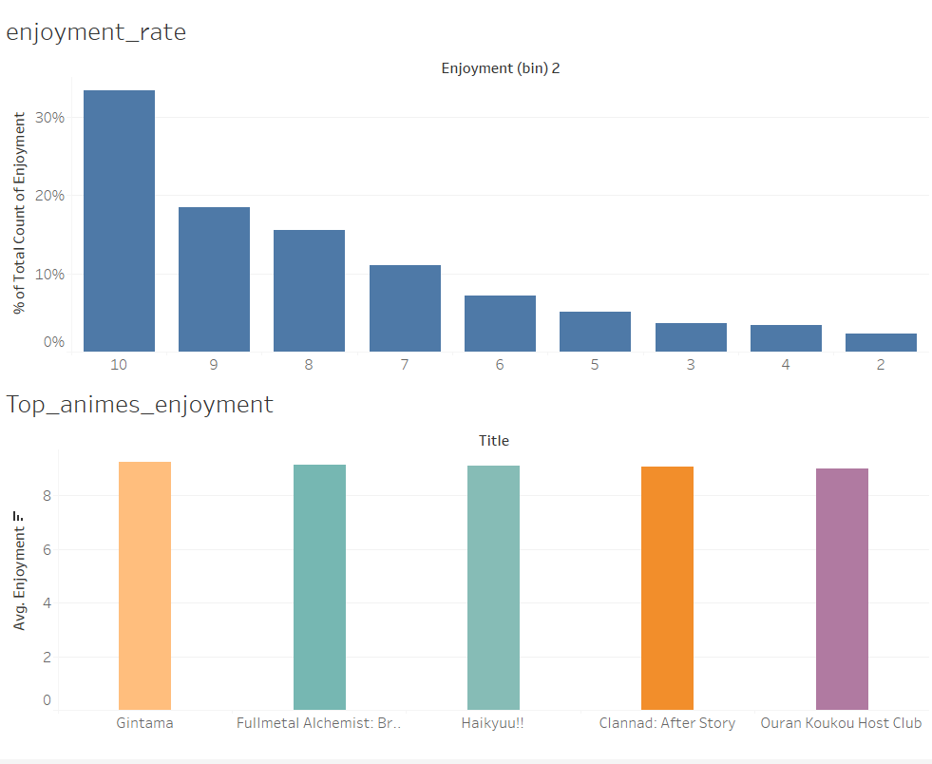
3.Enjoyment
From the graph it can be observed that users are particular about whether they enjoy an anime or not.
It can be seen that 35% of users have rated 10 for various anime under enjoyment.
So anything below 6 should not be considered.
The top 5 animes with high average score under the category ‘‘enjoyment’’.
Here again the condition by which these animes are top 5 is that they should have been watched by at least 100 users.

Slide 18
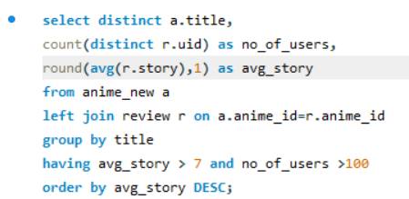
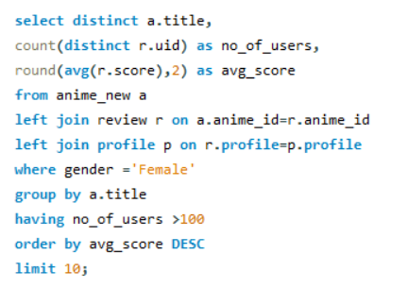
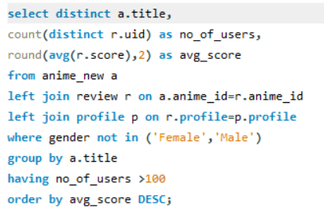
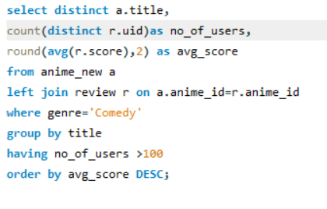
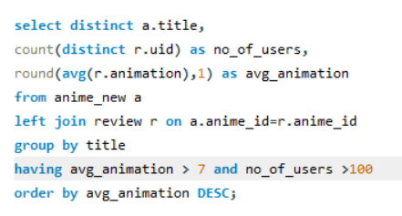
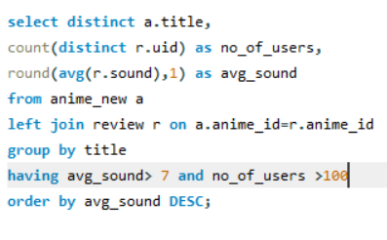
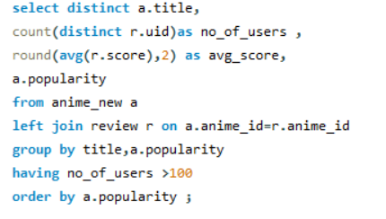
Code
Below are some code snapshots which I used to gain insights for my analysis

Slide 19
Appendix
The tools used for this project are
Microsoft excel
Tableau
Mysql workbench
Canva
Additional information about the other categories including sound and characters are below.

Slide 20
Questions?

Slide 21
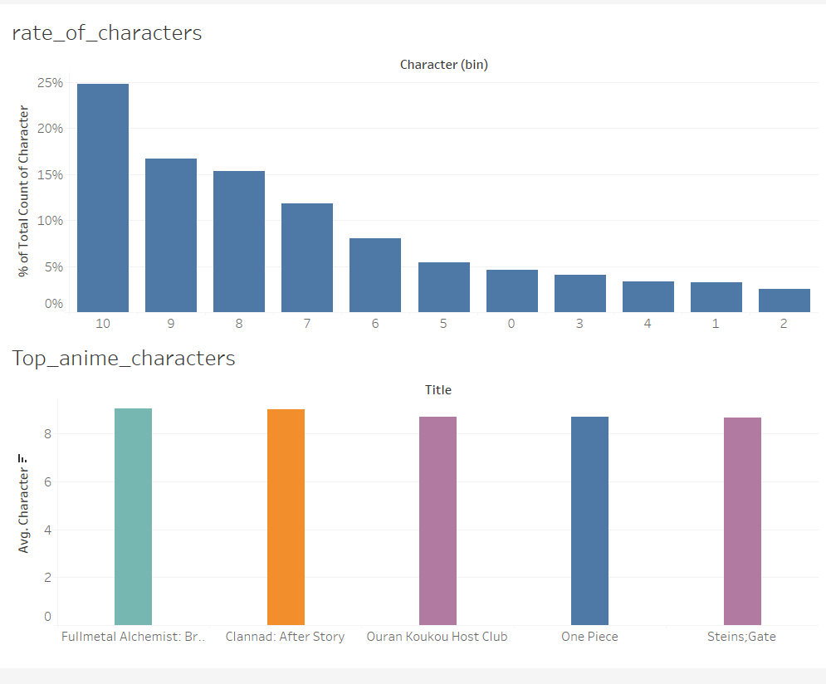
4.Characters
Here the percentage of users who have given a rating of 10 is 25%.
16.5 % have given a rating of 9.
There is a drastic drop in the ratings
Anything below six should not be considered.
The top 5 anime with high avg score in “characters”.
Here again the condition by which these animes are top 5 is that they should have been watched by at least 100 users.

Slide 22
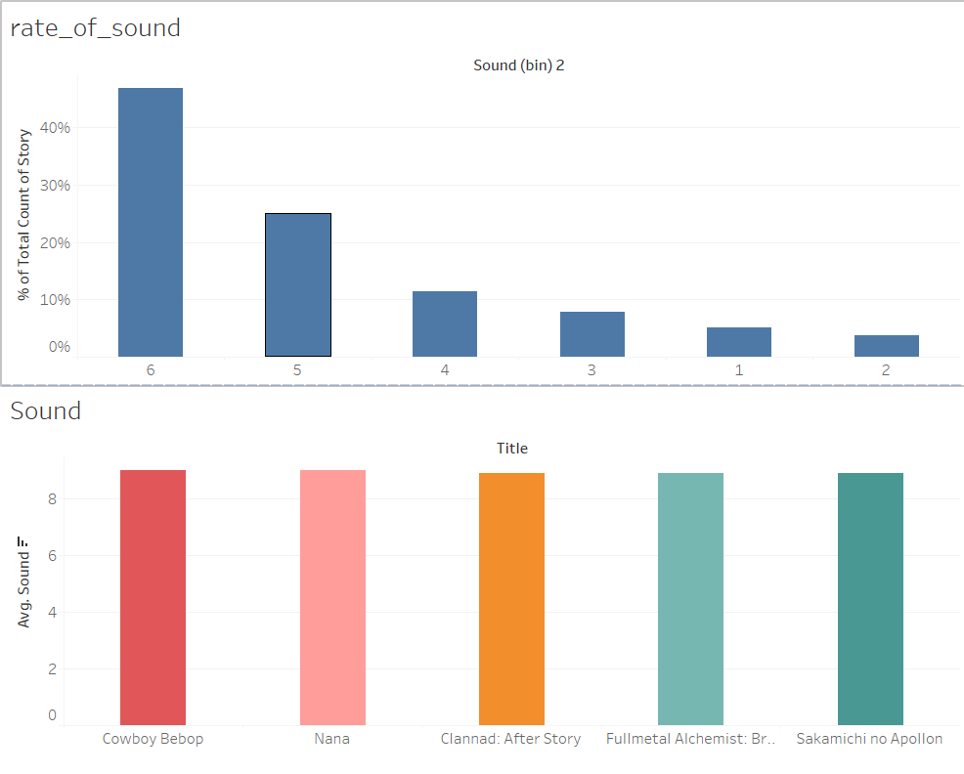
5.Sound
Here the percentage of users who have given a rating of 6 is 45%
Then 24.9% have given a rating of 8
It can be observed that users are not really liking the sound quality of the anime
Either the voices quality is not good or the music of the anime.This needs further analysis
The top 5 anime with high avg score in “sound”
Here again the condition by which these animes are top 5 is that they should have been watched by at least 100 users.

