Slide 1





INTRODUCE
PREVIEW
PREDICT
GROUP 6’S FINAL PROJECT/ NATURAL LANGUAGE PROCESSING
The research team would like to express our sincere gratitude to Dr. Đặng Ngọc Hoàng Thành for your guidance throughout the implementation of our project. Your knowledge and support have greatly contributed to the successful completion of our project.
MAIN APPLICATION
Evaluate the hyperparameters of the algorithm corresponding to each dataset. The purpose is to identify the dataset that has the best predictive ability.
From the dataset with the best evaluation, perform label prediction for the requested text.

Slide 2
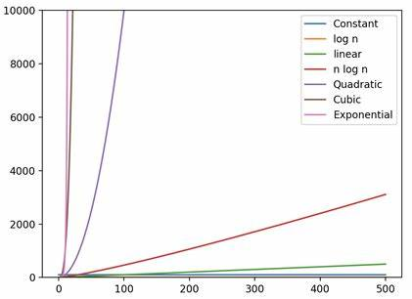

INTRODUCE
PREVIEW
PREDICT
Hyperparameter Comparison Between Machine Learning Methods
Acc
Pre
Recall
F1
SVM
0.63
0.63
0.63
0.63
Maxent
0.63
0.63
0.63
0.63
LSTM
0.63
0.63
0.63
0.63

Slide 3

INTRODUCE
PREVIEW
PREDICT
Find Appropriate Labels For Text Using Machine Learning Methods
TAG FINDING
Nhập nội dung cần tìm nhãn
LABEL PREDICTION RESULTS
Support Vector Machine
Maxent
Long-Short Term Memory
THỜI SỰ
THỜI SỰ
THỜI SỰ
Accuracy
63%
Accuracy
63%
Accuracy
63%

