Slide 1
Identifying Handwritten Arabic Characters Using Convolutional Neural Networks (CNNs)
تحديد على الحروف العربية المكتوبة بخط اليد باستخدام الشبكات العصبية التلافيفية
Maitiu Sexton
8 Sep 2021
ماتشو سيكستون
٨ سبتمبر ٢٠٢١

Slide 2
Roadmap
Motivation
The Arabic Alphabet
The Data
CNN #1
CNN #2
CNN #3
CNN #4
Future Research

Slide 3
Motivation
1: https://www.ethnologue.com/guides/ethnologue200
2: https://en.wikipedia.org/wiki/Arabic_script
OCR (Optical Character Recognition) tech mostly Latin-based
Arabic 5th most spoken language (behind English, Mandarin, Hindi, Spanish)¹
General OCR benefits
data entry (invoices, checks, receipts, etc.)
information extraction (passports, web scraping)
live translation
Potential applications to other languages²

Slide 4
The Arabic Alphabet - الأبجدية العربية
Written right to left - cursive necessary
28 letters & a few special characters, no capitals
Impure abjad - only some vowels written (normally)
Each letter has 4 positions
isolated
beginning
middle
end

Slide 5
The Arabic Alphabet - الأبجدية العربية
How ب (ba) is written
Position | End | Middle | Beginning | Isolated
Written | ب | ـبـ | بـ | ب
Example | مكتب “maktab” desk | مطبخ “matbakh” kitchen | بيت “bayt” house | باب “baab” door

Slide 6
The Arabic Alphabet - الأبجدية العربية
hello - مرحبا (merhaba)
١ | ب | ح | ر | م
a | b | h | r | m

Slide 7
The Arabic Alphabet - الأبجدية العربية
week - أسبوع (asbuua’)
ع | و | ب | س | أ
a’ | uu | b | s | a
weeks - أسابيع (asaabia’)
ع | ي | ب | ا | س | أ
a’ | i | b | aa | s | a

Slide 8
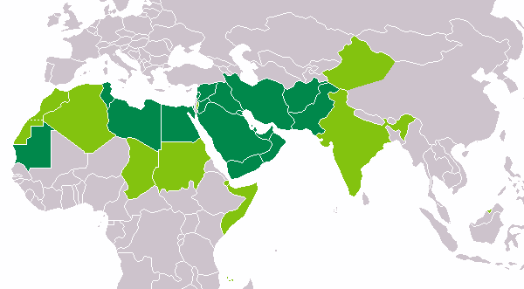
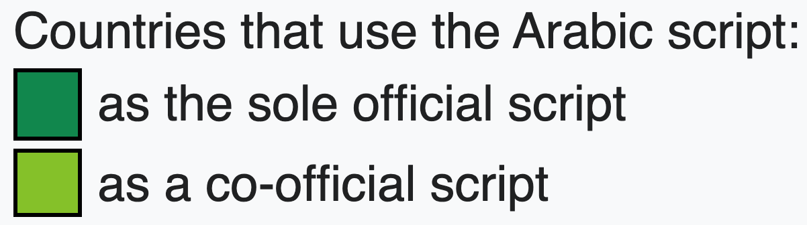
source: https://commons.wikimedia.org/wiki/File:Arabic_alphabet_world_distribution.png

Slide 9
The Data
Very similar to MNIST digits
16,800 observations of 28 characters written by 60 participants
Each participant wrote each character only in isolated form* 10 times
Images were scanned/processed
32x32 black/white .png
*with the exception of “heh” ه which was written in initial form ﻫ (standard practice)

Slide 10
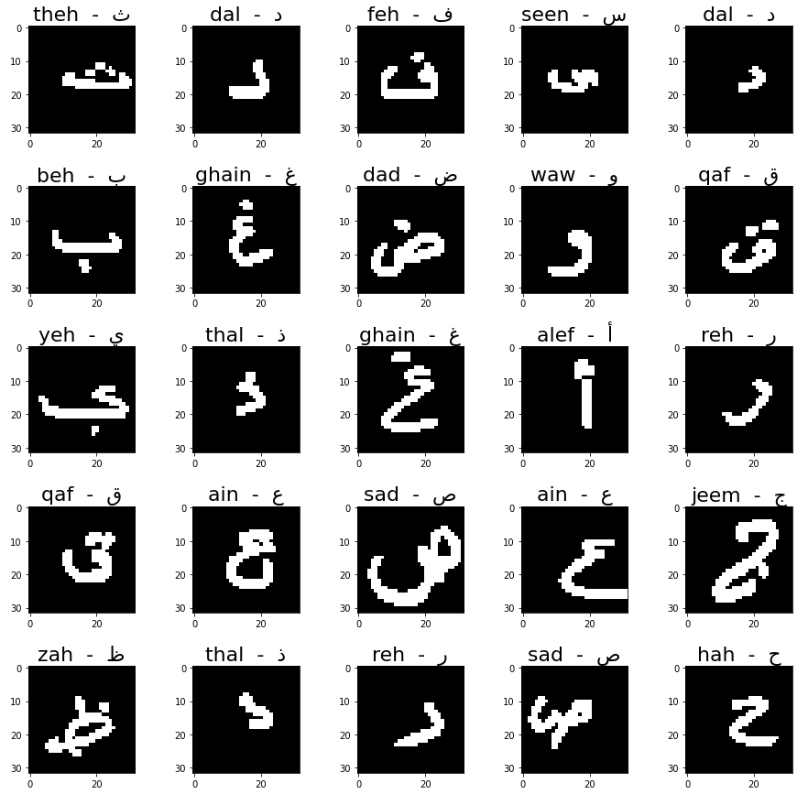

Slide 11
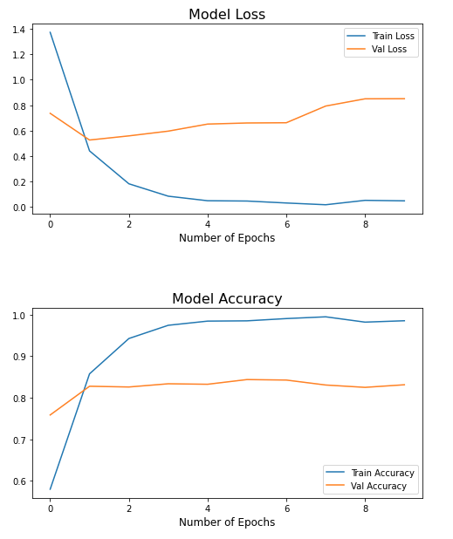
CNN #1
Baseline
Loss: 0.8514 Accuracy: 83.13%
optimizer: ADAM
loss function: Categorical Cross Entropy
metric: Accuracy

Slide 12
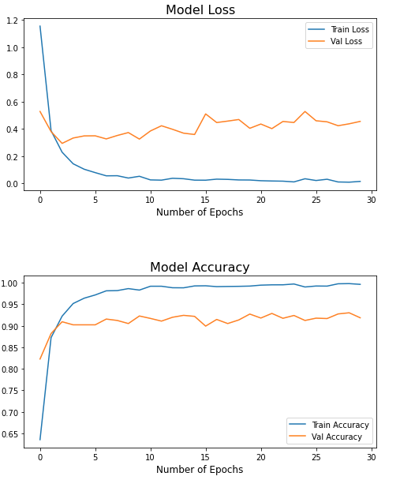
CNN #2
l₂ Regularization
Loss: 0.5071 Accuracy: 91.85%
optimizer: ADAM
loss function: Categorical Cross Entropy
metric: Accuracy

Slide 13
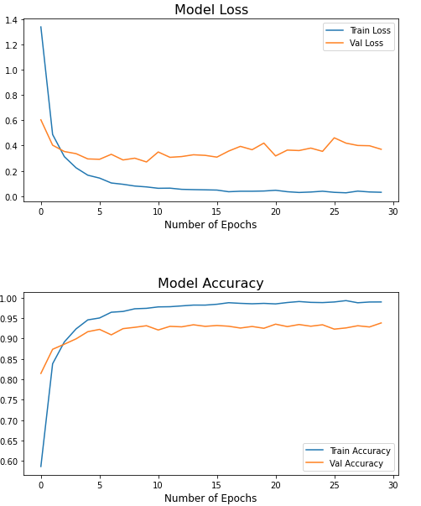
CNN #3
Drop Outs
Loss: 0.3709 Accuracy: 93.81%
optimizer: ADAM
loss function: Categorical Cross Entropy
metric: Accuracy

Slide 14
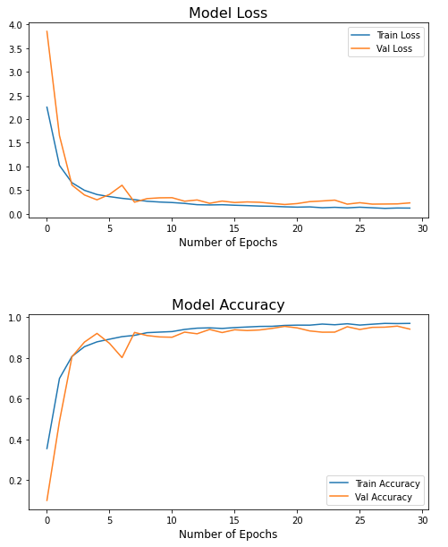
CNN #4
Batch Normalization
Loss: 0.2306 Accuracy: 94.17%
optimizer: ADAM
loss function: Categorical Cross Entropy
metric: Accuracy

Slide 15
Future Research
Training full word, sentence, paragraph OCR models
Combining existing datasets to create comprehensive training (MNIST digits, KHATT, IFN/ENIT, HACDB)
Applying models to real life images rather than scanned written texts

Slide 16
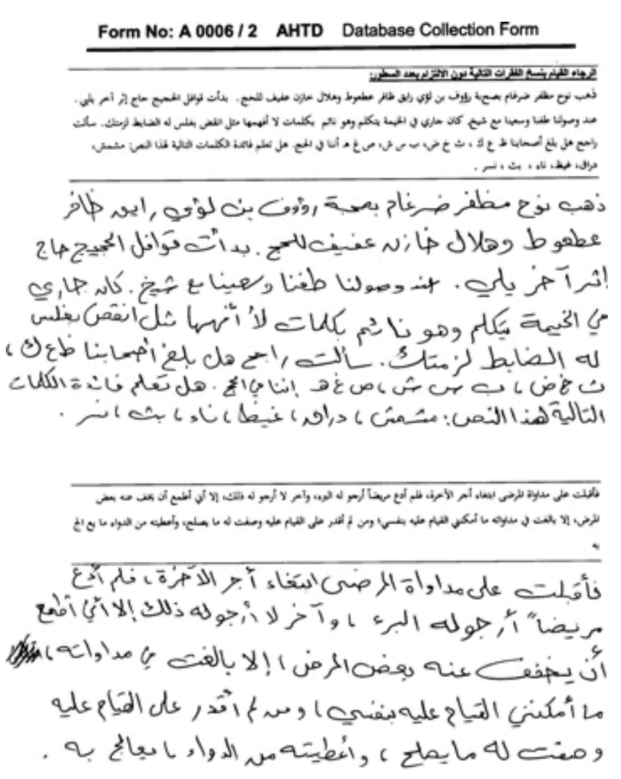
Future Research
KHATT Database:
4 full pages of written text
some paragraphs are identical, some are up to the writer
currently has 300 writers from various backgrounds

Slide 17
Sources Used
• A. El-Sawy, M. Loey, and H. EL-Bakry, “Arabic handwritten characters recognition using convolutional neural network,” WSEAS Transactions on Computer Research, vol. 5, pp. 11–19, 2017.
https://doi.org/10.1007/978-3-319-48308-5_54 , https://link.springer.com/chapter/10.1007/978-3-319-48308-5_54
• A. El-Sawy, H. EL-Bakry, and M. Loey, “CNN for handwritten arabic digits recognition based on lenet-5,” in Proceedings of the International Conference on Advanced Intelligent Systems and Informatics 2016, vol. 533, pp. 566–575, Springer International Publishing, 2016.
https://www.wseas.org/multimedia/journals/computerresearch/2017/a045818-075.php
• Loey, Mohamed, Ahmed El-Sawy, and Hazem El-Bakry. "Deep learning autoencoder approach for handwritten arabic digits recognition." arXiv preprint arXiv:1706.06720 (2017).
https://arxiv.org/abs/1706.06720

