Slide 1

Note: The data and information in this document is reflective of a hypothetical situation and client. This document is to be used for KPMG Virtual Internship purposes only.
Sprocket Central Pty Ltd
Data analytics approach
Maitrayi Rajawat

Slide 2
Note: The data and information in this document is reflective of a hypothetical situation and client. This document is to be used for KPMG Virtual Internship purposes only.
Agenda
Introduction
Data Exploration
Model Development
Interpretation

Slide 3
Note: The data and information in this document is reflective of a hypothetical situation and client. This document is to be used for KPMG Virtual Internship purposes only.
Introduction
Identifying and Recommending High Value Customers
Outline Of Problem
Approach for Data Analysis
Wealth segment
Bike related purchase in last 3 years
Number of car owned
Customer Classification
Gender
Profit
Property valuation
Tenure
Sprocket Central Pty Ltd is specialized in high quality bike and bike accessories.
The marketing team is looking to boost sales
Target 1000 new Customer that will bring the highest value to the business

Slide 4
Note: The data and information in this document is reflective of a hypothetical situation and client. This document is to be used for KPMG Virtual Internship purposes only.
Data Exploration
 | Transaction | Demographic | Address
No records | 2000 | 4000 | 3999
No unique records | 3494 | 4000 | 3999
No blank records | * | * | none
Receiving date | 24 June 2023 | 24 June 2023 | 24 June 2023
Data Quality assessment
 | Accuracy | Completeness | Relevancy | Consistency
Customer Demographics | DOB: outliers Age :missing | Last name , gender job_titile job_industry_category | Default :Meta data | Gender
Customer Address |  |  |  | State
Transaction |  | online_order Brand | Default product_first_sold_date

Slide 5
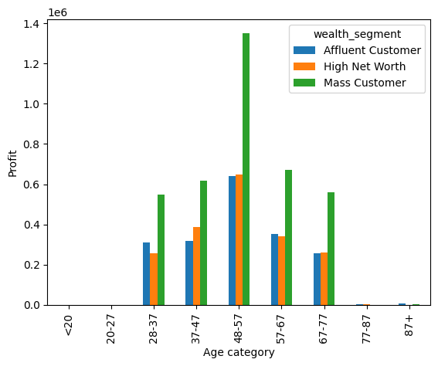
Note: The data and information in this document is reflective of a hypothetical situation and client. This document is to be used for KPMG Virtual Internship purposes only.
Data Exploration
Profit distribution in Wealth segment and Age category
Data shows majority profit is distributed in 48-57 age group.
In all age segment Mass customer are the major contributor to Profit.
Bikes need a certain level of physical fitness and sense of adventure that best coincide with middle age segment and Mass customer segment.

Slide 6
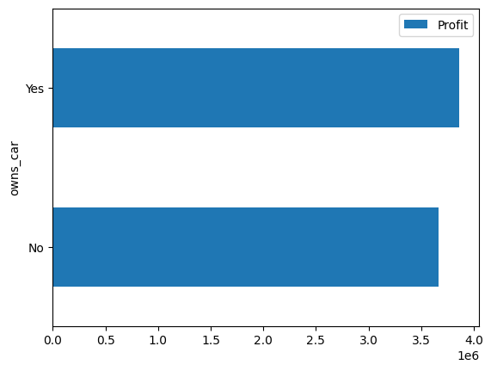
Note: The data and information in this document is reflective of a hypothetical situation and client. This document is to be used for KPMG Virtual Internship purposes only.
Data Exploration
Ownership of car is not a major deciding factor
Owner ship of car is not a major affecting factor.
There is only 1% difference in the contribution of car owners and non-car owners.
Shows cars are not competing directly with bikes in locomotion.

Slide 7
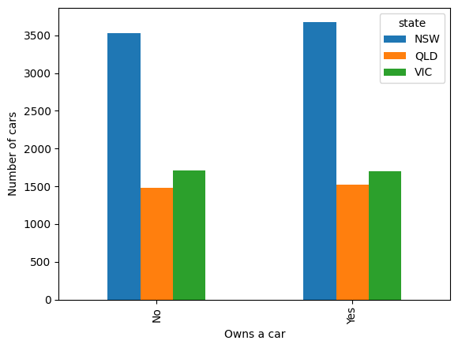
Note: The data and information in this document is reflective of a hypothetical situation and client. This document is to be used for KPMG Virtual Internship purposes only.
Data Exploration
Number of cars distribution in States and Car ownership
Number of cars are maximum in New South Whales.
Number of car owners and non-car owners are almost equally divided.
New South Whales being more metropolitan, higher population, lower population density, have more Locomotive needs.

Slide 8
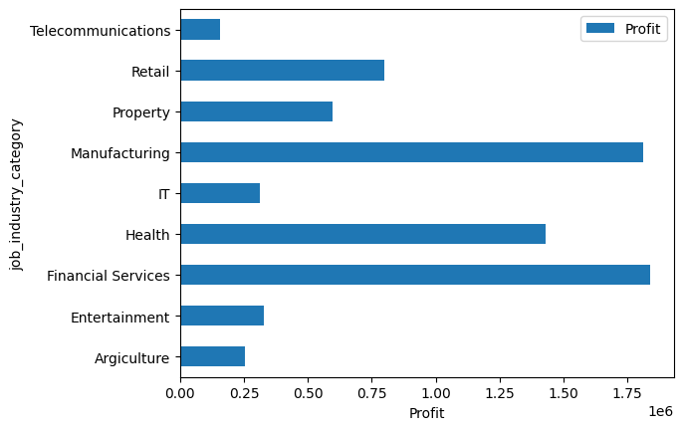
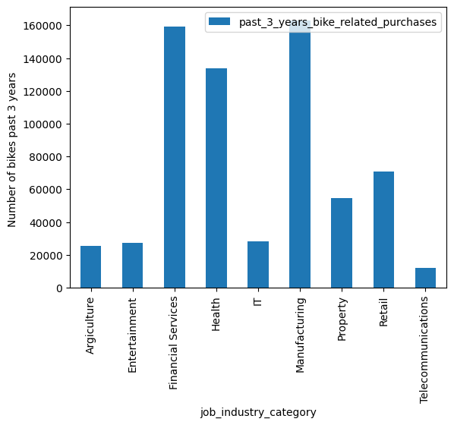
Note: The data and information in this document is reflective of a hypothetical situation and client. This document is to be used for KPMG Virtual Internship purposes only.
Data Exploration
Profits & 3 year bike related purchase distribution as per industry category
Manufacturing, Health, Financial services are the highest contributor to profit.
These three sector generally within the city or at the outskirts.
Other sector gives profit less than $100K.

Slide 9
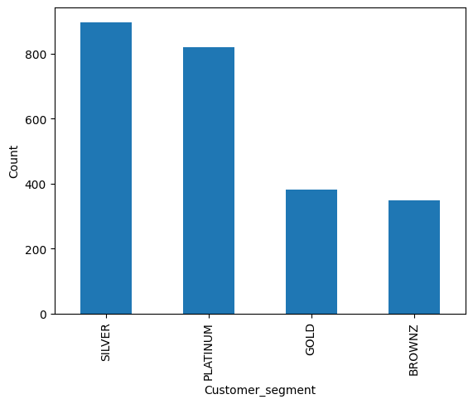
Note: The data and information in this document is reflective of a hypothetical situation and client. This document is to be used for KPMG Virtual Internship purposes only.
Data Exploration
RFM analysis customer segmentation
Customer Segmentation
BROWNZ - Lapsed customer,
GOLD - Average customer
SILVER - New customer
Platinum- Highest profit giver with high frequency

Slide 10
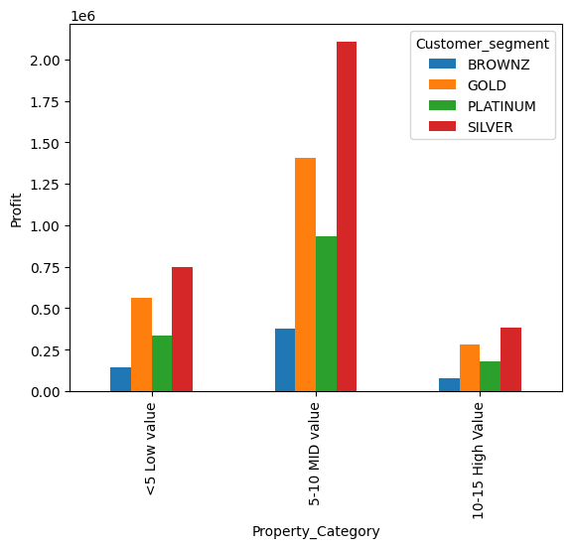
Note: The data and information in this document is reflective of a hypothetical situation and client. This document is to be used for KPMG Virtual Internship purposes only.
Data Exploration
Profit as per property segmentation
Mid valued Property are biggest contributor to profit.
People Buying high valued property will most likely be affluent, high net worth segment.
Mid valued segment coincide with Mass segment of customer.

Slide 11
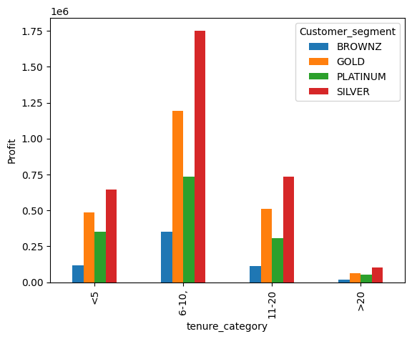
Note: The data and information in this document is reflective of a hypothetical situation and client. This document is to be used for KPMG Virtual Internship purposes only.
Data Exploration
Profit as per tenure segmentation
People with 20 or higher are least contributor to profit
People Occupying same property or a long time will less likely prefer as bike locomotive, as their motive is to have least locomotion reasons

Slide 12
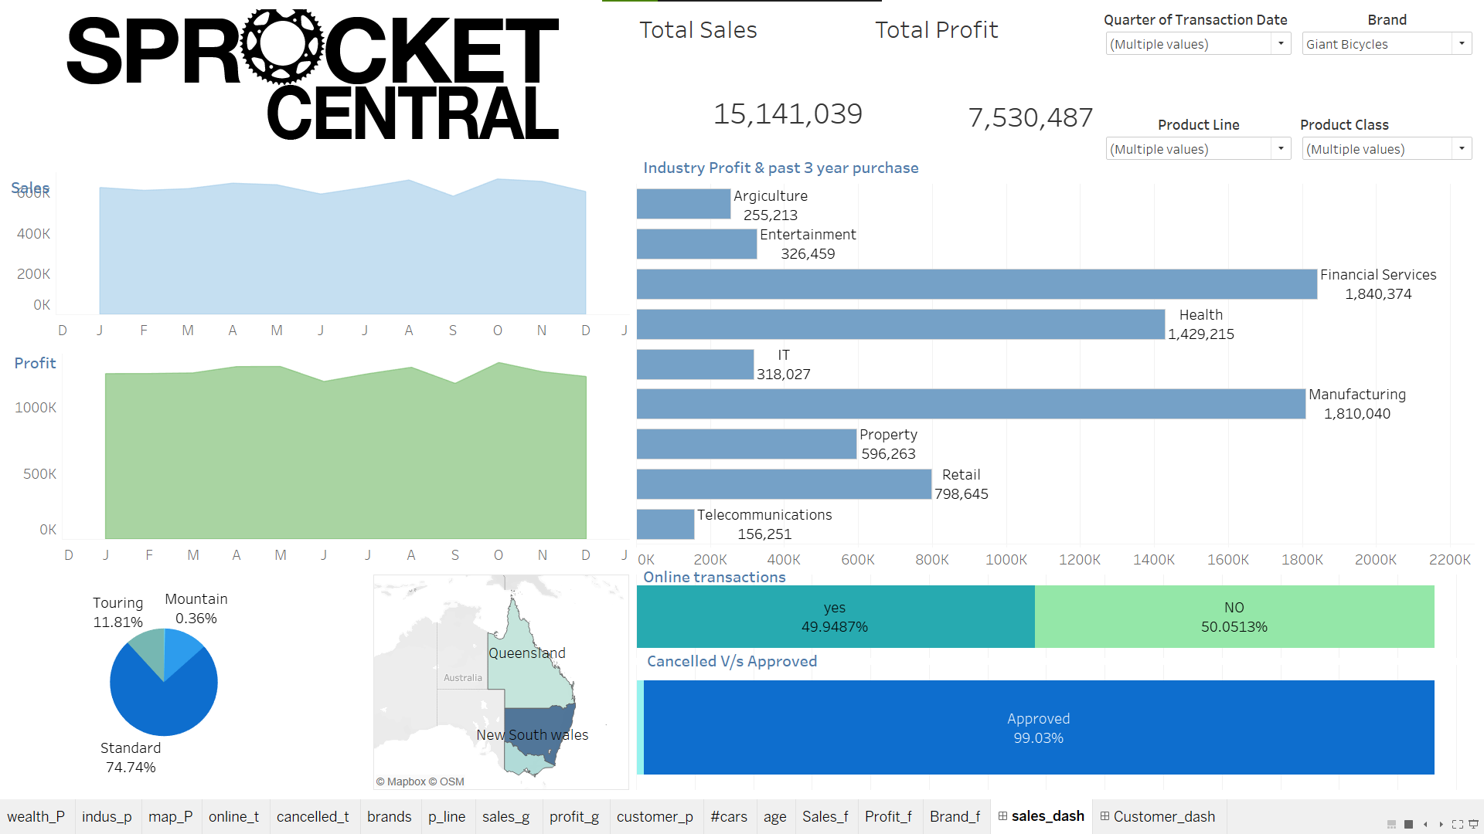

Slide 13
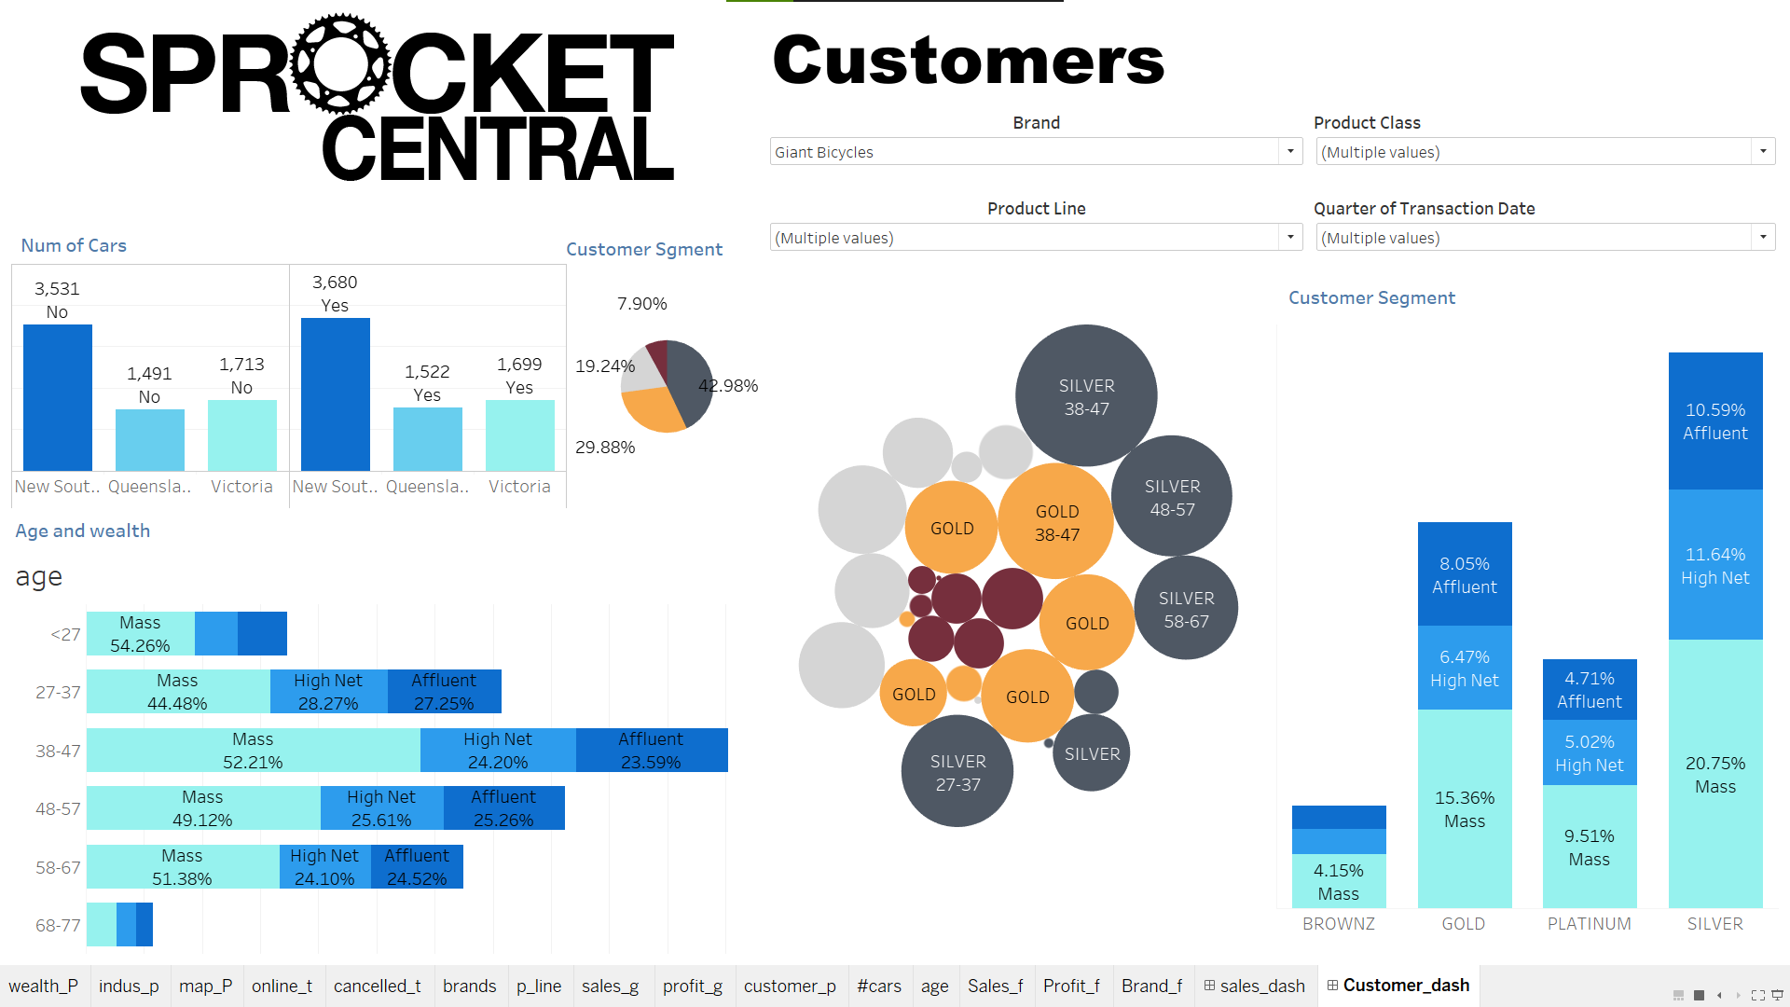
Interpretation

Slide 14
Note: The data and information in this document is reflective of a hypothetical situation and client. This document is to be used for KPMG Virtual Internship purposes only.
Model Development
Customer Classification – Targeting High Value Customer
The two customer category to target on should be -
SILVER - New customer
Platinum- Highest profit giver with high frequency
Age - 47 to 57
Industry – Financial , manufacturing , Health
Gender – Both Male and Female
Wealth segment – Mass Customer
State – NSW
Property valuation 6-10
Tenure – 6-10

Slide 15
Note: The data and information in this document is reflective of a hypothetical situation and client. This document is to be used for KPMG Virtual Internship purposes only.
Interpretation
New Customer Suggestion
First name | Last name | gender | Past 3 years bike related purchases | Job industry category | Wealth segment | Owns car | tenure | state | Property valuation | Age | Customer segment
Rutledge | Hallt | M | 23 | Financial Services | Mass Customer | No | 8 | NSW | 7 | 47 | PLATINUM
Lark | Gonet | F | 89 | Health | High Net Worth | No | 8 | NSW | 8 | 51 | SILVER
Alexina | Mabley | F | 72 | Manufacturing | Mass Customer | Yes | 10 | NSW | 9 | 48 | PLATINUM
Shepherd | Dutchburn | M | 33 | Financial Services | High Net Worth | Yes | 9 | NSW | 9 | 47 | SILVER
Inglebert | Butland | M | 71 | Financial Services | Mass Customer | Yes | 7 | NSW | 9 | 57 | SILVER
Meade | McReedy | F | 94 | Financial Services | Affluent Customer | Yes | 9 | NSW | 10 | 55 | SILVER
Becky | Lassen | F | 11 | Financial Services | Mass Customer | Yes | 7 | NSW | 8 | 50 | PLATINUM
Olia | O' Mullan | F | 77 | Health | Mass Customer | No | 8 | NSW | 7 | 50 | SILVER

Slide 16
Note: The data and information in this document is reflective of a hypothetical situation and client. This document is to be used for KPMG Virtual Internship purposes only.
Thank you

