Slide 1
—Someone
Life is like your computer. If you're on tilt by juggling too much, you'll crash. RELAX, Re-BOOT & Re-FRESH!

Slide 2
Message Queue implementation using RabbitMQ
A collaboration by
Maitree and Avi

Slide 3
AMQP
The Advanced Message Queuing Protocol is an open standard application layer protocol for message-oriented middleware. The defining features of AMQP are message orientation, queuing, routing, reliability, and security.
In addition to the Banking and Finance Industries, AMQP is also being used to connect hundreds of critical systems in Telecommunications, Defense, Manufacturing, Internet and Cloud Computing, and many additional market segments.

Slide 4
Java Support for AMQP
RabbitMQ Java Client Jar
Spring Framework Support
Spring-AMQP
Spring-Integration

Slide 5
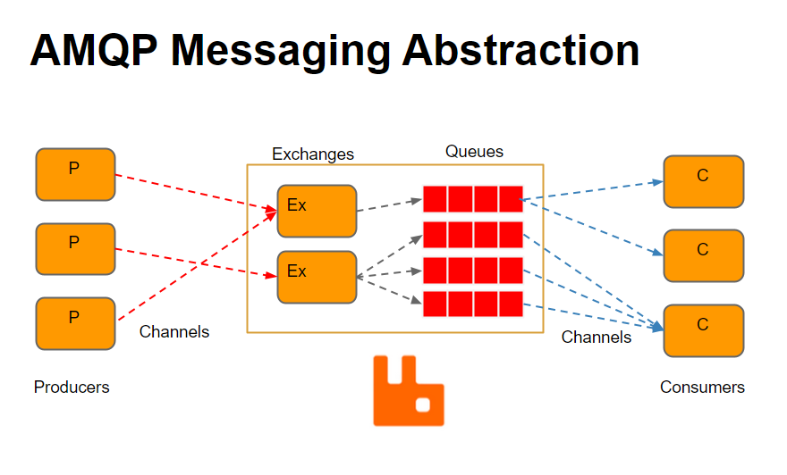

A picture is worth a thousand words

Slide 6

RabbitMQ
RabbitMQ is an open-source message-broker software that originally implemented the Advanced Message Queuing Protocol and has since been extended with a plug-in architecture.

Slide 7
Rabbit
Highly capable open source messaging server
Community and commercial support
Polyglot of client support
Scale up to meet your requirements
Support different integration / routing patterns

Slide 8
RabbitMQ High-Availability
RabbitMQ supports HA features
Built on top of clustering
Resources (exchanges, queues) are mirrored across nodes
Handling of automatic failovers

Slide 9
AMQP Message Model
Exchanges
Accepts messages from message-producing clients
Route messages to appropriate queues
Bindings
Decouples message routing from the producer
Rules for routing messages to the destination queue
Message Queues
Bound to an exchange
Buffers messages until consumed by client

Slide 10
AMQP Transport Model
Connection
A physical TCP connection between client and broker
A connection consists of many channels
Channel
A virtual conduit thread between your client/broker

Slide 11
exchange is used as a routing mediator, to receive messages from producers and push them to message queues according to rules provided by the RabbitMQ exchange type. -Exchanges support 3 routing strategies -Delivers messages based on algorithm -Allow for numerous routing scenarios.
Direct
Fanout
Topic

Slide 12
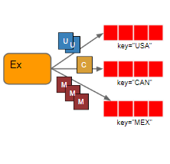
Direct
Simple strategy
Routed based on the binding key value in message
Message is delivered to the queue that matches the key value.

Slide 13
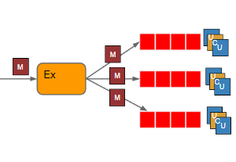
Fanout
Used to broadcast messages
All bounded queues receive same messages

Slide 14
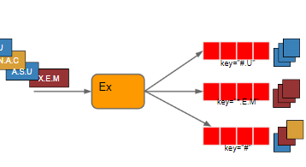
Topic
Routing based on binding key patterns
Messages can end up in one/more queues

Slide 15
Binding
bind method binds a queue to an exchange so that messages flow (subject to various criteria) from the exchange (the source) to the queue (the destination).

Slide 16
Message Queue
A message queue provides a lightweight buffer which temporarily stores messages, and endpoints that allow software components to connect to the queue in order to send and receive messages.

Slide 17
Channel and Connection
A connection is a TCP connection between your application and the RabbitMQ broker. A channel is a virtual connection inside a connection. In other words, a channel multiplexes a TCP connection.

Slide 18
RabbitMQ Implementation: Key Points
Leveraged Spring AMQP for seamless integration with RabbitMQ message broker.
Established Asynchronous Communication: Producers publish messages to designated queues, decoupling message delivery from processing.
Implemented Message Consumption: Consumers subscribe to queues, ensuring timely retrieval and processing of messages.

Slide 19
List of references
https://www.rabbitmq.com
https://docs.google.com/presentation/u/0/d/11Fim1w8MS_Du99VmCNvQbg8R7i1zD7u_DQK6n1DVWdA/htmlpresent?pli=1
https://en.wikipedia.org/wiki/RabbitMQ
Write your references here
Write your references here

Slide 20
Thanks
Do you have any questions?
Please keep this slide for attribution

