Slide 1
Hands-On Developing Microservice with gRPC using
ASP.Net Core 3.x,
Worker Service and EF Core 3.x
Viswanatha Swamy
LinkedIn: https://www.linkedin.com/in/viswanatha-swamy-b57326128/
Twitter: https://twitter.com/vishipayyallore
C# Corner: https://www.c-sharpcorner.com/members/vishipayyallore
C# Corner

Slide 2
Today’s Topics
What we will discuss and work today ….
Adding gRPC into existing ASP.Net Core 3.x Web API.
Enhancing the .proto file to return collection and Date Time data type.
Returning single and multiple rows from gRPC.
Creating Worker Service in .NET Core 3.x and gRPC Client to Worker Service.
C# Corner

Slide 3
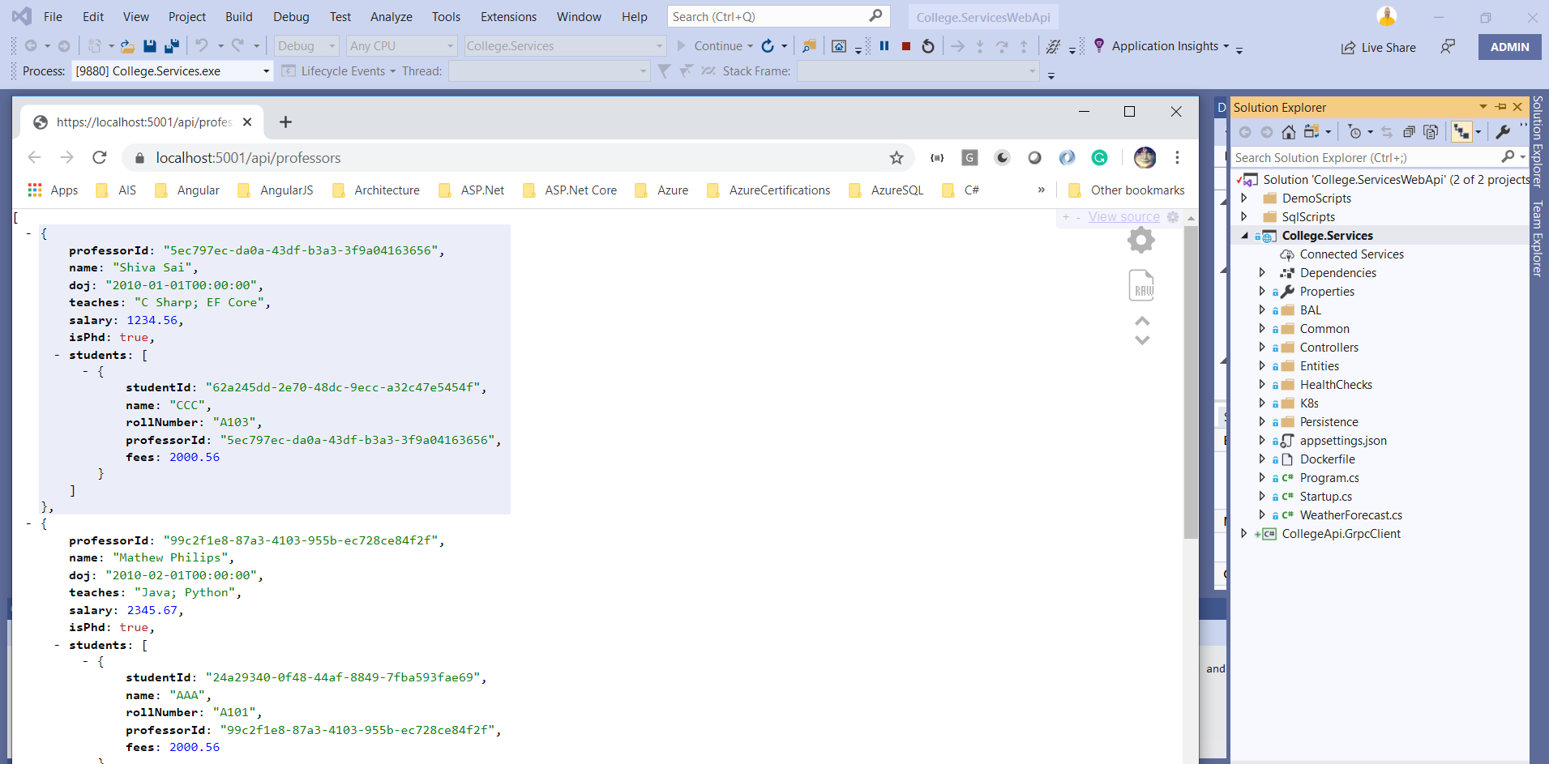
A Quick walk through of Existing ASP.Net Core Web API
C# Corner

Slide 4
Existing ASP.Net Core Web API
Demo 1
ASP.Net Core Web API
EF Core
SQL Server
C# Corner

Slide 5
Adding gRPC to existing ASP.Net Core Web API
Unary RPC: this is the simplest form of RPC. In this case, the client sends a request message to the server and receives a response.
Added “Grpc.AspNetCore” using Nuget .
Create the .proto file inside the Protos folder.
Compile the Project and View the Messages and gRPC Classes automatically created.
Implement the gRPC Service inside “RPCServices” folder.
Add gRPC to Services Container, and Http Request Pipeline in StartUp.cs.
Create a gRPC Client and test the gRPC service.
C# Corner

Slide 6
Demo 2
Adding gRPC to
existing APS.Net Core
C# Corner

Slide 7
Protocol Buffers
Protocol Buffers is an interface language used to build contracts.
Tools are available for the most common programming languages to translate these Protobuf interfaces into code.
Interface Definition Language | Language-neutral | Platform-neutral | Serializable
1. Version 3 (proto3)
proto2 and proto3. In C#, generated classes will be placed in a namespace matching the package name if csharp_namespace is not specified.
2. Defining A Message Type
message SimpleRequest {
string userName = 1;
int32 userId = 2;
}
The first line of the file specifies proto3 syntax: if you don't do this the protocol buffer compiler will assume proto2.
We are using scalar type for the fields.
Each field in the message definition has a unique number.
It is used to identify the fields in the message binary format, and should not be changed once your message type is in use.
We can define multiple message inside single .proto file.
Adding Comments // OR /* */
C# Corner

Slide 8
Protocol Buffers
3. Scalar Value Types
.proto type = C# Type
double = double
float = float
int32 = int
int64 = long
bool = bool
string = string
4. Default Values
strings = the default value is the empty string.
bools = the default value is false.
numeric = the default value is zero.
C# Corner

Slide 9
Demo 1
Simple gRPC Service
C# Corner

Slide 10
Create a gRPC service
Step 1
Dotnet Version Verification:
dotnet --list-sdks
dotnet --version
Step 2
mkdir first-grpcdemo
cd first-grpcdemo
dotnet new grpc -o GrpcGreeter
dotnet run and verify the URL in browser
Step 3
Verify the .csproj file
Verify the .cs files (Greet.cs, GreetGrpc.cs) auto generate GRPC tools
Verify the StartUp.cs
C# Corner

Slide 11
Create a gRPC Client
Step 1
dotnet new console -o GrpcGreeterClient
Step 2
<ItemGroup>
<PackageReference Include="Google.Protobuf" Version="3.11.1" />
<PackageReference Include="Grpc.Core" Version="2.25.0" />
<PackageReference Include="Grpc.Net.Client" Version="2.26.0-pre1" />
<PackageReference Include="Grpc.Tools" Version="2.26.0-pre1">
<PrivateAssets>all</PrivateAssets>
<IncludeAssets>runtime; build; native; contentfiles; analyzers; buildtransitive</IncludeAssets>
</PackageReference>
</ItemGroup>
<ItemGroup>
<Protobuf Include="Protos\greet.proto" GrpcServices="Client" />
</ItemGroup>
Step 3
using var channel = GrpcChannel.ForAddress("https://localhost:5001");
var client = new Greeter.GreeterClient(channel);
var reply = await client.SayHelloAsync(new HelloRequest { Name = "GreeterClient" });
Console.WriteLine("Greeting: " + reply.Message);
Console.WriteLine("Press any key to exit...");
Console.ReadKey();
C# Corner

Slide 12
Demo 2
gRPC with ASP.Net and EF Core
C# Corner

Slide 13
Demo 3
Adding to existing APS.Net Core
C# Corner

Slide 14
Q & A
C# Corner

Slide 15
Thank You
C# Corner

