Slide 1
2013.10.19
0xFFFF FFFF
0xFF00 0000
16MB
Virtual Memory Map
VMA영역 240MB
0xF000 0000
0xEF80 0000
Buffer 8MB
Kernel Code 영역
Low mem 영역
0xC000 8000
1st level page table
16kb
= 4bytes * 4096
파란색 상자가 4096개 존재
page table을 위한 영역
TTBR
0xC000 4000
1st level page table entry
0xC000 0000
16MB
Module 영역
0xBF00 0000
User 영역
0x0000 0000

Slide 2
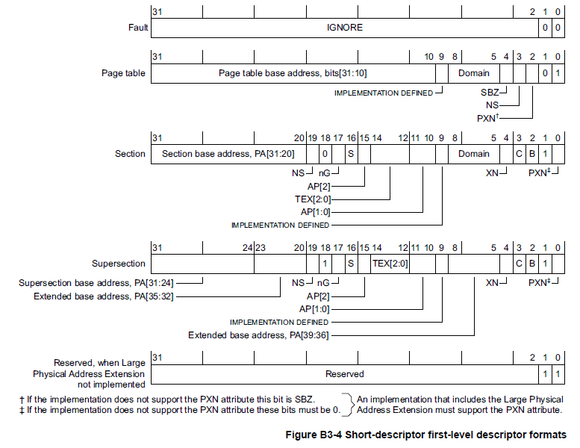
2013.10.19 "arch/arm/mm/mmu.c"
static pte_t * __init early_pte_alloc(pmd_t *pmd, unsigned long addr, unsigned long prot)
H/W page table 1
H/W page table 0
Linux page table 1
Linux page table 0
0xC000 8000
파란색 상자가 4096개 존재
page table을 위한 영역
= pgd 영역
1024개
Section
Section base addr | …options…
2nd level page table = 4kb
1st level page table
pgd = 16kb
= 4bytes * 4096
H/W page table 1
1024 bytes
Page table address(22bit) | options
H/W page table 0
1024 bytes
Page table address(22bit) | options
Linux page table 1
1024 bytes
3072개
Page Table
Linux page table 0
1024 bytes
TTBR 0xC000 4000
=init_mm.pgd
= swapper_pg_dir

Slide 3
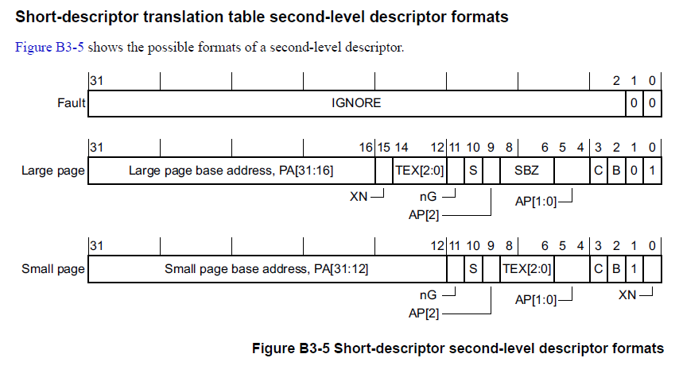
2013.10.19 "arch/arm/mm/mmu.c"
set_pte_ext(pte, pfn_pte(pfn, __pgprot(type->prot_pte)), 0);
H/W page table 1
1024 bytes = 1kb
0x???? ?C00
Page Table
H/W page table 0
Page table address(22bit) | options
Page table address(22bit) | options
Small page base addr | …..
0x???? ?800
Linux page table 1
0x???? ?400
Linux page table 0
Small page base addr | …..
0x???? ?000

Slide 4
2013.10.19 "arch/arm/mm/mmu.c“, “arch/arm/mm/proc-v7-2level.S”
set_pte_ext(pte, pfn_pte(pfn, __pgprot(type->prot_pte)), 0);
cpu_v7_set_pte_ext
Small page base addr, PA[31:12]
nG
S
AP[2]
1
TEX[2:0]
001
AP[1:0]
01
C
1
B
1
1
XN
0
r3
H/W page table 1
Read-only, only at PL1 or higher
Small Page
Outer and Inner Write-Back, Write-Allocate
H/W page table 0
*PL0, PL1, PL2.
PL0 : User (Application)
PL1 : Supervisor (Kernel)
PL2 : Hypervisor
Small page base addr | …..
Linux page table 1
Linux page table 0
L_PTE_MT_WRITEALLOC = 0111
SHARED USER DIRTY PRESENT (=VALID)
r0
Small page base addr | …..
http://www.joinc.co.kr/modules/moniwiki/wiki.php/Site/Embedded/Documents/LinuxKernelStudyForSystemenginer/arm.mmu.html 참고
r1
NONE RDONLY FILE YOUNG
Small page base addr, PA[31:12]
0
0
XN
0
0
0
1
Memory
Type [2:5]
0111
1
1

Slide 5
2013.10.19 "arch/arm/kernel/traps.c"
void __init early_trap_init(void *vectors_base)
http://venkateshabbarapu.blogspot.kr/2012/09/interrupt-handling-in-arm.html

Slide 6
