Slide 1

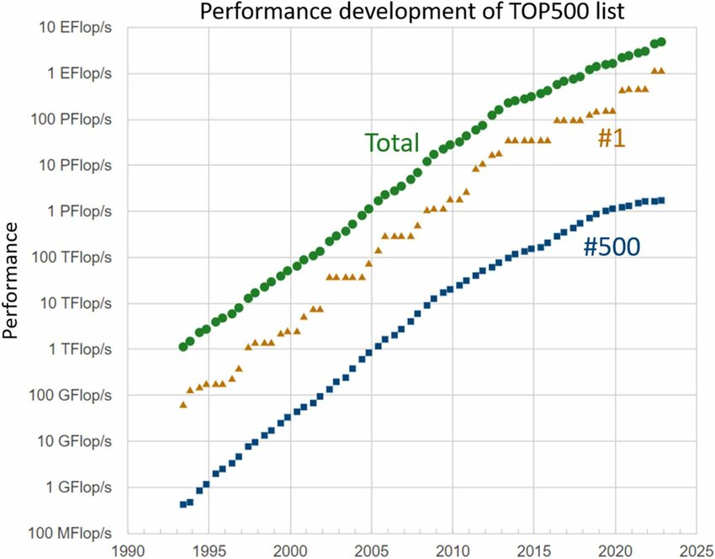
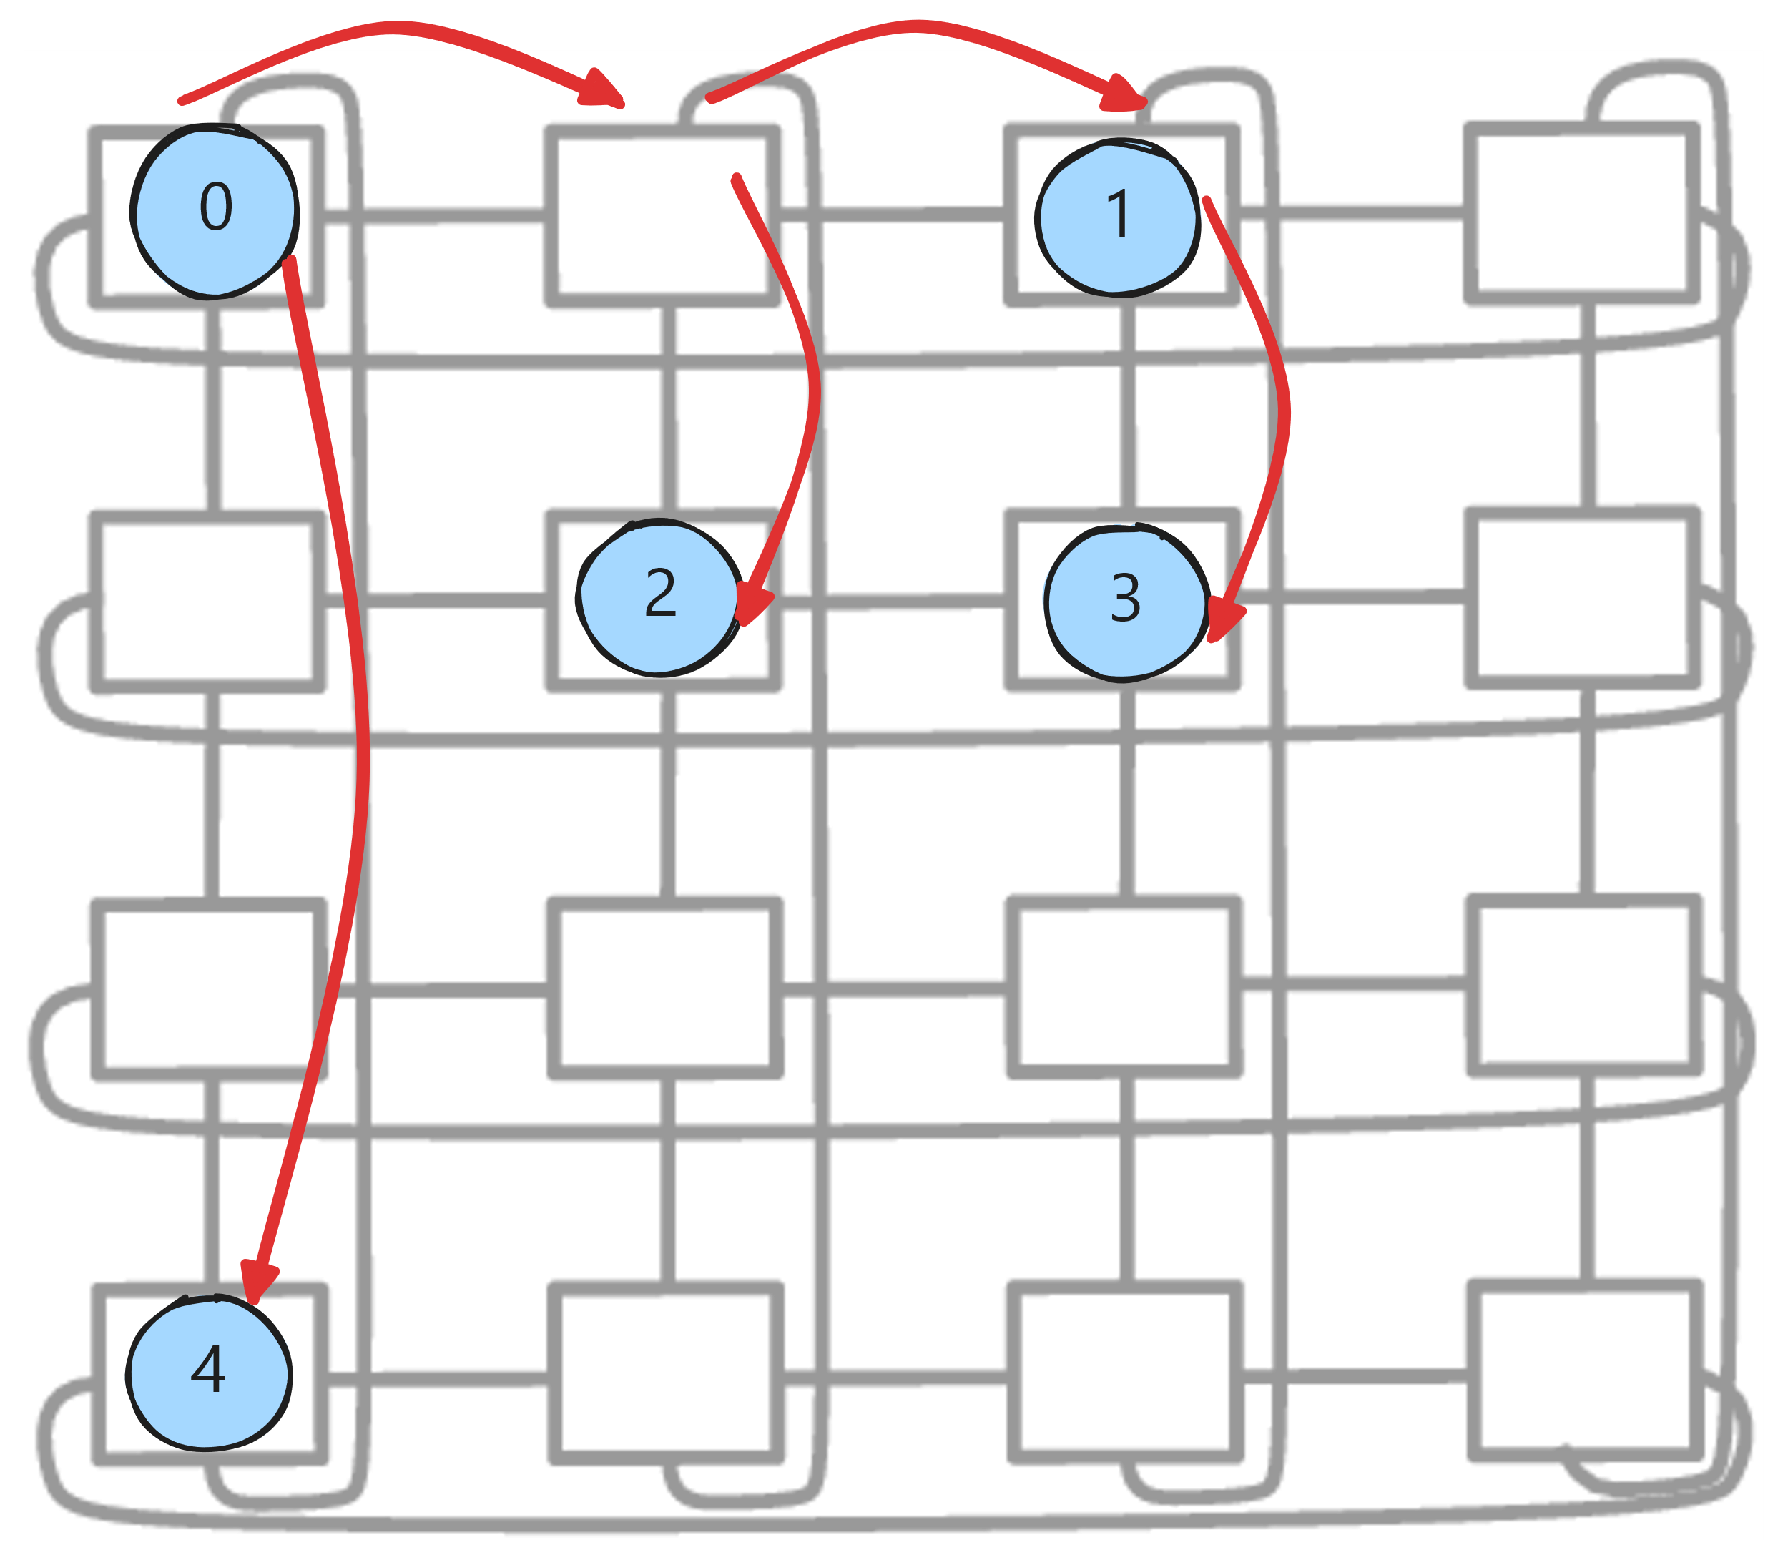
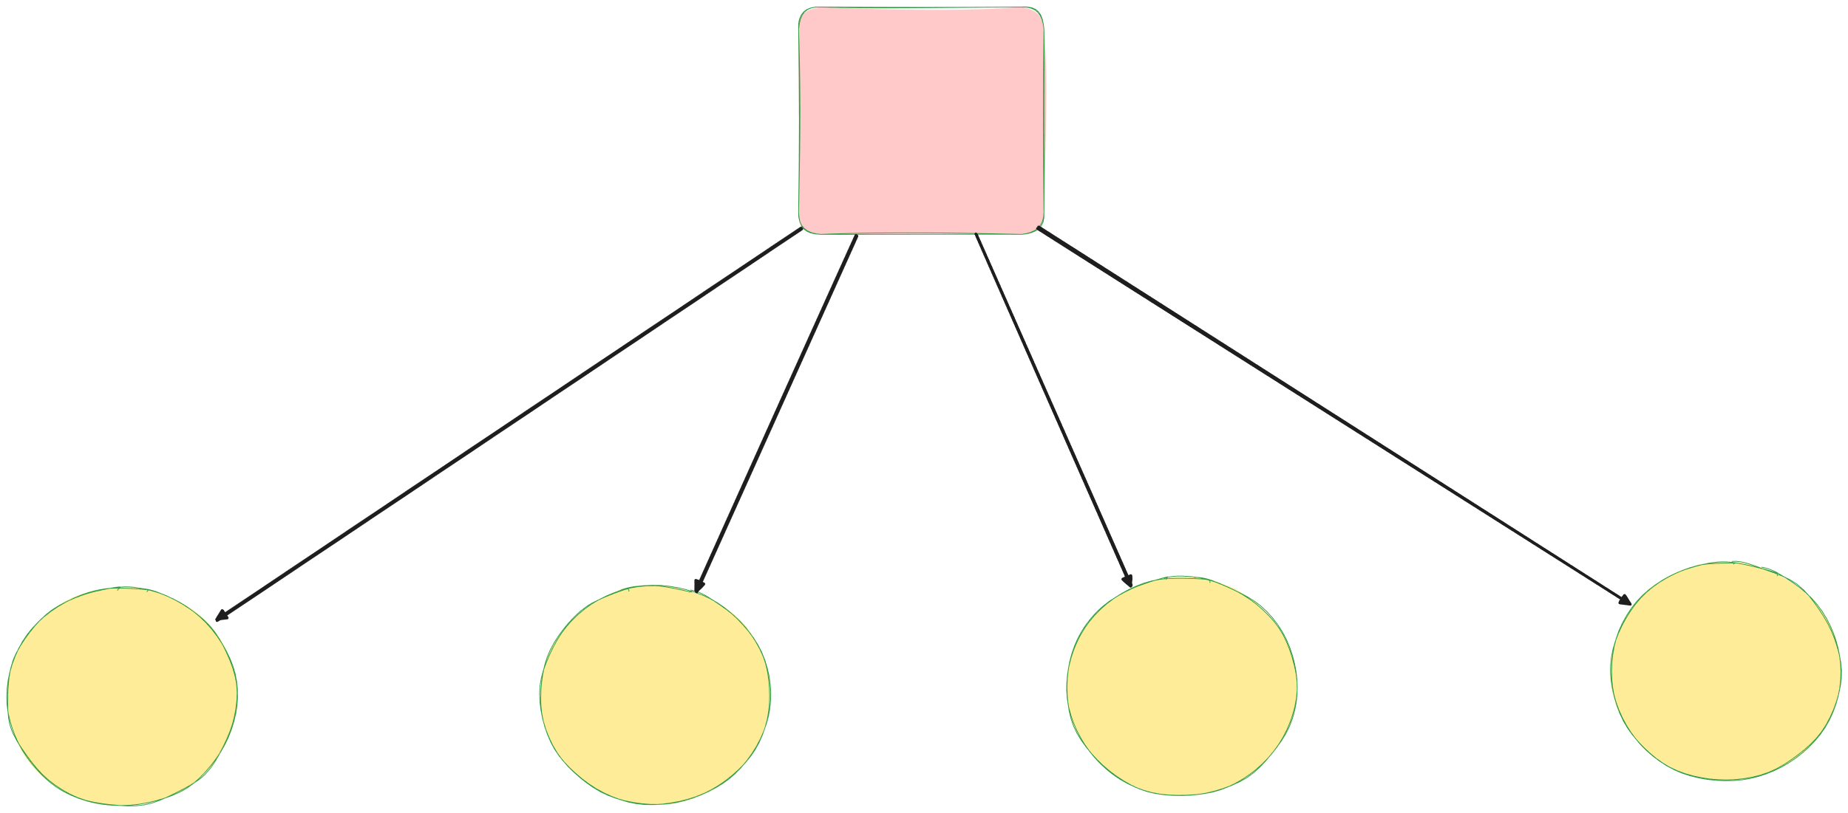

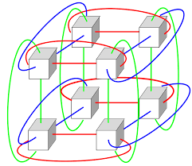
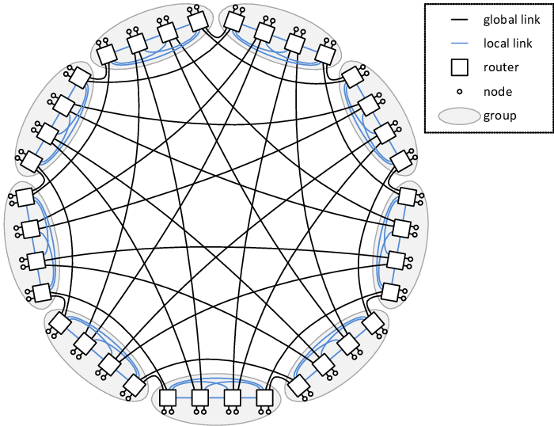

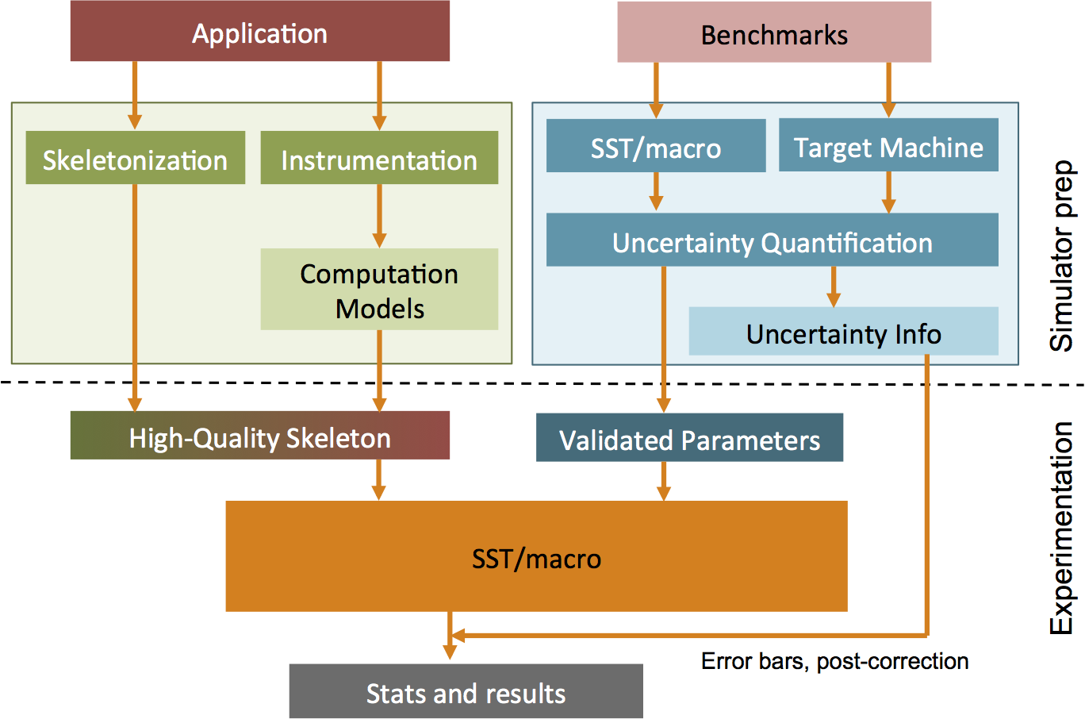

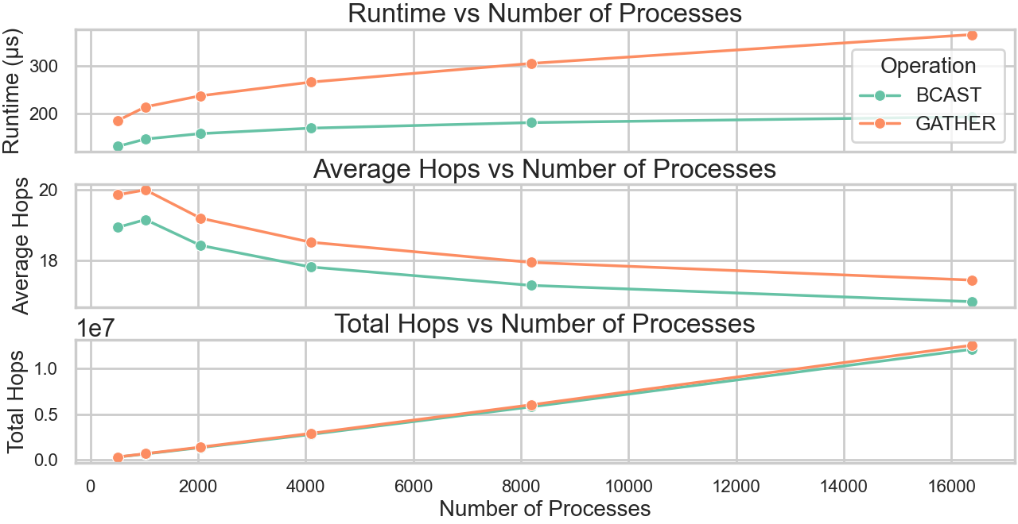
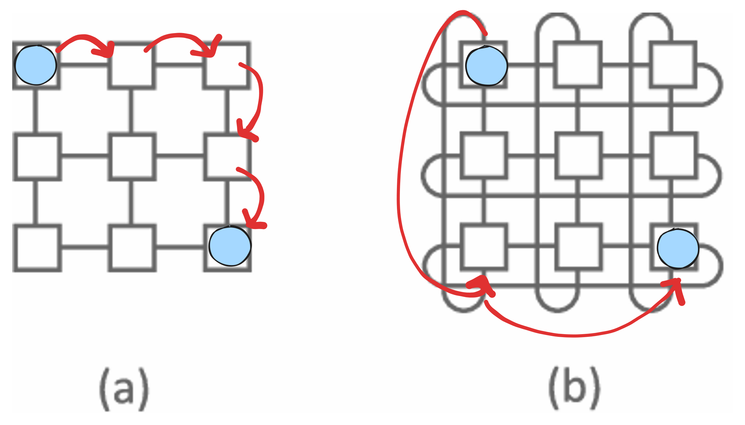
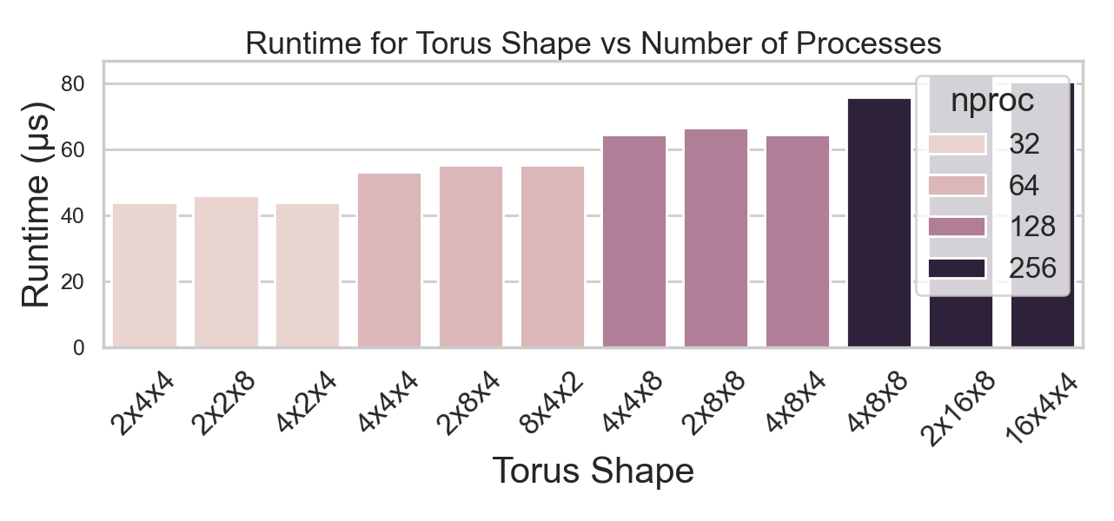
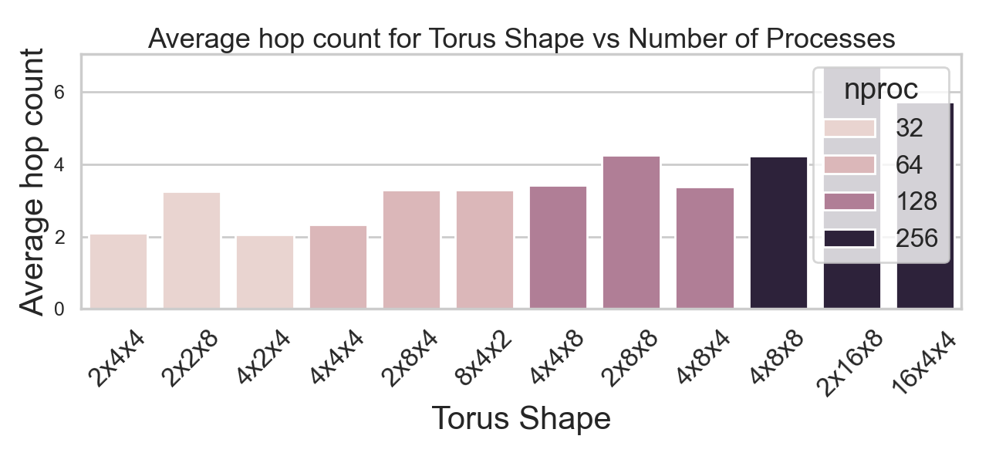
Modeling Network Behaviour and Interference in HPC Networks at Scale
Performance of supercomputers in the TOP500 list between 1992 and 2023. The lines represent the cumulative performance of all 500 systems (green), the #1 ranked system (brown), and the #500 system (blue).
Reproduced with permission from TOP500.org ©1993–2023. Source: TOP500.org.
Maitreyee Sar, under the mentorship of Dr Preeti Malakar
Department of Computer Science and Engineering
SURGE 2025
Problem Statement
Example: MPI_bcast
One-to-many, process with rank root (0) sends a message to all other processes of the group.
As supercomputers scale up to support modern workloads, their underlying networks experience increasing communication and I/O demands, leading to potential performance bottlenecks. This study uses simulation to analyze how different network topologies and communication patterns affect performance.
#include<mpi.h>
#include<iostream>
#include<stddef.h>
int main(int argc, char** argv) {
MPI_Init(&argc, &argv);
…
MPI_Bcast(send_buf, nelems, MPI_INT,0, MPI_COMM_WORLD);
…
MPI_Finalize();
}
data
0
data
data
data
data
Conclusion and Future Work
4
3
2
1
SST/macro enables scalable, controlled interconnect simulations.
Performance depends on topology, placement, and communication patterns.
Future work: custom topologies and focus on routing to study specific impact.
A 4x4 2-D Torus network to explain “hops” between endpoints for a broadcast operation
(2 hops to 1, 2 hops to 2, 3 hops to 3, 1 hop to 4)
Interconnect Design and Performance
Structural Simulation Toolkit (SST)/macro and Simulation Results
SST/macro package allows simulation of full scale machines using a coarse-grained simulation approach.
MPI-C code
sst++ compiler
sstmac Executable
2x2x2 3-D Torus
Dragonfly with 36 routers and 72 compute nodes
Statistical output
Topology affects key performance factors like latency and congestion, which can be estimated through hop counts.
More hop counts = Higher latency = Slow communication + probable data loss
include small_torus.ini
node { app1 {
launch_cmd = aprun -n 32 -N 1
exe=./run }
Parameter file
Workflow of SST/macro
(Source: SST/macro User’s Manual
Performance v/s number of processes (512 to 16384) running MPI_BCAST (blue) or MPI_GATHER (orange) on a 32x32x16 3-D Torus network
Rodrigues, Arun F., et al. "The structural simulation toolkit." ACM SIGMETRICS Performance Evaluation Review 38.4 (2011): 37-42.
SST/macro 15.0 User’s Manual https://github.com/sstsimulator/sst-macro/blob/master/docs/manual/manual.md
Increase in #processes shows increase in runtime and total hop count, but average hop count decreases
Runtime and average hop counts of BCAST for different 3D torus configurations with fixed process counts
References
I extend my sincere gratitude to my faculty mentor, Dr. Preeti Malakar, for her invaluable guidance and support throughout this program. I also thank the Office of Outreach Activities, IIT Kanpur, for granting me this prestigious opportunity through SURGE 2025.
Performance improvement of 3x3 Torus (b) over 3x3 Mesh (a) (lower hops = less latency = faster communication)
Acknowledgements

