Slide 1
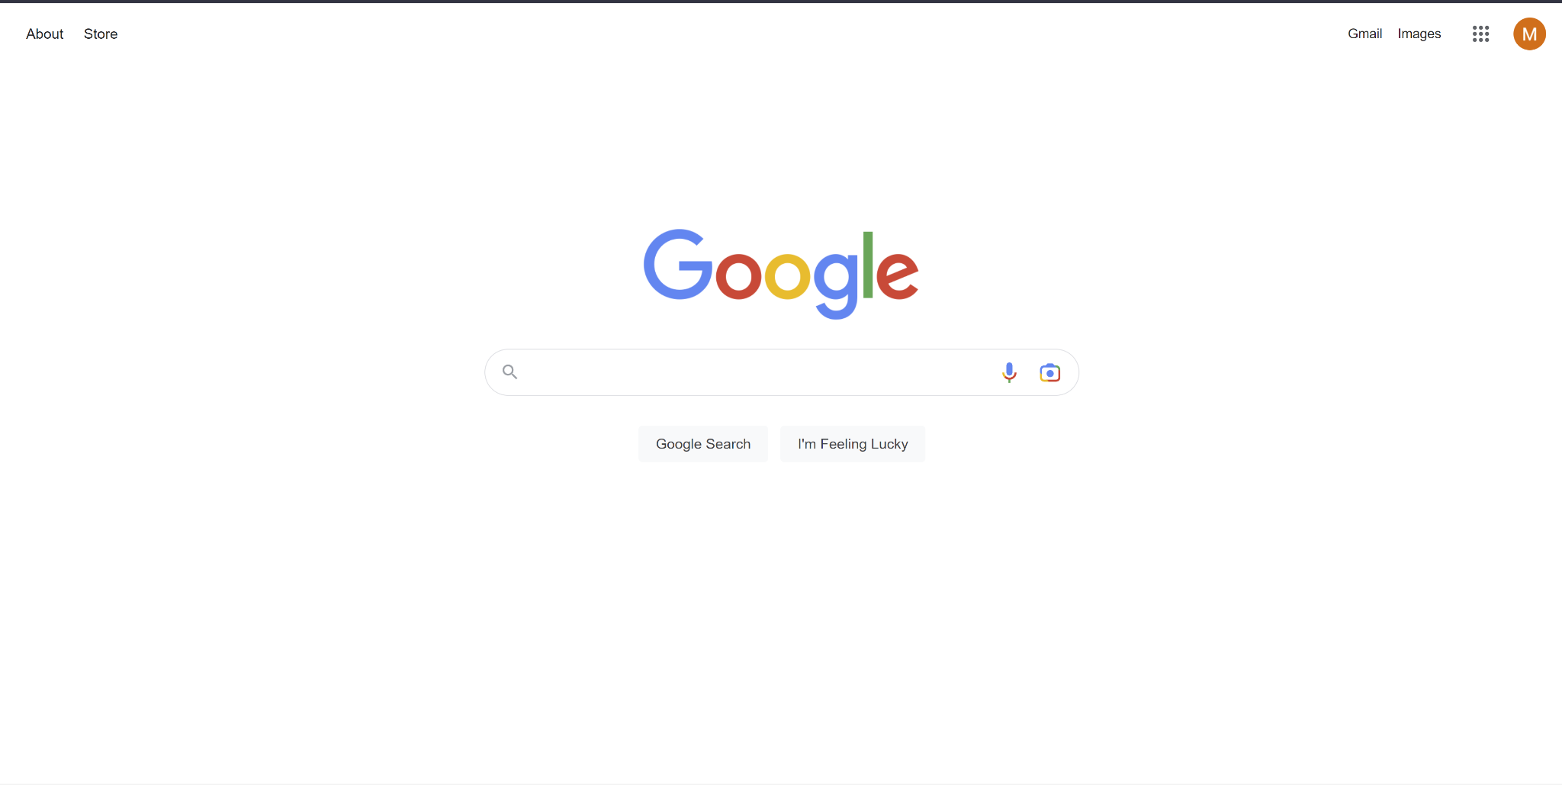

Search
Search
CMPE 297
Presented By:
Maitreyi Kunnavakkam Vinjmur- 016007082
Palak Agarwal - 016696511
Riya Uchagaonkar - 016677609

Slide 2
Problem
How do you search for a word
Make it faster
Indexing methods
Compare the time and performance between the methods

Slide 3
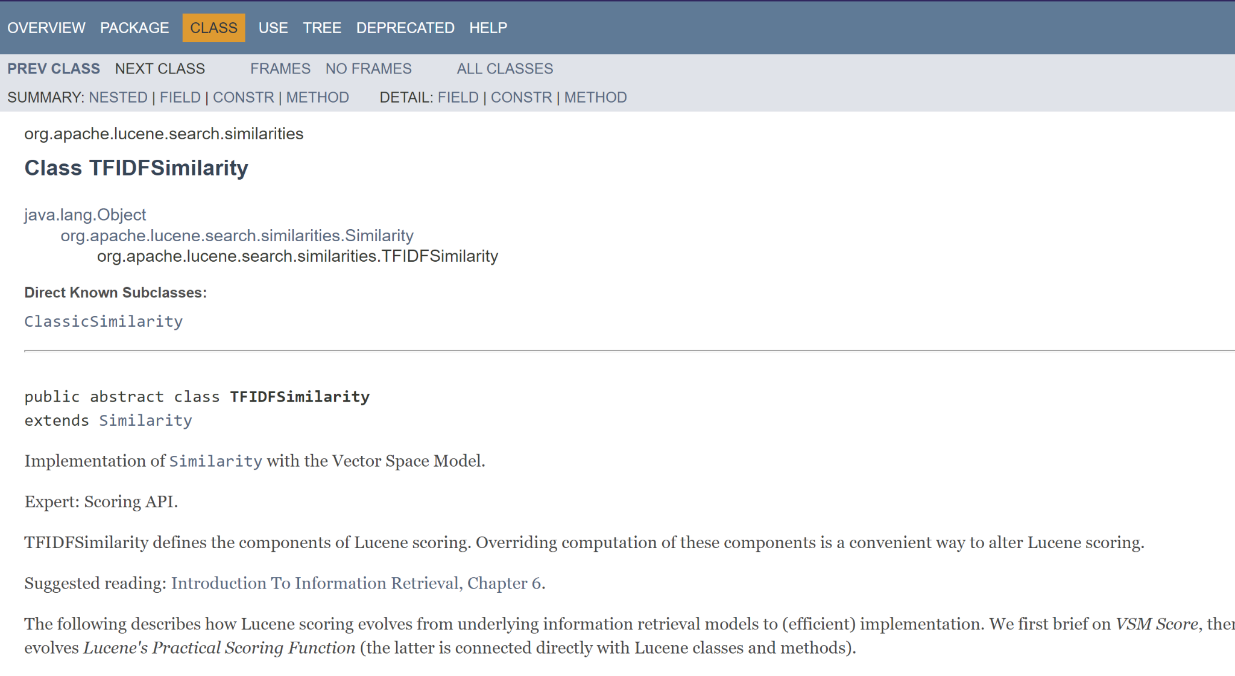
Apache Lucene

Slide 4
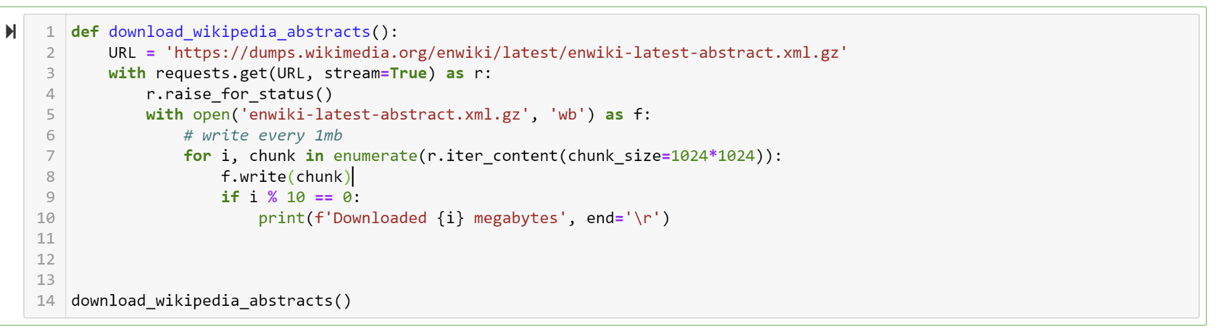
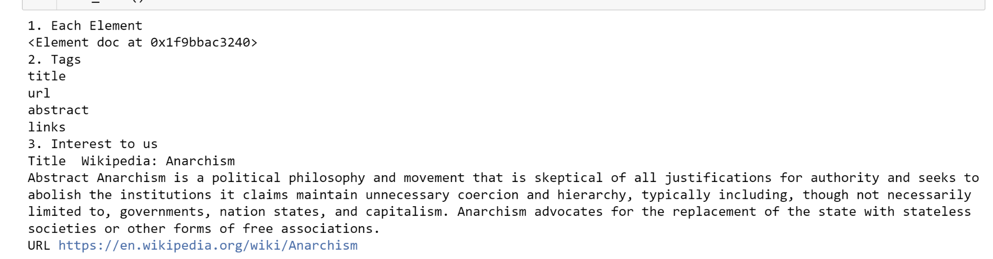
Dataset
Size: 800 MB
Docs: 6,000,000 Abstracts

Slide 5
Baseline Methods
Code Walkthrough

Slide 6
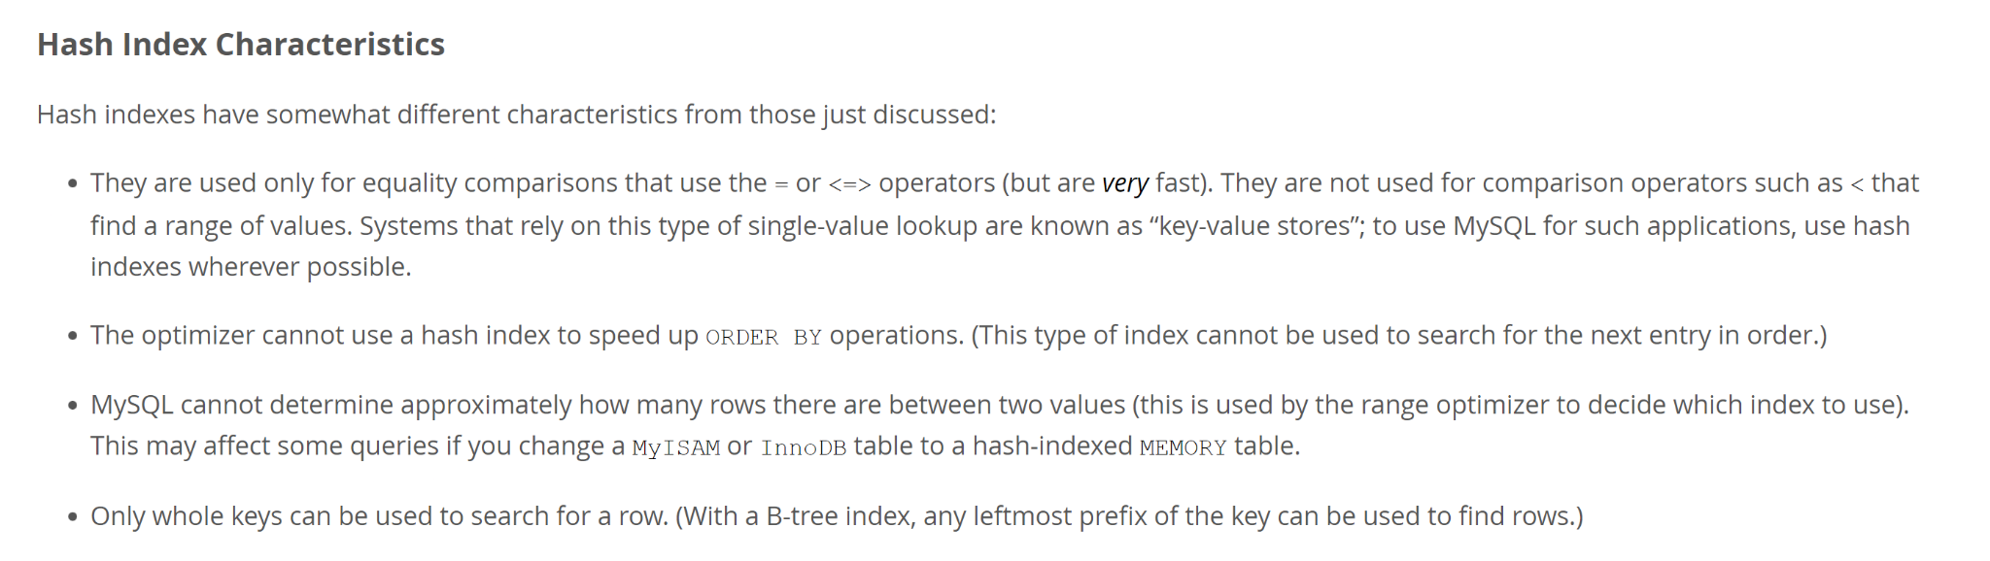
MySql and Hash Indexes

Slide 7
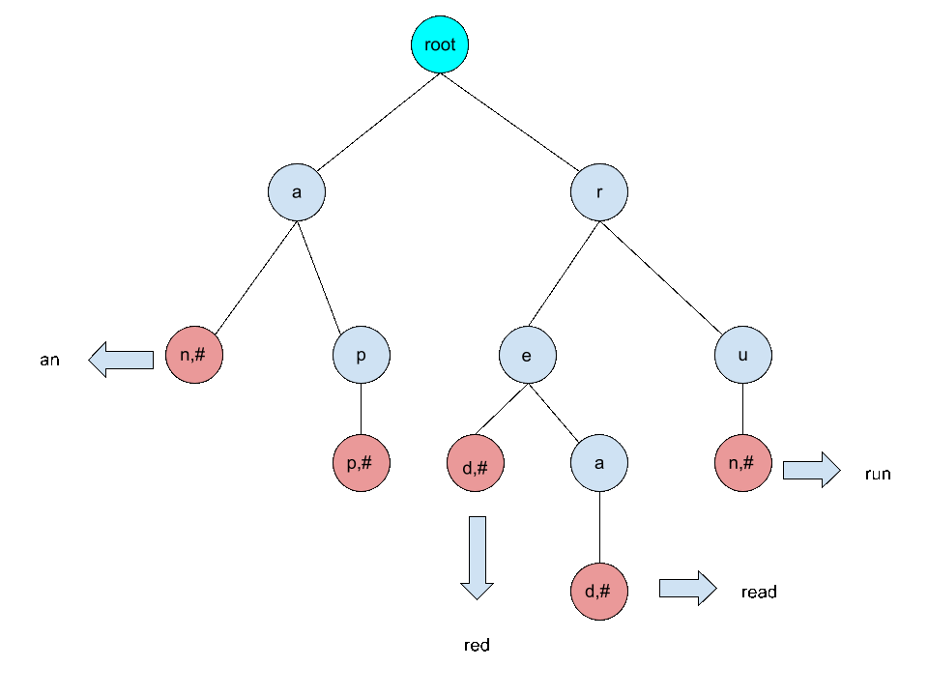
Explored: Trie

Slide 8
Results
 | Iterative | Hash | Binary Tree
Time to Index | - | 367.40 s
Size of index | - | # Indexes - 13213410 Size: 671.08 MB | Storing as a list and using Bisect utility
Time to search a key (Top 5) | Word: San Jose Docs searched 50612 Time taken 2.710167646408081 Word: not present Time: 205.93 s | 0 - 0.002s | 0.04686s

Slide 9
Solution : TF-IDF Approach
Following steps are followed for TF-IDF approach:
Step 1: Preparing data
Data contains title, url and abstract
Adding doc id to the data

Slide 10
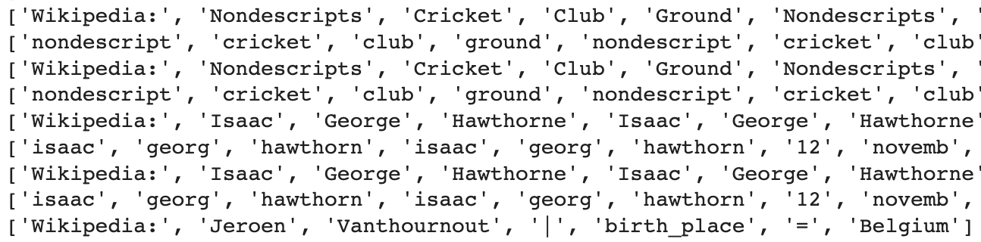
Step 2 : Tokenizing and formatting the data
First we create tokens from the data - separate each word in data
Lowercase all the tokens
Remove the punctuations
Remove all the stop words - stop words are words that occur in all the documents and won’t contribute much while we search
Lastly stemming is used to match different words to the root word

Slide 11
Step 3 : Indexing
Create a dictionary
keys are tokens and values are document ID
Step 4 : To improve relevency
Until step 3 the documents returned may not necessarily be relevant
To improve relevance document score is calculated
For a given query, document score is how often the document mentions that word
Step 5 : Term Frequency
Count the frequency of each word
This is used to rank the documents to give relevant output

Slide 12
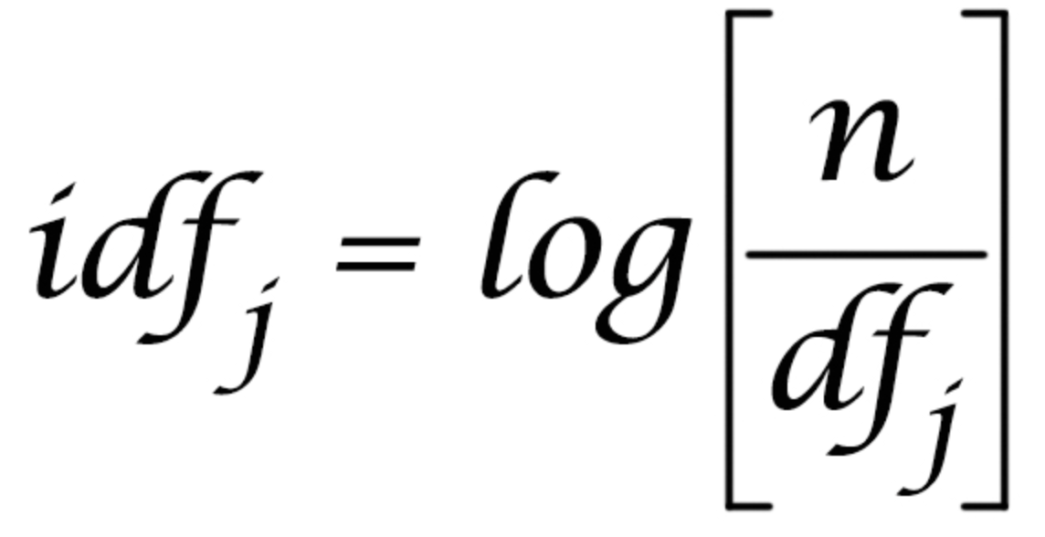
Step 6 : Inverse Document Frequency
Some terms are repeated often in document but don’t contribute much in relevance
Eg. A collection about ‘cake’ will have the word cake repeated in documents multiple times. Searching this will retrieve all documents
To address this inverse document frequency is used
IDF is calculated by dividing the number of documents in the index (n) by the number of documents that contain the term and taking logarithm of it

Slide 13
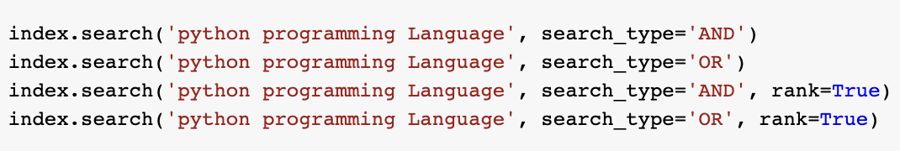
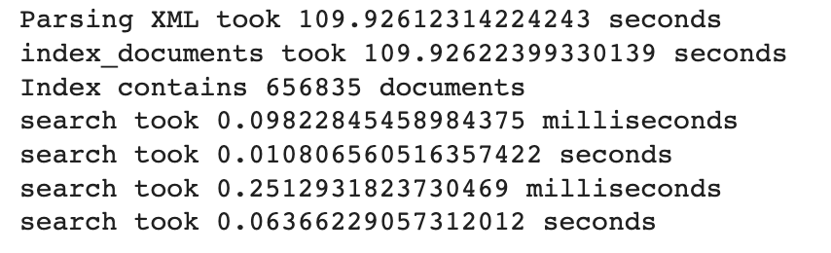
Step 7: Searching
Two types of searching one retrieving documents containing all tokens from query
Second retrieving documents containing one of the tokens from query

Slide 14
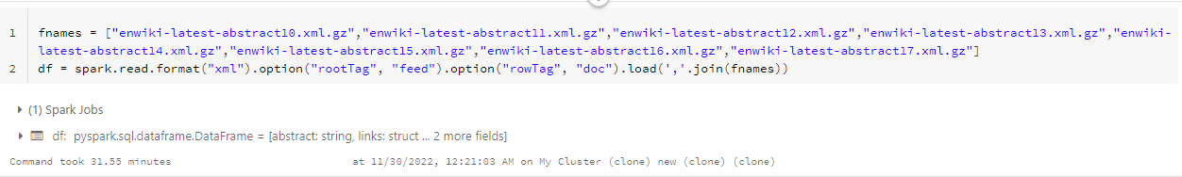
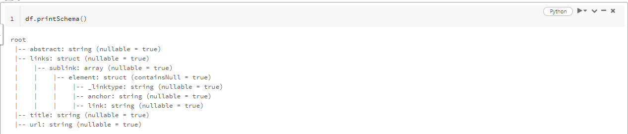
Solution : Accelerate on Spark
Requirements:https://mvnrepository.com/artifact/com.databricks/spark-xml_2.10/0.2.0 - Download jar file from this link and add this to the cluster
Load data to df in pyspark

Slide 15
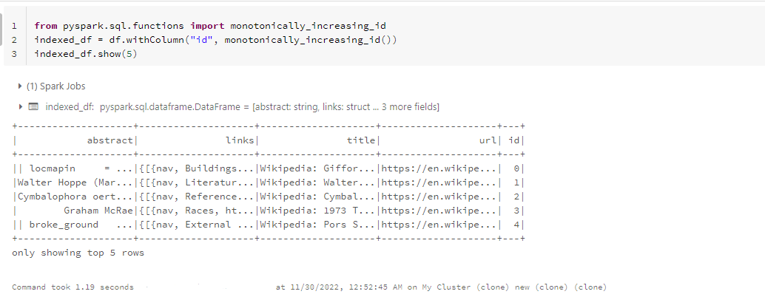
Adding the id column to df

Slide 16
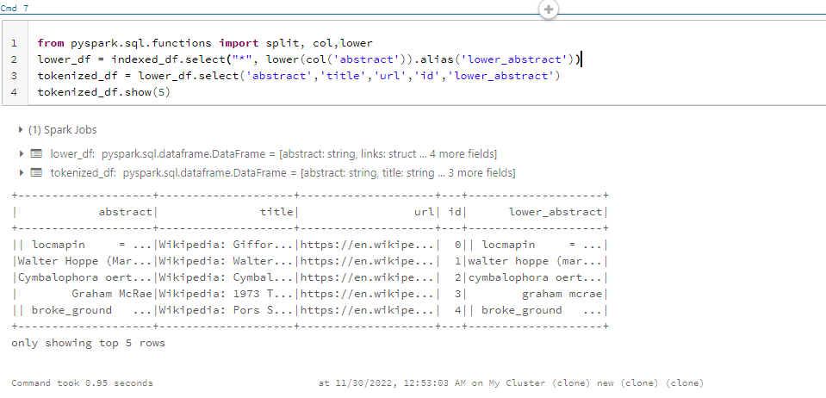
Pre-processing

Slide 17
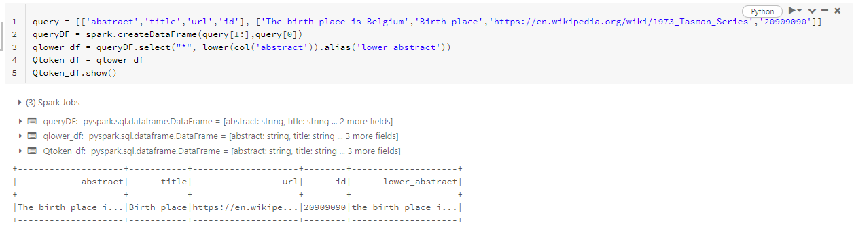
Query document to df
Tokenization is the process of taking text (such as a sentence) and breaking it into individual terms (usually words)
Stages:
RegexTokenizer - allows advanced tokenization based on regular expression (regex) matching. By default, the parameter “pattern” (regex, default: "\\s+") is used as delimiters to split the input text.
StopWordsRemover - Common (English) words that do not contribute much to the content or meaning of a document (e.g., "the", "a", "is", "to", etc.). Stopwords add noise to bag-of-words comparisons, so they are usually excluded.
CountVectorizer - Extracts a vocabulary from document collections
IDF - This implementation supports filtering out terms which do not appear in a minimum number of documents

Slide 18
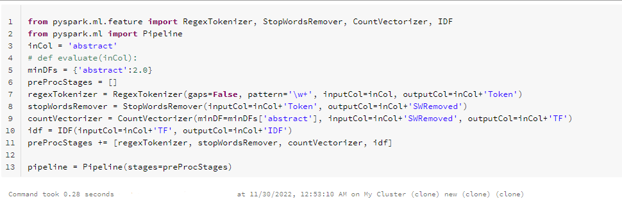
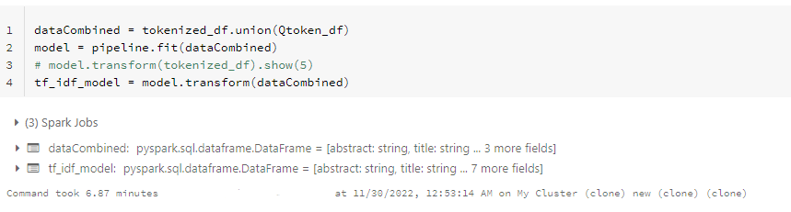

Slide 19
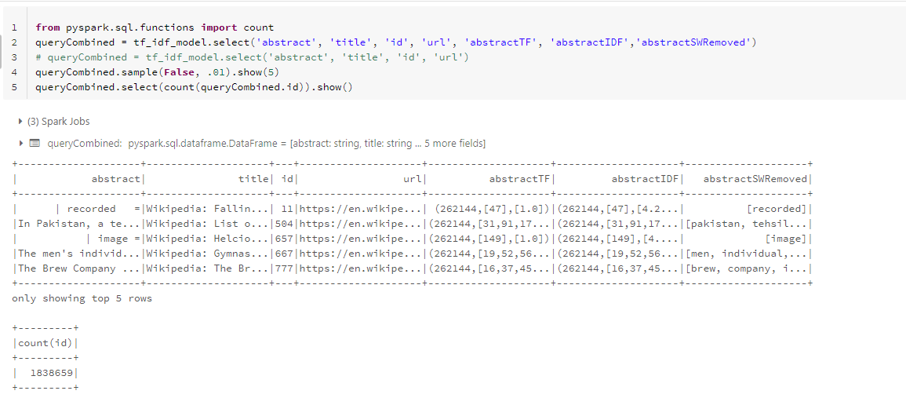

Slide 20
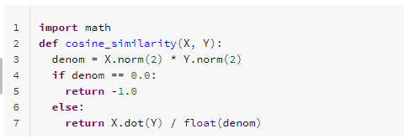

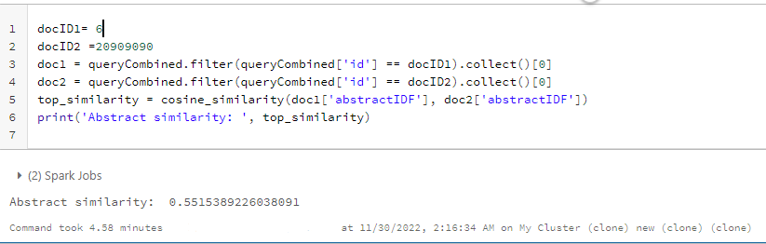
Text Similarity - Each document is considered as a vector in some high dimensional space. Then, to compare two documents we compute the cosine of the angle between their two document vectors.
The angle between two document vectors is small if they share many tokens in common, because they are pointing in roughly the same direction. For that case, the cosine of the angle will be large. Otherwise, if the angle is large (and they have few words in common), the cosine is small. Therefore, cosine similarity scales proportionally with our intuitive sense of similarity.

Slide 21
Results
 | Iterative | Hash | Binary Tree | Tfidf | Spark
Time to Index | - | 367.40 s |  | 109.92 sec | 6.87 m
Size of index | - | # Indexes - 13213410 Size: 671.08 MB | Storing as a list and using Bisect utility
Time to search a key | Word: San Jose Docs searched 50612 Time taken 2.710167646408081 Word: not present Time: 205.93 s | 0 - 0.002s | 0.04686s | Docs searched - 656835 index_documents took 109.926 sec | Docs Searched - 1838659 Tokens searched - 262144 Time taken - 4.28 minutes

Slide 22
Lesson Learnt and Conclusion
So, we can conclude that the efficiency increase as we moved to indexing.
As we increase the number of nodes for our cluster, the data can be increasingly read in parallel and the time can be further reduced. For reading 1 file of data to reading more files, the time do not increase proportionally
The limitation of 15.3 GB memory with only 2 cores for the cluster led to extra time of processing in pyspark.

Slide 23
Thank You

