Slide 1
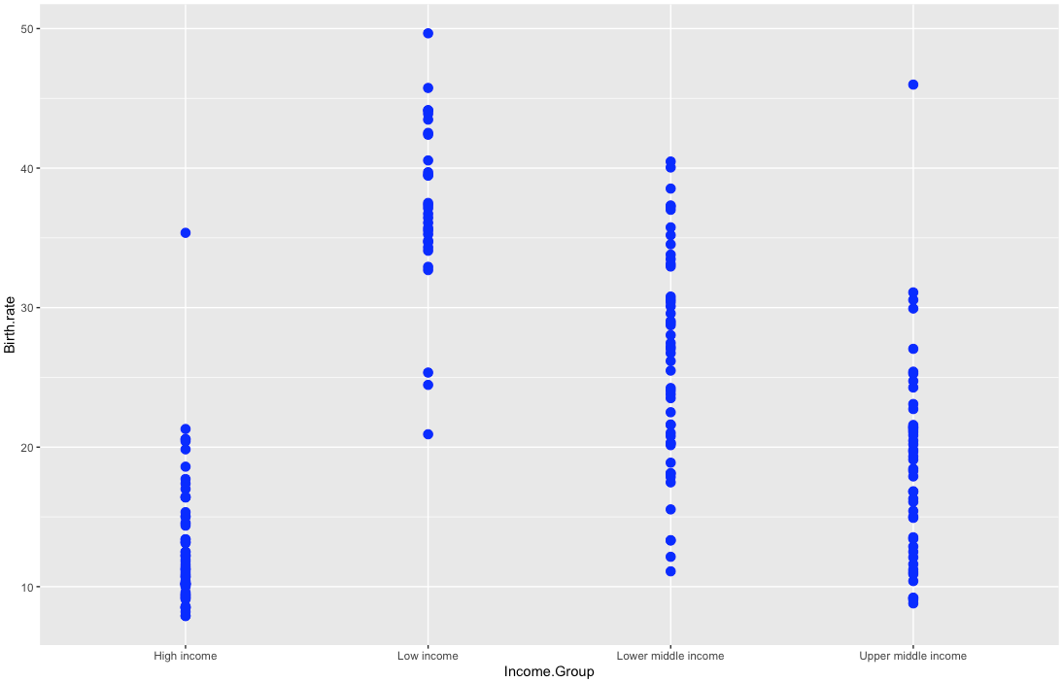
Birth rate vs. income groups

Slide 2
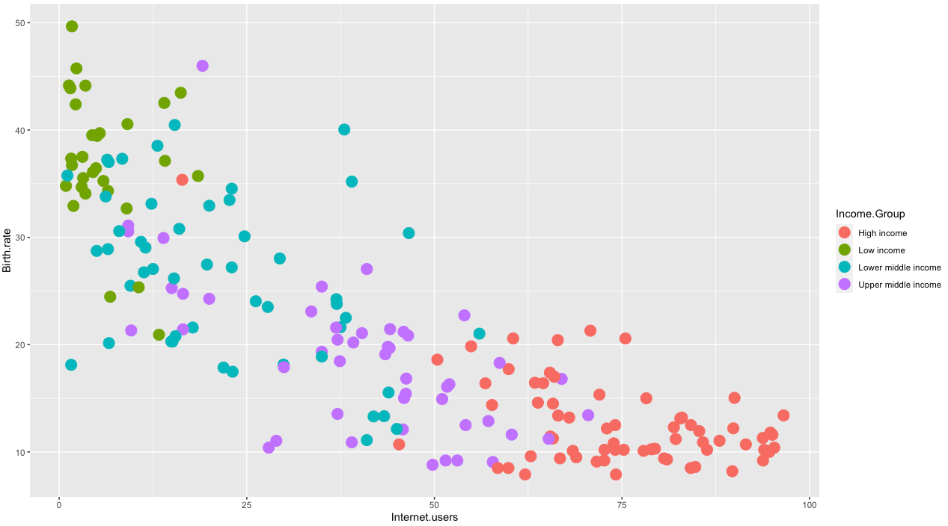
Birth rate vs. Internet Users (Income Groups)

Slide 3
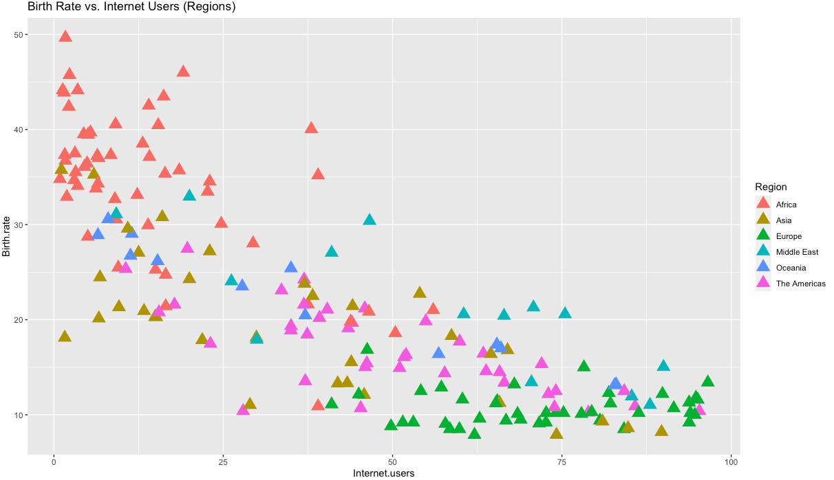
Birth rate vs. Internet Users vs. Regions

Slide 4
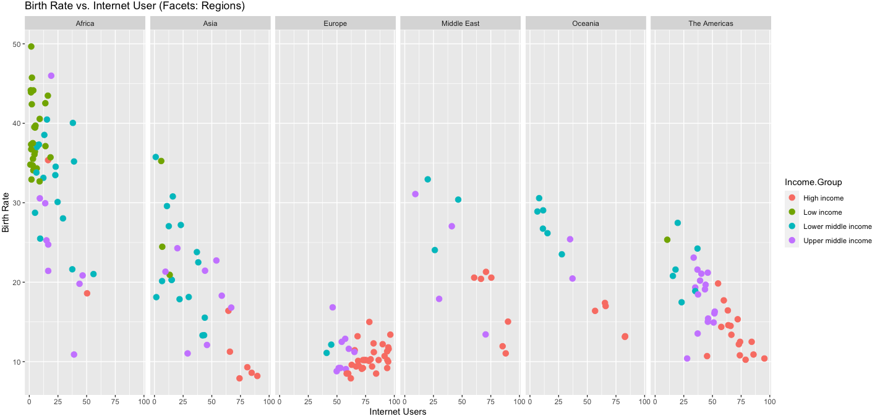
Birth rate vs. Internet Users (Facets: Regions)

Slide 5
Data Set:
Demo Graphic information
Dataset 1: countries, birth rate, internet user, income groups and
Dataset 2: countries region
Exploring the data:
Exploring various aspects of dataset using R functions like structure, summary, nrow, ncol, etc.
EDA:
Chats/Graphs
internet users vs. income group
Conclusion: Low-income group have more birth rate than any other income group
Birth rate vs. internet users
Conclusion: High-income have less birth rate, more users and Low-come have more birth rate and less users
Birth rate vs. internet users and countries region
Conclusion: Analyzed the data set by merging Regional information to dataset.
Region wise Europe shows low birth rate and more users
Methodologies
Data pre-processing
Exploratory analysis
Dimensionality reduction
Charts / Graphs
ML Modeling

Slide 6
ML Modeling & Performance
Models explored
Linear Regression
Decision Tree
Random Forest
Dataset columns used
Dependent variable = Internet.Users
Independent variable = Income.Group + Region
Performance based on RMSE (Root Mean Squared Error)
L.R = 38.47
D.F = 17.71
R.F = 14.11
So, Better model is Random Forest for this Dataset

Slide 7
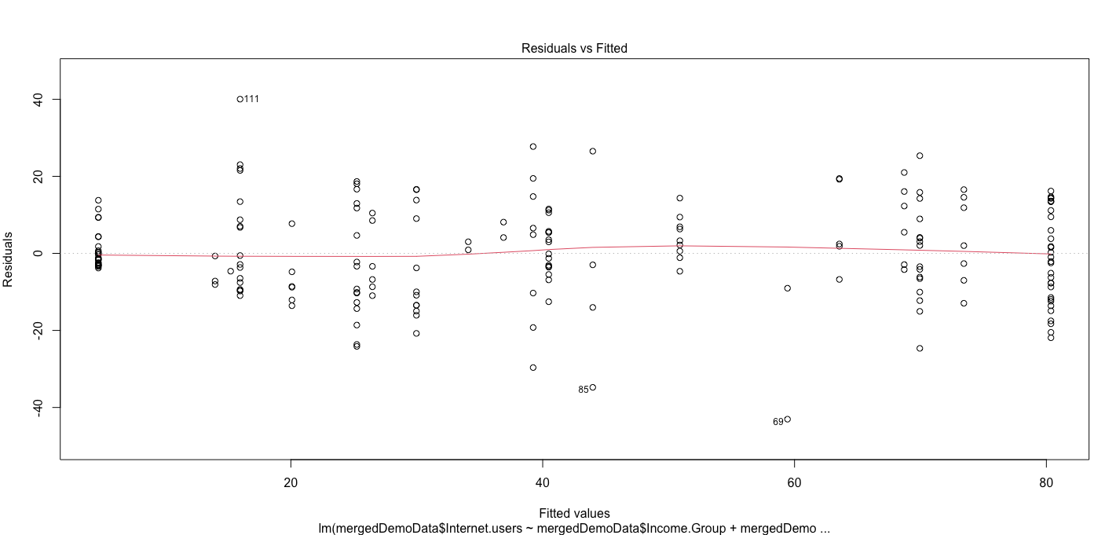

Slide 8
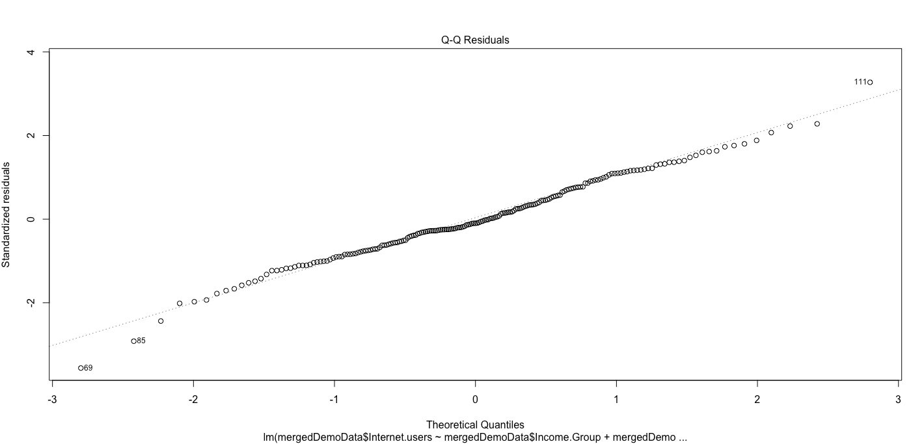

Slide 9
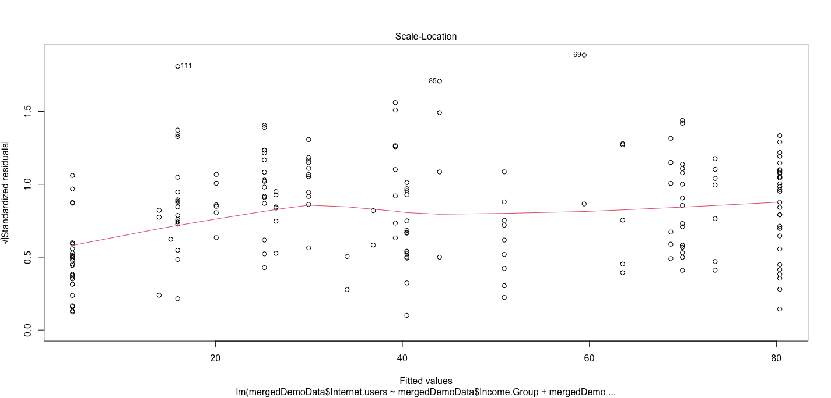

Slide 10
