Slide 1
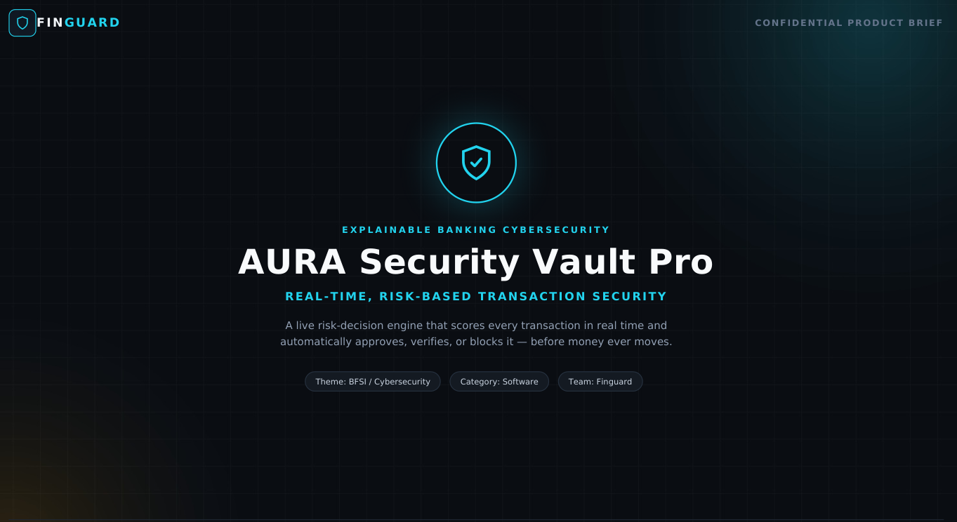

Slide 2
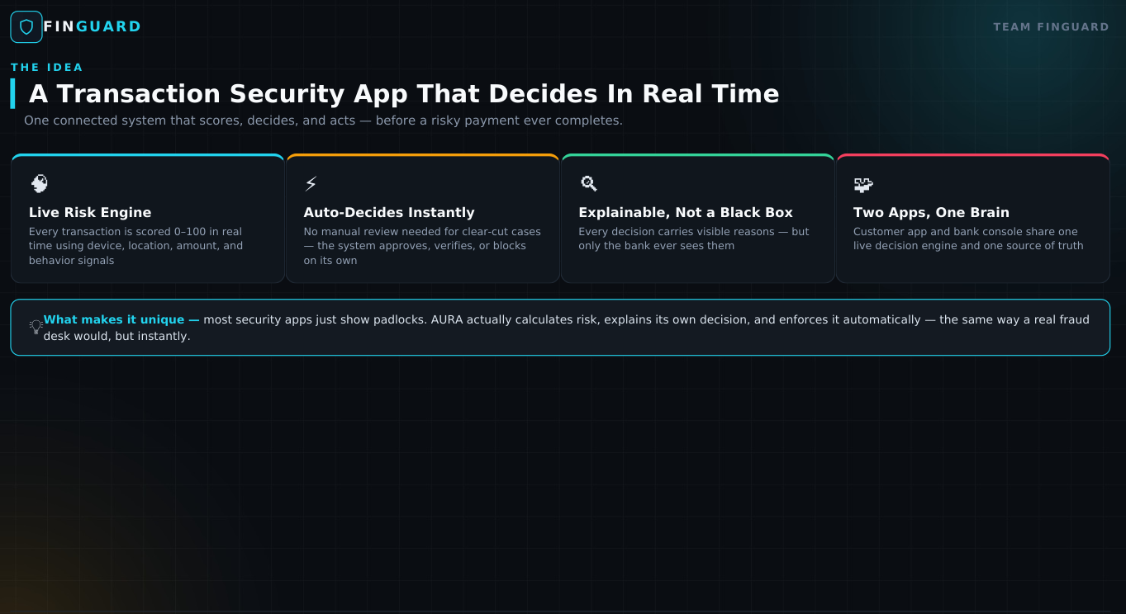

Slide 3
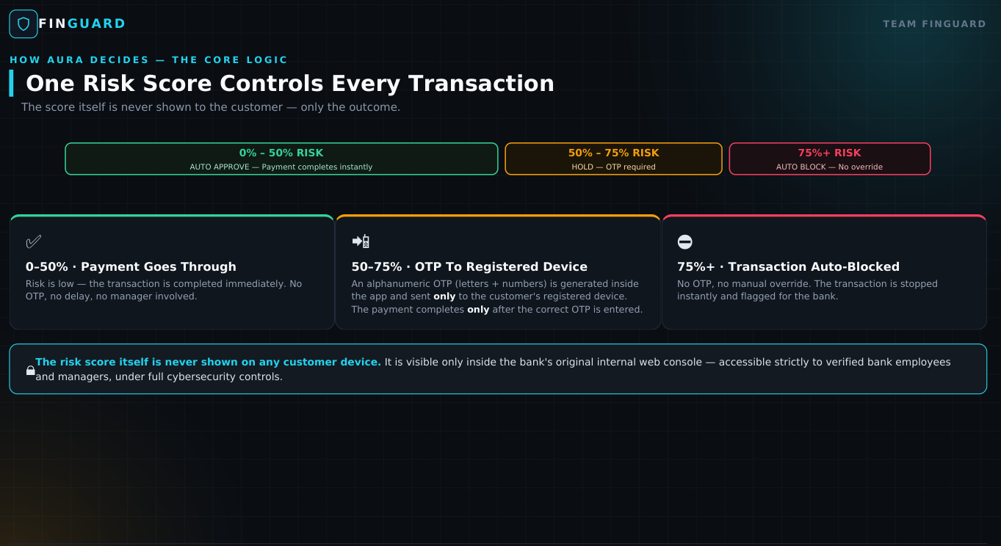

Slide 4
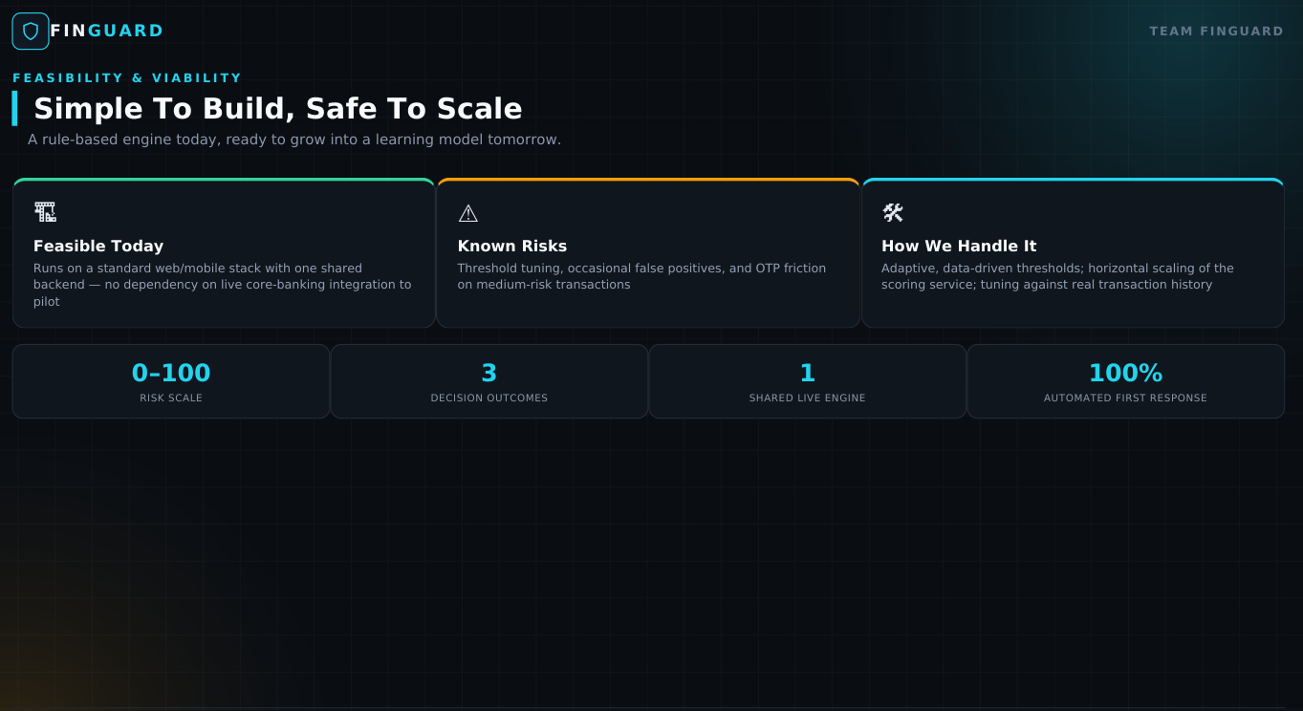

Slide 5
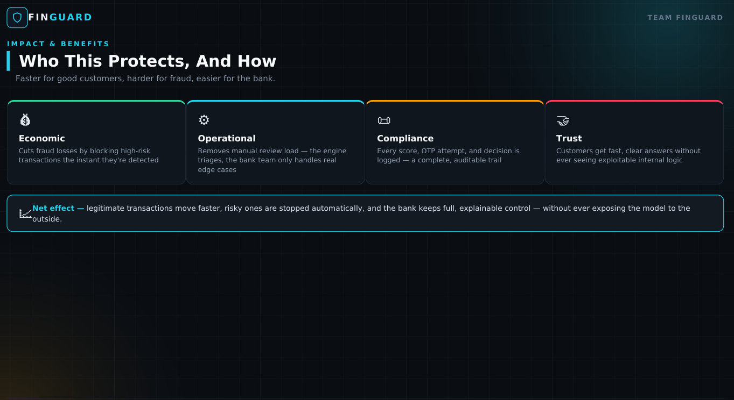

Slide 6
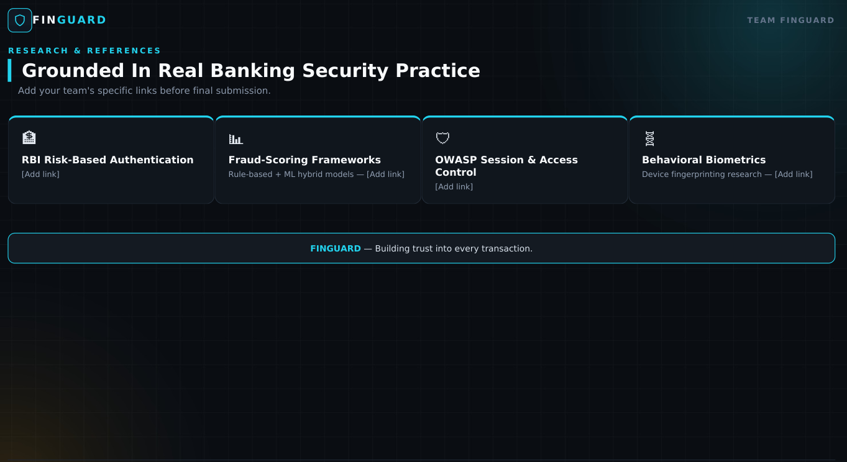

Slide 7
WHY AURA IS DIFFERENT
Not just fraud detection — real-time, explainable transaction decisions.
01 DETECT → DECIDE
AURA doesn't only flag suspicious activity. It automatically chooses APPROVE, VERIFY or BLOCK before money moves.
02 ONE SECURITY BRAIN
Customer app + bank/manager console share one live risk engine and one source of truth.
03 EXPLAINABLE RISK

Slide 8
HOW AURA WORKS — AND WHY IT MATTERS
Transaction → Signals → Risk Score → Decision → Action → Audit History
TRANSACTION
RISK SIGNALS
0–100 SCORE
DECISION
ACTION
TRANSACTION
0–100 SCORE
RISK SIGNALS
DECISION
ACTION
Decision logic

