Slide 1
THE JUKEBOX
(A modern jukebox that contains songs by artists and podcasts by celebrities.)
By-MAYUKH MAITY
(DATE: 11th April,2022)

Slide 2
PROBLEM DOMAIN:
Users who are not well versed with the technology, find it difficult to navigate through the existing jukebox applications.
This program will allow such people to effectively and conveniently navigate through the application through an interactive process combining search and play.

Slide 3
FEATURES:
This application provides security to the users through user validation.
This jukebox contains a catalogue of songs by various artists along with their genres and albums all stored in database.
The jukebox also contains a catalogue of podcasts by various celebrities along with their publishing dates all stored in database.
The user can search for a song based on artist, genre or album name.
The user can search for a podcast by the name of the celebrity or publishing date.
One user can create multiple playlists which can contain both songs and podcasts.
The user can perform pause, resume, next, previous, shuffle or loop of the records in the playlist.

Slide 4
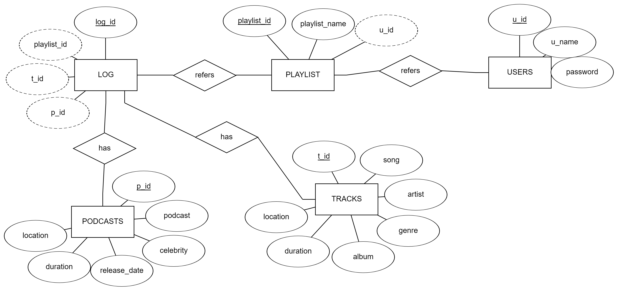
ER DIAGRAM:

Slide 5
WORKING OF PROJECT:
Demonstration of the project output.

Slide 6
THANK YOU.

