Slide 1
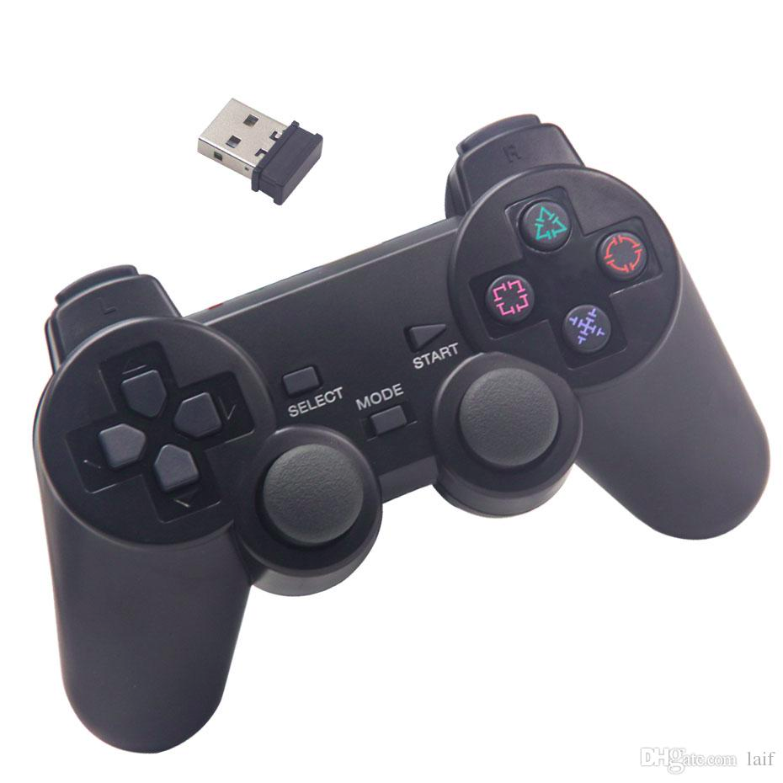
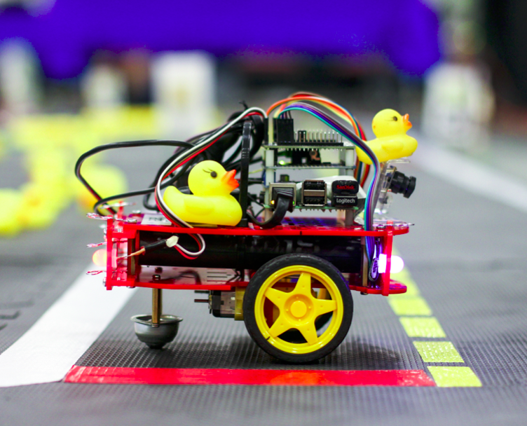
Day 2: Following lanes – part 1
Remember how we used the joystick:
joystick
joy
joy_mapper
Kinematics
car_cmd

Slide 2
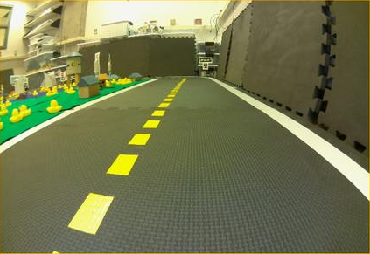

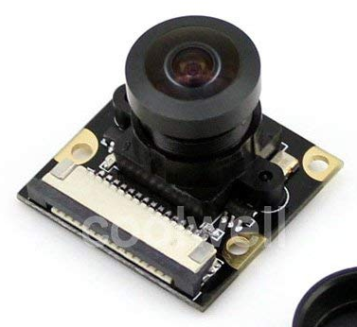
Day 2: Following lanes – part 1
I want to hear you!
How would you do
this program?
Camera
image_compressed
SOME PROGRAM
Kinematics
car_cmd

Slide 3
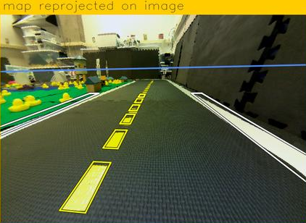
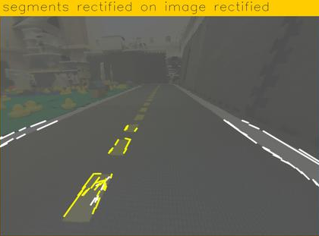
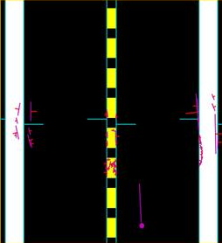
Day 2: Following lanes – part 1
Camera
line_detector
image_compressed
line_detector
segment_list
lane_filter
lane_pose
lane_filter
lineseglist_out
ground_projection
lane_controller
Kinematics
lane_controller
car_cmd

Slide 4
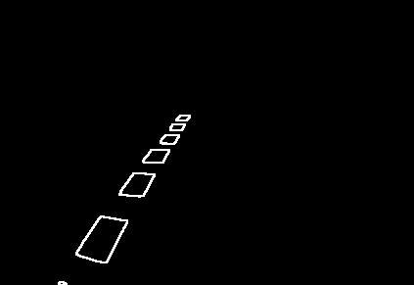
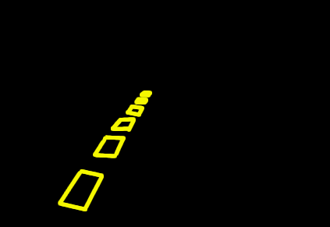
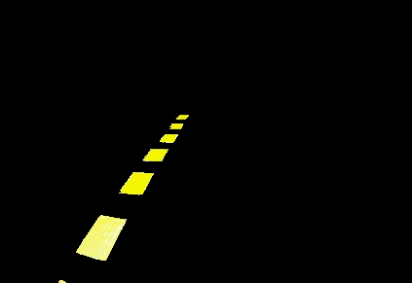
Line detector
How do we detect lines of color in an image?
Convert image from Red-Blue-Green to Hue-Saturation-Value.
Filter color to only have the one wanted (white, yellow or red)
Get edges with contrast
Get lines through Hough transform

Slide 5

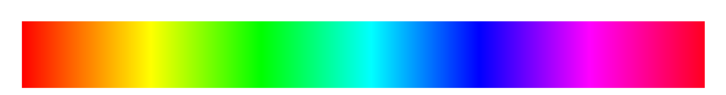
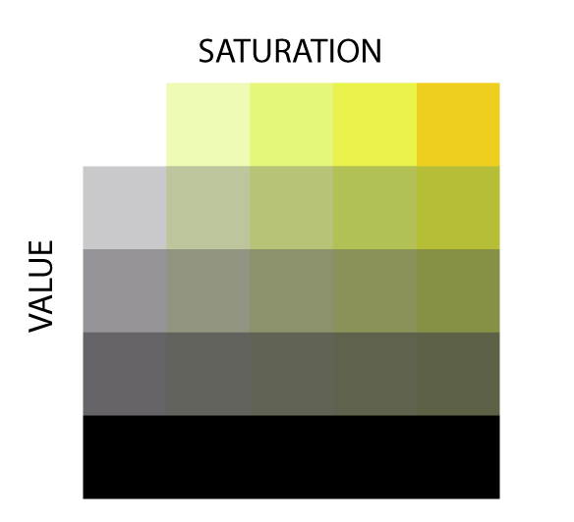
1. Convert an image from BGR to HSV
HUE
0 90 180
255
According to you,
why do we need the
image to be in HSV?
0
255

Slide 6
2. Filter color: we only want the yellow!
HUE
0 90 180
25 45
255
255
What parts of the
image are yellow?
100
140
255
Yellow limits:
Hue : 25 - 45
Sat. : 140 - 255
Val. : 100 - 255
0
255

Slide 7
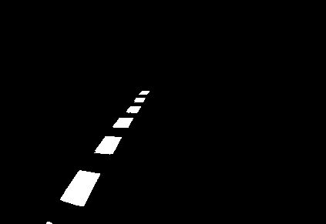
3. Detecting the edges
How would you detect the edges?
Answer:
1st : turn into black and white
2nd: look for the contrast!

Slide 8
4. Detecting lines
What do we have?
  An image with white pixels forming lines.
What do we want?
  A list of lines
How do we do this?
  Hough transform!
Line 1: (78, 259)
Line 2: (103, 221) to (129, 224)
Line 3: (129, 224) to (105, 267)
Line 4: ( , ) to ( , )
Line 5: ( , ) to ( , )
Line 6: ( , ) to ( , )
Line 7: ( , ) to ( , )
Line 8: ( , ) to ( , )
Line 9: ( , ) to ( , )
Line 10: ( , ) to ( , )
Line 11: ( , ) to ( , )
Line 12: ( , ) to ( , )
Line 13: ( , ) to ( , )
Line 14: ( , ) to ( , )
0
421
to (103, 221)
290

