Slide 1
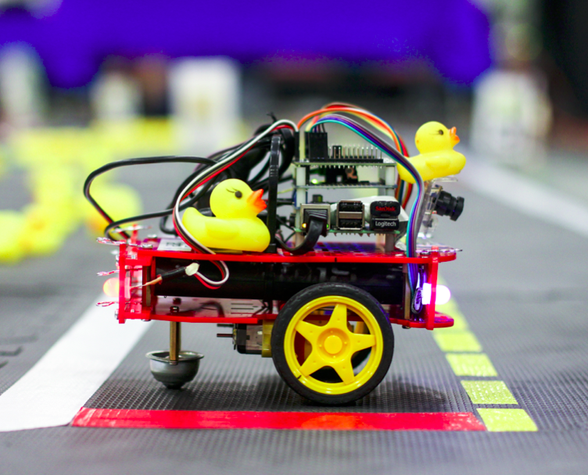
MISE Foundation Summer School
Robotics

Slide 2

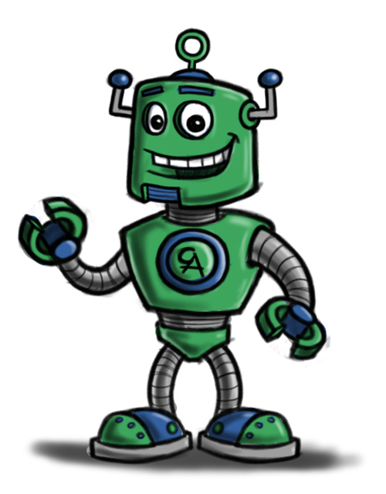
Welcome!
My name: Vincent Mai
I am from: Canada
I am a PhD student in Robotics at Université de Montréal.
And you, who are you?
Tell me about you.

Slide 3
This is a DuckieBot.
I have one here. Its name is Moose.
Question: according to you, what is Moose?
A. a toy
B. a miniature car
C. a robot
Answer: all of them!

Slide 4
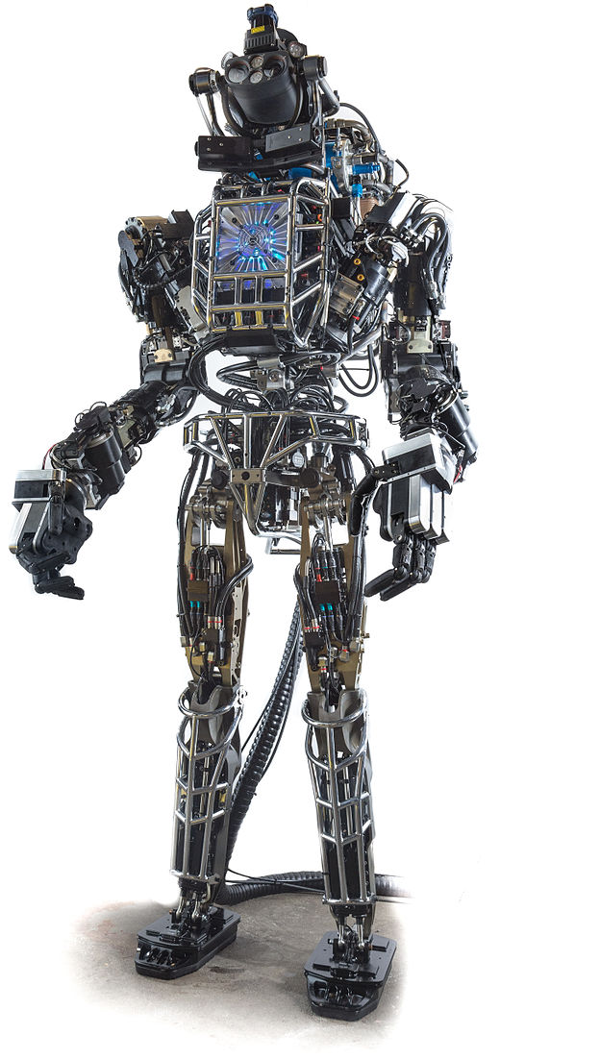
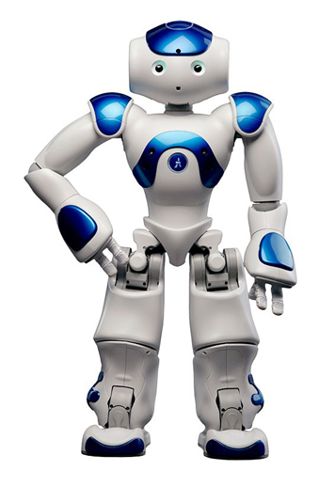
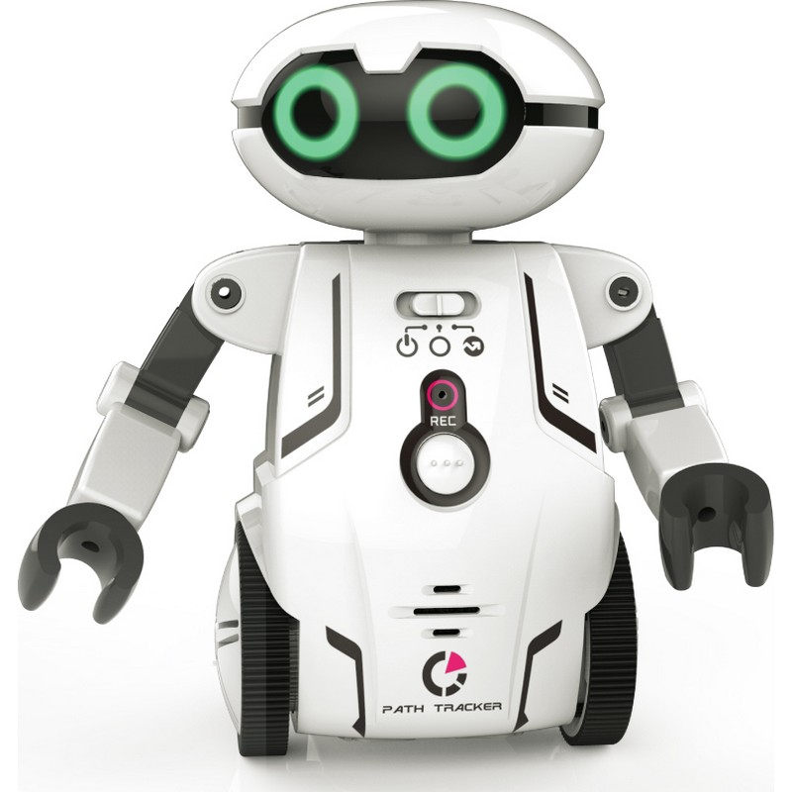
What is a robot?
According to Google Images...

Slide 5
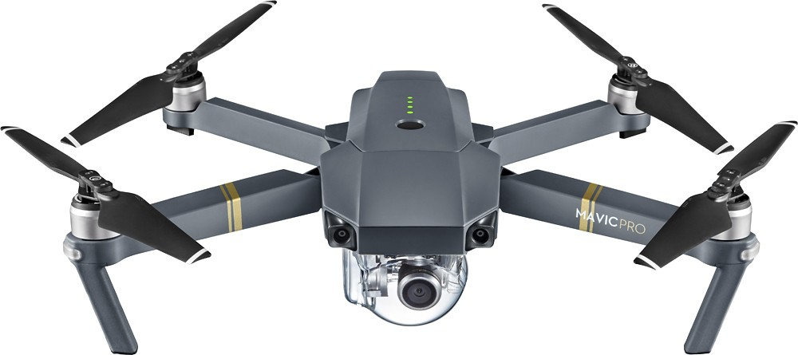
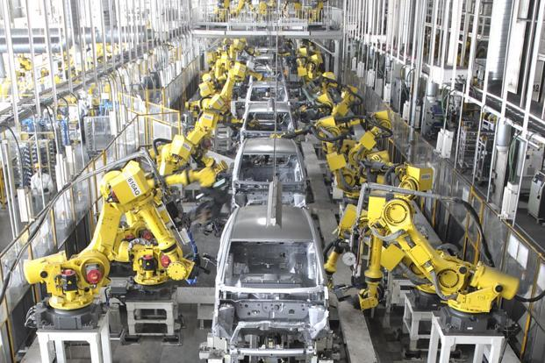
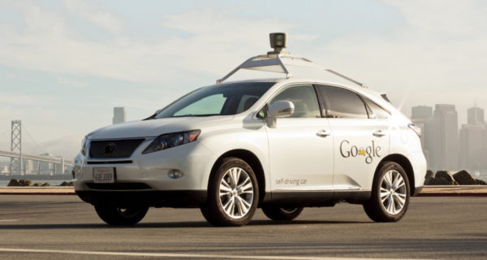
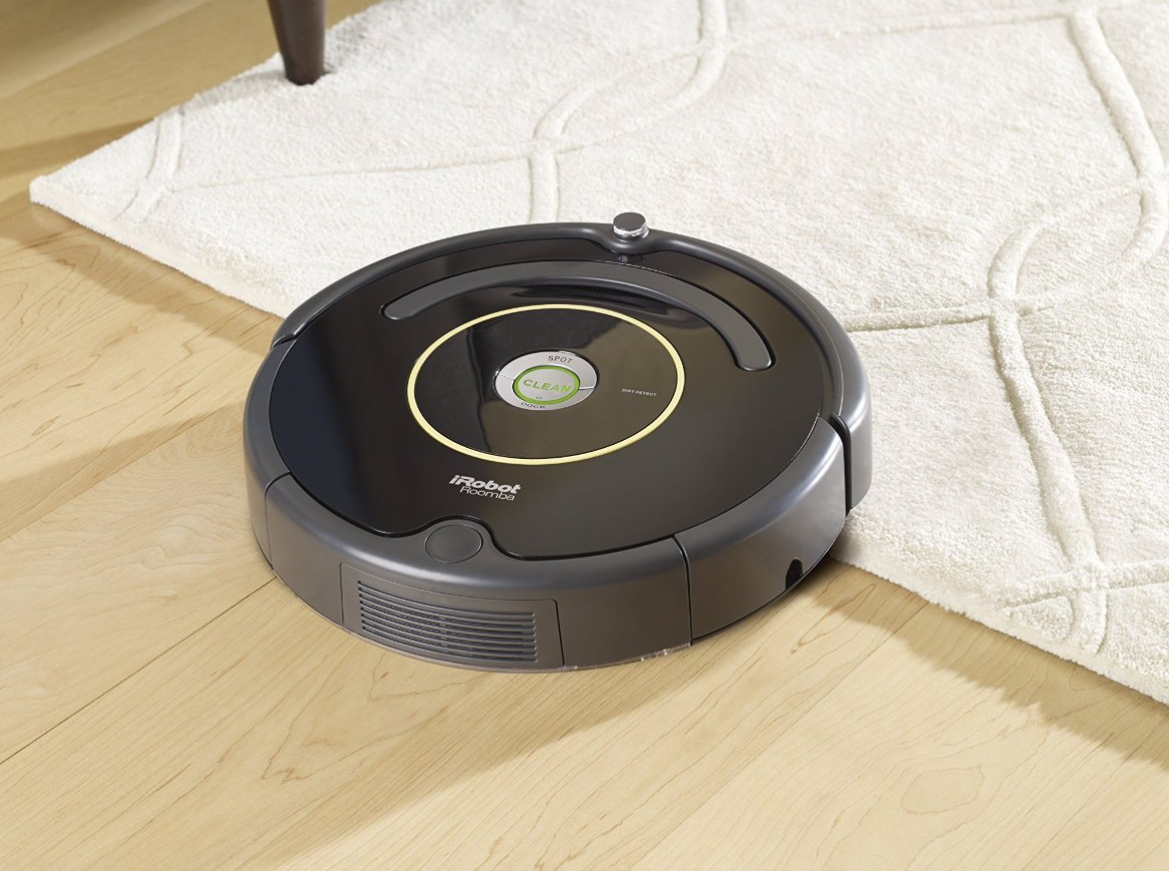
But also...

Slide 6
What is a robot?
“A machine capable of carrying out a complex series of actions automatically, especially one programmable by a computer.”
  Oxford dictionary

Slide 7
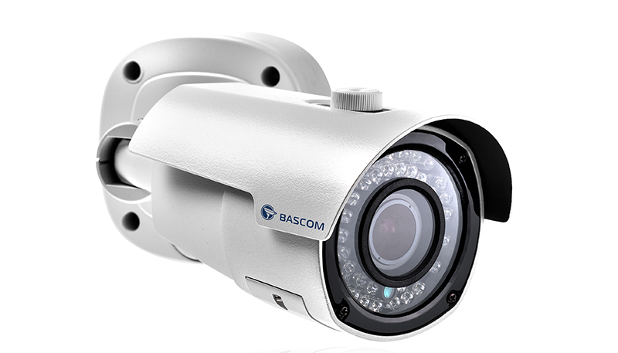
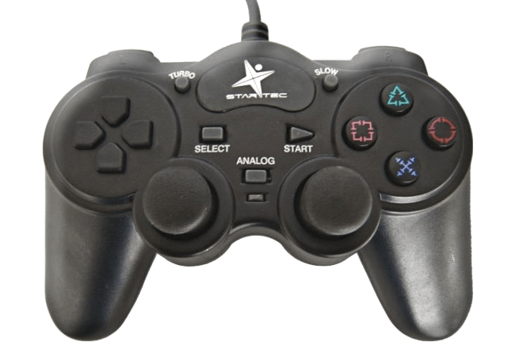
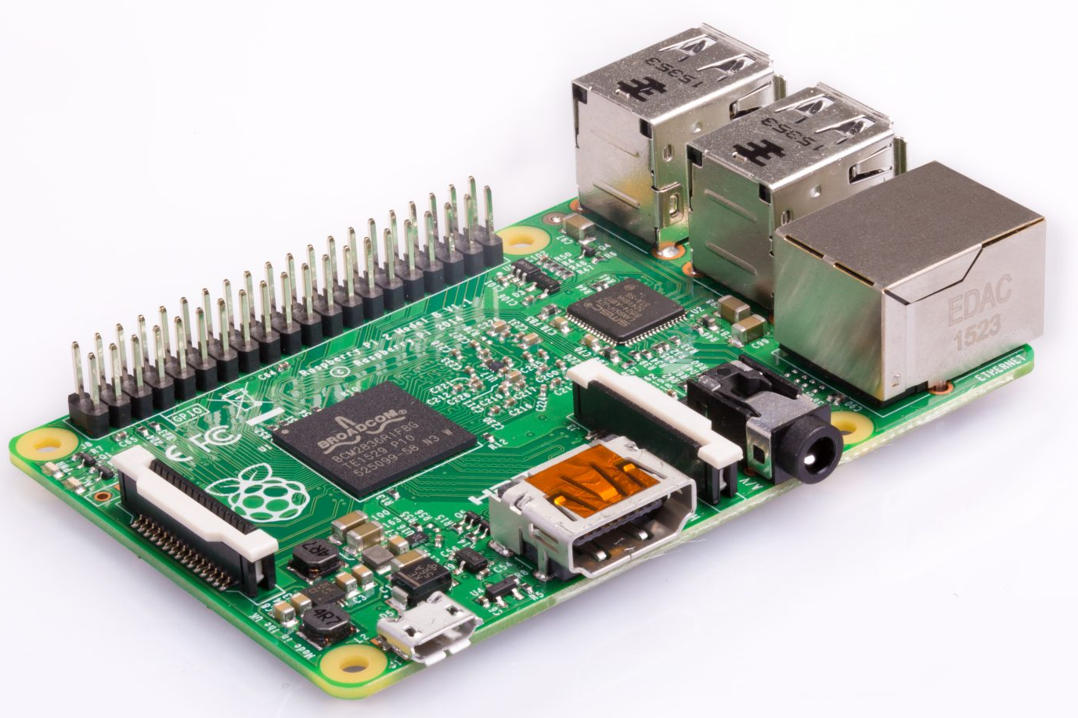
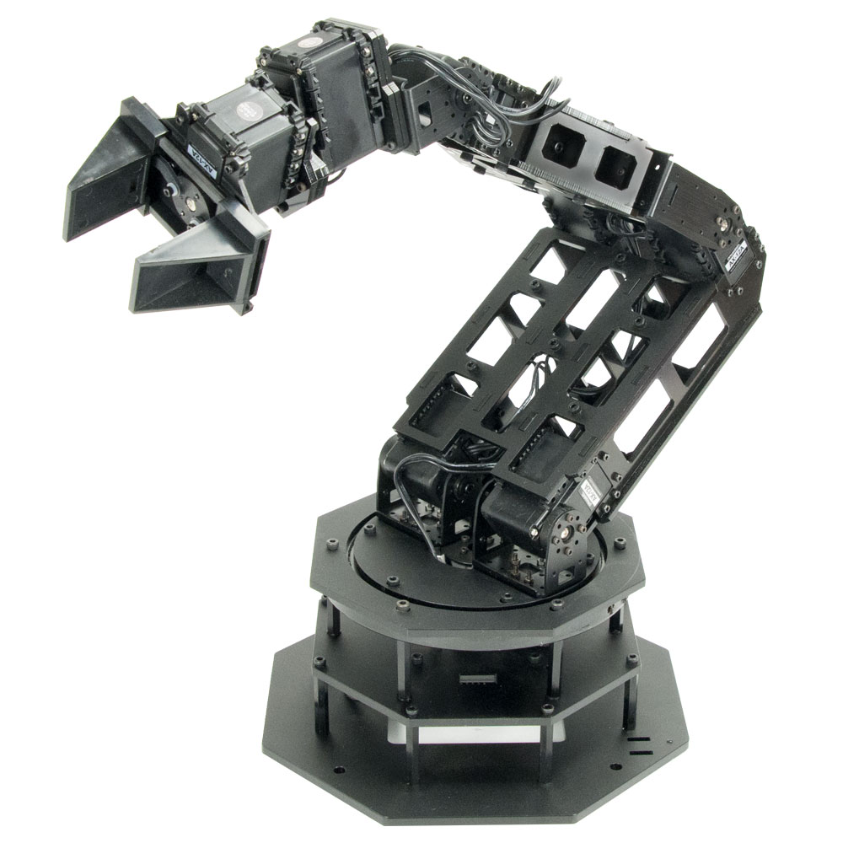
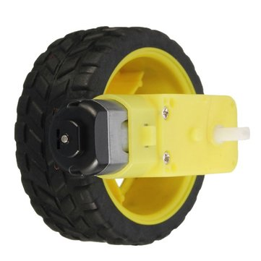
How does a robot work?
1) Sensors
Get information from the environment.
2) Processor
Understand this information and take decisions
3) Actuators
Act the decisions upon the real world

Slide 8
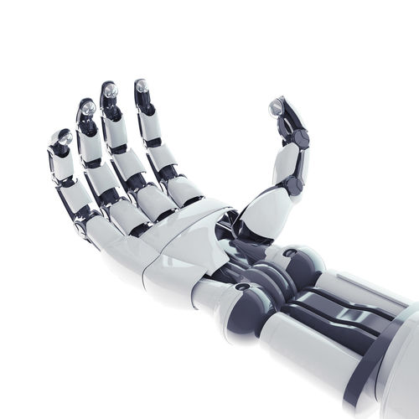
Your turn!
Which sensors and actuators
can you find on this drone?
Robotic hand: actuator or sensor?

Slide 9
Your turn!
Name all the existing sensors you can think of!
Button, joystick
Camera
Infrared sensor
Light sensor
Lidar
Sonar
Thermometer
Pressure sensor
Barometer
Voltmeter
Pedometer
Wheel encoder
GPS
Accelerometer
Gyroscope
Ultrasound
Radio
Magnetometer
...

Slide 10
Back to the DuckieBot
Sensors?
1 camera
Actuators?
2 wheel motors
Processor?
1 Raspberry Pi

Slide 11
What will we do during two weeks?
Objective: lane following for Moose
Maths & physics prerequisites
Computer science for robotics
1st application: drive Moose with a joystick
2nd application: lane following for Moose

