Slide 1
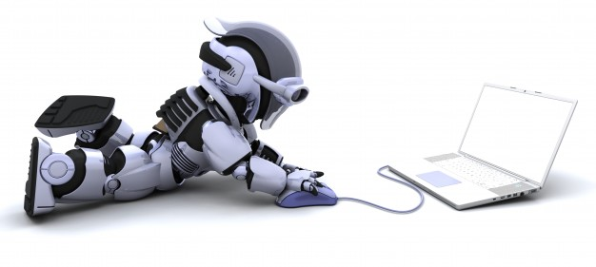
Computer science for robotics

Slide 2
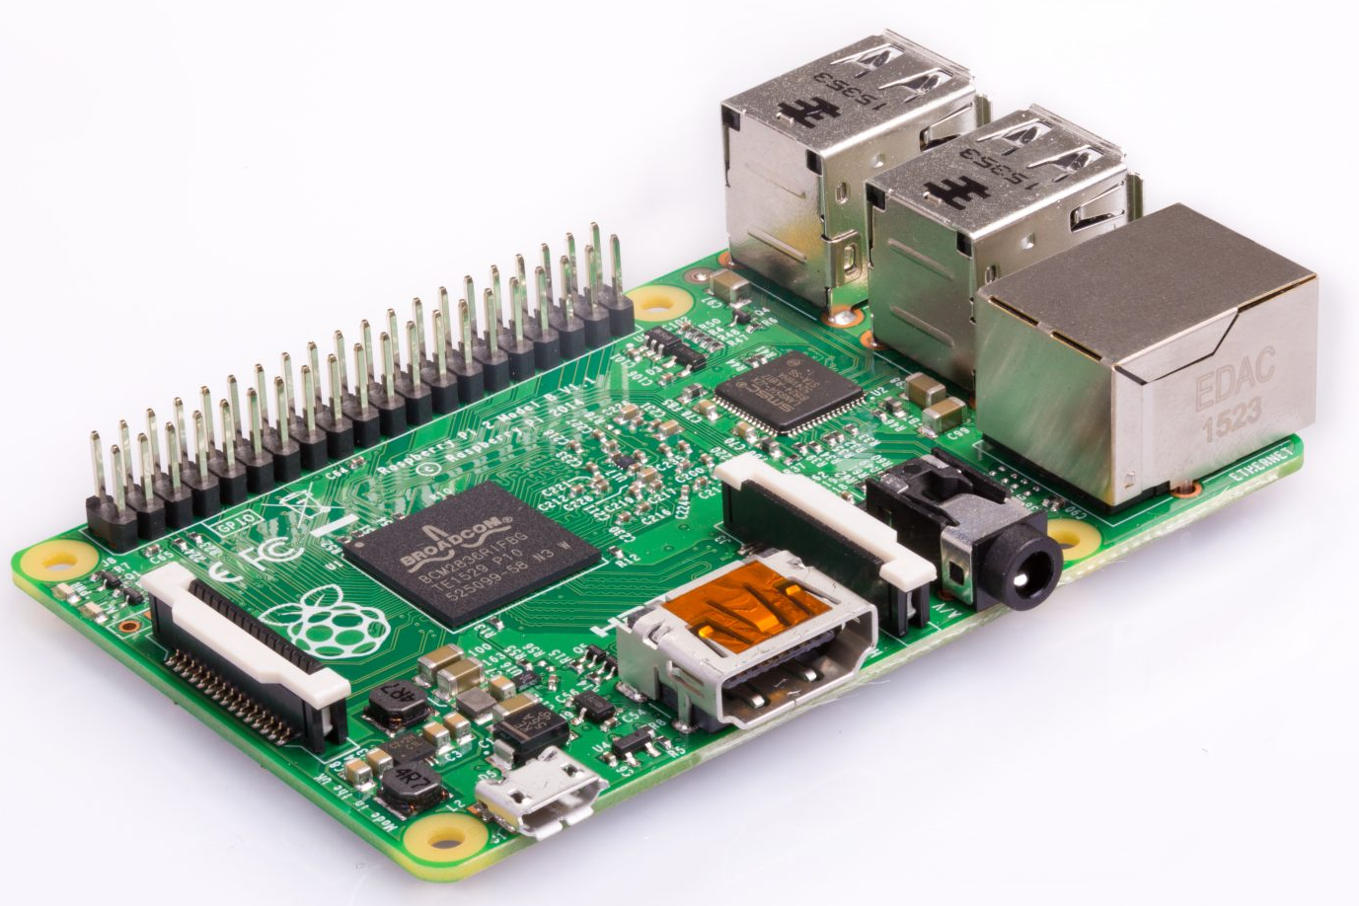
What is the link?
Inside a robot, there is always a computer!
To learn how to code a robot, we must understand some
computer science

Slide 3
3 topics
Images
Middleware (ROS)
Numpy (Python library)

Slide 4
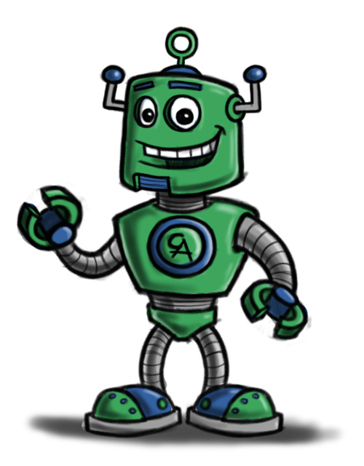
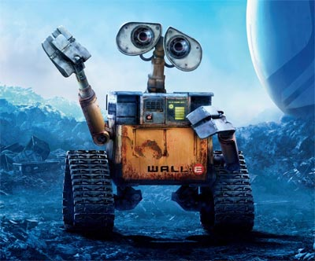
Images
When I take a photo on a numeric camera, how is it saved?
How is it sent from the camera to a computer, and then to another?
Like with Facebook!

Slide 5
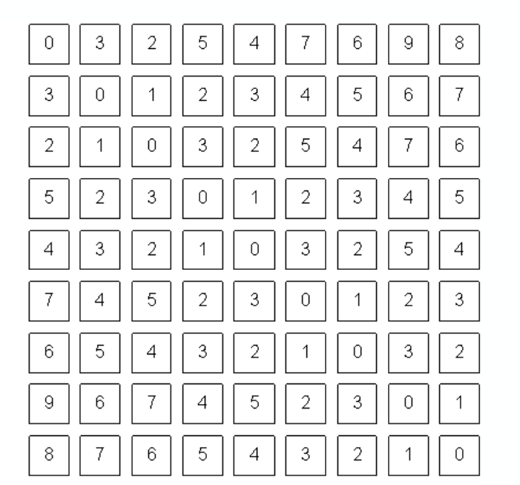
Images are a table of pixels!
Pixel: little square of one color.
A lot of pixels form an image!
In grayscale, only one value per pixel:
- black: 0
- white: 255
- gray: all in between!

Slide 6
Image resolution
Resolution: number of pixels in an image
0
400
332
Question: what are the coordinates of the point in the center of the image?

Slide 7
BGR color pictures
In each pixel, 3 values from 0 to 255:
  B for BLUE
  G for GREEN
  R for..? RED
0 - 0 - 0
0-0-127
0-0-255
127-0-255
0-127-0
0-127-127
0-127-255
127-127-255
0-255-0
0-255-127
0-255-255
127 - 0 - 0
127-255-0
127-255-127
127-255-255
255 - 0 - 0
255-255-0
255-255-127
255-255-255
255-255-255

