Slide 1
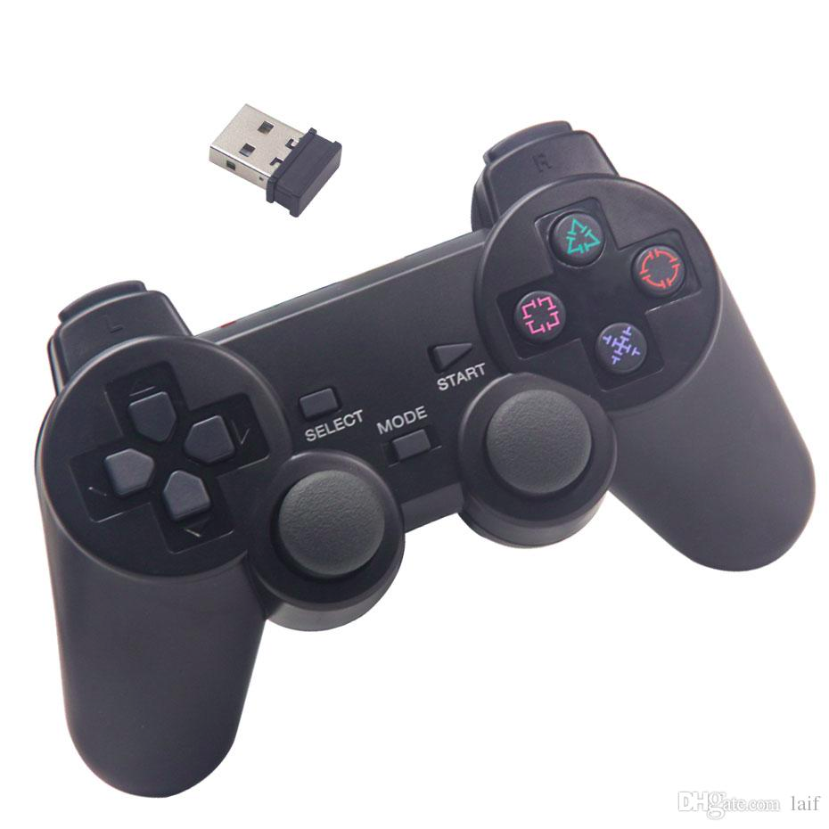
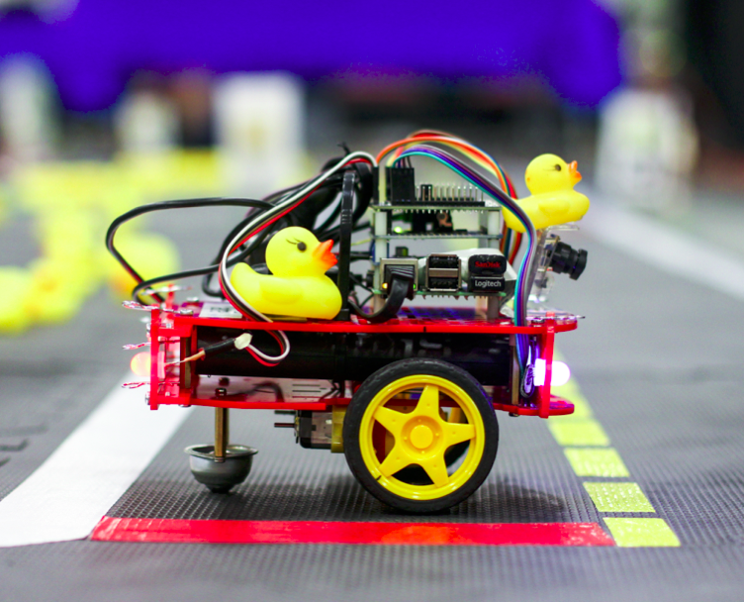
Day 1: Use the joystick to drive Moose
Behind the scene:
joystick
joy_mapper
joy_msg
joy_mapper
inverse_kinematics
inverse_kinematics
car_cmd
wheels_cmd
wheels_driver

Slide 2
Step 1: Joy_mapper
joy_msg
joy_mapper
car_cmd
What buttons are being pressed?
At which linear and angular
velocities should the car go?
Buttons and axis

Slide 3
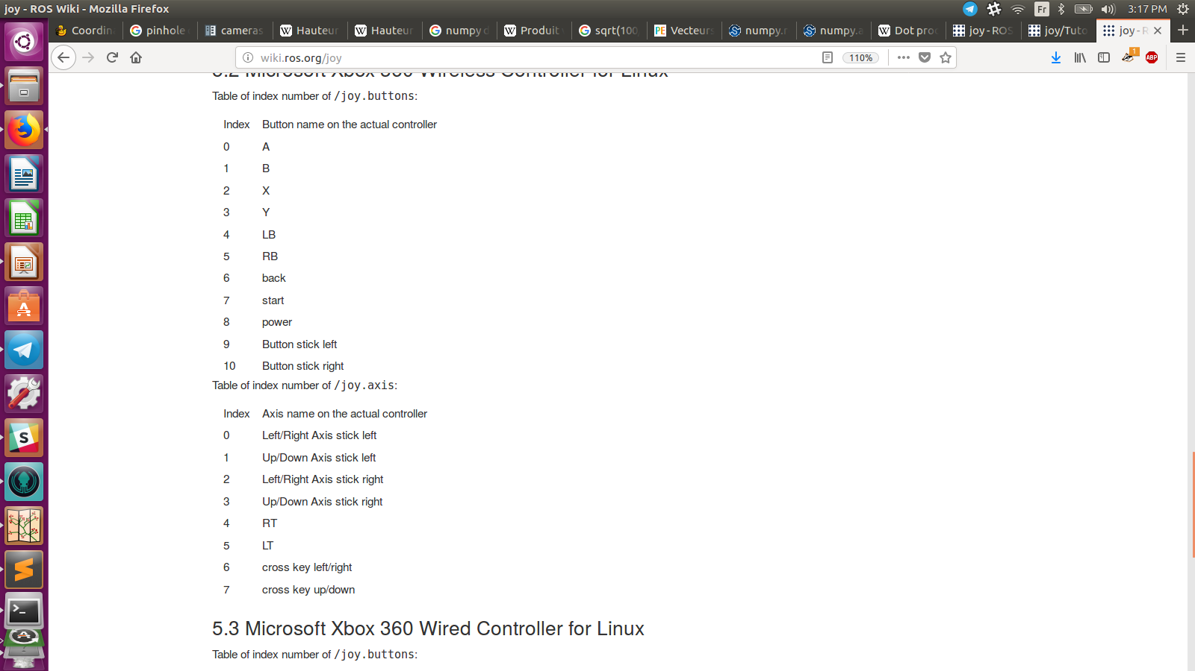
Structure of a joy_msg
2 tables
Buttons: joy_msg.buttons
Axis: joy_msg.axis
For buttons:
0 if not pressed
1 if pressed
For axis:
0 if not touched
1 if up
-1 if down

Slide 4
Structure of a car_cmd
Linear velocity: car_cmd.v
Angular velocity: car_cmd.omega

Slide 5
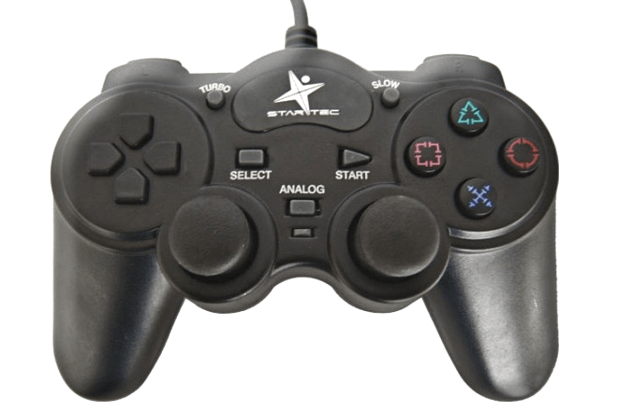
Driving the car
Forwards
Turn left
Backwards
Turn right

Slide 6
Function to complete:
publishControl(self)
1) Change the 0’s on lines 74 and 75
Linear velocity v :
0 if left joystick is not touched
v_gain if left joystick is up
- v_gain if left joystick is down
Angular velocity omega :
0 if right joystick is not touched
omega_gain if right joystick is up
- omega_gain if right joystick is down

Slide 7
Let’s try something else!
Forwards
Turn left
Turn right
Backwards

Slide 8
Step 2: Inverse_kinematics
car_cmd
inverse_kinematics
wheels_cmd
At which linear and angular
velocities should the car go?
At which velocity should
each wheel motor turn?

Slide 9
Structure of a car_cmd
Structure of a wheel_cmd
Linear velocity: car_cmd.v
Angular velocity: car_cmd.omega
duty cycle right wheel: wheels_cmd.vel_right
duty cycle left wheel: wheels_cmd.vel_left

Slide 10
What is duty cycle u?
Command to the motor:
u
-L
Maximum speed backwards
0
The motor does not move
+L
Maximum speed forwards

Slide 11
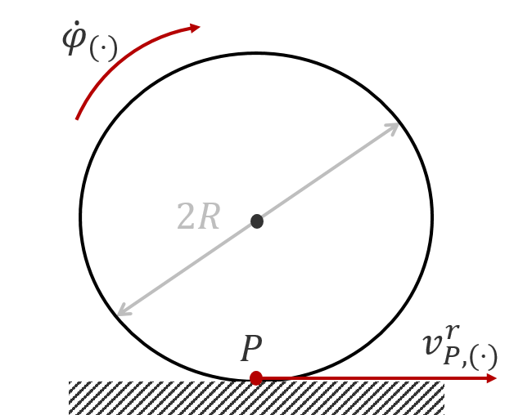
Wheel angular velocity
ωwheel
Car linear velocity :
Car angular velocity :
Wheel radius : R
Baseline : B
Wheel angular velocity :
car
ωwheel
+ if right wheel
- if left wheel

Slide 12
Your turn!
car_cmd_callback(self, msg_car_cmd)
1) Code the wheel velocities lines 171 and 172
Reminder:
+ if right wheel
- if left wheel
2) Constraint u_r_limited and u_l_limited lines 179 and 180
-L if u < - L
u if -L < u < L
L if u > L

Slide 13
Kinematics : stays the same for every application
joystick
joy_mapper
joy_msg
joy_mapper
inverse_kinematics
inverse_kinematics
car_cmd
wheels_cmd
wheels_driver
KINEMATICS

