Slide 1
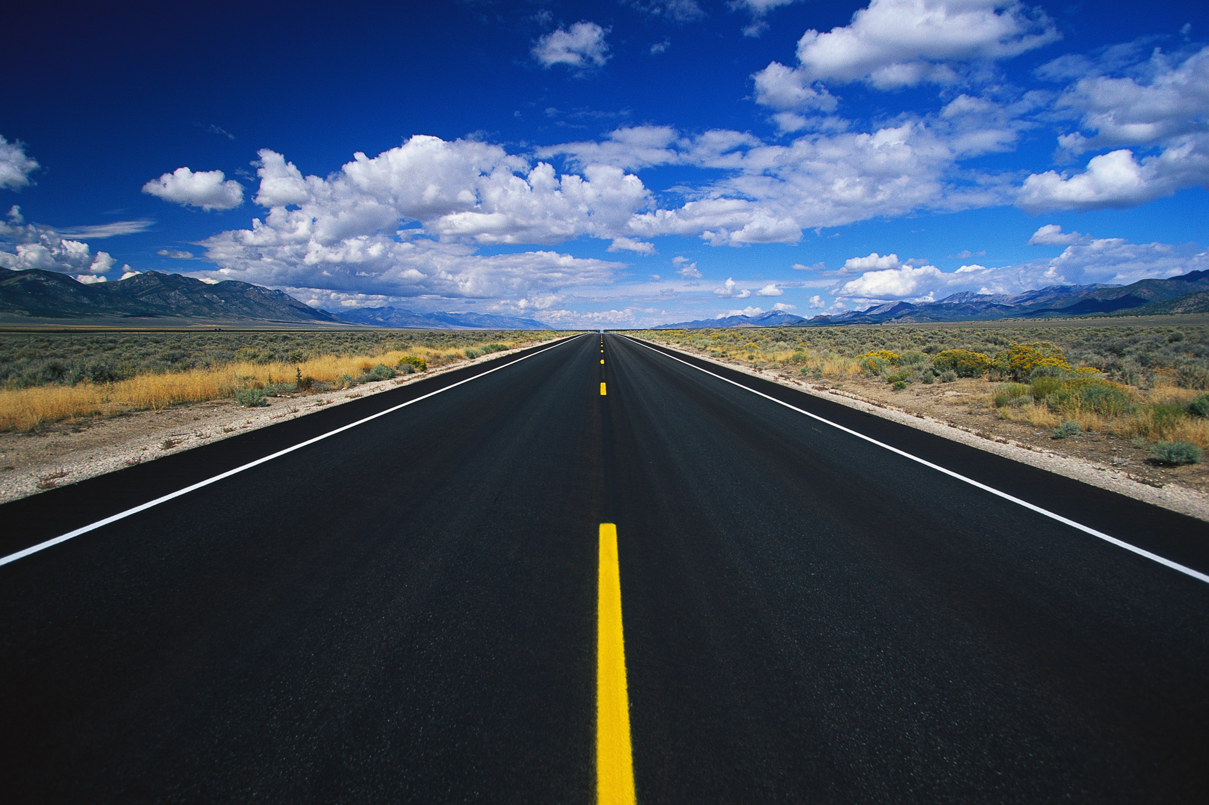
Following lanes
Moose must advance autonomously on the road, staying in the middle of the right lane.

Slide 2

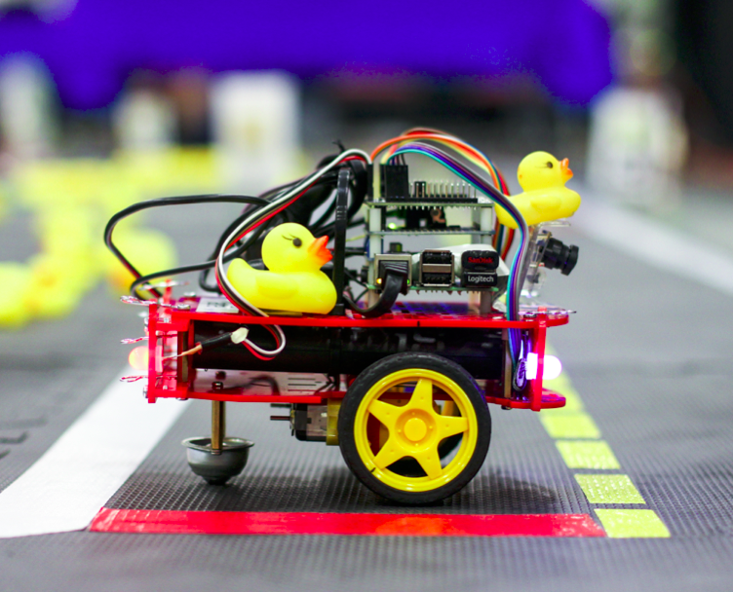
Remember the joystick?
Was Moose autonomous then?
joystick
joy
joy_mapper
Motion
Control
car_cmd

Slide 3

Autonomous mobile robot
See – think – act
Localization
Cognition
Think
See
Act
Real world
environment
Perception
Motion control
THIS IS THE MOST IMPORTANT SLIDE OF THE WEEK!
Autonomous Mobile Robots – R. Siegwart, I. Nourbakhsh, D. Scaramuzza

Slide 4
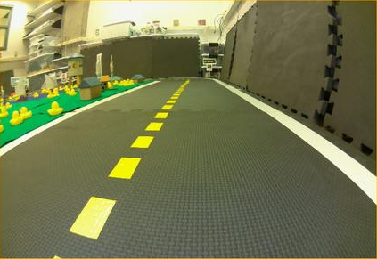
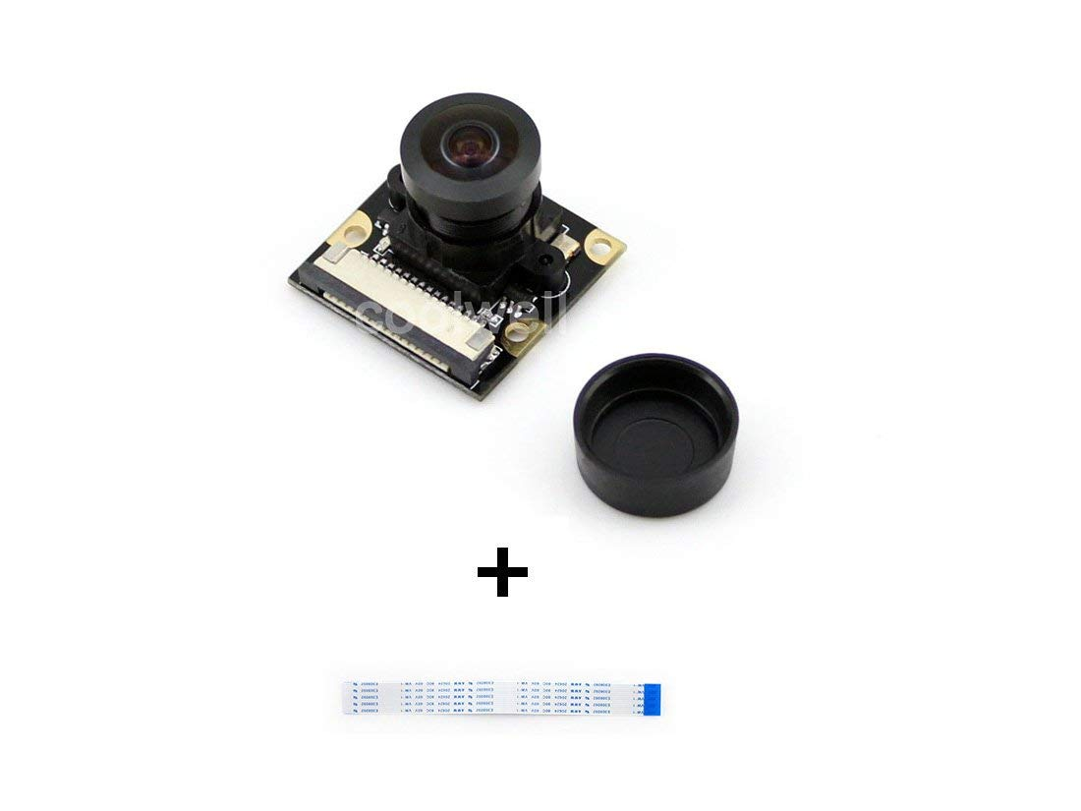
Following lanes – Overview
How would you do
this program?
Camera
image
Some program
Motion
Control
car_cmd

Slide 5
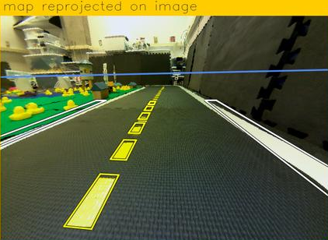
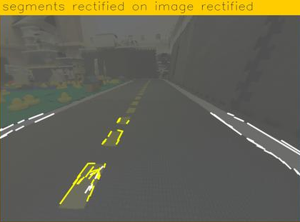
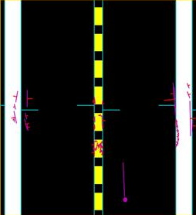
Following lanes – Overview
Camera
line_detector
image
line_detector
segment_list
lane_filter
robot_pose
lane_filter
line_positions
ground_projection
ground_projection
Motion
Control
lane_controller
lane_controller
car_cmd

Slide 6
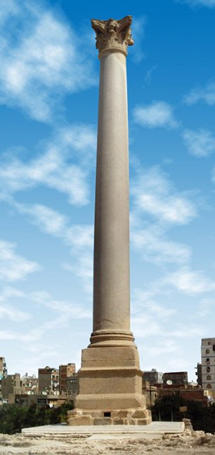
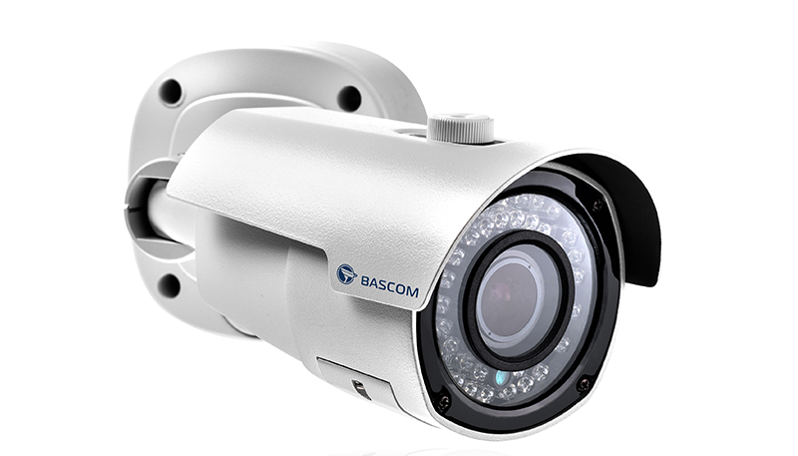
Perception : Line detection
Sensing
Information
Extraction
Raw data
It’s a pillar!
Here are the lines

Slide 7
Line detector
line_detector
image
line_detector
segment_list
What we have:
A BGR image from the camera on the car.
What we want:
A list of segments of color, given by the coordinates of the extremity points.
What we do:
A line detector!
Line 1: (78, 259) to (103, 221)
Line 2: (103, 221) to (129, 224)
Line 3: (129, 224) to (105, 267)
Line 4: ...
...

Slide 8


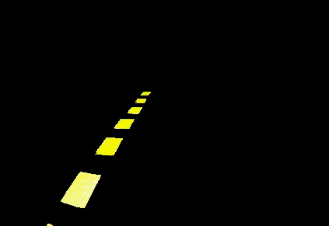
Line detector
How do we detect lines of color in an image?
Convert image from Red-Blue-Green to Hue-Saturation-Value.
Filter color to only have the one wanted (white, yellow or red)
Get edges with contrast
Get lines through Hough transform

Slide 9
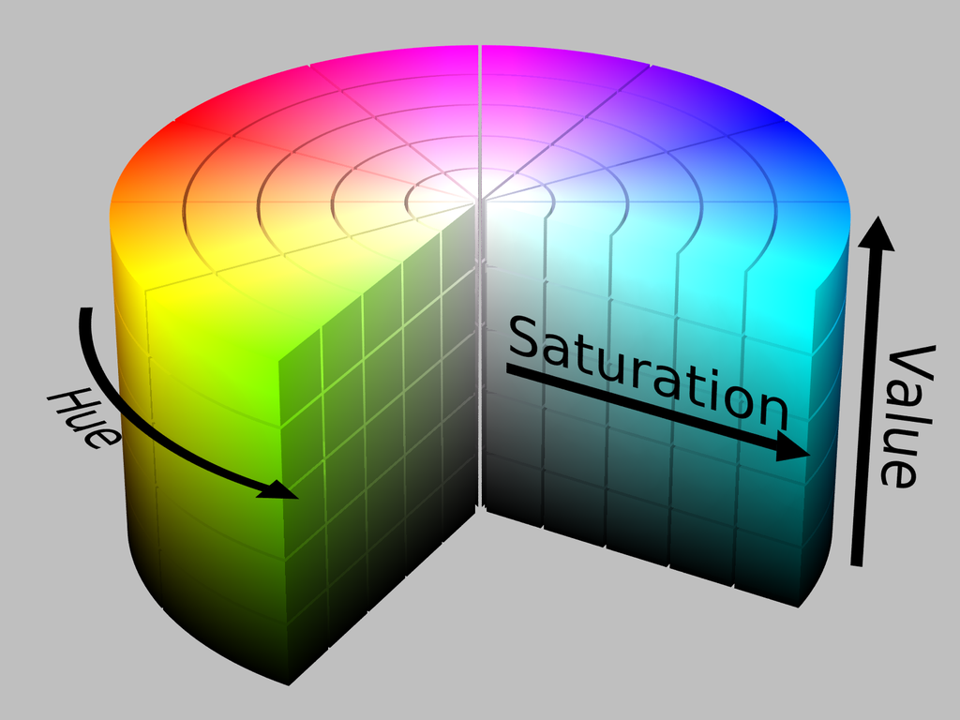
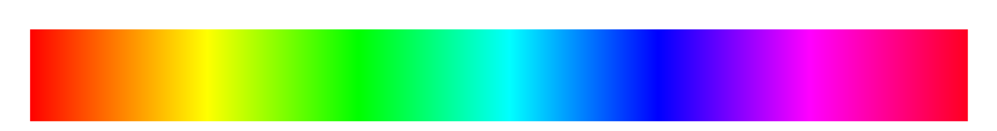
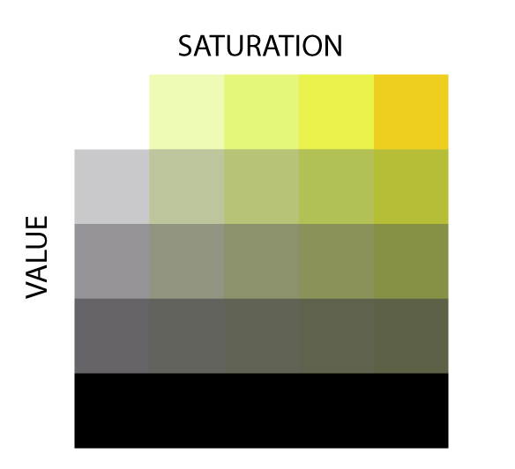
1. Convert an image from BGR to HSV
HUE
0 90 180
255
According to you,
why do we need the
image to be in HSV?
0
255

Slide 10
2. Filter color: we only want the yellow!
HUE
0 90 180
25 45
255
255
What parts of the
image are yellow?
100
140
255
Yellow limits:
Hue : 25 - 45
Sat. : 140 - 255
Val. : 100 - 255
0
255

Slide 11
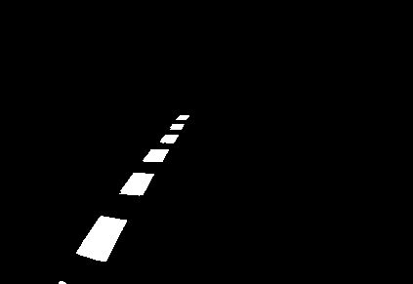
3. Detecting the edges
How would you detect
the edges?
Answer:
1st : turn into black and white
2nd: look for the contrast!
The real process is a bit more complex and it is called: Canny edge detection.

Slide 12
4. Detecting lines
What do we have?
  An image with white pixels forming lines.
What do we want?
  A list of lines
How do we do this?
  Hough transform!
Line 1: (78, 259)
Line 2: (103, 221) to (129, 224)
Line 3: (129, 224) to (105, 267)
Line 4: ( , ) to ( , )
Line 5: ( , ) to ( , )
Line 6: ( , ) to ( , )
Line 7: ( , ) to ( , )
Line 8: ( , ) to ( , )
Line 9: ( , ) to ( , )
Line 10: ( , ) to ( , )
Line 11: ( , ) to ( , )
Line 12: ( , ) to ( , )
Line 13: ( , ) to ( , )
Line 14: ( , ) to ( , )
0
421
to (103, 221)
290

Slide 13





Ouf! We made it!
But now, it is your time to act!
Vincent is in trouble. He is trying to make
Moose follow a lane but it does not work.
He needs to look into the line detection code
to see where is the bug.
But he realizes that there are 4 different
line detectors codes! And the one that Moose
is currently using is totally empty!
Somebody made a mess in there...
Could you help Vincent choose which of the
4 line detectors is the one Moose should use?
A, B, C, or D?

Slide 14
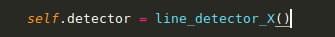
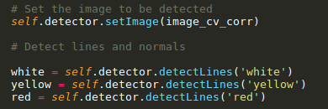
line_detector
image
line_detector
segment_list
1) What we have: BGR image from the camera
2) What we do: “line_detectorX.py”
3) What we get: list of white, yellow and red segments in the image.

Slide 15
You found it? Great!
Now that we have the segments, we need to do a bit more work:
  Set the segment direction.
  Compute the normals and centres of the segments.
But we are not done!

Slide 16
Convention
Where is the line with respect to the yellow, white or red band?
D
A
What are the 4 lines we can see here?
AB, or BA? BC or CB? CD or DC? AD or DA?
We need a convention:
The color has to be on the LEFT of the segment from P1 to P2.
C
B
Therefore, we want the segments to be:
BA, AD, DC, CB.

Slide 17
Center and norm
We also need the center and norm of each segment.
D
What is the center?
- the middle point of the segment
A
What is the norm?
- an unit vector perpendicular to the segment.
It always goes from the color to outside.
As a vector, it has two members: x, y
C
B

Slide 18
Task of the day
In line_detector1.py, write function self._findNormal(bw, lines)
Inputs:
bw is a black and white image of the color filter.
lines is a matrix of lines
Outputs:
centers is a vector of centers
norms is a matrix of norms
lines follows the convention
Line 1 A | Line 1 B
Line 2 A | Line 2 D
Line 3 D | Line 3 C
Line 4 B | Line 4 C
Center line 1
Center line 2
Center line 3
Center line 4
Norm1 x | Norm1 y
Norm2 x | Norm2 y
Norm3 x | Norm3 y
Norm4 x | Norm4 y
Line 1 B | Line 1 A
Line 2 A | Line 2 D
Line 3 DC | Line 3 P2
Line 4 C | Line 4 B
_findNormal
bw
lines
centers
norms
lines

Slide 19
You made it? Awesome!
Now, let’s see it working in real life, on Moose!
Notes:
Byobu 4 windows
1. ssh moose – cd duckietown – source environment.sh – make demo-line_detector
2. ssh moose – cd duckietown – source environment.sh – rosparam set /moose/line_detector_node/verbose true
3. Raptor: cd duckietown – source environment.sh – source set_ros_master.sh moose – rqt
4. Raptor: cd duckietown – source environment.sh – source set_ros_master.sh moose – rqt_image_view

