Slide 1

Autonomous mobile robot
See – think – act
Localization
Cognition
Think
See
Act
Real world
environment
Perception
Motion control
THIS IS THE MOST IMPORTANT SLIDE OF THE WEEK!
Autonomous Mobile Robots – R. Siegwart, I. Nourbakhsh, D. Scaramuzza

Slide 2
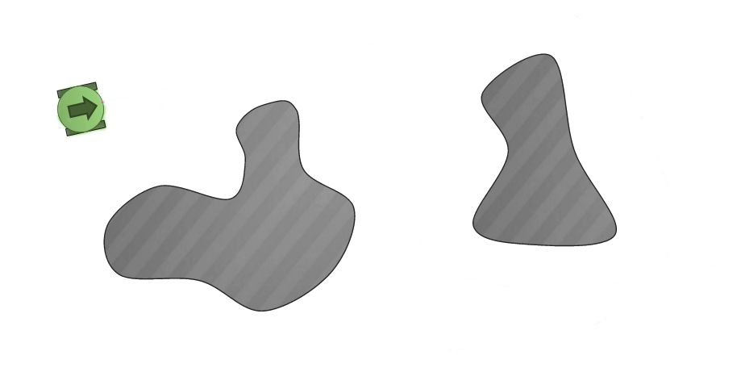
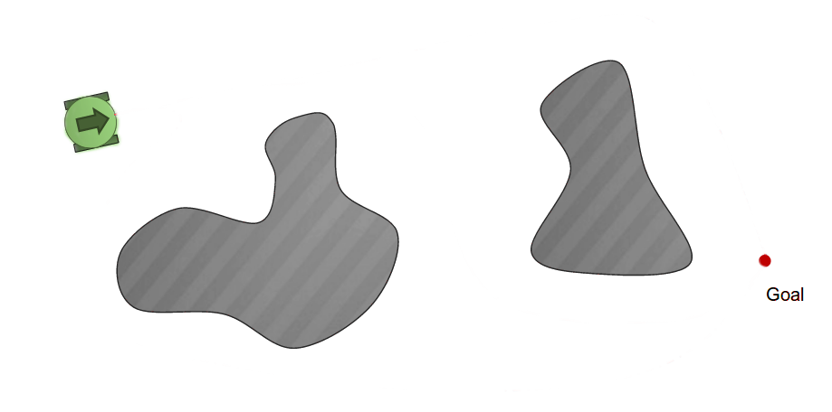
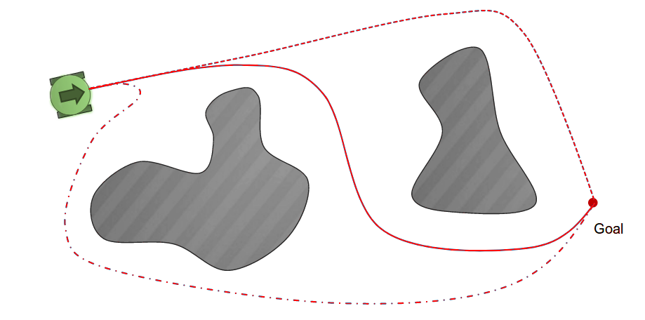

Cognition
Mission
Position
Movement
command
Global map
Forward!

Slide 3

Cognition
Mission
Position
Movement
command
Global map
Advance in the
middle of the lane
d, φ
v, ω

Slide 4
Cognition
Goal
  Advance in the middle of the name
How?
  Velocity v has to be constant
  Angular velocity ω is used to correct
    φ
    d

Slide 5
Cognition
Angular velocity ω is used to correct
  φ
  d
If φ = 0 (looking forward) and d > 0 (too much on the left), what should I do?
If d = 0 (right at the center) and φ < 0 (looking on the right), what should I do?
If d = 0, φ_1 < 0 and φ_2 < φ_1, would ω_1 > ω_2?

Slide 6
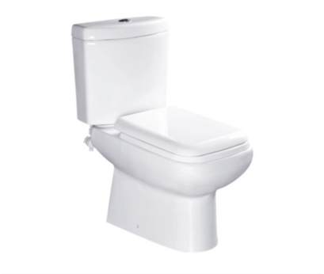
Proportional control

Slide 7
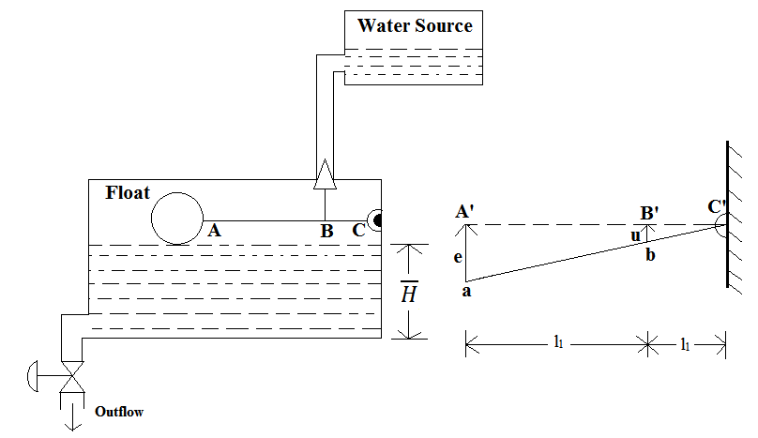
Proportional control
The water flow F is in liters/second. It is the time derivative of the volume V of water
in the tank :
F(t) = V’(t)
The floater position a is in m, and it is the height of the cuboid formed by the water.
As width and depth are constant, a is proportional to V:
a(t) = V(t)/c
Therefore,
F(t) = c x a’(t)

Slide 8
Proportional control
F(t) = c x a’(t)
The toilet boil uses a proportional control system:
A is the desired position for the floater (tank is full).
The error e is the difference:
e(t) = A - a(t)
And the toilet lets in a flow proportional to e with a constant k_flow:
F(t) = - k_flow x e

Slide 9
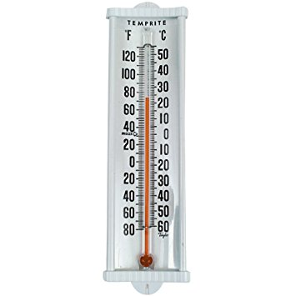
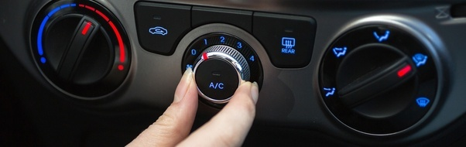
Another example: temperature control in your car
Objective: keep the car temperature T at T₀ = 25°C

Slide 10
Adjusting the heater power
Objective: keep the temperature T(t) at 25°C
We can prove that the power W of the heater/air conditionner is proportional to T’(t):
W = c x T’(t)
How much power should we use to keep the car at T0 = 25?
Error e

Slide 11
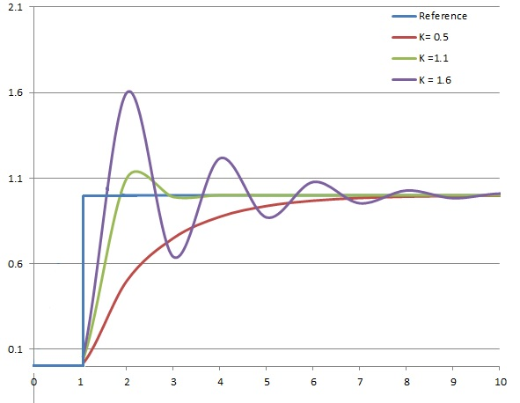
Influence of k_heater
The people who made this example are crazy!
Canadians, probably.
T₀
https://en.wikipedia.org/wiki/PID_controller#/media/File:PID_varyingP.jpg

Slide 12
Influence of k_heater
The people who made this example are crazy!
Canadians, probably.
All this is very interesting Vincent.
But... what is the link with Moose?
T₀
https://en.wikipedia.org/wiki/PID_controller#/media/File:PID_varyingP.jpg

Slide 13
Let’s summarize.
To use proportional control to keep variable a(t) to desired value a₀ we need:
  To be able to control the derivative a’(t)
  To be able to measure the error between a(t) and a₀
Then, we use:
We have to choose k_{a} correctly, so that we change fast enough but not too much.

Slide 14
ω and φ
We know that ω(t) = φ’(t), and we can control ω(t).
We can measure φ(t) and we know φ₀ = 0
Therefore, we will use:

Slide 15
φ(t) and d
We know that
d’(t) = v_{d}(t) = v(t) x sin(φ(t))
We set v(t) as constant.
We use an approximation: sin(x) ≈ x when x is small.
Thinking that φ(t) is small, we have:
d’(t) = v(t) x φ(t)
So we would like :

Slide 16
φ(t) and d
We know that
d’(t) = v_{d}(t) = v(t) x sin(φ(t))
We set v(t) as constant.
We use an approximation: sin(x) ≈ x when x is small.
Thinking that φ(t) is small, we have:
d’(t) = v(t) x φ(t)
So we would like :
But, Vincent, we cannot control φ(t)!

Slide 17

But... we cannot control φ(t)

Slide 18
But... we cannot control φ(t)
Yes we can!

Slide 19
So, what do we have

Slide 20
That’s it?
Yes, that’s it!
But now, we have to find k_{d} and k_{θ}.

Slide 21
Calibrating k_{d} and k_{θ}
Let’s try it!

