Slide 1
Experiments
Design your experiment!

Slide 2
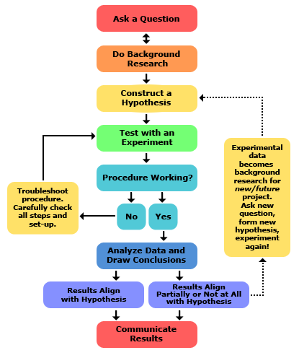
The scientific method

Slide 3
Question ideas:
How do the control parameters influence the performance of Moose?
How do the motion gain/trim parameters influence the performance of Moose?
What event could break the system and have Moose do unwanted behavior?

