Slide 1

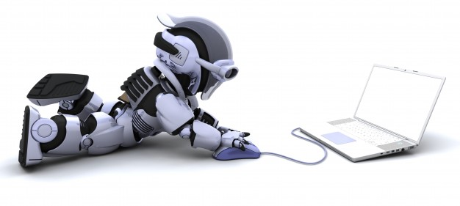
Computer science for robotics

Slide 2
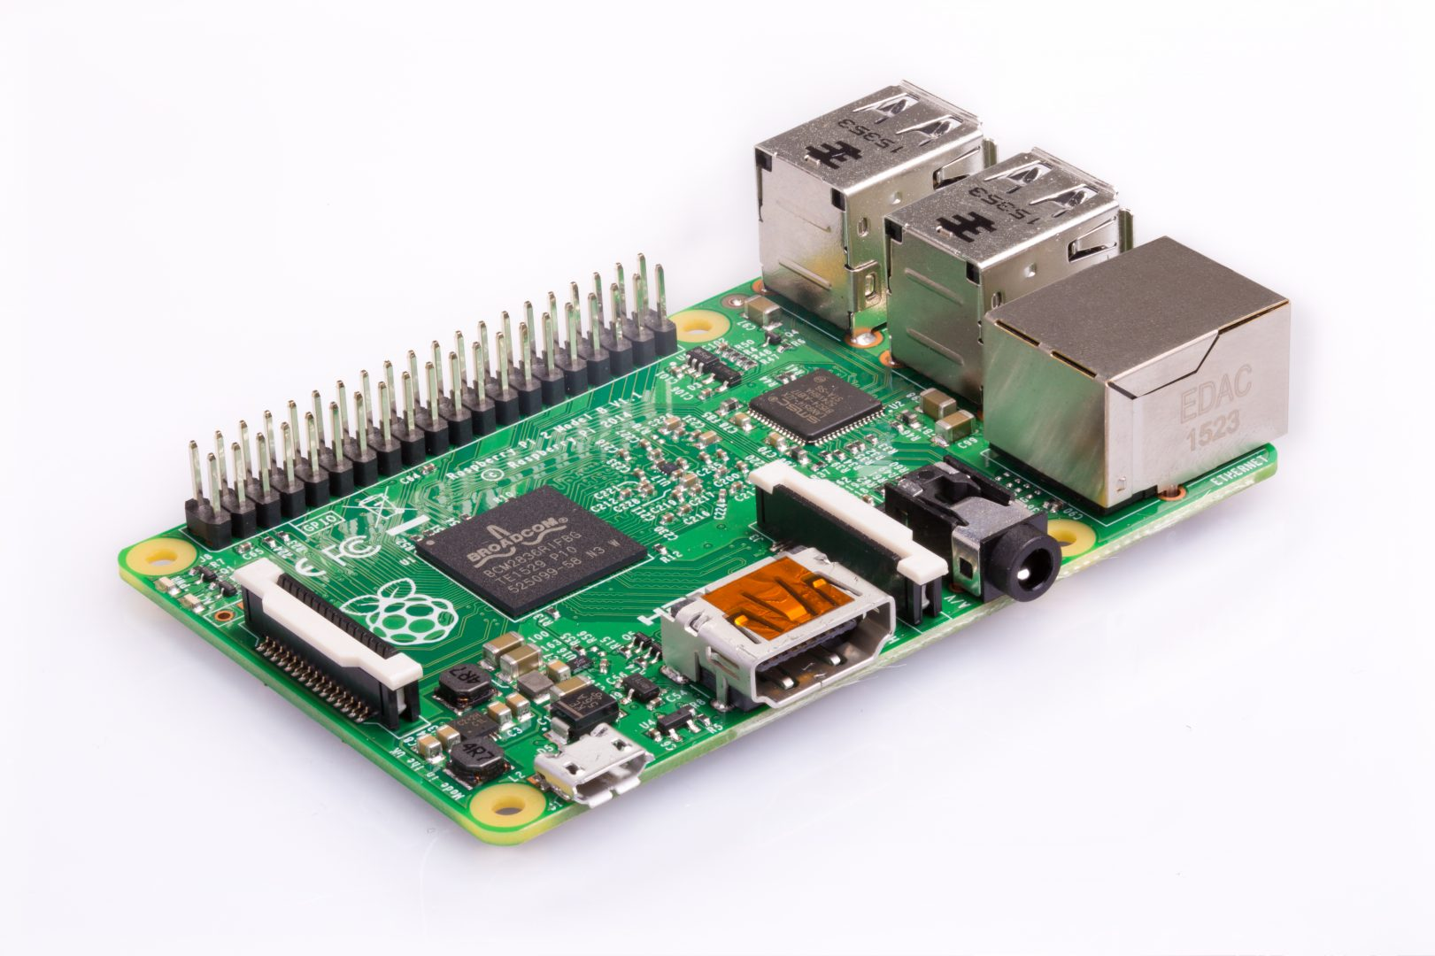
What is the link?
Inside a robot, there is always a computer!
To learn how to code a robot, we must understand some
computer science

Slide 3
3 topics
Images
Middleware (ROS)
Numpy and OpenCV (Python libraries)

Slide 4
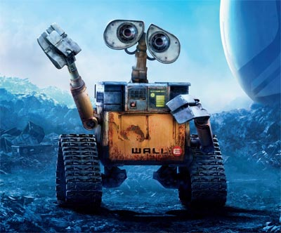
Images
When I take a photo on a numeric camera, how is it saved?
How is it sent from the camera to a computer, and then to another?
Like with Facebook!

Slide 5
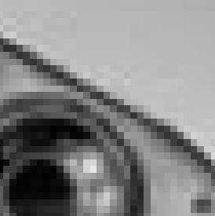
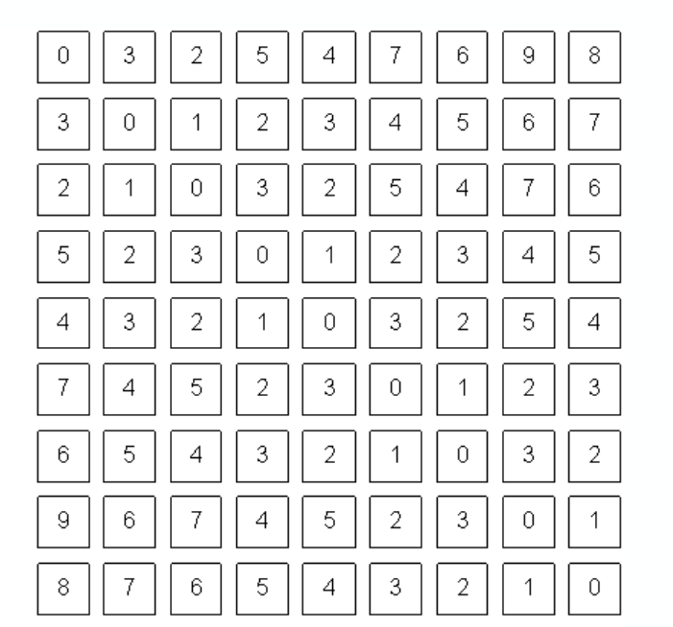
Images are a table of pixels!
Pixel: little square of one color.
A lot of pixels form an image!
In grayscale, only one value per pixel:
- black: 0
- white: 255
- gray: all in between!
Why is the value from 0 to 255?

Slide 6
Image resolution
Resolution: number of pixels in an image
0
400
332
Question: what are the coordinates of the point in the center of the image?

Slide 7
BGR color pictures
In each pixel, 3 values from 0 to 255:
  B for BLUE
  G for GREEN
  R for..? RED
0 - 0 - 0
0-0-127
0-0-255
127-0-255
0-127-0
0-127-127
0-127-255
127-127-255
0-255-0
0-255-127
0-255-255
127 - 0 - 0
127-255-0
127-255-127
127-255-255
255 - 0 - 0
255-255-0
255-255-127
255-255-255
127-127-127

Slide 8
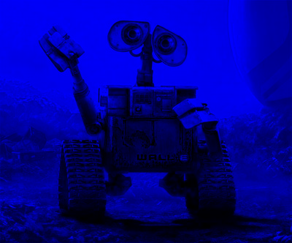
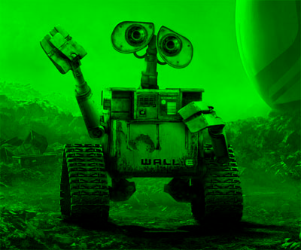
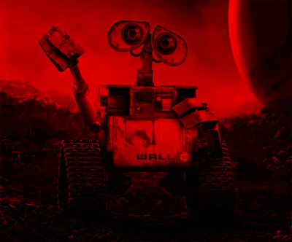

Slide 9
Your turn!
You are given an image.
Flip it!
0
400
Flip
332
Notes:
python2.7 dt_image-flip.py image-ops-original.jpg image-ops-flip.jpg

Slide 10
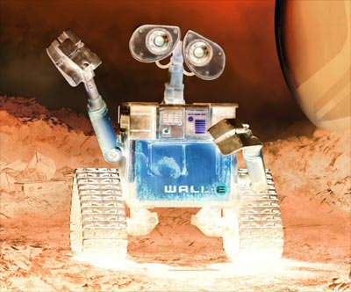
Your turn!
You are given an image.
Inverse it!
0
400
Inverse
332
Notes:
python2.7 dt_image-flip.py image-ops-original.jpg image-ops-flip.jpg

Slide 11
ROS
A middleware
Used in most universities and industries
Allows to focus on the program and not the frame
OK... but what does this mean?

Slide 12
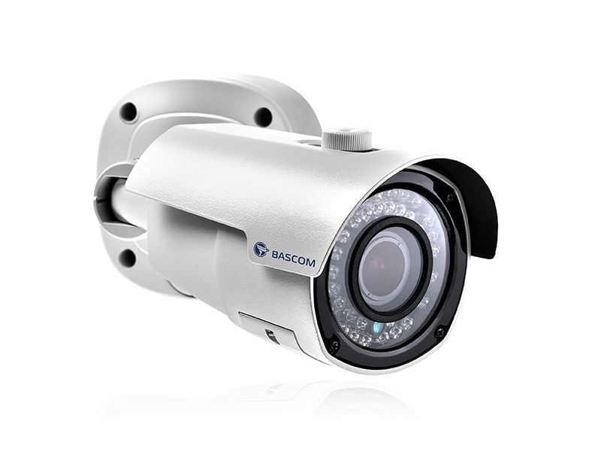
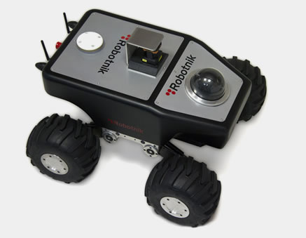
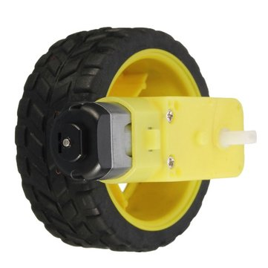
“Program” that receives the
sensor’s measurements
I got this measurement!
“Program” that decides
what to do
I need to do that!
“Program” that tells the
actuators what to do
Actuator

Slide 13
Nodes and topics
subscribe
NODE 3
NODE 1
publish
Topic 1
Topic 2
subscribe
subscribe
NODE 2
NODE 4
Each topic accepts only 1 type of message

Slide 14
Receiving a message
Addition example
subscribe
Add_node
publish
result_topic
addition_topic
Addition_msg:
float a
float b
Result_msg:
float c
addition_topic has been updated!
def Callback(addition_msg):
c = addition_msg.a + addition_msg.b
result_msg = Result_msg()
result_msg.c = c
Topic2.publish(Result_msg)

Slide 15
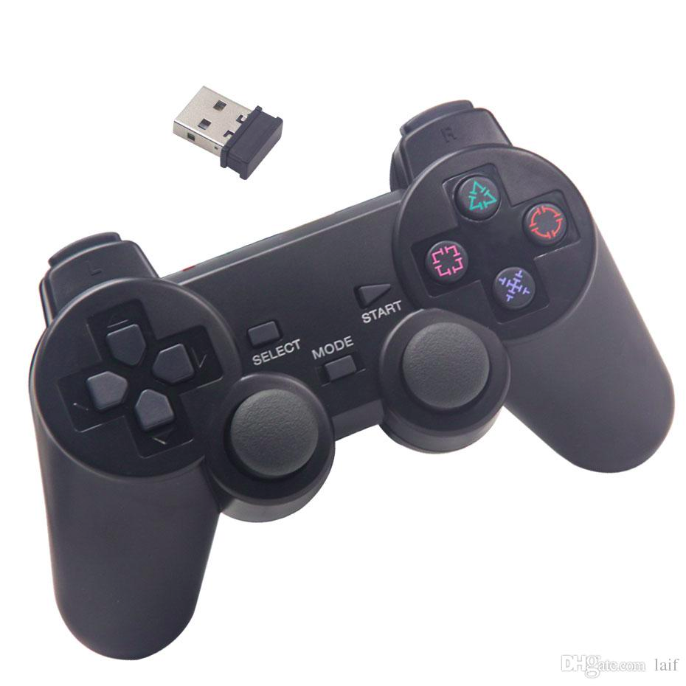
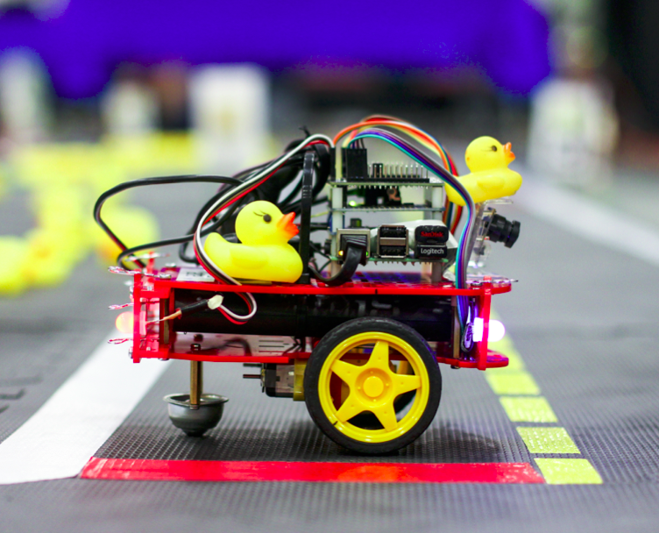
Chain example: driving with a joystick
joy_message:
int[ ] buttons
Int[ ] axis
Hey! The “forward” button has been pressed!
car_command:
float v
float omega
Joystick
joy_message
Mapper
The duckieBot must go straight
at 3 km/h!
Kinematics
car_command
wheels_command
Wheels
Both wheels must turn
at 180 deg/sec!
wheels_command:
float vel_right
float vel_left

Slide 16
Exercise: what is this doing?
def callback(distance_msg):
if distance_msg.distance < 0.5
stop_robot_msg = Stop_msg()
stop_robot_msg.stop = “True”
stop_robot_topic.publish(stop_robot_msg)
distance_msg:
float dist
Laser distance
sensor
distance_topic
Distance_compare
wheels_command
Decision_center
stop_robot_topic
stop_robot_msg:
bool stop
wheels_command:
float vel_right
float vel_left
def callback(stop_robot_msg):
if stop_robot_msg.stop
wheel_cmd_msg = Wheel_command_msg()
wheel_cmd_msg.vel_right = 0
wheel_cmd_msg.vel_left = 0
wheel_command_topic.publish(wheel_cmd_msg)
Wheels

Slide 17

Exercise: what is this doing?
def callback(distance_msg):
if distance_msg.distance < 0.5:
stop_robot_msg = Stop_msg()
stop_robot_msg.stop = True
stop_robot_topic.publish(stop_robot_msg)
distance_msg:
float dist
Laser distance
sensor
distance_topic
Distance_compare
wheels_command
Decision_center
stop_robot_topic
stop_robot_msg:
bool stop
light_msg:
bool on
string color
Light_control
def callback(stop_robot_msg):
if stop_robot_msg.stop:
light_msg = light_msg()
light_msg.color = “red”
light_msg.on = true
light_topic.publish(light_msg)
Wheels
light_topic
Light

