Slide 1
Ground projection

Slide 2
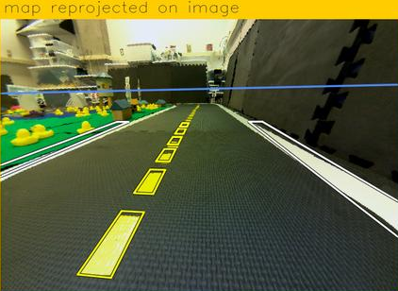
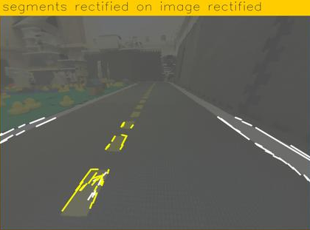
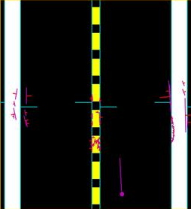
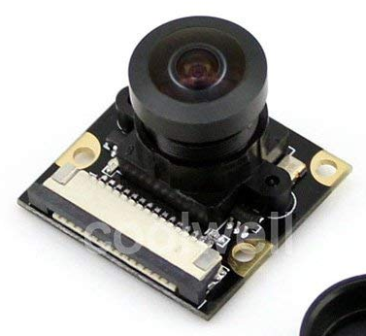
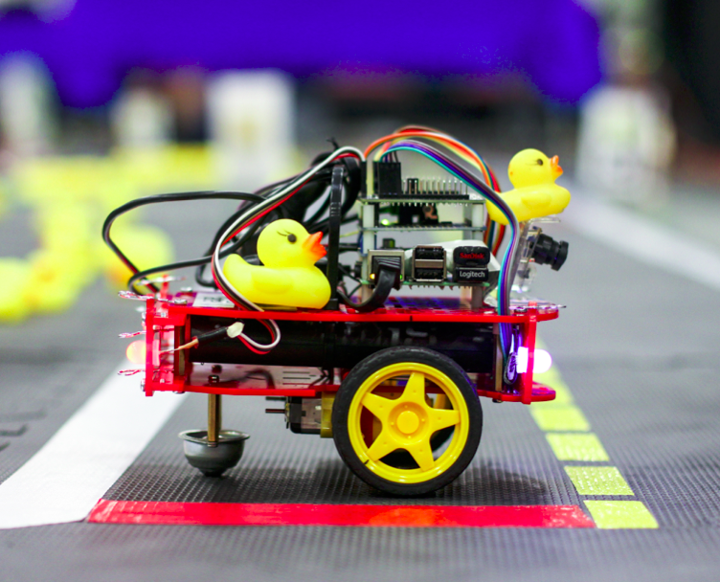
Following lanes – Overview
Camera
line_detector
image
line_detector
segment_list
lane_filter
robot_pose
lane_filter
line_positions
ground_projection
ground_projection
Motion
Control
lane_controller
lane_controller
car_cmd

Slide 3
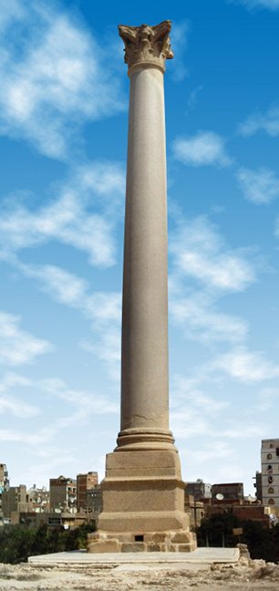
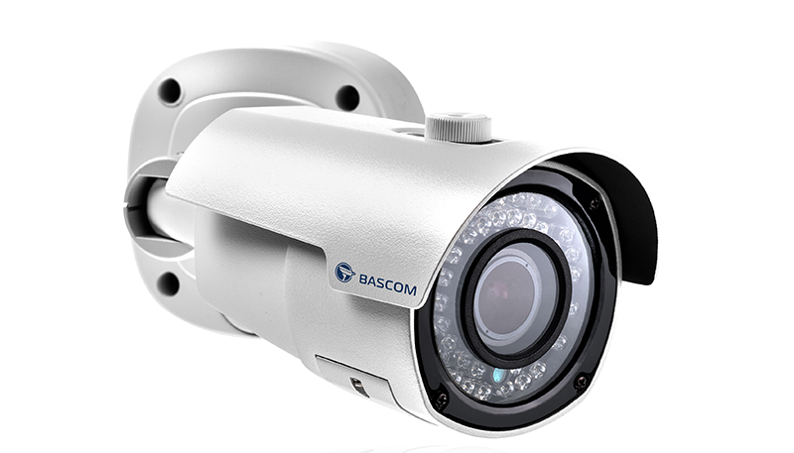
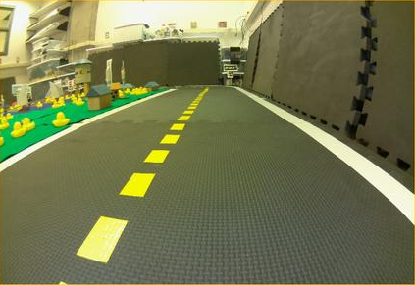
Perception : Line detection
Sensing
Information
Extraction
Raw data
It’s a pillar!
Here are the lines

Slide 4
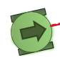
Perception : Ground projection
y
x
Where are the lines with respect to me?

Slide 5

How does a camera work?
A sensor (CMOS or CCD) : a matrix of a lot of pixels. Each pixel detects
the light and colors hitting it.

Slide 6
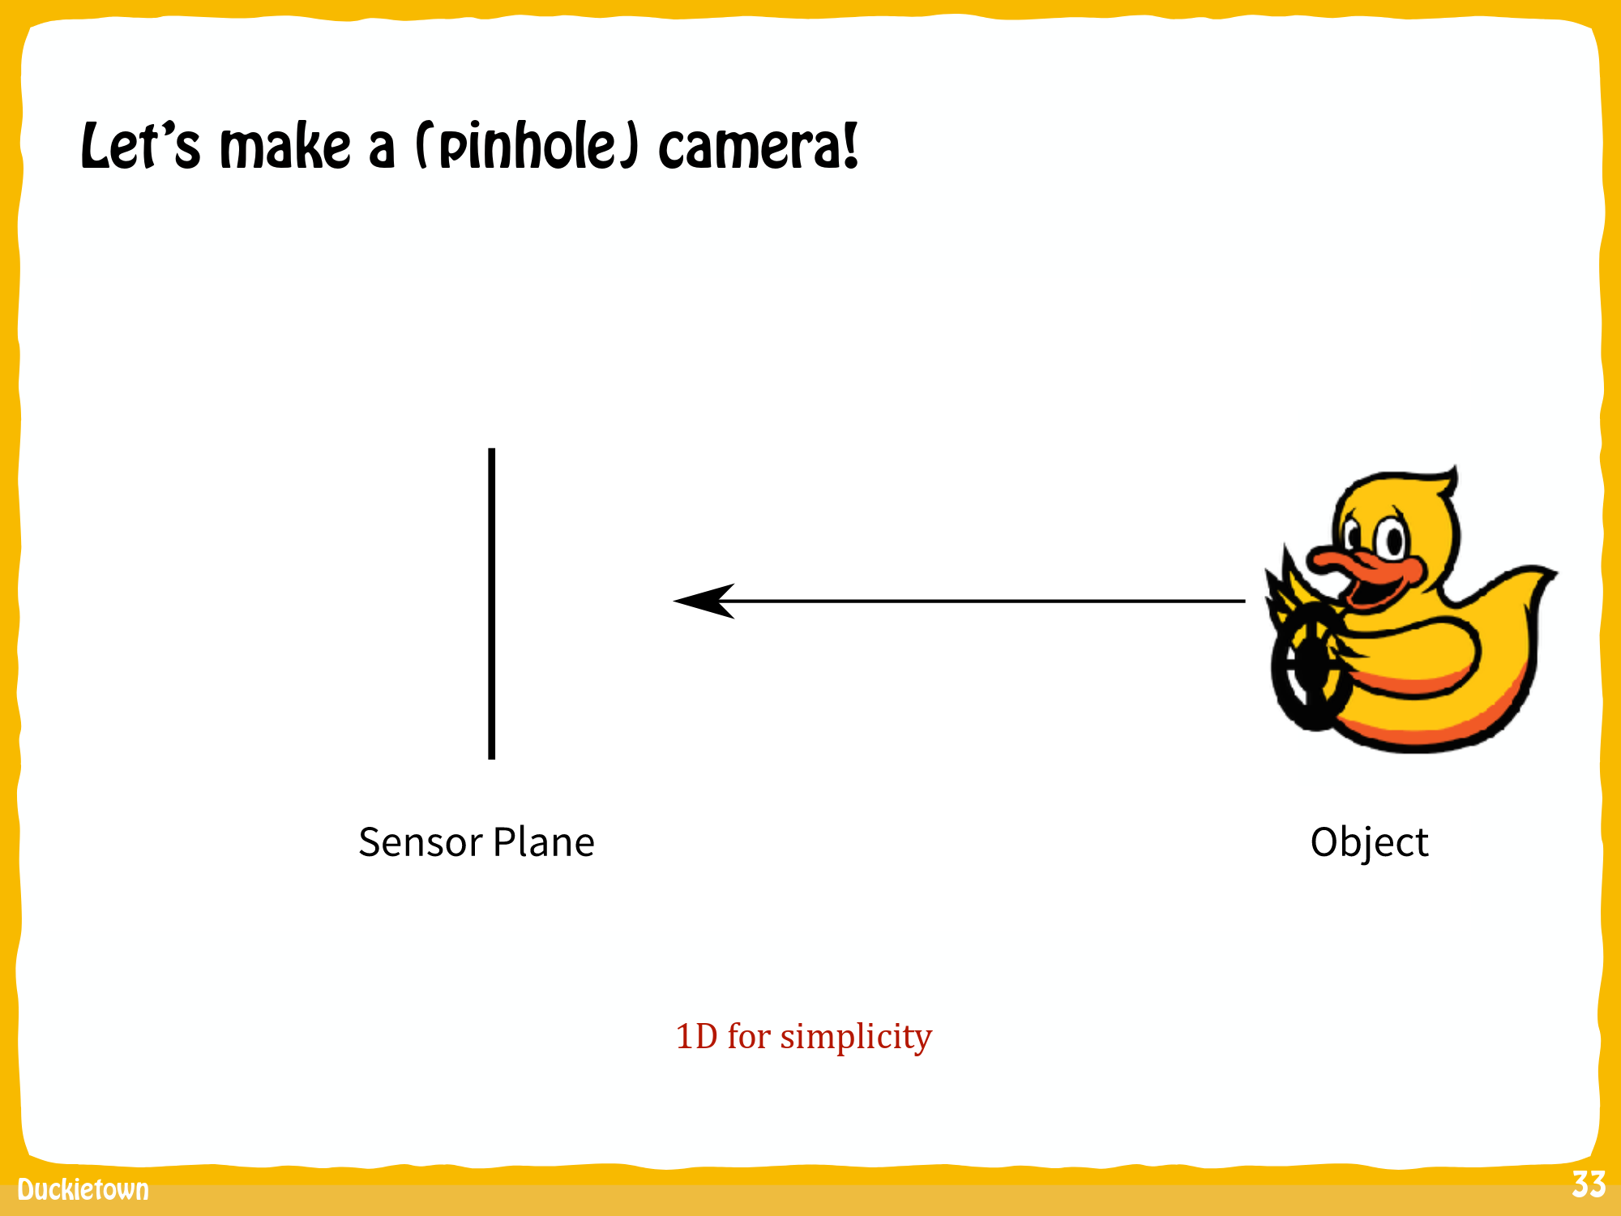
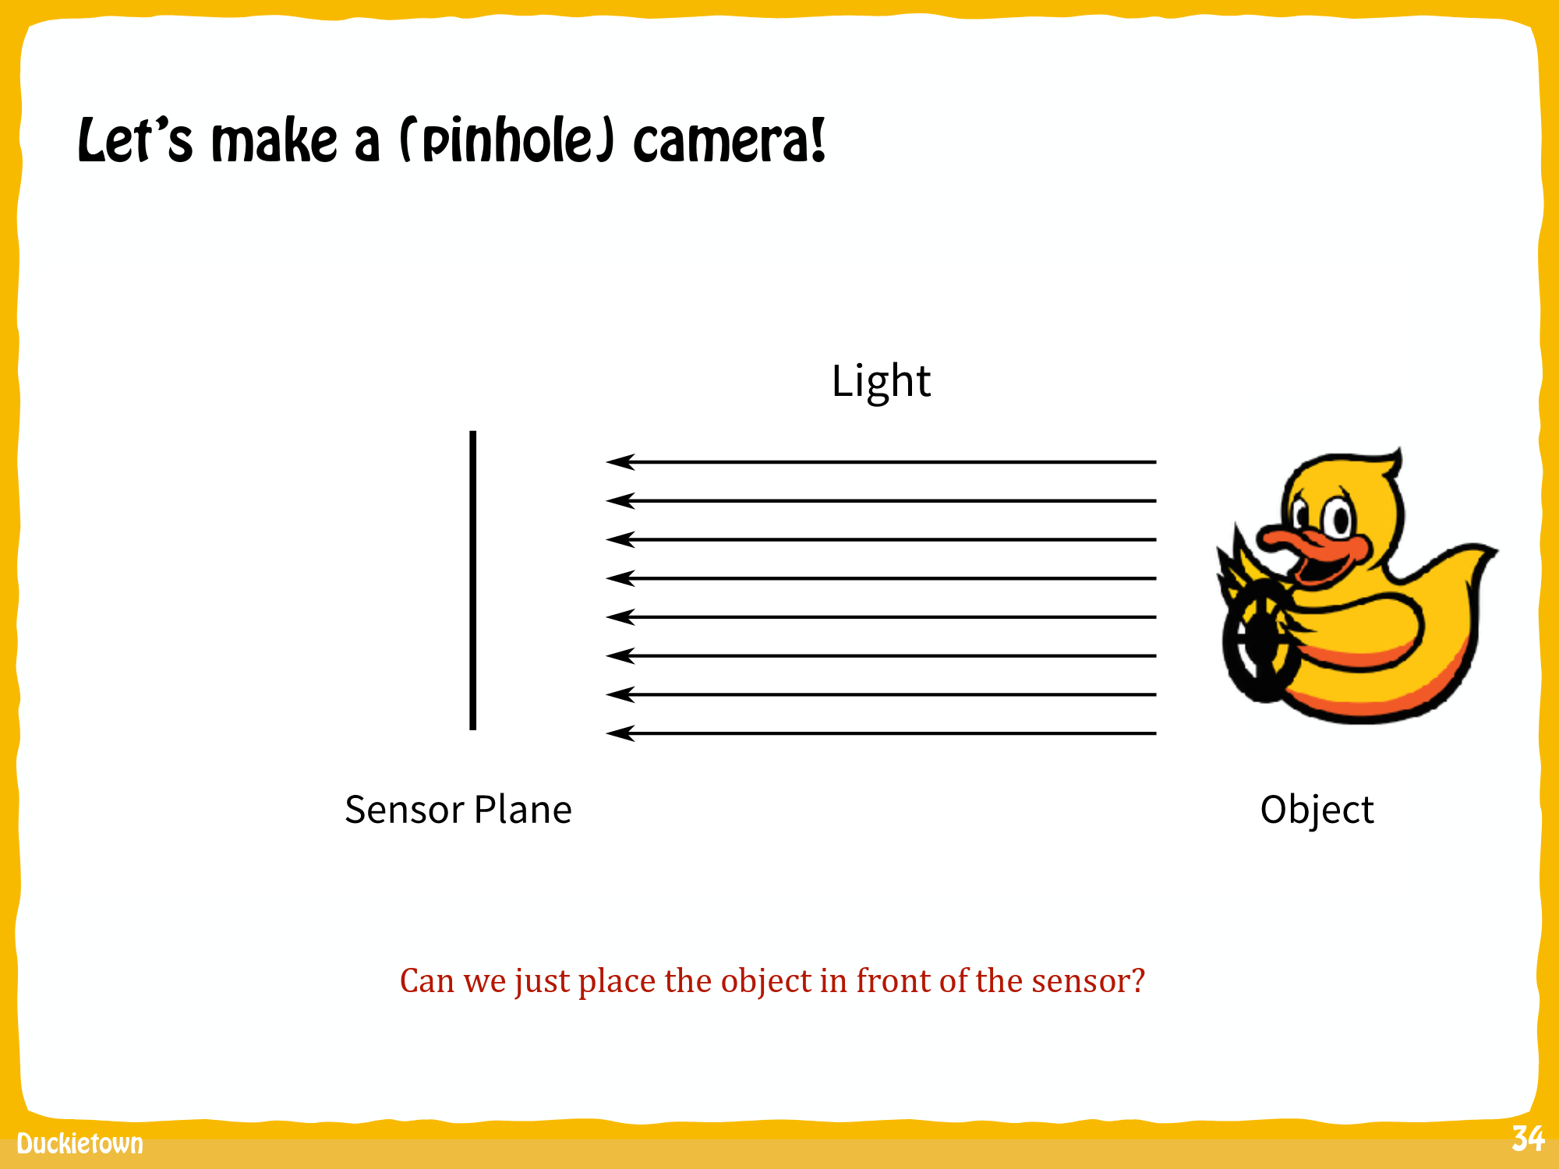
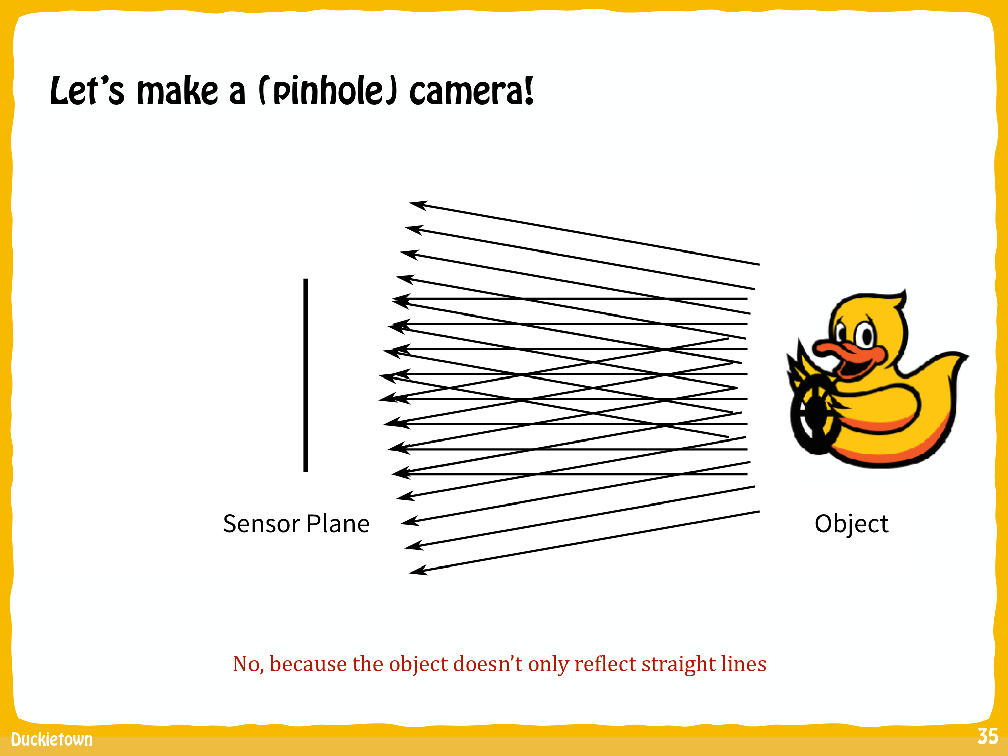
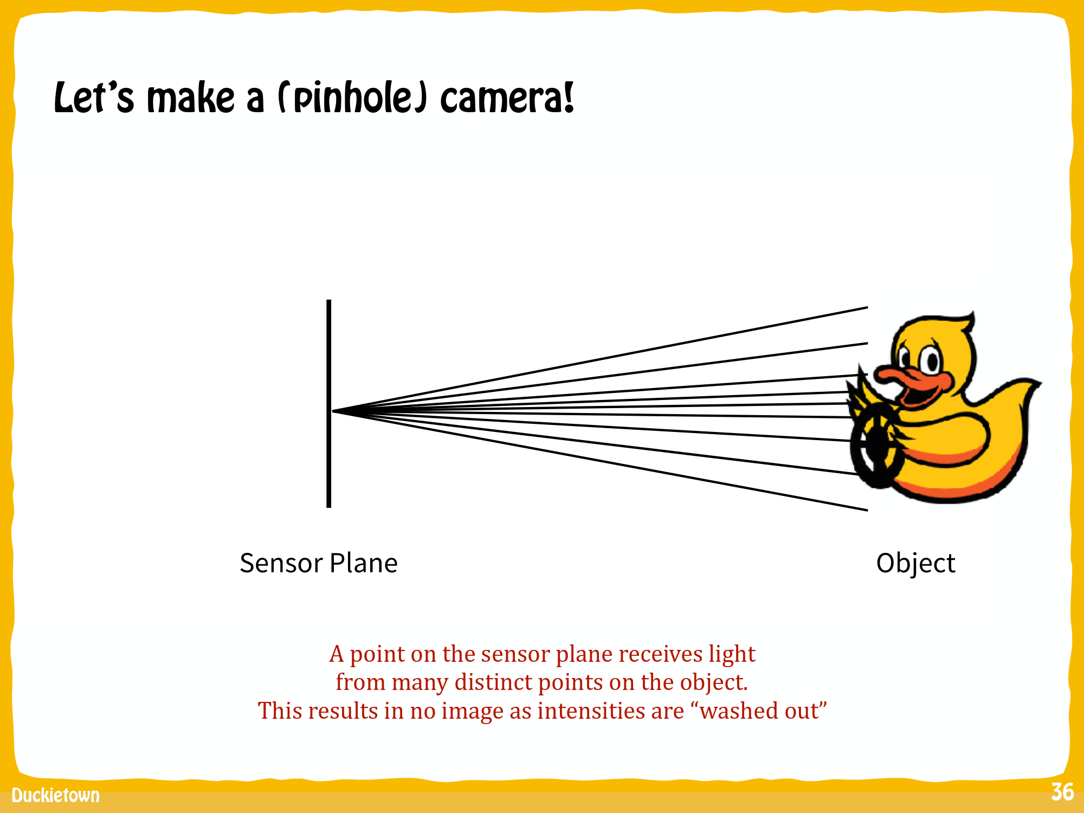
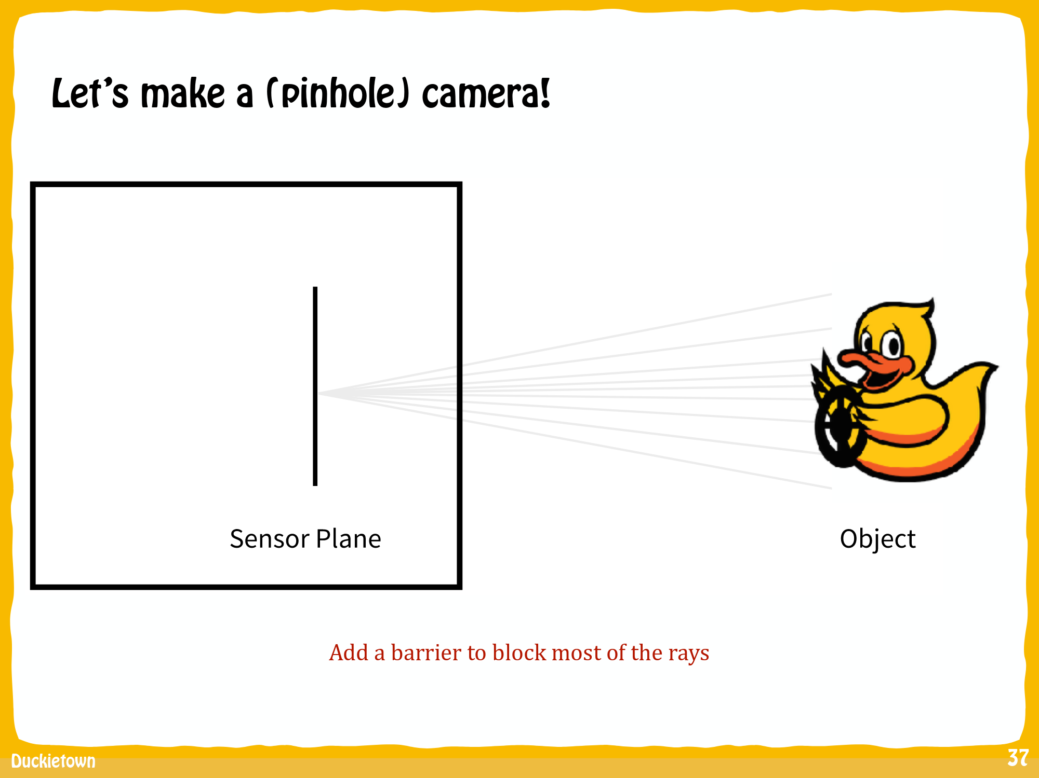
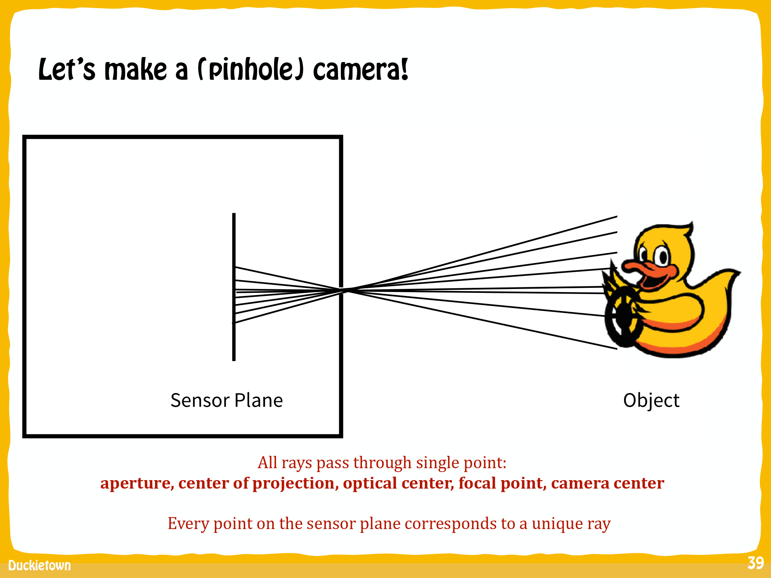
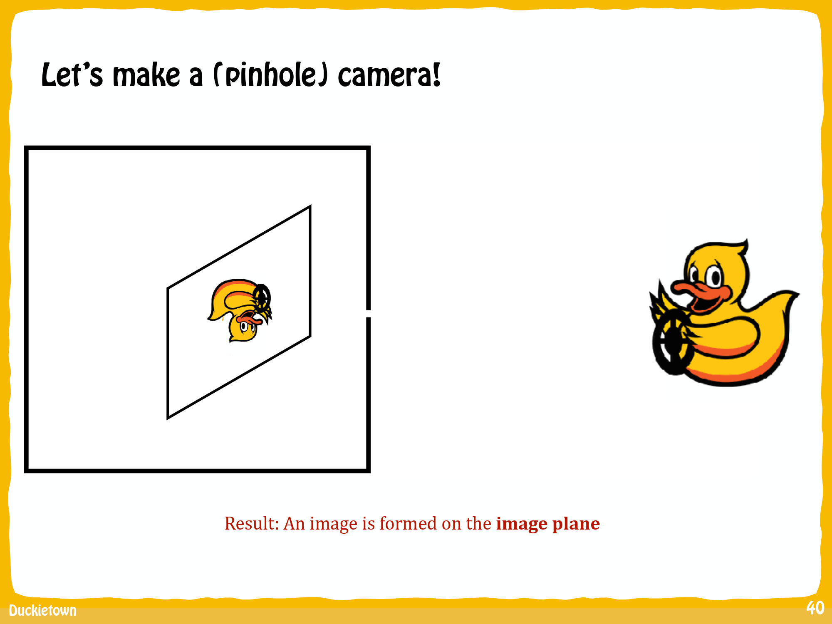
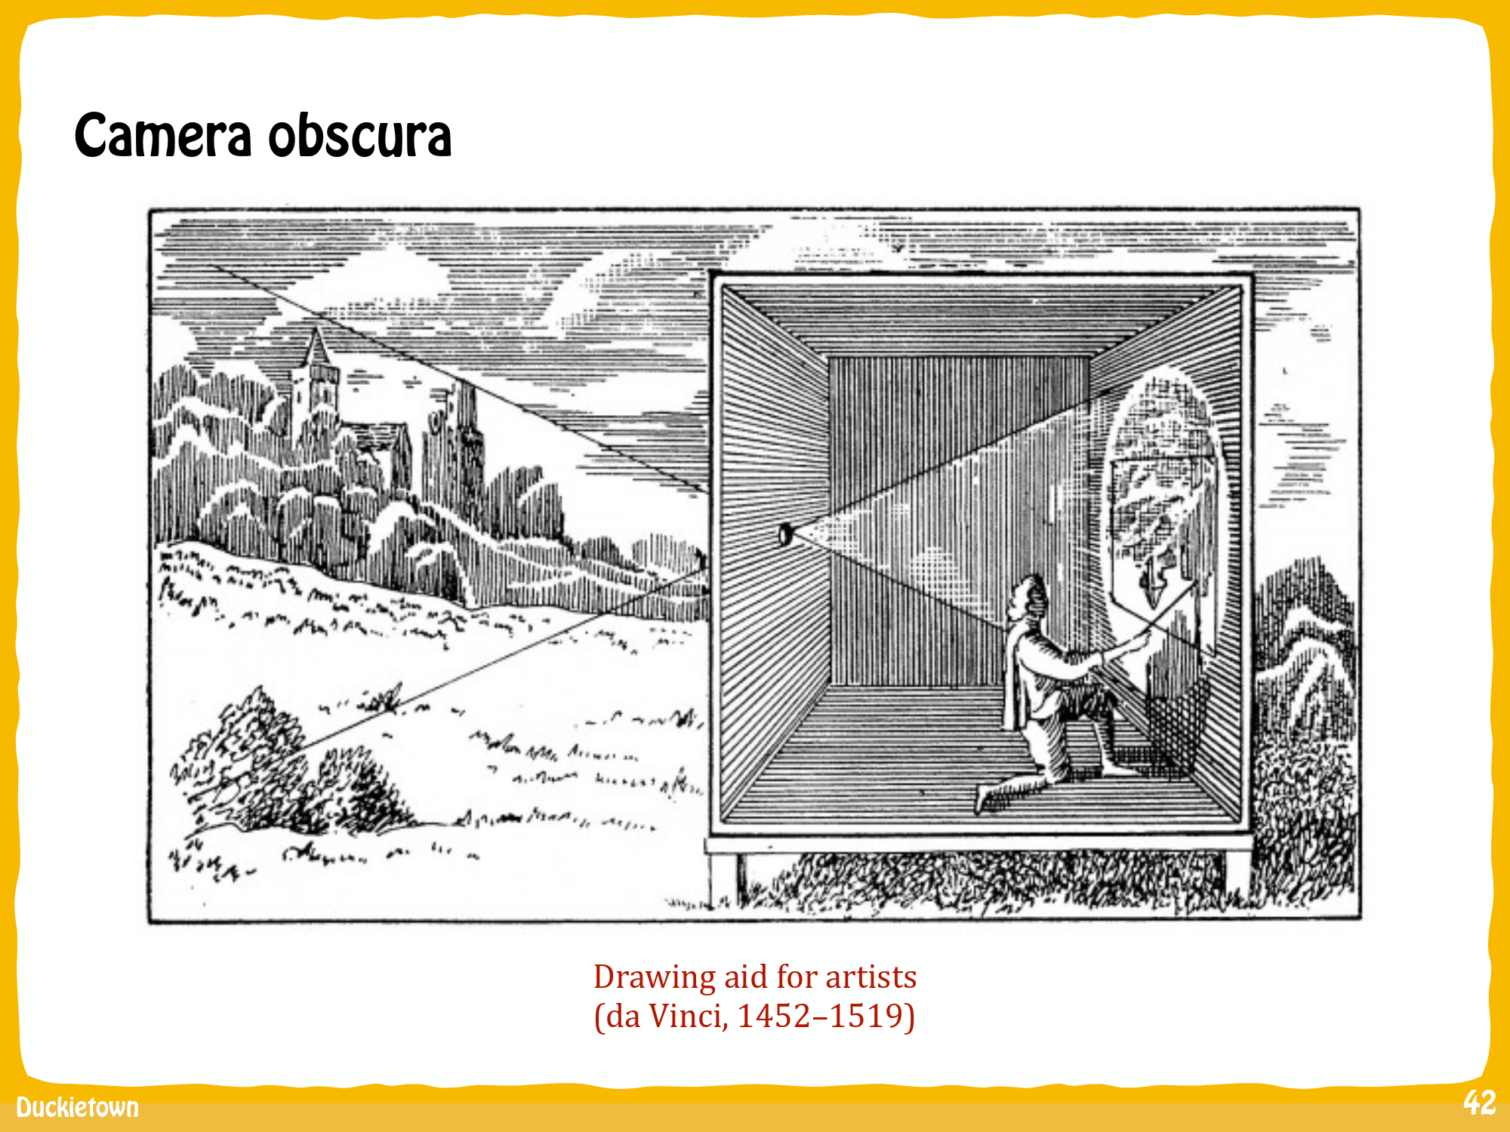

Slide 7
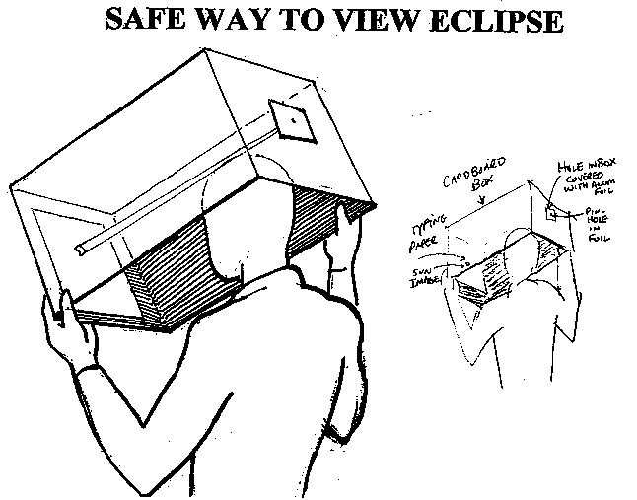

Slide 8
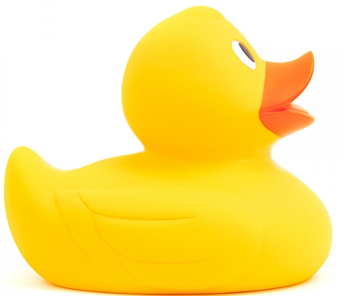
World to image
3
2
1
1
2
3
x

Slide 9
World to image
Notice that point 2 is now at the same pixel that point 1 was before.
Normal: they are at the same position with respect to the camera!
3
2
1
2
3

Slide 10
What does this mean?
u
v
3
2
If a point (x, y) is on the ground (z = 0), there is a unique function
such that (u, v) represent the pixels of the point on the camera image.

Slide 11

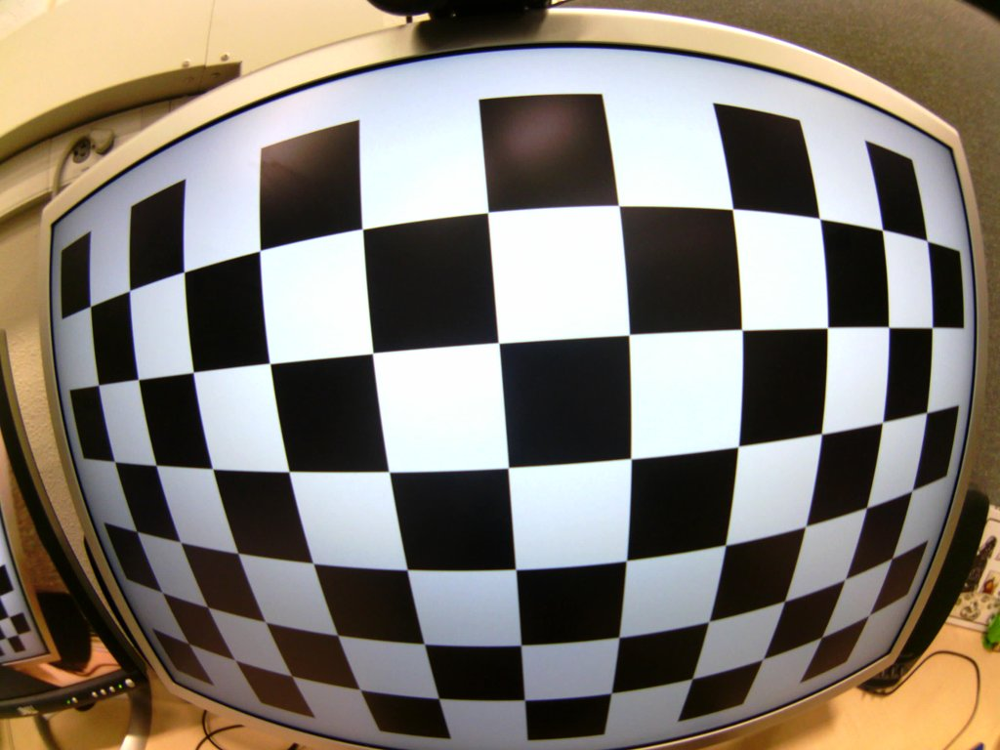
According to you, what influences
on this function?
Intrinsic camera parameters
(lens effect, opening angle, ...)
Position/orientation of the camera with respect to the ground and the DuckieBot
How do we get this function?
We calibrate!

Slide 12

Calibration: take something we KNOW and see what does the camera give us.
Example: a checkboard.
Let’s do it for real!
Notes:
Moose:
cd duckietown
source environment.sh
roslaunch duckietown camera.launch veh:=moose raw:=true
Raptor:
$ cd duckietown
$ source environment.sh
$ source set_ros_master.sh moose
$ roslaunch duckietown intrinsic_calibration.launch veh:=moose
“Commit”
And then git commit in duckiefleet

Slide 13
Step 1: Internal camera parameters
Move the checkboard in all directions (up-down, left-right, close-far, turn it).
This allows to correct the weird effects on the sides!

Slide 14
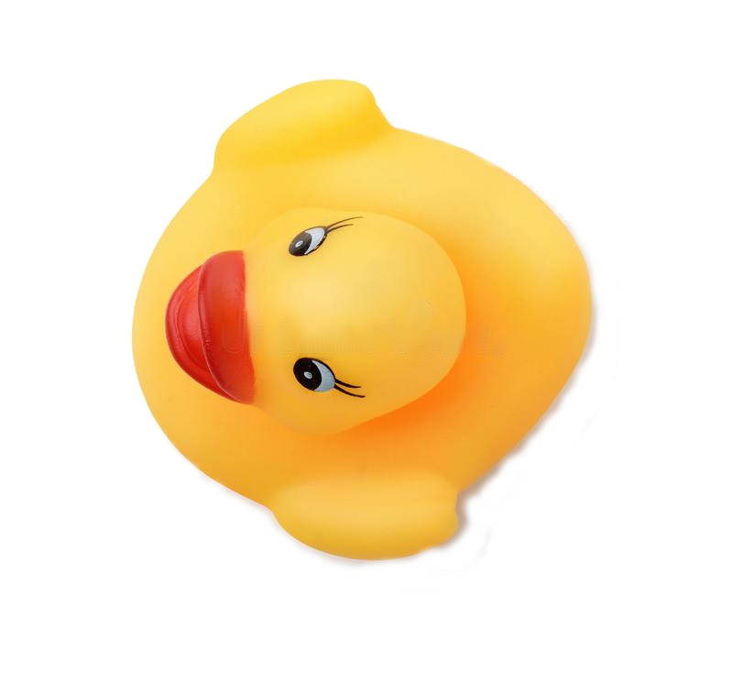
Step 2: Position and orientation of the camera
Put the bot in a known position in front of the checkboard.
This allows to know exactly the projection of each pixel on the ground!

Slide 15
Alright, all this is done.
What did we get from this?
Great!
But... why did we want this again?

Slide 16
Remember what we are looking for?
What we have is (u, v): position of lines on the image.
What we want is (x, y): position of lines on the ground.
Knowing f allows us to do the inverse operation.

Slide 17
How does it work?
The calibration gives us the “homographic” matrix H.
We can describe f ⁻¹ in 2 steps:
1)
2)

Slide 18
Your turn!
Implement 1) and 2) in the the pixel2ground function
of GroundProjection.py
1)
2)

Slide 19
Still your turn!
H that has been computed for a very similar camera.
Experiment with it to tell me: from which v is the horizon?
0
u
640
H
v
480
Notes:
128

Slide 20
Think further
If you did not know the point was
on the ground, what would you be able to know from u and v?

