Slide 1
Lane filter

Slide 2

Autonomous mobile robot
See – think – act
Localization
Cognition
Think
See
Act
Real world
environment
Perception
Motion control
THIS IS THE MOST IMPORTANT SLIDE OF THE WEEK!
Autonomous Mobile Robots – R. Siegwart, I. Nourbakhsh, D. Scaramuzza

Slide 3
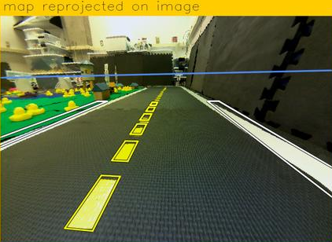
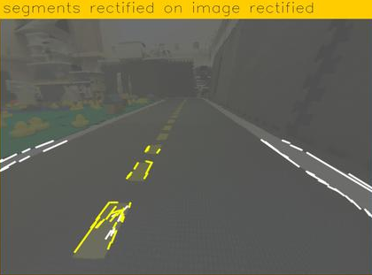
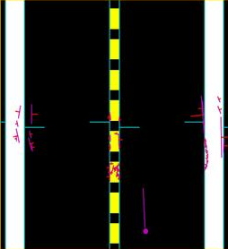
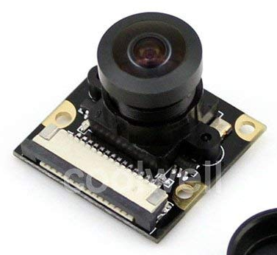
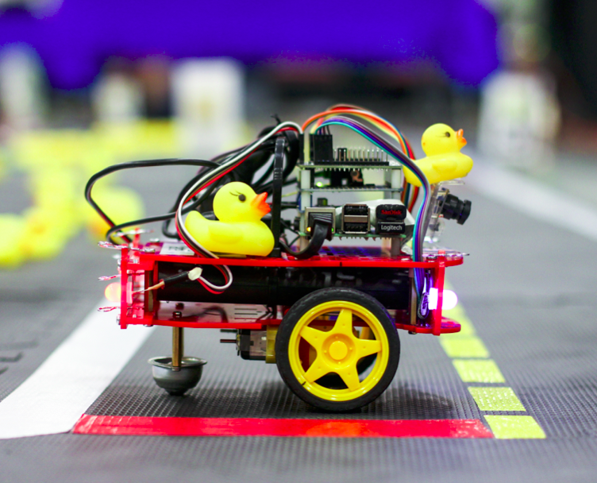
Following lanes – Overview
Camera
line_detector
image
line_detector
segment_list
lane_filter
robot_pose
lane_filter
line_positions
ground_projection
ground_projection
Motion
Control
lane_controller
lane_controller
car_cmd

Slide 4
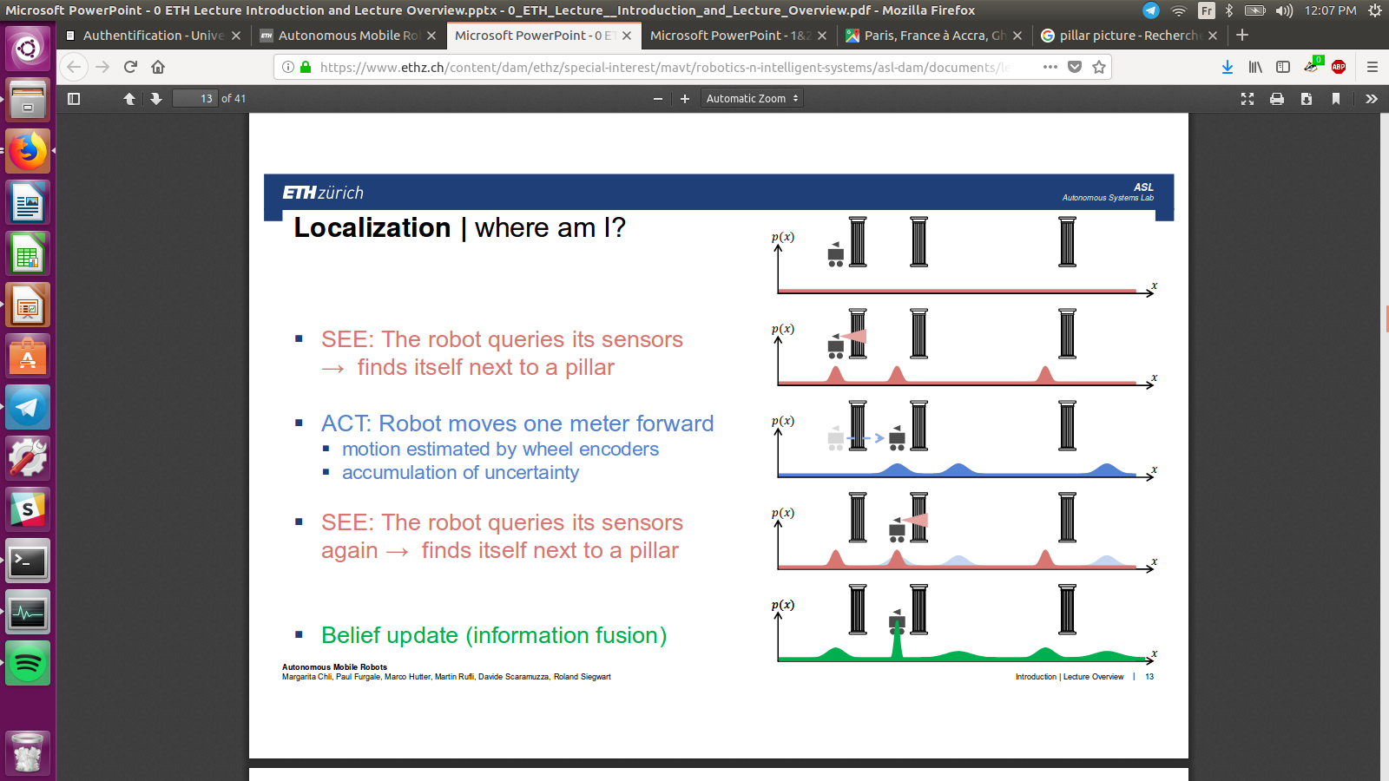
Localization
Data base
Information
Position
Movement
#
Data base: where are the pillars.
Autonomous Mobile Robots – R. Siegwart, I. Nourbakhsh, D. Scaramuzza
I see a pillar
There are 3 places I can see a pillar from
I moved forward
This is where I can be now
I see a pillar again
There are 3 places I can see a pillar from
Therefore I must be here now

Slide 5
Lane filter
Predict
Update
With movement
With measurements and database

Slide 6

Localization
Data base
Information
Position
Movement
Position of white, red and
yellow lines with respect
to Moose
Distance from lane center: d
Orientation: φ
Applied
Velocities

Slide 7
What do we want to estimate?
Distance d
from center of lane
d > 0 : too much on the left
Orientation φ
from straight direction
φ > 0 : looking too much to the left
φ

Slide 8
Can we be sure?
Do you see anything
interesting on this
picture?

Slide 9
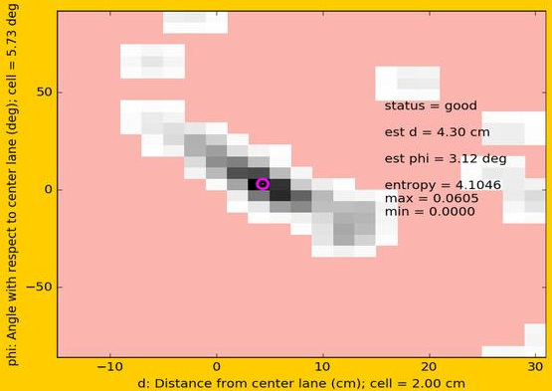
Representing belief
  p( d, φ )
1.5
0.2
0.1
φ
0
-0.1
-0.2
...
-1.5
-0.15
...
-0.02
0
0.02
0.04
...
0.3
d

Slide 10
Representing belief
  p( d, φ )
This is a probability map. The sum of all elements is 1.

Slide 11
Lane filter
d
φ
Predict
Update
With applied velocities
With position of lanes

Slide 12
Predicting
the previous orientation estimation
How would you get
φ_new and d_new?
the previous position estimation
the angular velocity
the linear velocity
the time since previous estimation

Slide 13
Your turn! Find a way to estimate φ_new and d_new.
the previous orientation estimation
the previous position estimation
the angular velocity
the linear velocity
the time since previous estimation

Slide 14
Predicting
Angular velocity ω is the derivative of orientation φ!
Therefore:

Slide 15
Predicting
Linear velocity v is the derivative of position... in 2 dimensions!
φ
v
d
d_{new}
d_{old}

Slide 16
Predicting
Linear velocity v is the derivative of position... in 2 dimensions!
We need to project v
in the d direction.
φ
v
v_{d}
d
d_{new}
d_{old}

Slide 17
Predicting
Dynamic equations:

Slide 18
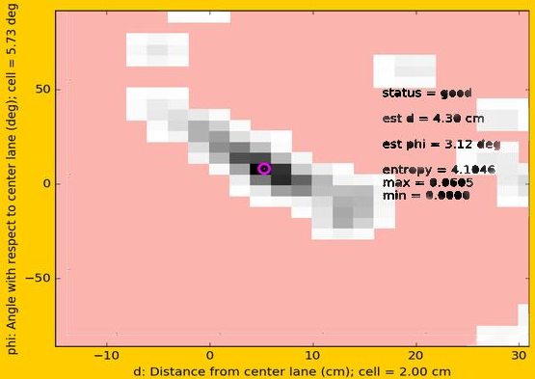
Propagate prediction on belief
Move of each point with a
ω·δt in the φ direction
v·sin(φ)·δt in the d direction

Slide 19
Lane filter
d
φ
Predict
Update
With applied velocities
With position of lanes

Slide 20
Updating
Idea: combine
  Our current idea of where we are: the prior
  p( d, φ )
  The probability of observations m: the likelihood
  p ( m | d, φ )
To get the posterior
p( d, φ | m)

Slide 21
Probabilities...
This is Bayes law!
We want this
(posterior)
We can evaluate this
(likelihood)
We have this (prior)
We don’t need this (normalization constant)

Slide 22
Probabilities...
We want this
We can compute this
We have this (prior)
We don’t need this because we can normalize:

Slide 23
Probabilities...
How do we compute the likelihood?

Slide 24
Computing the likelihood
is computed by voting.
1) For each line in m, we compute the corresponding d and φ
2) We add +1 in the corresponding square of a new belief map
3) We normalize the new belief map when we have seen all the maps.

Slide 25
What do we want to estimate?
Distance d
from center of lane
d > 0 : too much on the left
Orientation φ
from straight direction
φ > 0 : looking too much to the left
φ

Slide 26
Computing the likelihood
1) For each line in m, we compute the corresponding d and φ
2) We add +1 in the corresponding square of a new belief map
3) We normalize the new belief map when we have seen all the maps.
Line position
φ
0
x
y
0
d

Slide 27
Computing d and φ for each line
1) For each line in m, we compute the corresponding d and φ
x
φ
φ
y

Slide 28
Your turn!

Slide 29
Your turn
1) For each line in m, we compute the corresponding d and φ
x
φ
φ
y

