Slide 1
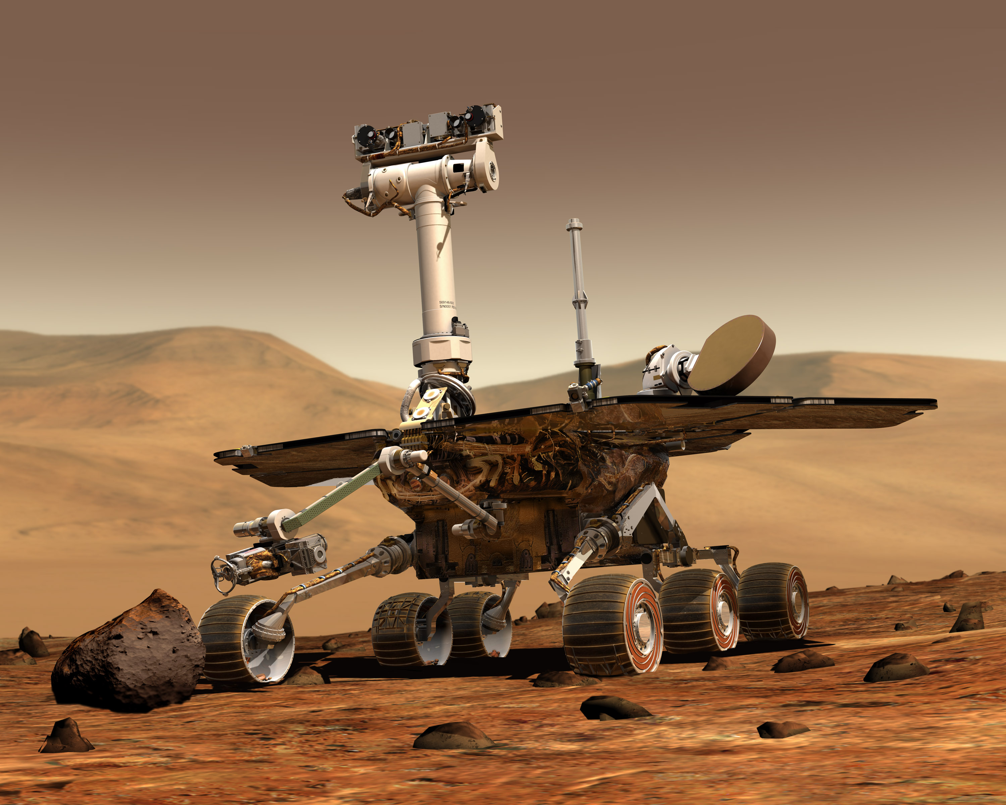
Autonomous mobile robots

Slide 2
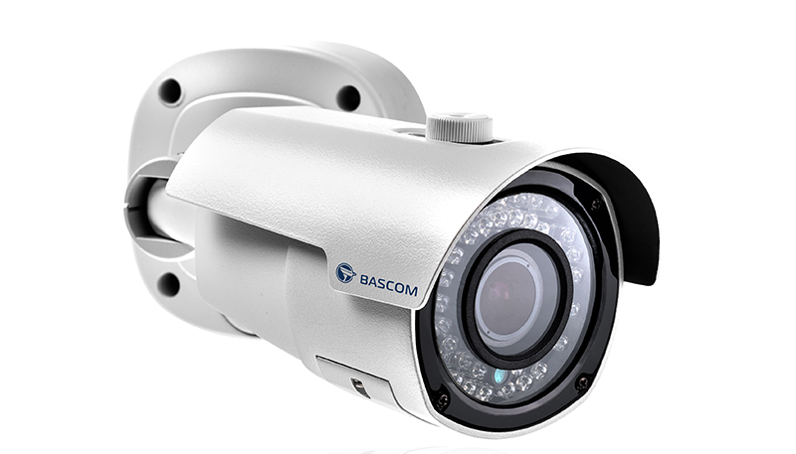
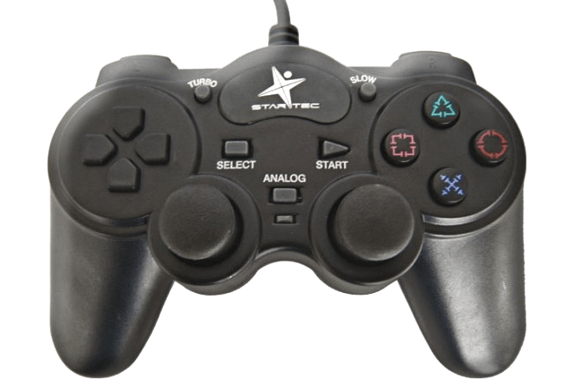
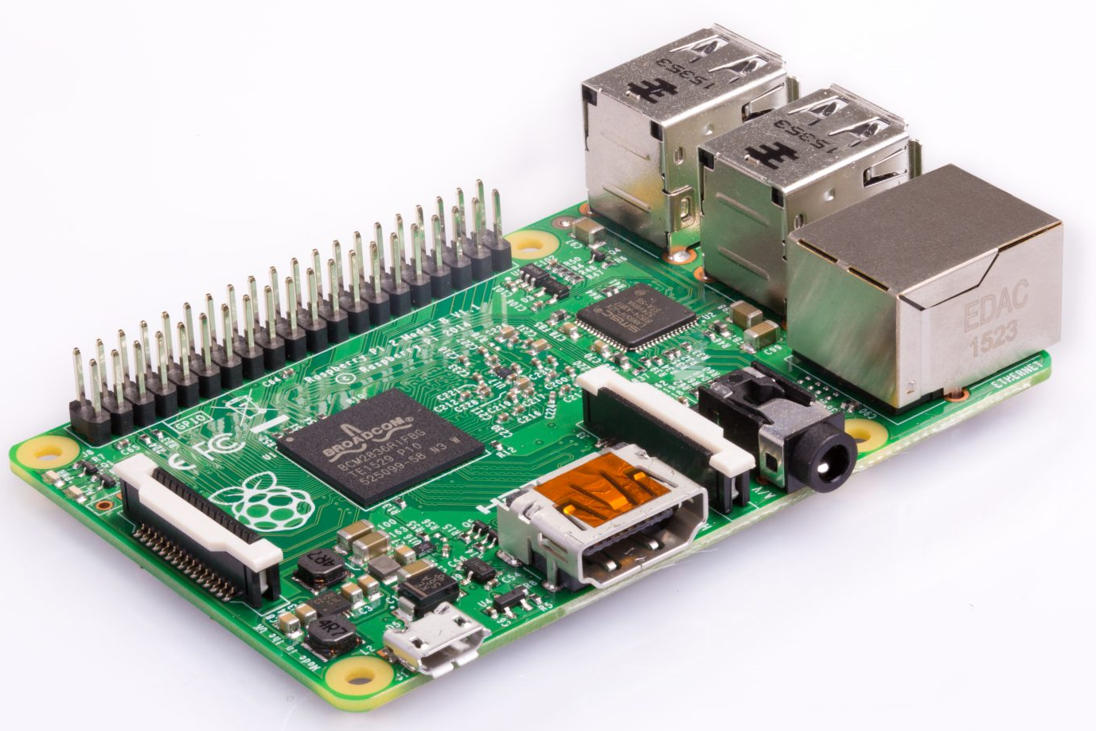
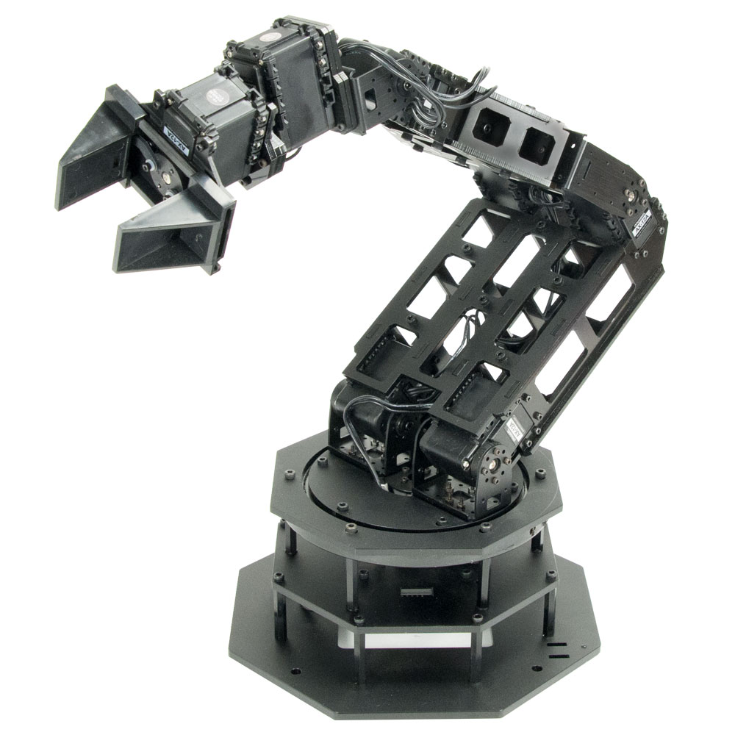
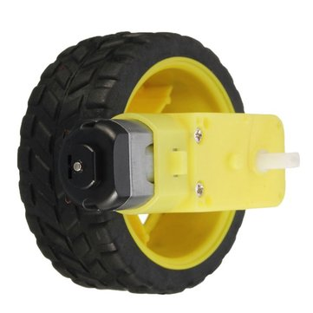
How does a robot work?
1) Sensors
Get information from the environment.
2) Processor
Understand this information and take decisions
3) Actuators
Act the decisions upon the real world

Slide 3
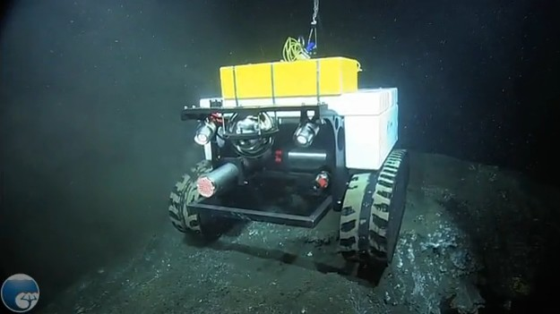
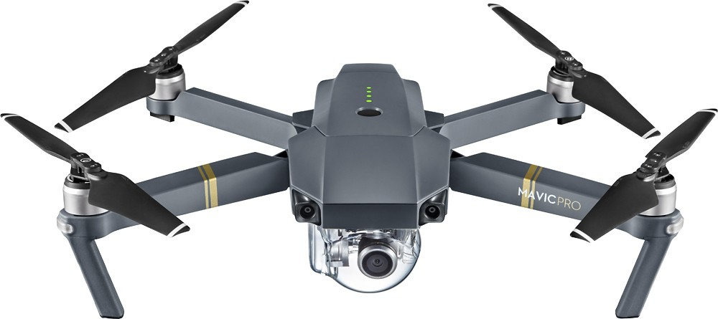
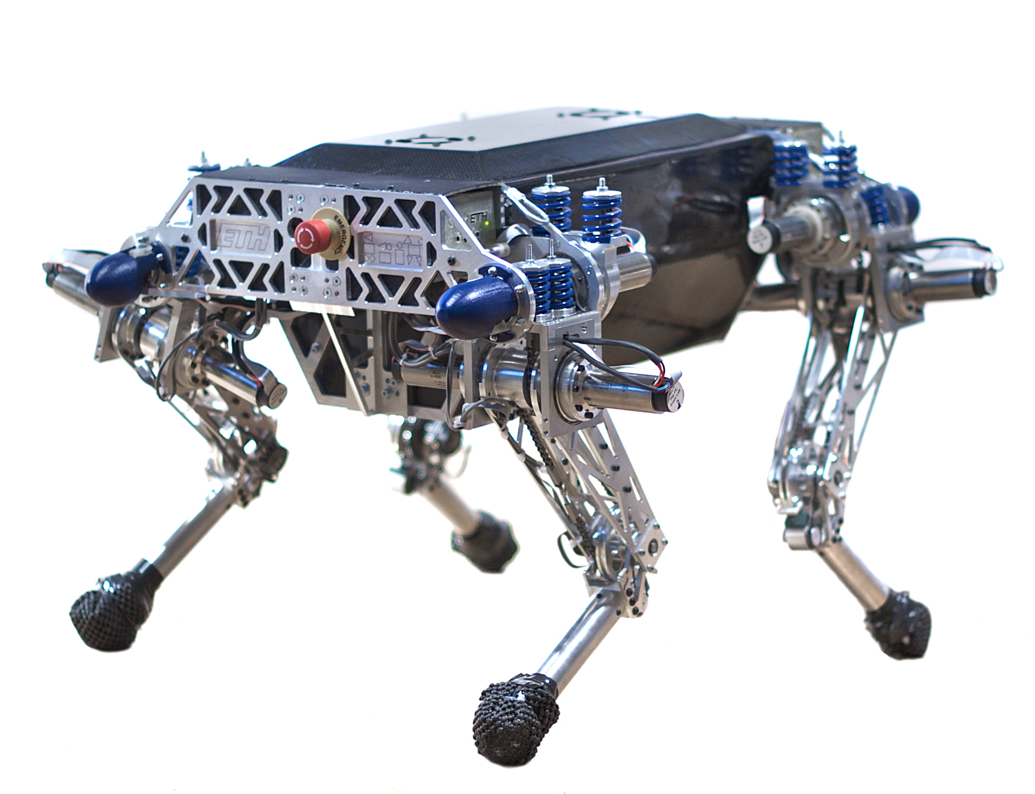
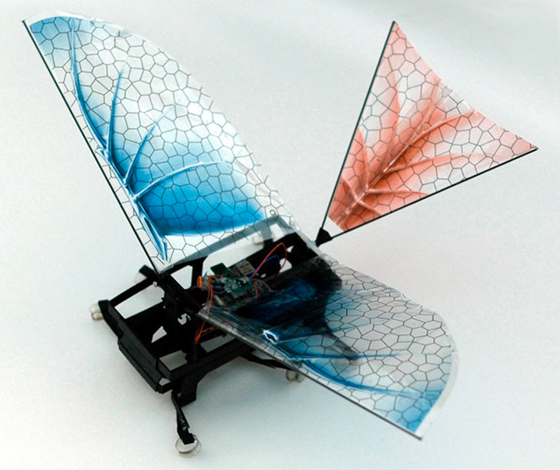
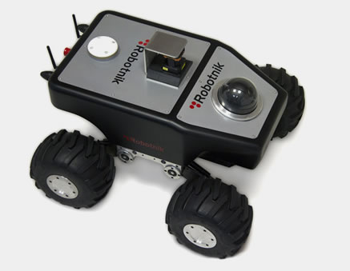
Mobile robot
Some actuators allow it to move:
  Wheels
  Legs
  Propellers
  Wings
  Caterpillar
  ...

Slide 4

Autonomous mobile robots
3 key questions:
  Where am I?
  Where should I go?
  How do I go there?

Slide 5
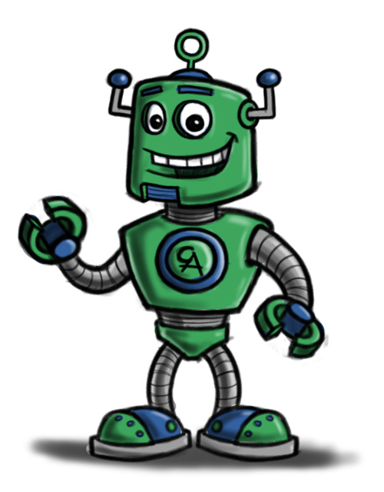
Autonomous mobile robot
See – think – act
Localization
Cognition
Think
See
Act
Real world
environment
Perception
Motion control
THIS IS THE MOST IMPORTANT SLIDE OF THE WEEK!
Autonomous Mobile Robots – R. Siegwart, I. Nourbakhsh, D. Scaramuzza

Slide 6
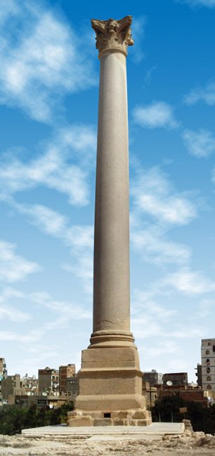
Perception
Sensing
Information
Extraction
Raw data
It’s a pillar!

Slide 7
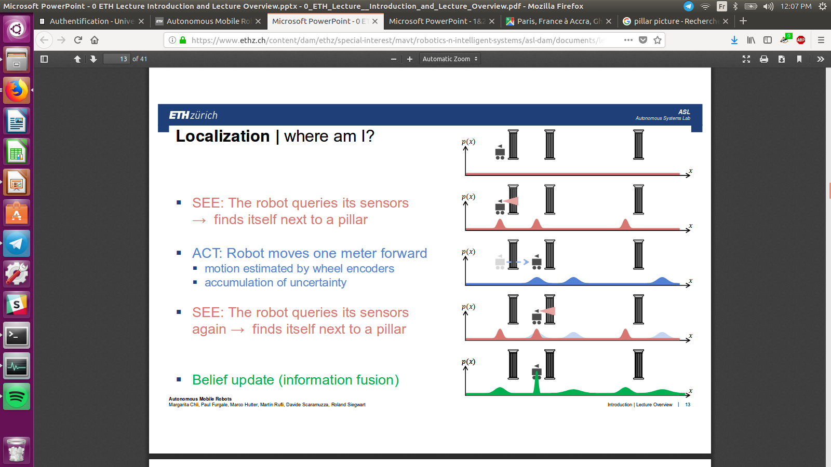
Localization
Data base
Information
Position
Movement
#
Data base: where are the pillars.
Autonomous Mobile Robots – R. Siegwart, I. Nourbakhsh, D. Scaramuzza
I see a pillar
There are 3 places I can see a pillar from
I moved forward
This is where I can be now
I see a pillar again
There are 3 places I can see a pillar from
Therefore I must be here now

Slide 8
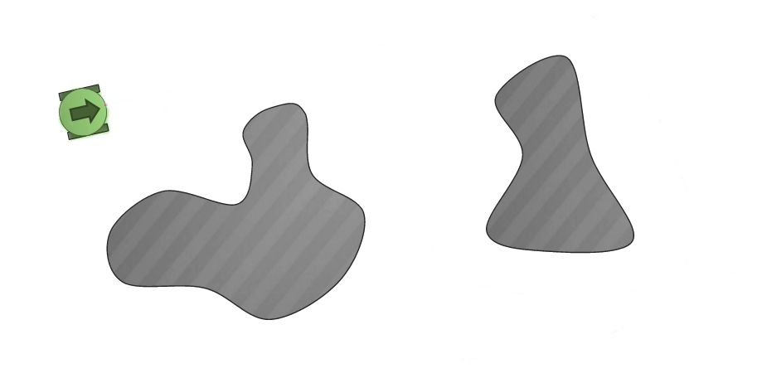
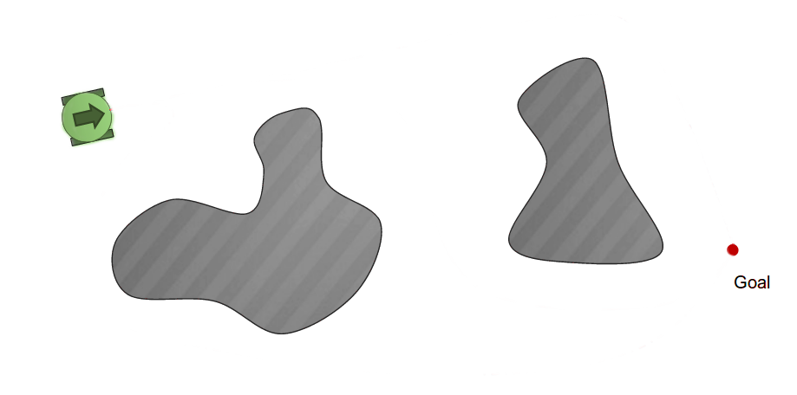
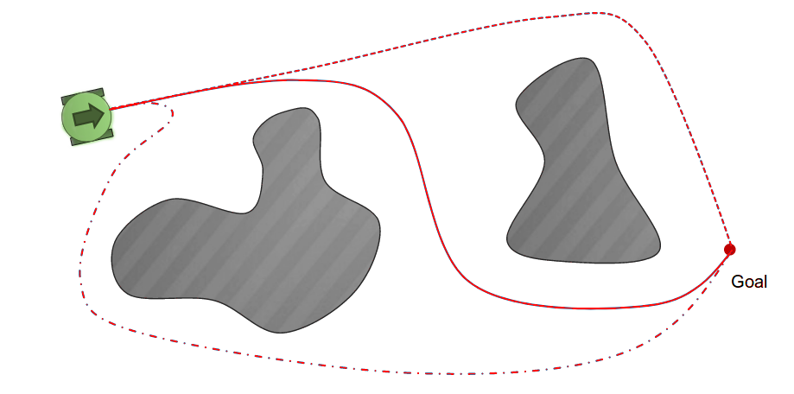

Cognition
Mission
Position
Movement
command
Global map
Forward!

Slide 9
Motion control
Movement
command
Movement
execution
Actuator
commands
Acting
Wheels have to turn:
Forward
Same speed for both
Forward!
Wheels, turn!

Slide 10
Then, we start the loop again
Think
See
Act
And again, and again, and again...
Unitl we reach our goal!

Slide 11
Discussion
Why do we have to repeat the cycle?
Why could not we just decide once what to do and just do it?
Try to walk
closing your eyes!

Slide 12

Discussion
You are a robot!
  What are your sensors and actuators?
  How do you do Perception? Localization? Cognition? Motion control?

