Slide 1
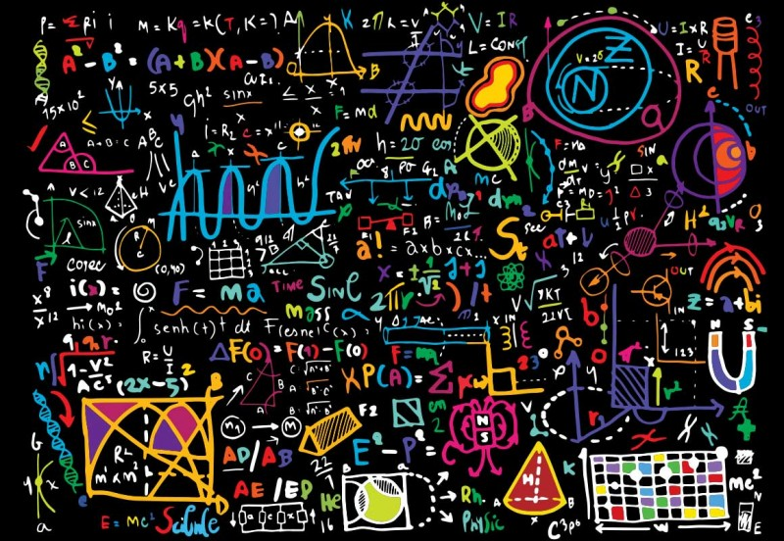
Maths and Physics
Quick review exercises

Slide 2
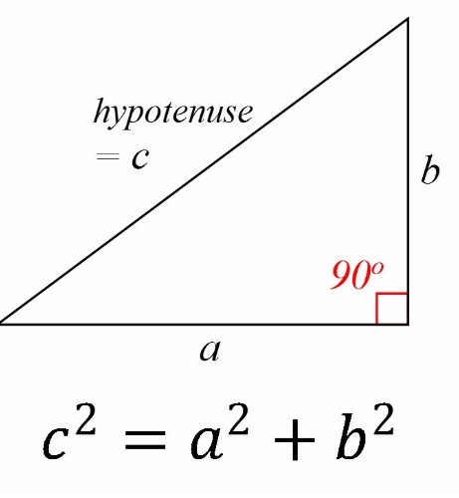

Pythagoras’ theorem
The square on the hypotenuse is equal to
the sums of the squares on the other two sides.

Slide 3
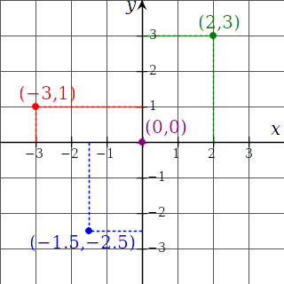
Coordinate system & vectors
A
B
O
C
B
A
C
C
O
A
Compute for each of those vectors:
- the length of each vector.
- a unit vector in the same direction
- a perpendicular unit vector (norm)
Notes:
|AO| = sqrt(4 + 9) = sqrt(13) = 3.6
|BC| = sqrt(1.5^2 + )(-3.5)^2) = 3.81
|AC| = sqrt((-3.5)^2 + (-5.5) ^2) = 6.52

Slide 4
Coordinate system & vectors 2
A
B
O
C
Compute :
C
A
A
O
C
A
A
O
B
A
O
O
Notes:
AC * AO = (-3.5, -5.5) * (-2,-3) = -7 - 16.5 = 23.5
= |AC| * |AO| * cos(AC, AO)
BO x AO = (-3, 1, 0) x (2, 3, 0) = (0, 0, -12)
|BO x AO| = |BO| * |AO| * sin(BO, AO)

Slide 5
Coordinate system & vectors 3
A
B
O
C
Compute the angle between:
C
A
A
and
O
B
C
O
and
A
Notes:
AC * AO = 23.5 = |AC| * |AO| * cos(AC, AO)
= 6.519 * 3.606 * cos(AC, AO)
= 23.505 * cos(AC, AO)
--> (AC, AO) = cos⁻¹ (23.5/23.505)= 0.0198013332 rad
= 1.13 degrees
BO * AC = (3,-1) * (-3.5, -5.5) = -10.5 + 5.5 = -5
= 3.162 * 6.519 * cos(BO, AC)
= 20.615 * cos(BO, AC)
--> (BO, AC) = cos⁻¹(-5/20.615) = 1,57055378 rad
= 89.99 degrees

Slide 6
Coordinate system & vectors 4
y
x
A
B
O
C
Compute coordinates of A, B, C, O in the orange coordinate frame

Slide 7
Matrices
Compute the following multiplication:
Notes:
(5 5 5)

Slide 8
Matrices
Write the following equation in a system of equations and solve it.
Notes:
(1 3 2)

Slide 9
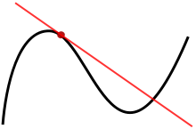
Derivatives
What is the derivative of function f(t) with respect to t?
Compute f’(t)
f(t) = 3t
f(t) = t²
f(t) = sin(t)
f(t) = 3t + 5t² + 6sin(t)

Slide 10
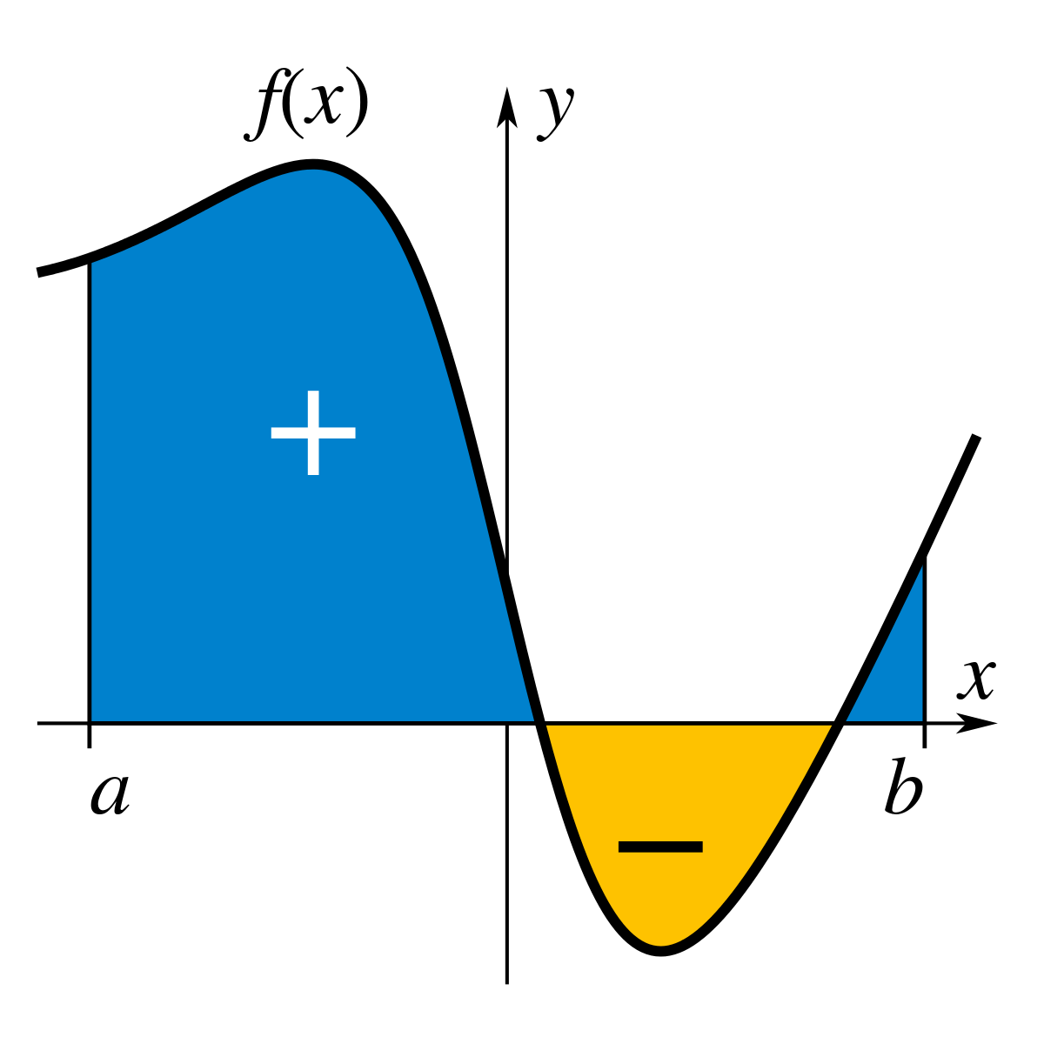
Integrals
What is the integral of function f(t) with respect to t?
Compute
f(t) = 3t
f(t) = t²
f(t) = sin(t)
f(t) = 3t + 5t² + 6sin(t)

Slide 11
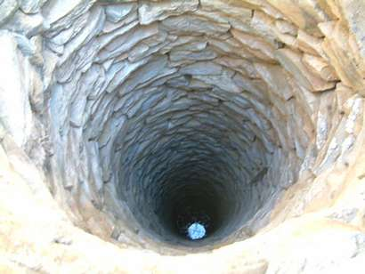
Linear dynamics
What is the relation between position x(t), linear velocity v(t) and linear acceleration a(t)?
How much time does a rock need to hit the ground of a well 50 m deep? Reminder: gravity accelerates objects at 9.81 m/s².
Notes:
x(T) = int(v(t) dt, 0, T)
= int( int (a(tau) dtau, 0, t) dt, 0, T)
= int(9.81 t dt, 0, T)
= 1/2*9.81T²
= 50m
Therefore, T² = 100/9.81 = 10.19 and T = 3.19s

Slide 12
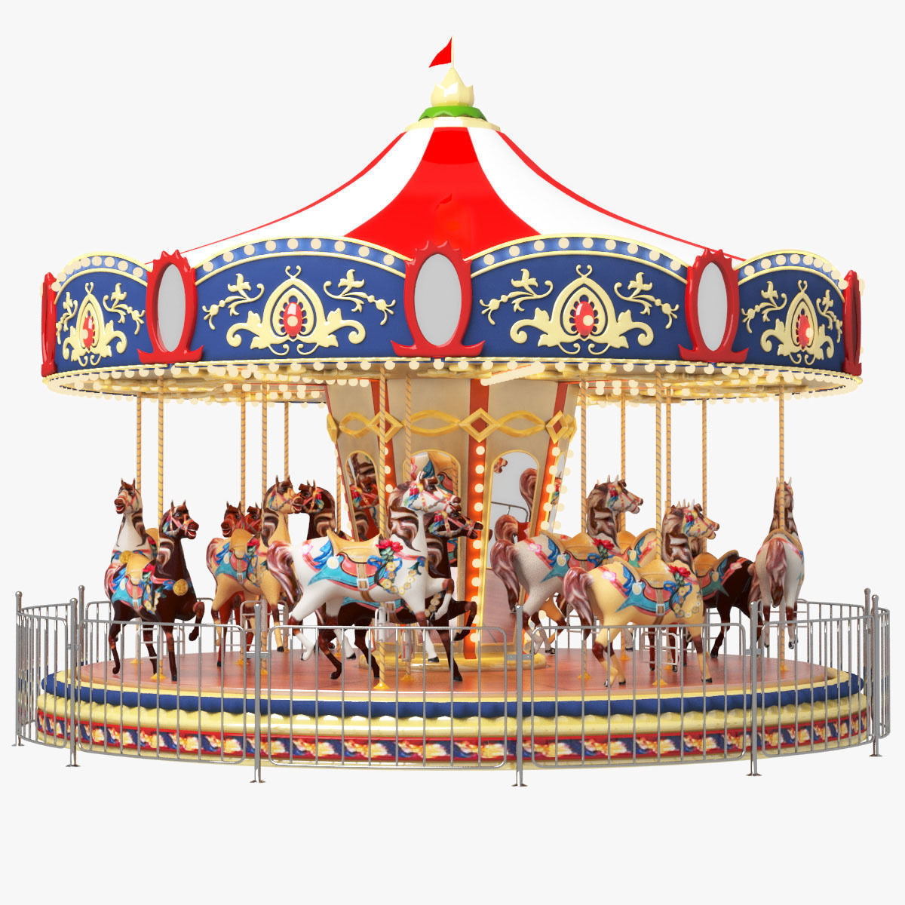
Angular dynamics
What is the relation between orientation θ(t), angular velocity ω(t) and angular acceleration α(t)?
How much time does a carousel need to make a full rotation if it turns at ω(t) = 15˚/s ?
What if ω(t) = - 3π/4 rad/s ?

