Slide 1

BUILDING ENGLISH VOCABULARY & PRONUNCIATION LEARNING APPLICATION
Author: Mai Xuan Diep

Slide 2
CONTENTS
Overview
Target Users
Actors
Business Process
Development Plan
Features List
Technologies
Issue

Slide 3
What is this project about?
1. OVERVIEW
This project builds
An “English Vocabulary & Pronunciation Learning System”.
The system can help people learn vocabulary with topics, take a lot of tests.
The system allows people to check their pronunciation.

Slide 4
2. TARGET USERS
Vietnamese
The people who want to improve English vocabulary and pronunciation.
Children

Slide 5
3. ACTORS
Admin
User

Slide 6
4. DEVELOPMENT PLAN
01/09/2020 - 20/09/2020
Research technologies, design Database
01
21/09/2020 - 18/10/2020
Develop API for system
02
19/10/2020 - 21/11/2020
Develop iOS application for user
03
22/11/2020 - 30/11/2020
Test functions of system, deploy system
04

Slide 7
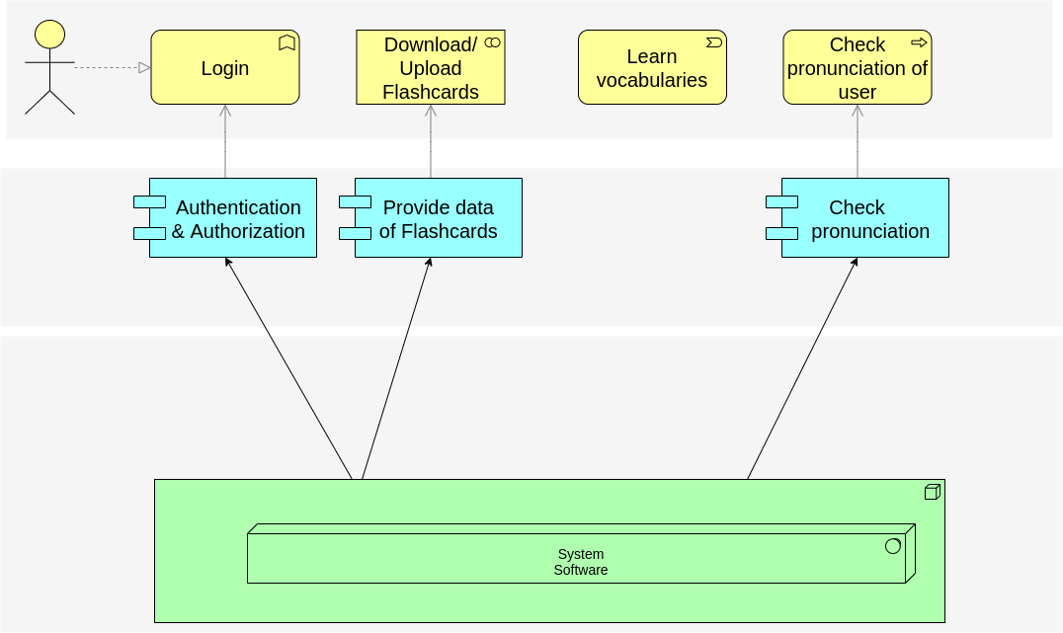
5. BUSINESS PROCESS
User
System

Slide 8
6. FEATURES LIST
WEB API
Authenticate users
CRUD Flashcards
Check Pronunciation
ADMIN WEBSITE
Login/Logout
CRUD Flashcards
iOS APP
Login/Logout
Download/Update Data
Learn vocabularies
Show meaning
Check pronunciation
Take Tests

Slide 9
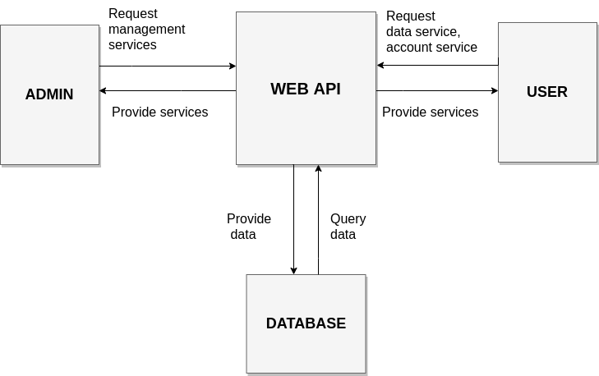
7. SYSTEM ARCHITECT

Slide 10
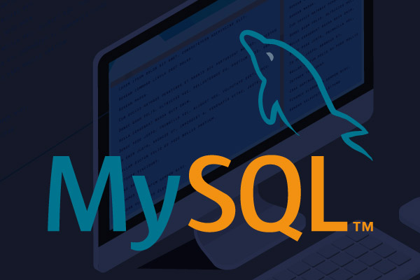

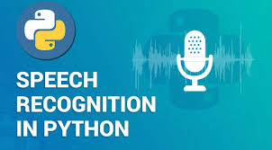

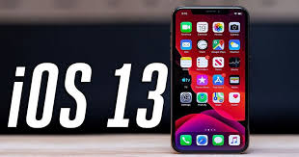
8. TECHNOLOGIES

Slide 11
9. ISSUES
It is a simple application.
01
What is the difference between my application and other apps in the market?
02

Slide 12
Thank you!
Any Question?

Slide 16
