Slide 1

BUILDING ENGLISH VOCABULARY & PRONUNCIATION LEARNING APPLICATION
Author: Mai Xuan Diep

Slide 2
CONTENTS
Overview
Target Users
Actors
Business Process
Development Plan
Features List
Technologies
Issue

Slide 3
What is this project about?
OVERVIEW
This project builds
An “English Vocabulary & Pronunciation Learning System”.
The system can help people learn vocabulary with topics, take a lot of tests.
The system allows people to check their pronunciation.

Slide 4
TARGET USERS
Vietnamese
The people who want to improve English vocabulary and pronunciation.
Children

Slide 5
ACTORS
Admin
User

Slide 6
DEVELOPMENT PLAN
Research technologies, design Database
01
Develop API for system
02
Develop iOS application for user
03
Test functions of system, deploy system
04

Slide 7
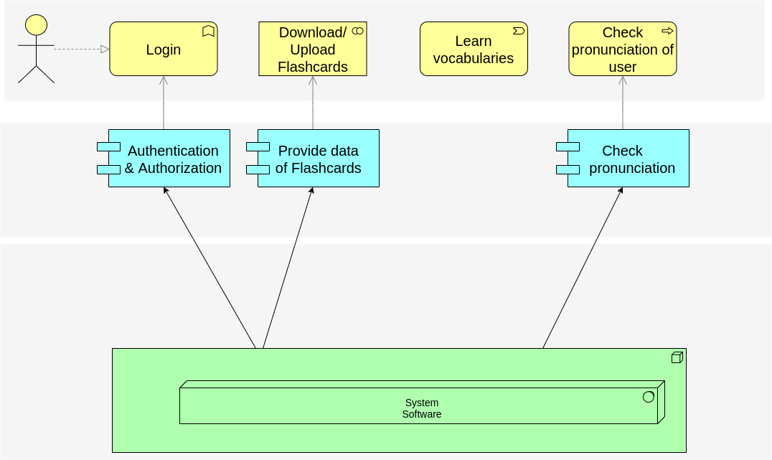
BUSINESS PROCESS
User
System

Slide 8
FEATURES LIST
WEB API
Authenticate users
CRUD Flashcards
Check Pronunciation
ADMIN WEBSITE
Login/Logout
CRUD Flashcards
iOS APP
Login/Logout
Download/Update Data
Learn vocabularies
Show meaning
Check pronunciation
Take Tests

Slide 9
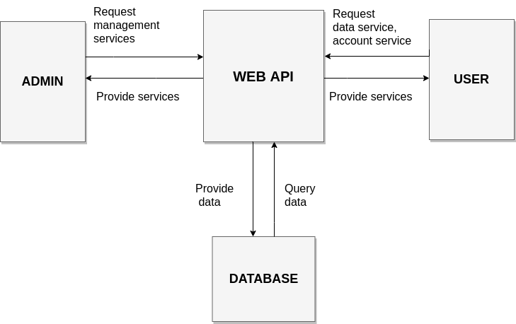
SYSTEM ARCHITECT

Slide 10
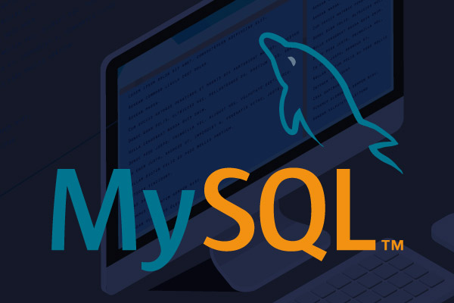

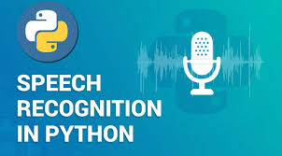

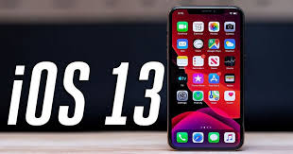
TECHNOLOGIES

Slide 11
ISSUES
It is a simple application.
01
What is the difference between my application and other apps in the market?
02

Slide 12
Thank you!
Any Question?

Slide 16
