Slide 1
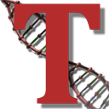



Tassel 5 Variance Component Annotation Pipeline (VCAP)
Terry Casstevens, Jeff Glaubitz, Peter Bradbury, Liya Wang, Ed Buckler, Others
April 11, 2016

Slide 2
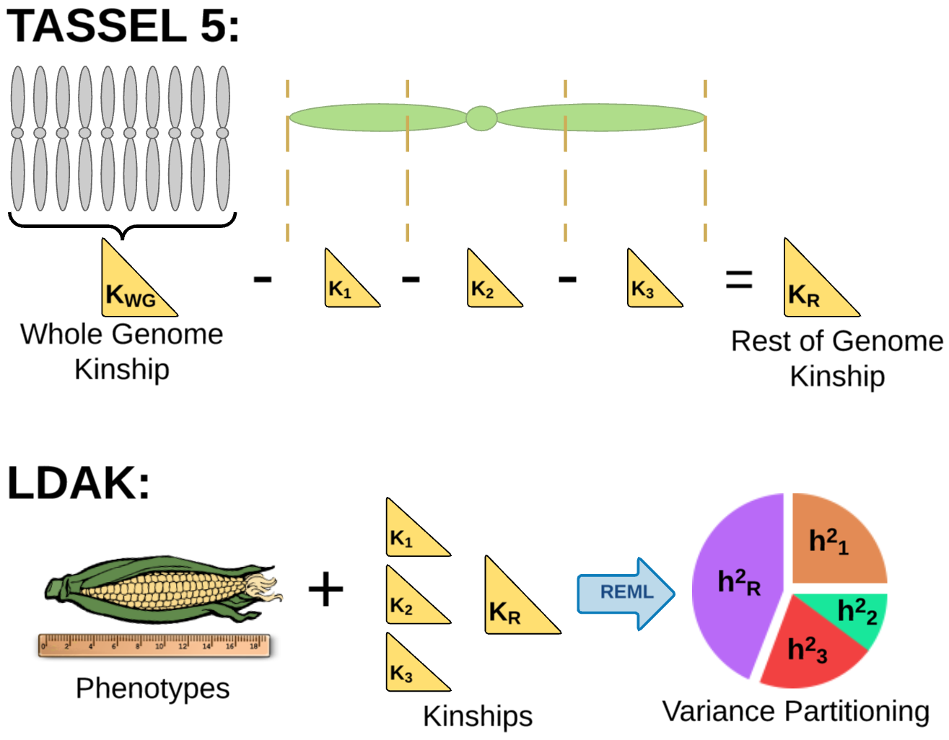
VCAP Strategy…

Slide 3
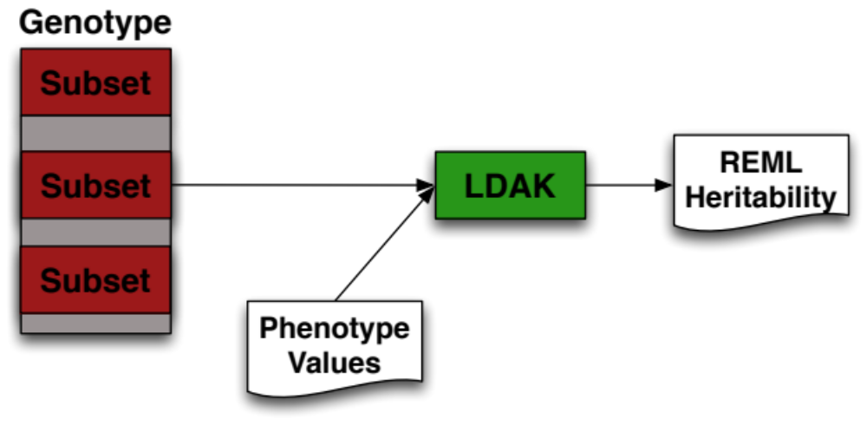
VCAP Strategy…
Using LDAK, determine subset of genotype with most heritability for given phenotype.
Subsets can be created in many ways.
http://dougspeed.com/ldak

Slide 4
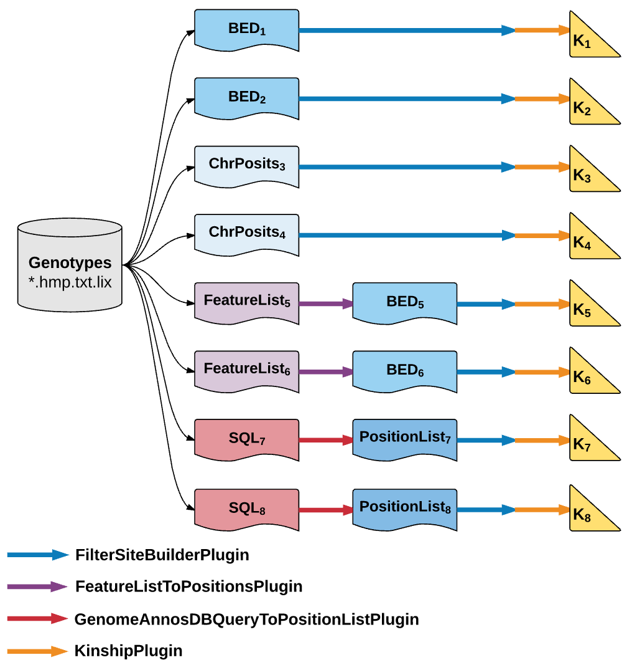
VCAP Ways to Subset Genotype…

Slide 5
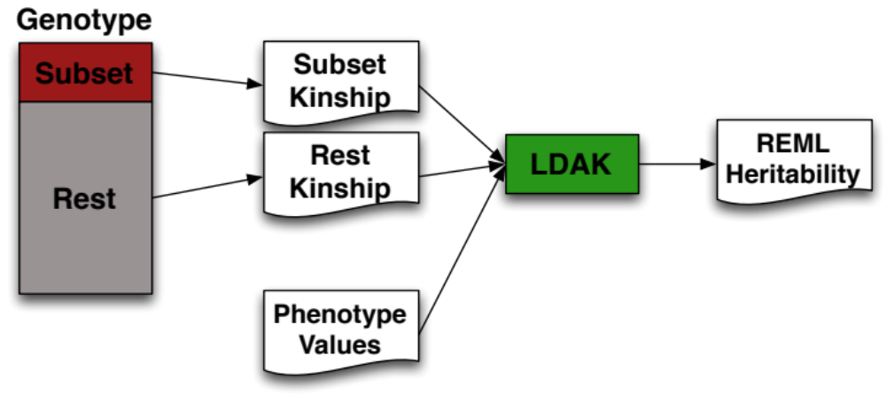
VCAP Strategy…
Using subset of genotype sites / positions, estimate heritability compared to rest of dataset / genome.

Slide 6
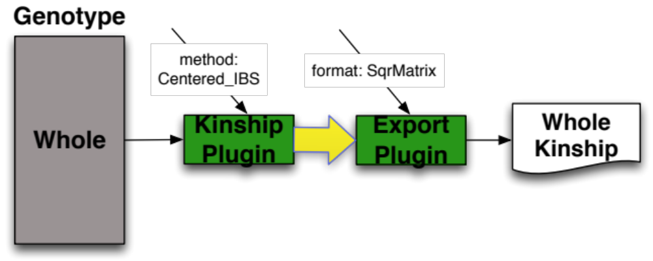
Create Whole Kinship Matrix…
./run_pipeline.pl -importGuess <genotype file>
-KinshipPlugin -method Centered_IBS -endPlugin
-export whole.txt -exportType SqrMatrix

Slide 7
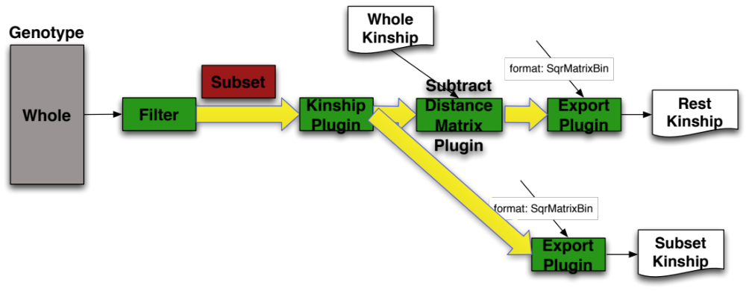
Create Subset and Rest Matrix…
./run_pipeline.pl -forkSubset -importGuess <genotype file>
-FilterSiteBuilderPlugin -startChr 1 -endChr 1 -endPlugin
-KinshipPlugin -method Centered_IBS -endPlugin -forkRest
-SubtractDistanceMatrixPlugin -wholeMatrix whole.txt
-endPlugin -inputSubset -export rest.txt -exportType SqrMatrixBin -forkExport -export subset.txt -exportType SqrMatrixBin -inputSubset

Slide 8
VCAP Strategy…
ldak.4.9.fast --reml vcap/ResultsKinship_9 --mgrm kinship_list.txt --pheno 282/phenotypes/BetaCarotene.txt --kinship-details NO

Slide 9
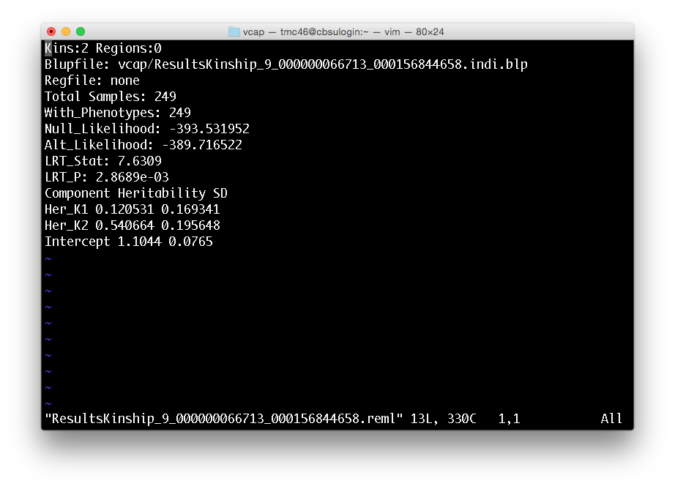
LDAK REML Results…

Slide 10
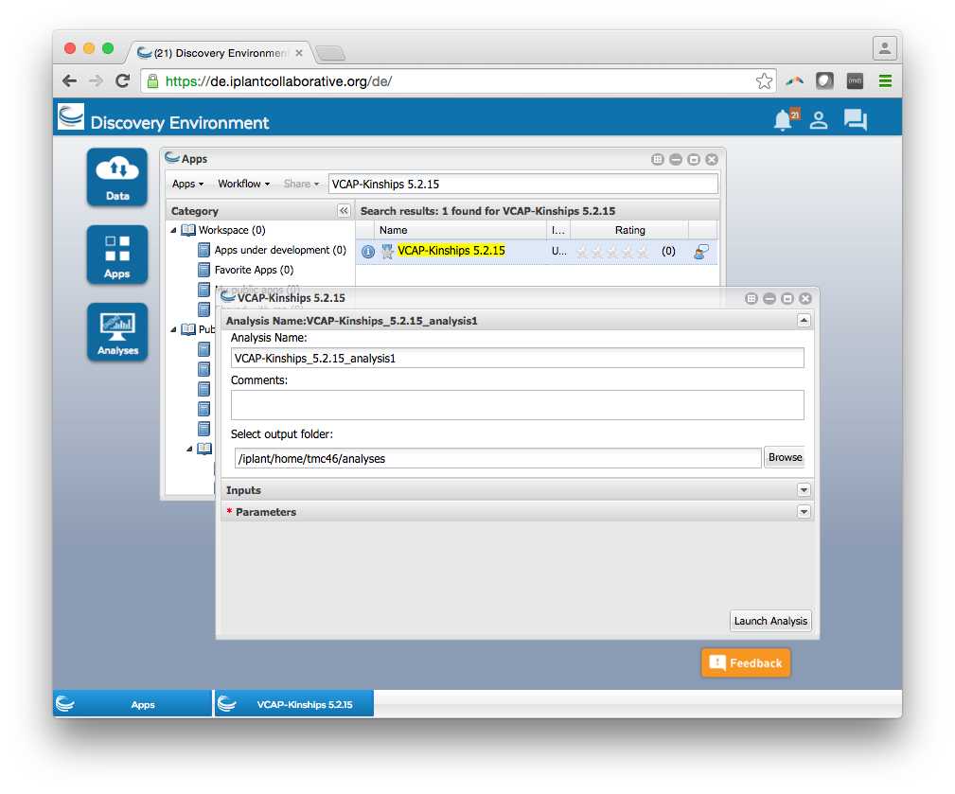

Slide 11
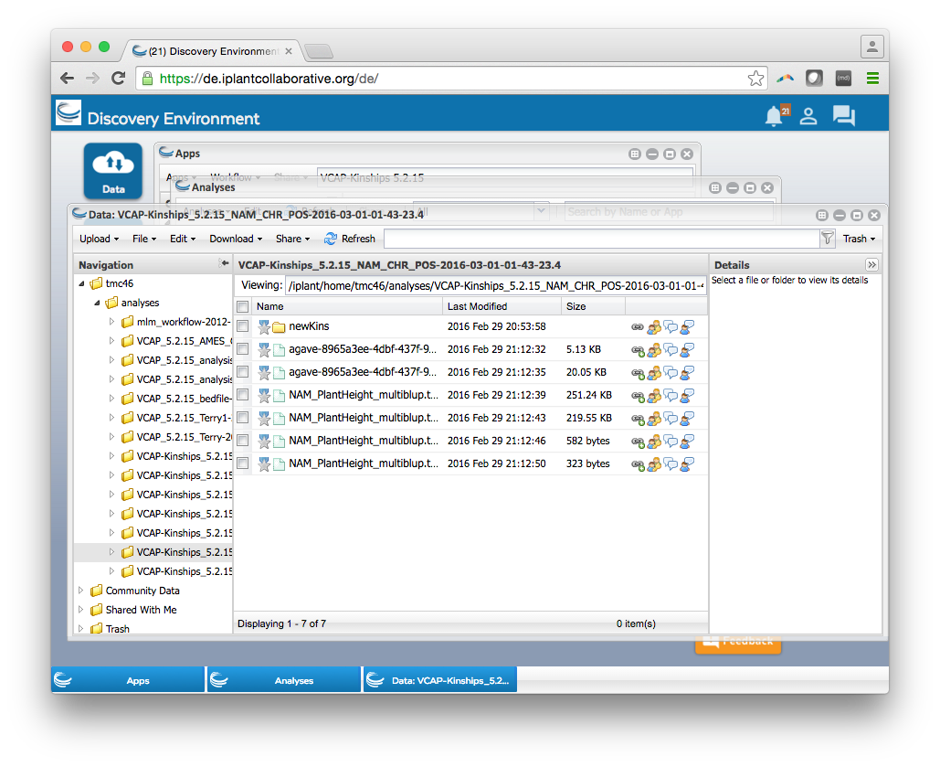

Slide 12
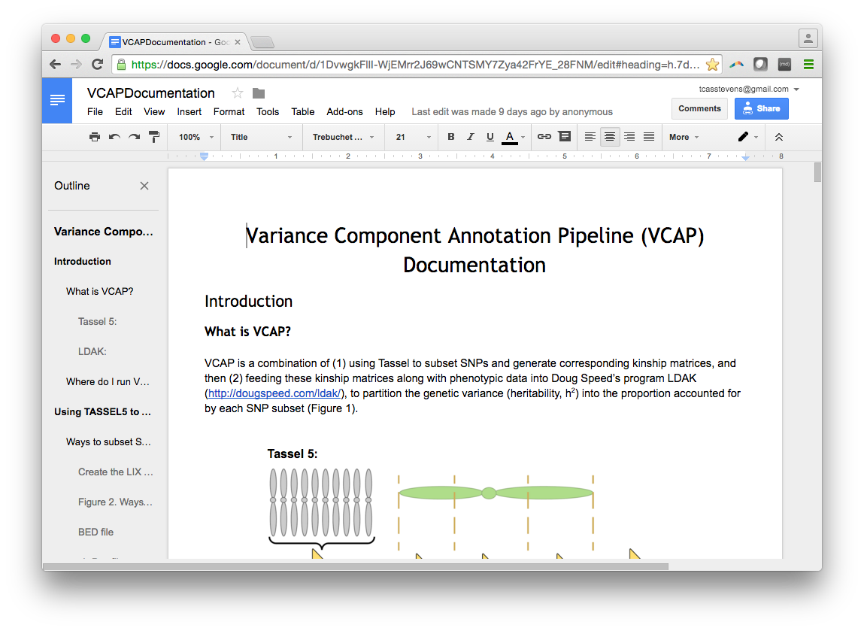

Slide 13
run_pipeline.pl -VCAPScanPlugin –help
VCAPScanPlugin <options>
-method <Scan method> : Scan method [Chromosome, Site_Blocks, Bed_File] (Default: Chromosome)
-numSitesPerBlock <Num Sites Per Block> : For Site_Blocks method, this sets number of sites per block. Blocks do not span chromosomes. (Default: 10000)
-bedFile <Bed File> : For Bed_File method, this specifies bed file to use. Each line / range in the bed file will be a block in the scan.
-phenotypeFile <Phenotype File> : The phenotype file to use with LDAK. Must have only one phenotype. (required)
-ldakCommand <Ldak Command> : Command to call LDAK. If not on PATH, full pathname needed. (Default: ldak.4.9.fast)
-outputDir <Output Dir> : Directory to output kinship matrices and LDAK reml results. (Default: .)
-wholeMatrix <Whole Matrix> : Kinship matrix of whole genotype dataset. This will be created if not specified. Must have been exported from Tassel with export type SqrMatrixBin.

Slide 14
VCAPScanPlugin Example…
run_pipeline.pl -importGuess 282/Maize282_ZeaGBSv27impV5_MAF02_AGPv3.hmp.txt.gz -VCAPScanPlugin -method Chromosome -phenotypeFile 282/phenotypes/BetaCarotene.txt -outputDir vcap -endPlugin

Slide 15
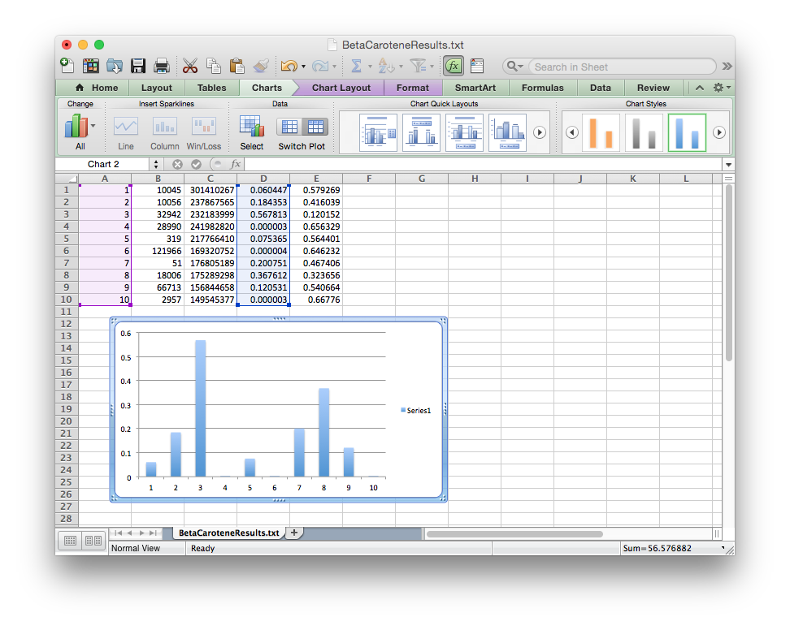
LDAK REML Results…

Slide 16
VCAPScanPlugin Example…
run_pipeline.pl -importGuess 282/Maize282_ZeaGBSv27impV5_MAF02_AGPv3.hmp.txt.gz -VCAPScanPlugin -method Site_Blocks -phenotypeFile 282/phenotypes/TotalCarotenoids.txt -outputDir vcap
-endPlugin

Slide 17
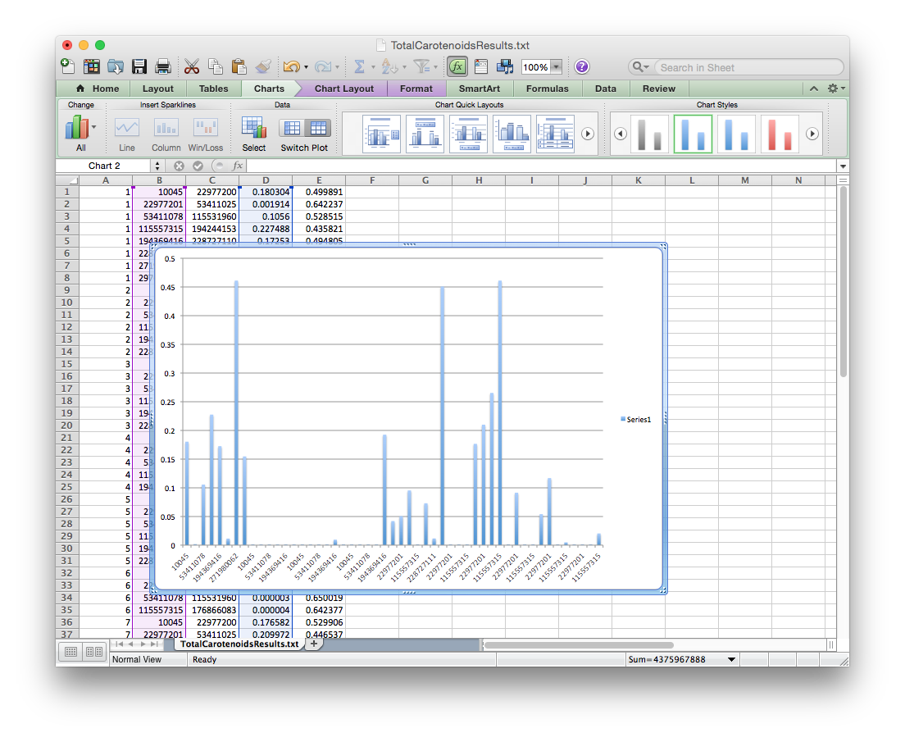
LDAK REML Results…

Slide 18
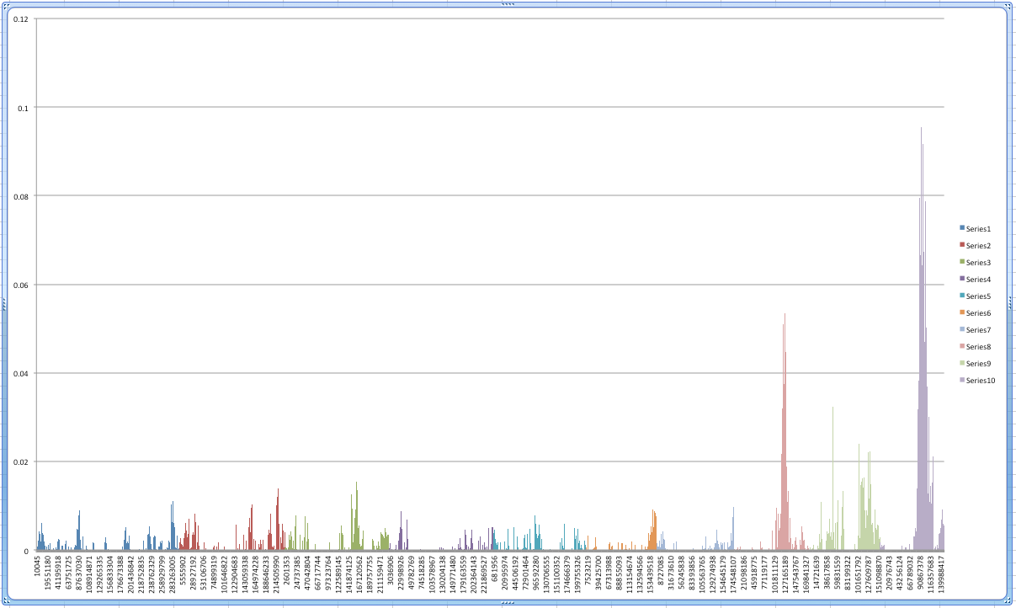
LDAK REML Results for DTA…

