Slide 1
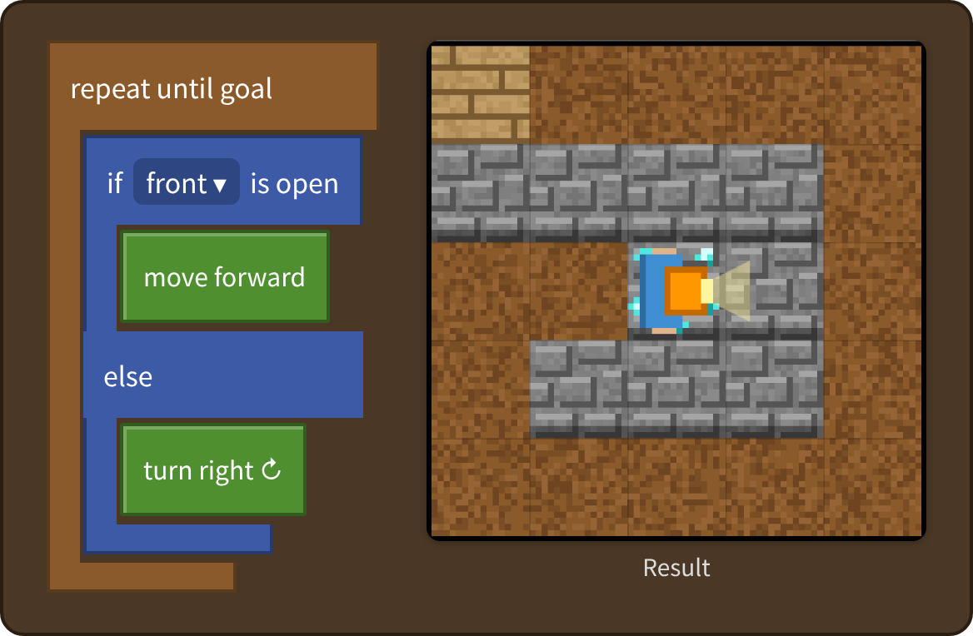

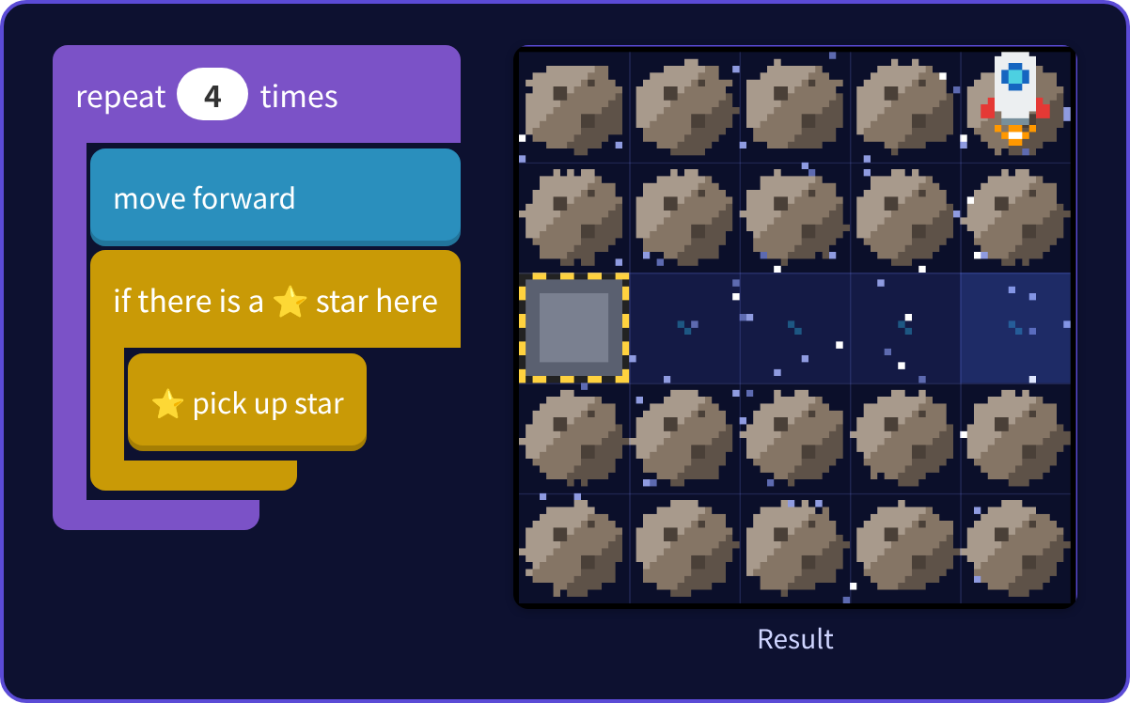
Block
Programming
A free programming curriculum for elementary and junior high students
System overview
National Institute of Technology, Maizuru College — Yasuhito Inoue
Notes:
This is a free, browser-based block programming curriculum for elementary and junior high students. Students start with blocks and move on to Python.

Slide 2



Just a browser: from blocks to Python
Free, no installation
Blocks → Python
Ready for the classroom
Runs in the browser on computers, tablets and phones. Published on GitHub Pages
The same tasks in blocks and in Python. Building blocks also shows the Python code
Guide, videos, worksheets, books, lesson plans and slides are included
Notes:
Three key features: it is free with no installation, it goes from blocks to Python, and it comes with a full set of classroom materials.

Slide 3
The curriculum in numbers
14
86
172
2
Apps
Tasks
Videos
Languages
7 blocks, 7 Python
Challenges and stages
Japanese and English (86 each)
Japanese, English
Classroom materials: 9 worksheets (JA/EN), 4 books (JA/EN, PDF), 7 lesson plans (JA), 16 slide decks (JA/EN), certificates
Notes:
There are 14 apps and 86 tasks, with 172 videos in Japanese and English.

Slide 4
Learning path: order → generalization → Python
Order
Loops
If
State
General
Python
top to bottom, in order
pack with repeat
decide with “if”
what you carry, timing
solve any maze
the same in code
Grades 1–2: Arrow Maze (order only, no direction) Grades 3–6: Maze, Space, Break & Build, Keys, Slime Grade 6 – junior high: 7 Python apps
Notes:
Students move step by step through order, loops, conditions, state and timing, and generalization, and finally write the same ideas in Python.

Slide 5








7 block apps (each with a Python version)
9
8
6
4
Drawing
Maze
Arrow Maze
Keys & Doors
Angles, loops, variables
Order → loops → if → general
For grades 1–2, order
State (what you carry)
4
7
7
Free
Dodge the Slime
Space
Break & Build
Aquarium
Timing, conditions
Check, then act
Counting, two conditions
Move fish with blocks
Notes:
There are seven block apps, each with a Python version. The Aquarium is a free-creation app.

Slide 6
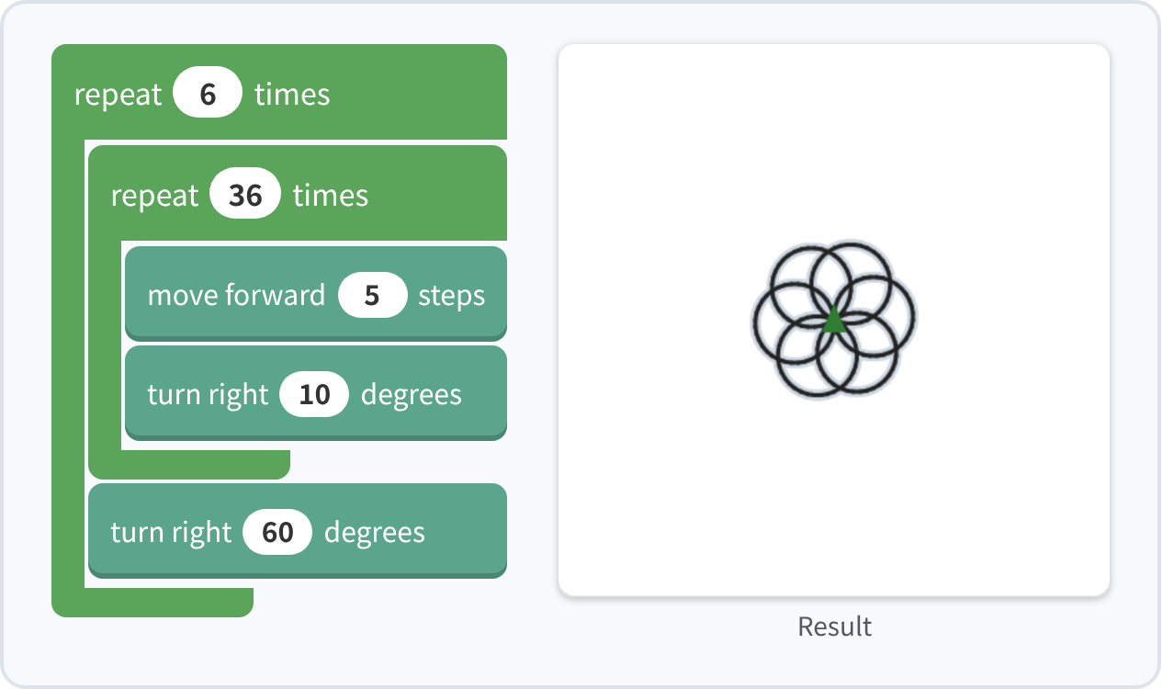
Drawing: move a turtle to draw shapes
Correct when the drawing matches the model
9 challenges: hexagon, star and circle up to nested loops, spirals with variables and a snowflake
Students discover turn angle = 360 ÷ number of sides
Fits the Grade 5 math unit on regular polygons and circles
Notes:
In Drawing, students give commands to a turtle. The answer is correct when the lines match the model.

Slide 7
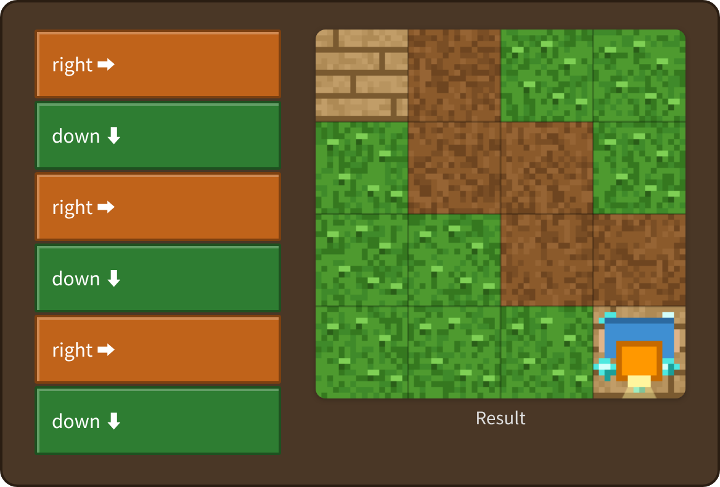
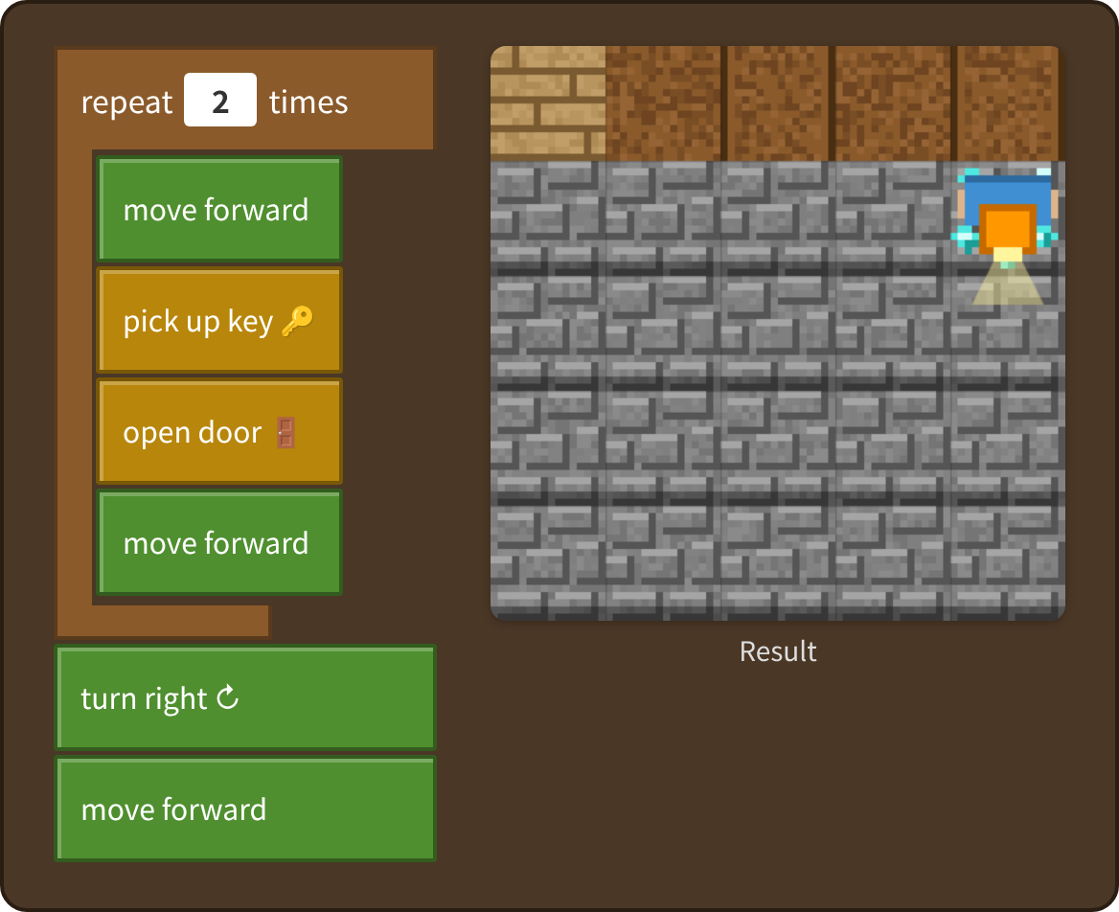
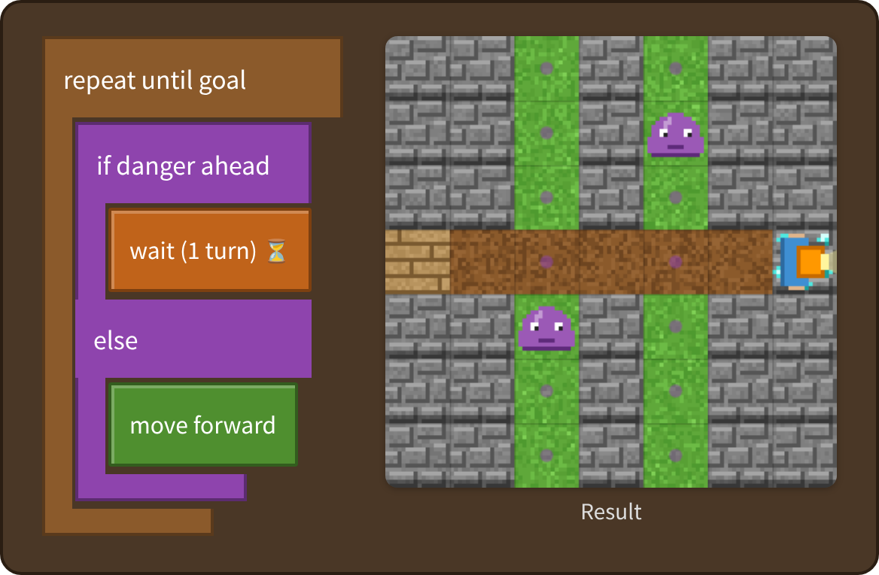
Maze and its variations
Arrow (grades 1–2)
Keys & Doors
With “if front is open”, the explorer decides by itself. Stage 8 is tested on 30 random mazes
Dodge the Slime
Notes:
The Maze goes from order to generalization. Its variations are the Arrow Maze for younger kids, Keys & Doors for state, and Dodge the Slime for timing.

Slide 8
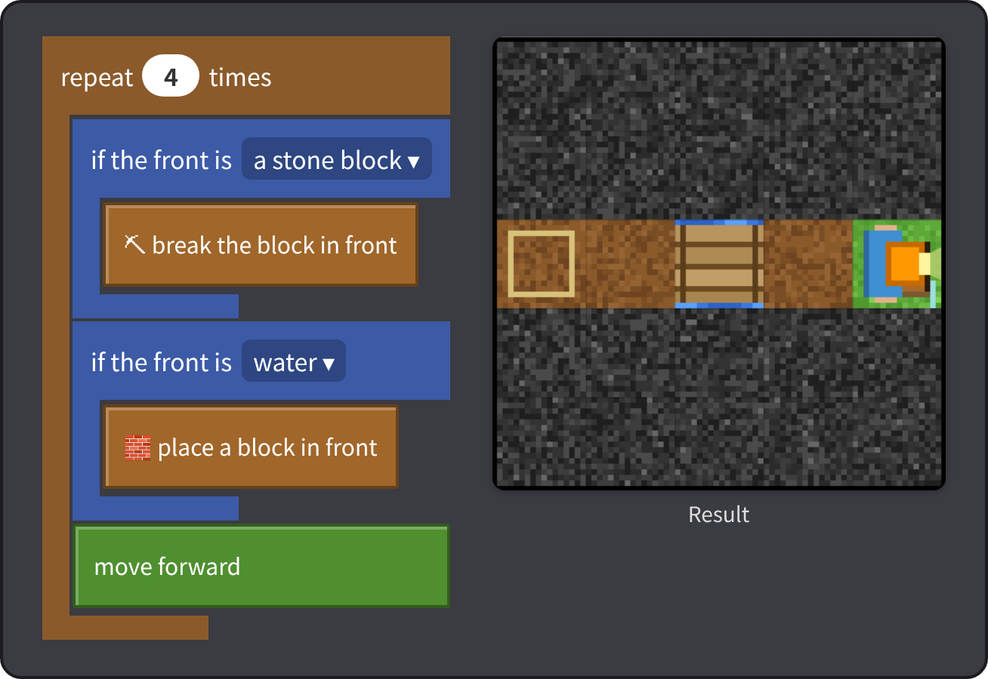
Space and Break & Build
Space Star Hunt
Pick up only when there is a star — check, then act
Break & Build Quest
Break +1, place −1 — think about what you carry (state)
Notes:
Space teaches conditions; Break & Build teaches planning while keeping count of what you carry.

Slide 9
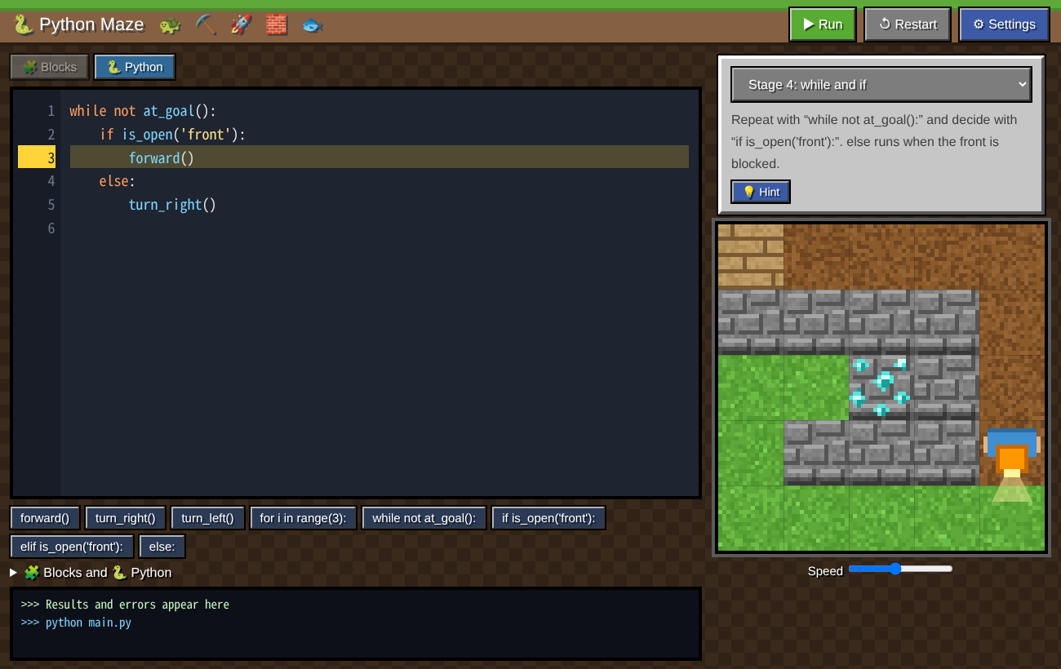
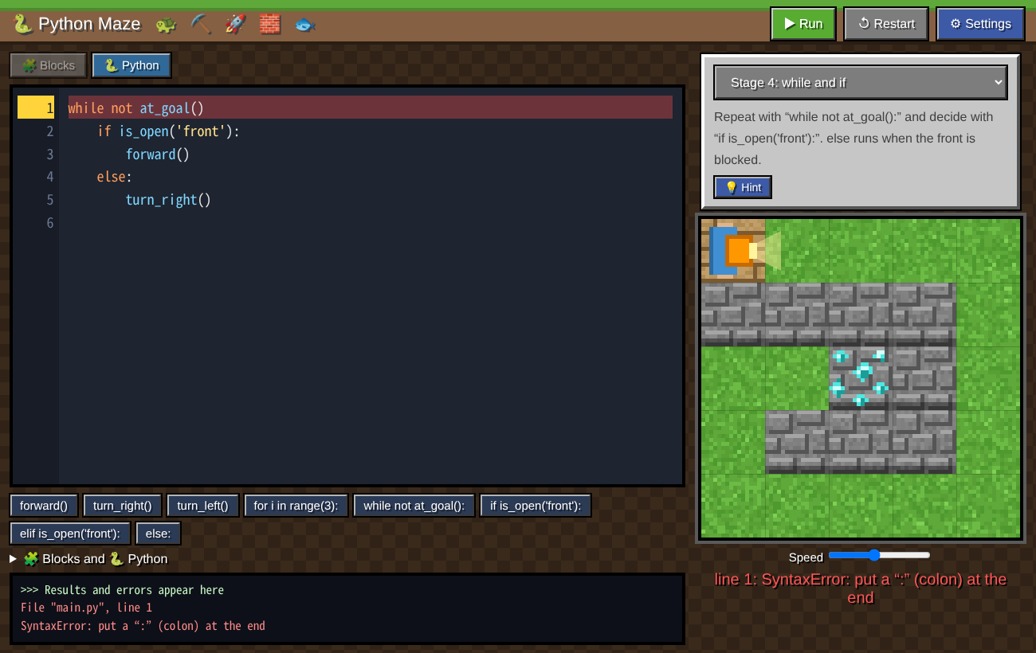
Python versions: write the same tasks as text
Write Python and watch it run; the running line lights up
Errors such as SyntaxError come with a plain-language hint
Notes:
The Python versions have 41 stages in 7 apps. Block mode shows the matching Python, so students move from blocks to text smoothly.

Slide 10
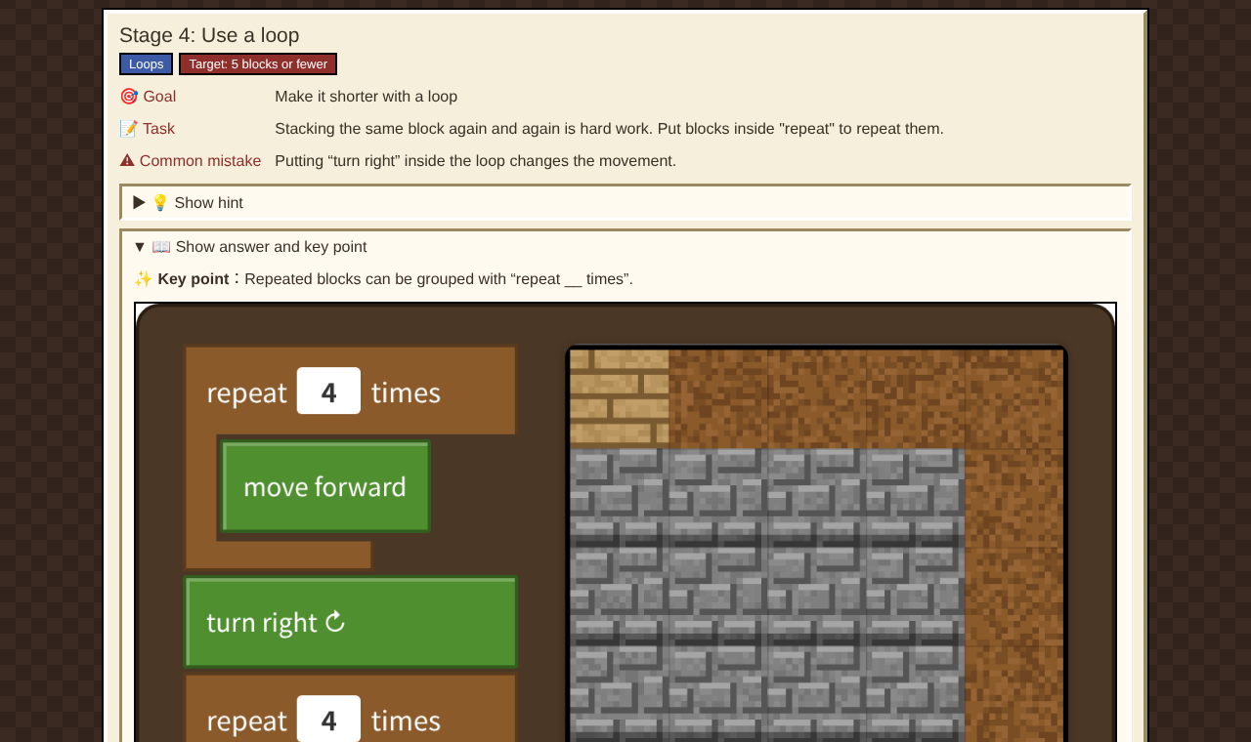






Materials that support lessons
Guide
Videos
Goals, mistakes, hints, answers
30–60 s each, captions and sound
Worksheets
Books (PDF)
9 types, Japanese and English
Kids + teacher guide, 4 books
Lesson plans
Lesson slides
From each task, open the video, book, worksheet and lesson plan in one click
7 plans for 45-minute lessons (JA)
PowerPoint, Japanese and English
Notes:
From each task in the Guide, teachers can jump straight to the video, book, worksheet and lesson plan.

Slide 11

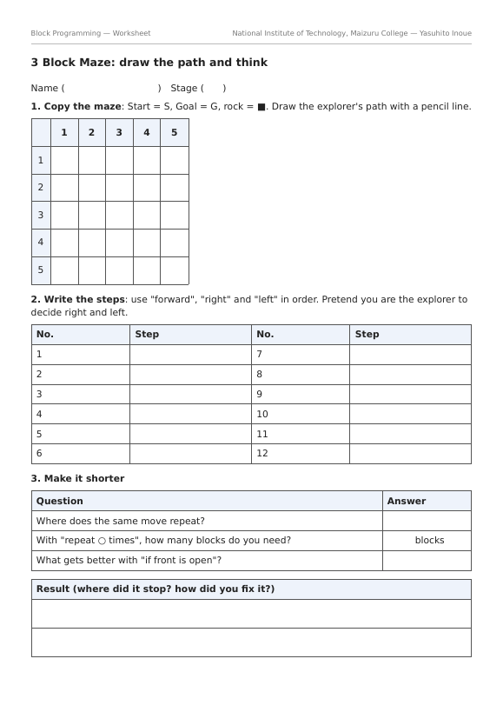
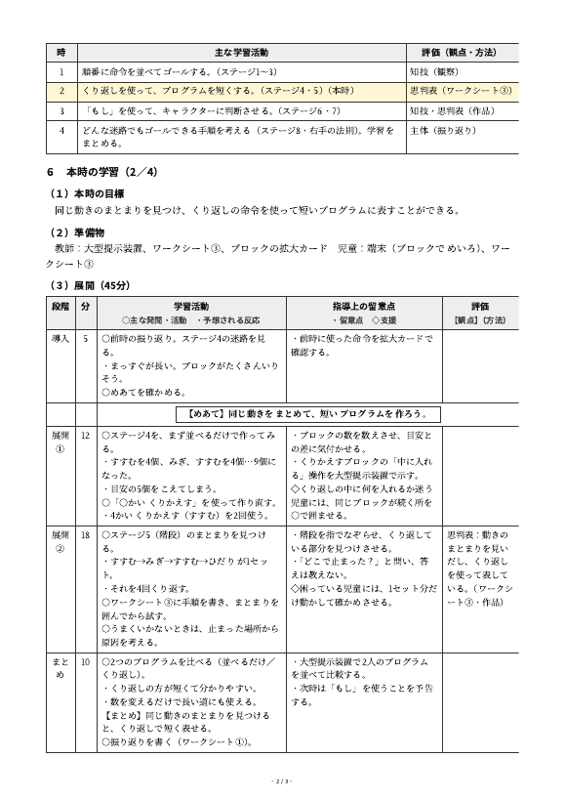
Printable: books, worksheets, lesson plans
Books (4, JA/EN)
Worksheets
Lesson plans (Japanese)
For kids: problem → hint → answer on the next page
Copy the path, write the steps, reflect
Unit plan, lesson flow, board plan
Notes:
Each book has a part for kids and a guide for teachers. Worksheets and lesson plans are also printable PDFs.

Slide 12
A 45-minute lesson (example)
Intro
5 min
Plan
5 min
Try
20 min
Share
10 min
Reflect
5 min
Intro
Share the goal (Worksheet 1)
Plan
Look at the maze and trace the steps with a finger
Try
Try in the app; find the cause where it stopped and fix it
Share
Compare different solutions and find shorter ones
Reflect
Write what you learned and what to try next
Notes:
The key is not to give the answer, but to ask “Where did it stop?”

Slide 13






Easy for everyone to use
Phones and tablets
Japanese, English
The layout adapts to the screen; build blocks by tapping
Switch anytime from “⚙ Settings”
Easy-to-read font
Night mode, calm colors
BIZ UDPGothic by default; a pixel font is also available
Less glare and stimulation
Certificate
Teacher mode
Show and print after clearing every stage
Add ?sensei to the address to load answers
Notes:
There is phone support, Japanese/English, an easy-to-read font, night mode, certificates and a teacher mode.

Slide 14
How it works: simple, no server
GitHub Pages
Serves HTML, JavaScript, images, videos and PDFs
Student device
Runs in the browser (no installation)
Browser storage
Progress and settings (on the device only)
Blockly (Google): the block editor (loaded from the internet)
Python versions: Python code is interpreted and run in the browser (our own interpreter)
No names or email addresses are entered. An internet connection is required
Notes:
There is no server. Progress is saved only in each device’s browser, and no personal information is handled.

Slide 15



Possible next steps
Recording and analyzing learning logs
Grade, experience, number of tries, common mistakes
Extending the Python versions
Variables, print, functions (def), an advanced mode with real Python
New kinds of mazes
Your own blocks (functions), time attack
More languages
Thai and Khmer (mockups made)
Notes:
The next step is recording and analyzing learning logs. GitHub Pages alone cannot collect data, so we plan to start with on-device logs and export.

Slide 16
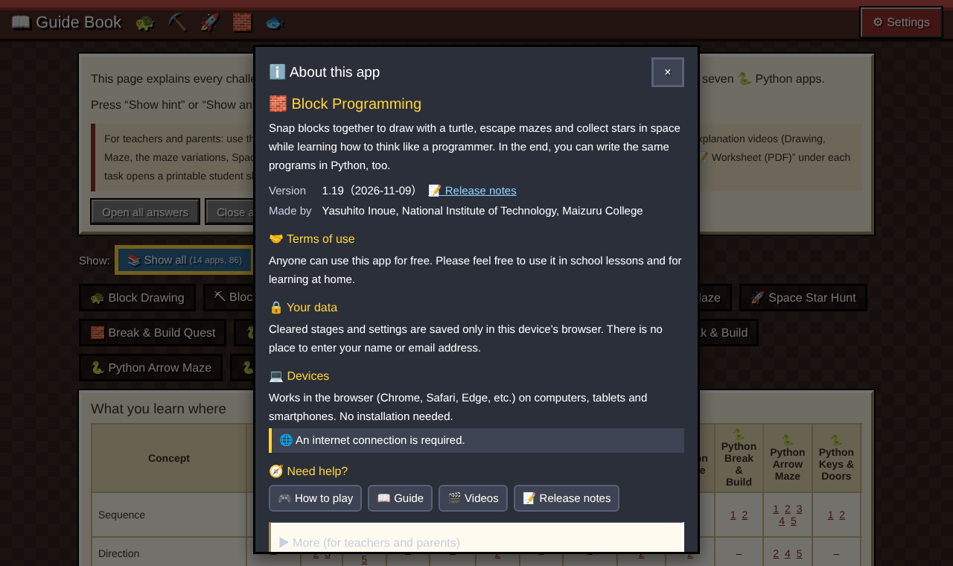
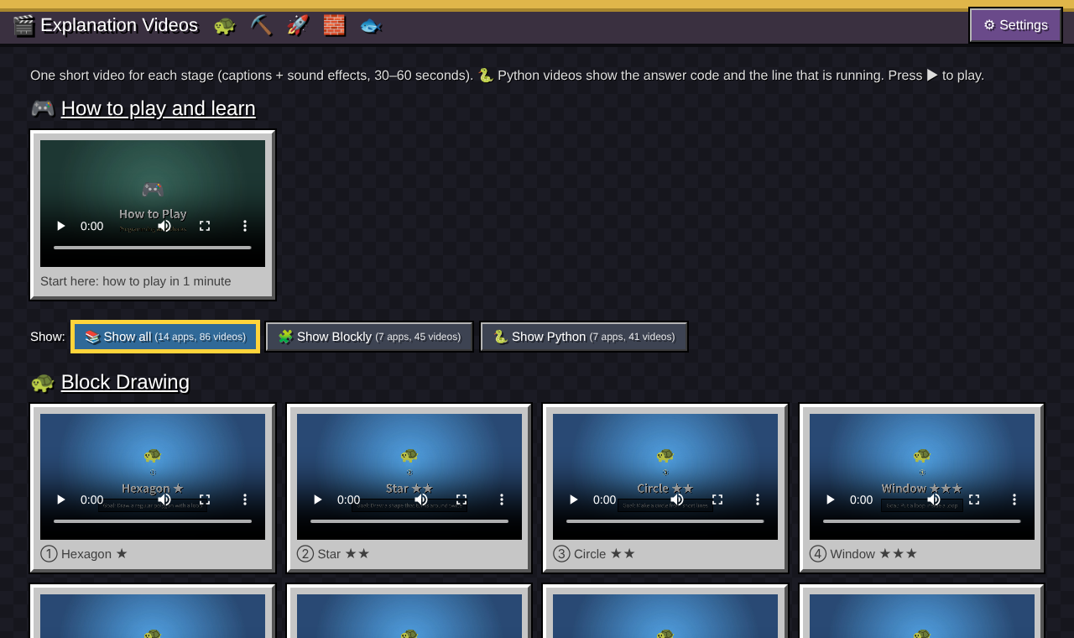
From blocks
to Python,
ready for the classroom
Free, no installation, Japanese and English
14 apps, 86 tasks, with videos, books, worksheets and lesson plans
National Institute of Technology, Maizuru College — Yasuhito Inoue
Notes:
Thank you for listening.

