Slide 1
🐢 Block Drawing
Lesson slides: 9 challenges
ブロックでおえかき
Notes:
[About these slides]
Lesson slides for Block Drawing (index.html). Each challenge has 3 slides: Task → Hint → Answer.
The slides use simple words for students; notes for teachers are here in the notes area.
Show the Answer slide only after students have tried.

Slide 2
What you will learn
🐢
Loops
Angles
Challenge 1, 2, 3, 6, 8
Challenge 1, 2, 3, 5
Move the turtle to draw lines. Match the model drawing to get it right. Learn angles, loops, and variables.
Nesting
Variables
Challenge 4, 5, 7
Challenge 6, 7, 9
Math
Decomposition
Challenge 7, 9
Challenge 8
Notes:
[Lesson aims]
Move the turtle to draw lines. Match the model drawing to get it right. Learn angles, loops, and variables.
[Concepts and challenges]
・Loops: Challenge 1, 2, 3, 6, 8
・Angles: Challenge 1, 2, 3, 5
・Nesting: Challenge 4, 5, 7
・Variables: Challenge 6, 7, 9
・Math: Challenge 7, 9
・Decomposition: Challenge 8

Slide 3
How to use
🗂
🧩
▶
📐
1. Choose a challenge
2. Move the turtle
3. Run and compare
4. Think about angles
Pick a challenge from the list. The faint lines are the model.
Connect blocks like “move forward” and “turn right”.
The turtle draws. If it matches the model: “Correct!”.
“360 ÷ number of corners” helps you find the turn.
Notes:
[Opening]
Add “index.html” to the end of your published address.
[Teacher mode]
Add “?sensei” to the address to show the “📖 Answer” button and load answers (e.g. index.html?sensei).
[Next player]
When students share a device, press “⚙ Settings → 🔄 Next player” twice to reset the records.

Slide 4
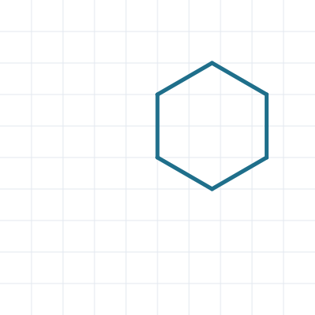
① Hexagon ★
🎯 Goal
Draw a regular polygon with a loop
📝 Challenge
Draw a hexagon with sides of 80 steps.
Notes:
[Goal] Draw a regular polygon with a loop
[Concepts] Loops / Angles
[How to start]
Look at the model shape and check the number of corners and the turning angle together before starting.
[Task] Draw a hexagon with sides of 80 steps.

Slide 5
① Hexagon ★ Hint
💡
How to think
Repeat 6 times. How many degrees to turn? 360 ÷ 6 = ?
Notes:
[Questions to ask]
- “How many corners are there?”
- “Is there a set of moves that repeats?”
- “Run it and see where it stops.”
[Common mistake]
Turning 120° (the inside angle). The turtle turns the outside angle.

Slide 6
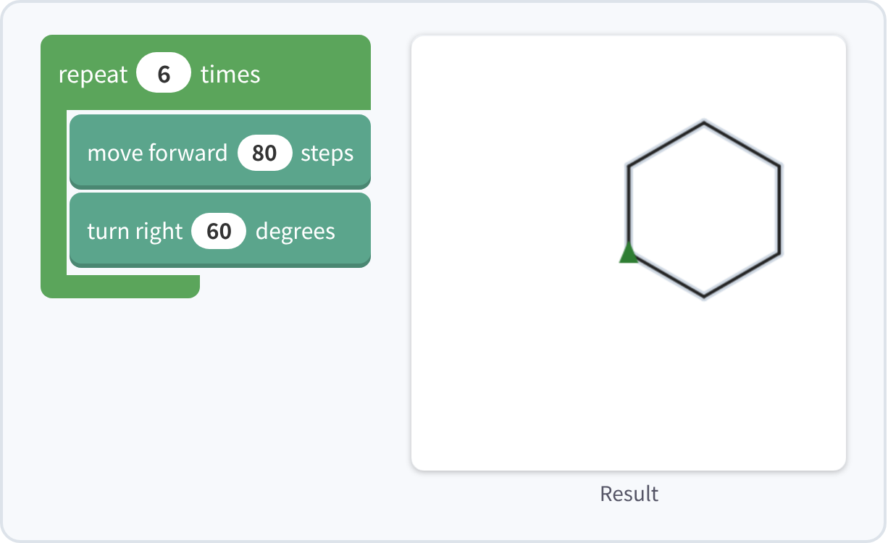
① Hexagon ★ Answer
✨ Key point
Repeat 6 times and turn 60° each time: 360 ÷ 6 = 60.
⚠ Watch out
Turning 120° (the inside angle). The turtle turns the outside angle.
Notes:
[Key point] Repeat 6 times and turn 60° each time: 360 ÷ 6 = 60.
[Common mistake] Turning 120° (the inside angle). The turtle turns the outside angle.
[Check in the app] Open index.html?sensei, choose challenge 1, then “📖 Answer” → “▶ Run”.

Slide 7

② Star ★★
🎯 Goal
Draw a shape that turns around twice
📝 Challenge
Draw a star with lines of 150 steps.
Notes:
[Goal] Draw a shape that turns around twice
[Concepts] Loops / Angles
[How to start]
Look at the model shape and check the number of corners and the turning angle together before starting.
[Task] Draw a star with lines of 150 steps.

Slide 8
② Star ★★ Hint
💡
How to think
After 5 repeats the turtle turns around twice (720 degrees). 720 ÷ 5 = ?
Notes:
[Questions to ask]
- “How many corners are there?”
- “Is there a set of moves that repeats?”
- “Run it and see where it stops.”
[Common mistake]
Using 72° (360 ÷ 5) draws a pentagon, not a star.

Slide 9
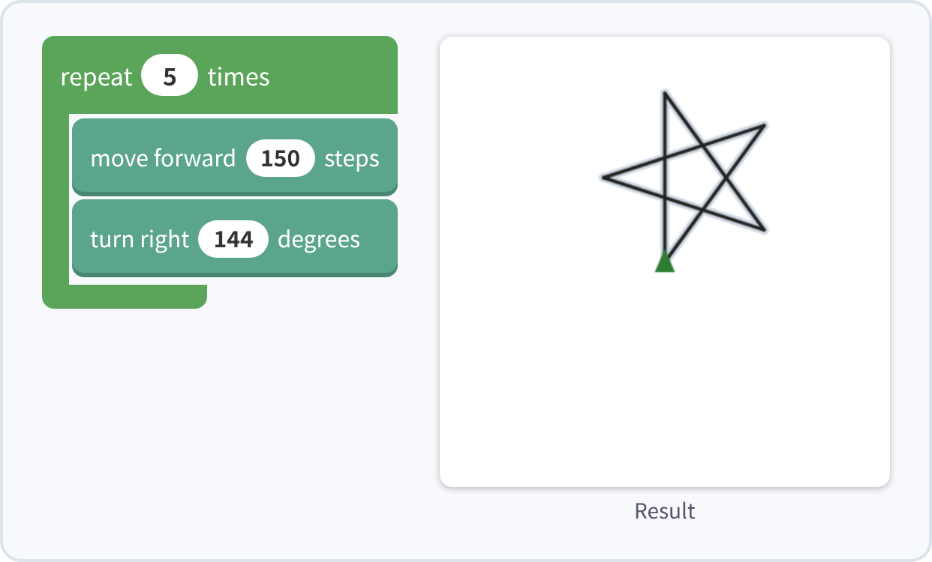
② Star ★★ Answer
✨ Key point
It turns 720° (twice around) in 5 repeats, so each turn is 720 ÷ 5 = 144°.
⚠ Watch out
Using 72° (360 ÷ 5) draws a pentagon, not a star.
Notes:
[Key point] It turns 720° (twice around) in 5 repeats, so each turn is 720 ÷ 5 = 144°.
[Common mistake] Using 72° (360 ÷ 5) draws a pentagon, not a star.
[Check in the app] Open index.html?sensei, choose challenge 2, then “📖 Answer” → “▶ Run”.

Slide 10
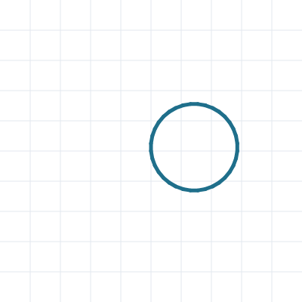
③ Circle ★★
🎯 Goal
Make a circle from short lines
📝 Challenge
Draw a circle by repeating: move 10 steps, then turn a little.
Notes:
[Goal] Make a circle from short lines
[Concepts] Loops / Angles
[How to start]
Look at the model shape and check the number of corners and the turning angle together before starting.
[Task] Draw a circle by repeating: move 10 steps, then turn a little.

Slide 11
③ Circle ★★ Hint
💡
How to think
One full turn is 360 degrees. If you turn 10 degrees each time, how many repeats do you need?
Notes:
[Questions to ask]
- “How many corners are there?”
- “Is there a set of moves that repeats?”
- “Run it and see where it stops.”
[Common mistake]
Too few repeats and the circle stops partway (360 ÷ 10 = 36).

Slide 12
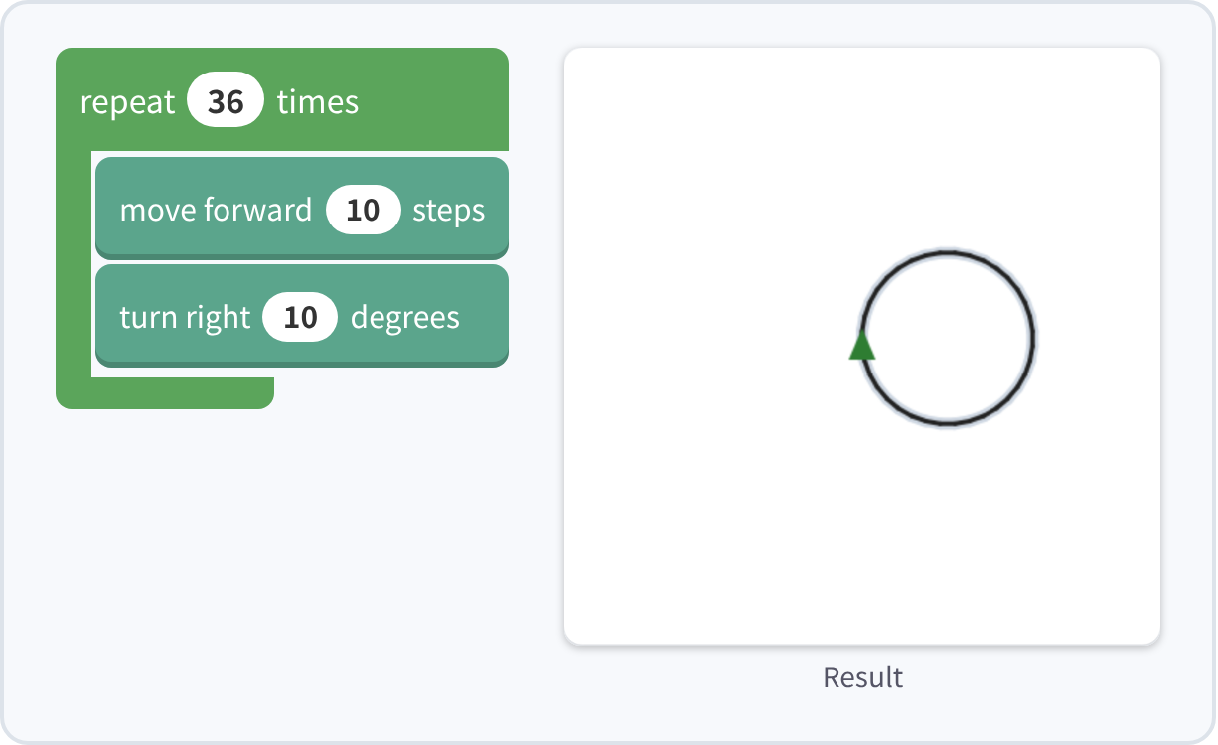
③ Circle ★★ Answer
✨ Key point
Move 10 and turn 10°, 36 times. Many small turns look like a circle.
⚠ Watch out
Too few repeats and the circle stops partway (360 ÷ 10 = 36).
Notes:
[Key point] Move 10 and turn 10°, 36 times. Many small turns look like a circle.
[Common mistake] Too few repeats and the circle stops partway (360 ÷ 10 = 36).
[Check in the app] Open index.html?sensei, choose challenge 3, then “📖 Answer” → “▶ Run”.

Slide 13
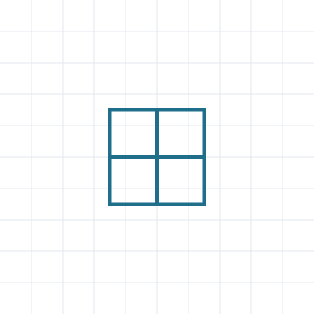
④ Window ★★★
🎯 Goal
Put a loop inside a loop
📝 Challenge
Draw 4 squares (sides of 60 steps) next to each other to make a window.
Notes:
[Goal] Put a loop inside a loop
[Concepts] Nesting
[How to start]
Look at the model shape and check the number of corners and the turning angle together before starting.
[Task] Draw 4 squares (sides of 60 steps) next to each other to make a window.

Slide 14
④ Window ★★★ Hint
💡
How to think
Repeat "draw a square" 4 times. After each square, turn right 90 degrees. Put a repeat inside a repeat!
Notes:
[Questions to ask]
- “How many corners are there?”
- “Is there a set of moves that repeats?”
- “Run it and see where it stops.”
[Common mistake]
Forget “turn right 90” after each square, and the squares overlap into one.

Slide 15
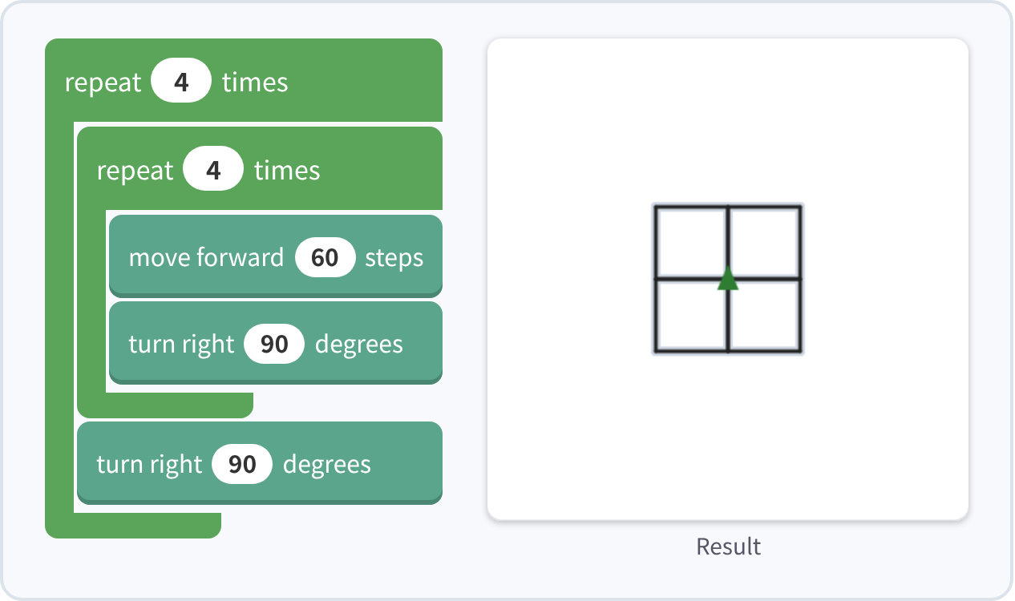
④ Window ★★★ Answer
✨ Key point
Repeat the square-drawing loop 4 more times.
⚠ Watch out
Forget “turn right 90” after each square, and the squares overlap into one.
Notes:
[Key point] Repeat the square-drawing loop 4 more times.
[Common mistake] Forget “turn right 90” after each square, and the squares overlap into one.
[Check in the app] Open index.html?sensei, choose challenge 4, then “📖 Answer” → “▶ Run”.

Slide 16
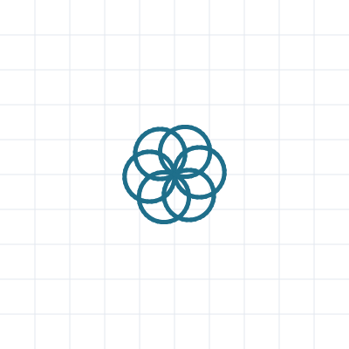
⑤ Flower ★★★
🎯 Goal
Nesting + rotating
📝 Challenge
Draw 6 circles, turning between them, to make a flower. (Circle: 5 steps and 10 degrees, 36 times)
Notes:
[Goal] Nesting + rotating
[Concepts] Nesting / Angles
[How to start]
Look at the model shape and check the number of corners and the turning angle together before starting.
[Task] Draw 6 circles, turning between them, to make a flower. (Circle: 5 steps and 10 degrees, 36 times)

Slide 17
⑤ Flower ★★★ Hint
💡
How to think
After each circle, turn 360 ÷ 6 = 60 degrees. Repeat this 6 times.
Notes:
[Questions to ask]
- “How many corners are there?”
- “Is there a set of moves that repeats?”
- “Run it and see where it stops.”
[Common mistake]
If the turn is not 60°, the petals are uneven.

Slide 18
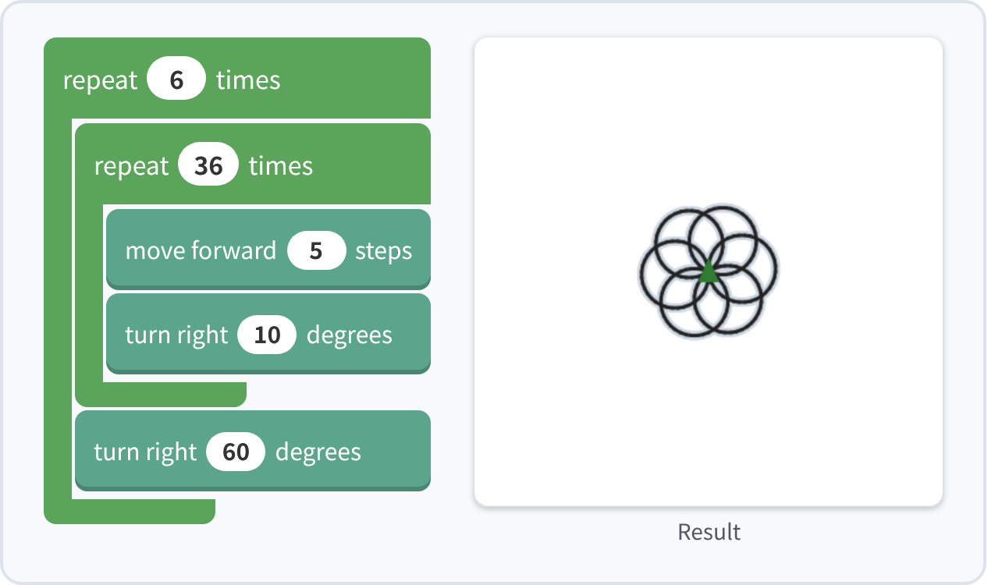
⑤ Flower ★★★ Answer
✨ Key point
After each circle, turn 60°. Do this 6 times.
⚠ Watch out
If the turn is not 60°, the petals are uneven.
Notes:
[Key point] After each circle, turn 60°. Do this 6 times.
[Common mistake] If the turn is not 60°, the petals are uneven.
[Check in the app] Open index.html?sensei, choose challenge 5, then “📖 Answer” → “▶ Run”.

Slide 19

⑥ Square spiral ★★★★
🎯 Goal
Use a variable as a length
📝 Challenge
Move 10, 20, 30 … up to 200 steps, turning right 90 degrees each time.
Notes:
[Goal] Use a variable as a length
[Concepts] Variables / Loops
[How to start]
Look at the model shape and check the number of corners and the turning angle together before starting.
[Task] Move 10, 20, 30 … up to 200 steps, turning right 90 degrees each time.

Slide 20
⑥ Square spiral ★★★★ Hint
💡
How to think
Use the loop "count with i from 10 to 200 by 10". Put the variable i into the "move" block.
Notes:
[Questions to ask]
- “How many corners are there?”
- “Is there a set of moves that repeats?”
- “Run it and see where it stops.”
[Common mistake]
With a fixed number in “move”, the length never changes. Put the variable i in.

Slide 21
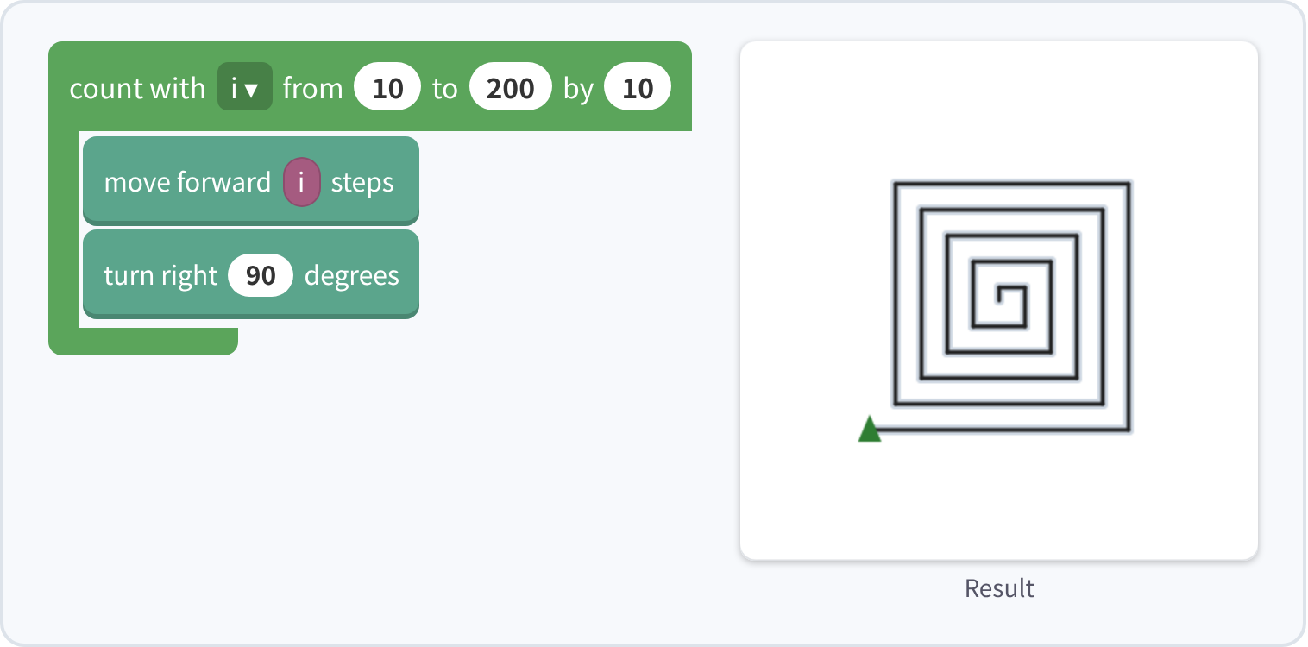
⑥ Square spiral ★★★★ Answer
✨ Key point
i changes to 10, 20, 30…, so the line gets longer and longer.
⚠ Watch out
With a fixed number in “move”, the length never changes. Put the variable i in.
Notes:
[Key point] i changes to 10, 20, 30…, so the line gets longer and longer.
[Common mistake] With a fixed number in “move”, the length never changes. Put the variable i in.
[Check in the app] Open index.html?sensei, choose challenge 6, then “📖 Answer” → “▶ Run”.

Slide 22

⑦ Polygons in a row ★★★★
🎯 Goal
Variable + math
📝 Challenge
From the same spot, draw a triangle, square, pentagon … up to an octagon, each with sides of 50 steps.
Notes:
[Goal] Variable + math
[Concepts] Variables / Math / Nesting
[How to start]
Look at the model shape and check the number of corners and the turning angle together before starting.
[Task] From the same spot, draw a triangle, square, pentagon … up to an octagon, each with sides of 50 steps.

Slide 23
⑦ Polygons in a row ★★★★ Hint
💡
How to think
Change n from 3 to 8: "repeat n times: move 50 steps, turn right 360 ÷ n degrees". Use the math block!
Notes:
[Questions to ask]
- “How many corners are there?”
- “Is there a set of moves that repeats?”
- “Run it and see where it stops.”
[Common mistake]
With a fixed turn (like 60), every shape is the same.

Slide 24
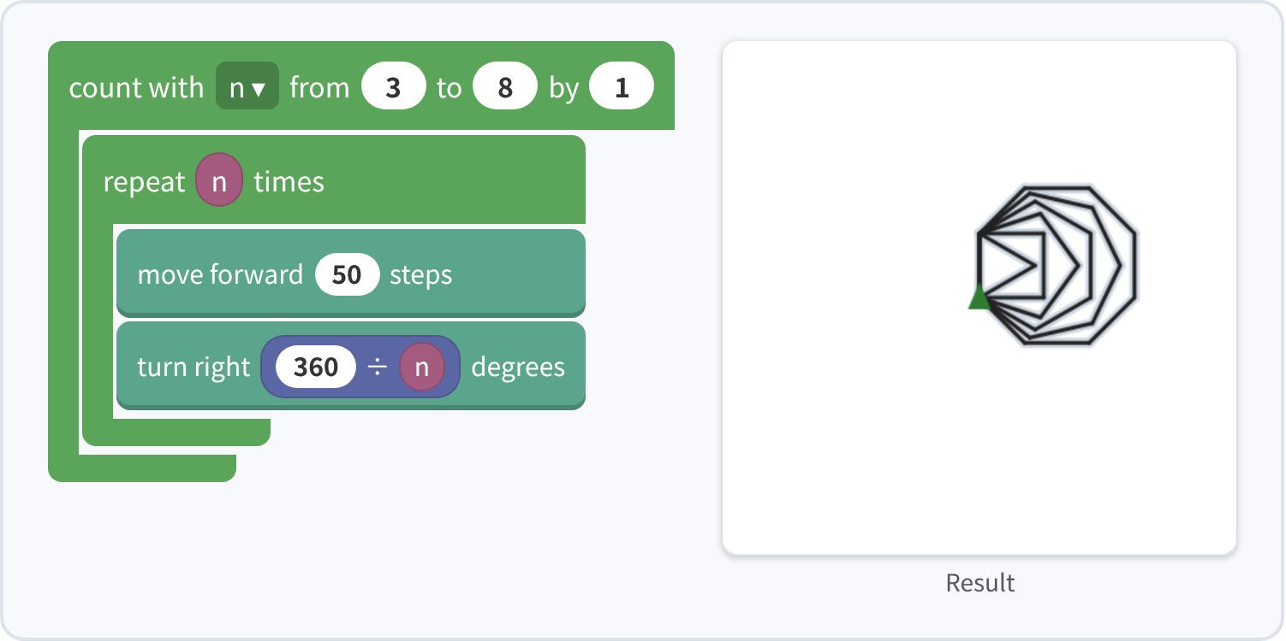
⑦ Polygons in a row ★★★★ Answer
✨ Key point
An n-sided shape turns 360 ÷ n each time. Change n from 3 to 8 to draw 6 shapes.
⚠ Watch out
With a fixed turn (like 60), every shape is the same.
Notes:
[Key point] An n-sided shape turns 360 ÷ n each time. Change n from 3 to 8 to draw 6 shapes.
[Common mistake] With a fixed turn (like 60), every shape is the same.
[Check in the app] Open index.html?sensei, choose challenge 7, then “📖 Answer” → “▶ Run”.

Slide 25

⑧ Snowflake ★★★★★
🎯 Goal
Break the task into steps
📝 Challenge
Draw one branch, come back to where you started, and turn 60 degrees. Repeat this 6 times.
Notes:
[Goal] Break the task into steps
[Concepts] Decomposition / Loops
[How to start]
Look at the model shape and check the number of corners and the turning angle together before starting.
[Task] Draw one branch, come back to where you started, and turn 60 degrees. Repeat this 6 times.

Slide 26
⑧ Snowflake ★★★★★ Hint
💡
How to think
Branch: forward 80 → back 30 → left 45 → forward 25 → back 25 → right 90 → forward 25 → back 25 → left 45 → back 50.
Notes:
[Questions to ask]
- “How many corners are there?”
- “Is there a set of moves that repeats?”
- “Run it and see where it stops.”
[Common mistake]
Forget the final “move back 50”, and the branches drift.

Slide 27
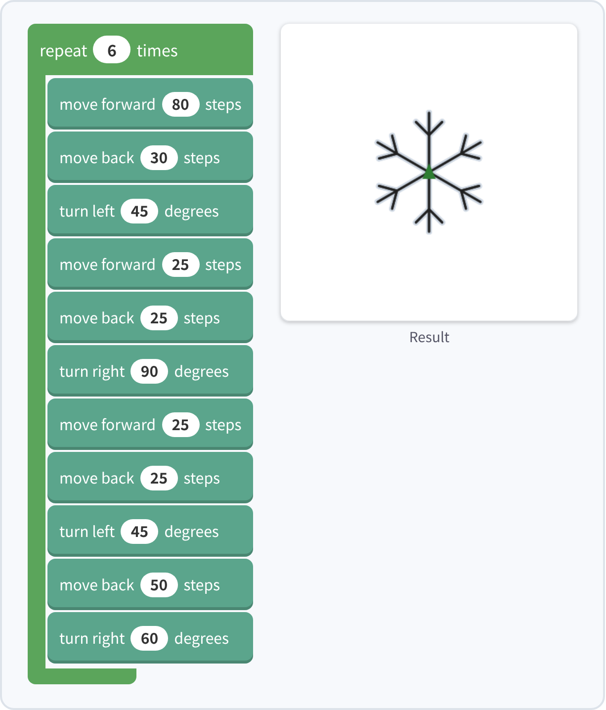
⑧ Snowflake ★★★★★ Answer
✨ Key point
The trick: after each branch, put the position and the direction back.
⚠ Watch out
Forget the final “move back 50”, and the branches drift.
Notes:
[Key point] The trick: after each branch, put the position and the direction back.
[Common mistake] Forget the final “move back 50”, and the branches drift.
[Check in the app] Open index.html?sensei, choose challenge 8, then “📖 Answer” → “▶ Run”.

Slide 28

⑨ Star spiral ★★★★★
🎯 Goal
Variable × math + turning
📝 Challenge
Move 4, 8, 12 … steps (4 more each time, 50 times), turning right 144 degrees.
Notes:
[Goal] Variable × math + turning
[Concepts] Variables / Math
[How to start]
Look at the model shape and check the number of corners and the turning angle together before starting.
[Task] Move 4, 8, 12 … steps (4 more each time, 50 times), turning right 144 degrees.

Slide 29
⑨ Star spiral ★★★★★ Hint
💡
How to think
Count i from 1 to 50 by 1. Move i × 4 steps. Try a "random" pen color!
Notes:
[Questions to ask]
- “How many corners are there?”
- “Is there a set of moves that repeats?”
- “Run it and see where it stops.”
[Common mistake]
Without the variable i in the multiply block, the length does not grow.

Slide 30
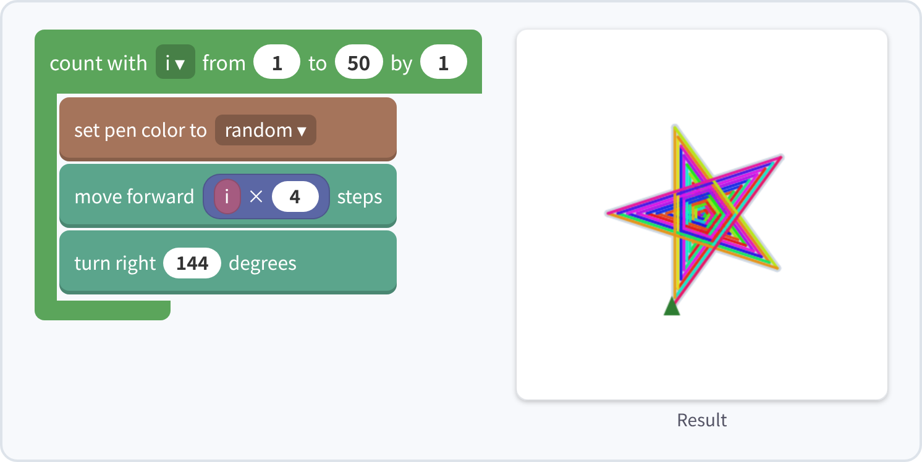
⑨ Star spiral ★★★★★ Answer
✨ Key point
The length i × 4 grows, and turning 144° each time makes a star spiral.
⚠ Watch out
Without the variable i in the multiply block, the length does not grow.
Notes:
[Key point] The length i × 4 grows, and turning 144° each time makes a star spiral.
[Common mistake] Without the variable i in the multiply block, the length does not grow.
[Check in the app] Open index.html?sensei, choose challenge 9, then “📖 Answer” → “▶ Run”.

Slide 31
Reflection
🤔
🛠
🚀
How did you choose the angle?
What was good about using a loop?
What shape would you like to make?
📜
After every challenge, draw your own picture in free mode!
Notes:
[Running the reflection]
Discuss one question at a time in pairs or groups, then ask 2–3 students to share with the class.
[Next step] Use “⚙ Settings → 🐍 Switch to Python” to solve the same world with Python.

