Slide 1
⛏ Block Maze
Lesson slides: 8 stages
ブロックでめいろ
Notes:
[About these slides]
Lesson slides for Block Maze (maze.html). Each stage has 3 slides: Task → Hint → Answer.
The slides use simple words for students; notes for teachers are here in the notes area.
Show the Answer slide only after students have tried.

Slide 2
What you will learn
⛏
Sequence
Direction
Stage 1, 2, 3
Stage 2, 3
Move the explorer to the diamond. Go from sequence → loops → “if” → a way to solve any maze.
Loops
Patterns
Stage 4, 5
Stage 5
Conditions
Repeat until
Stage 6, 7, 8
Stage 6, 8
Notes:
[Lesson aims]
Move the explorer to the diamond. Go from sequence → loops → “if” → a way to solve any maze.
[Concepts and stages]
・Sequence: Stage 1, 2, 3
・Direction: Stage 2, 3
・Loops: Stage 4, 5
・Patterns: Stage 5
・Conditions: Stage 6, 7, 8
・Repeat until: Stage 6, 8
・Nesting: Stage 7
・Generalization: Stage 8

Slide 3
How to use
🗂
🧩
▶
🔁
1. Choose a stage
2. Connect blocks
3. Run it
4. Fix and try again
Pick a stage from the list at the top right and read the task.
Drag blocks from the left and stack them in order.
Press “▶ Run”. The block that is running lights up.
If it fails, press “↺ Restart”. Stuck? Press “💡 Hint”.
Notes:
[Opening]
Add “maze.html” to the end of your published address.
[Teacher mode]
Add “?sensei” to the address to show the “📖 Answer” button and load answers (e.g. maze.html?sensei).
[Next player]
When students share a device, press “⚙ Settings → 🔄 Next player” twice to reset the records.

Slide 4
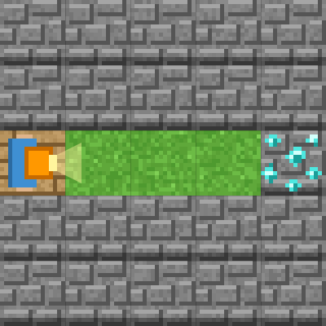
Stage 1: Go straight
🎯 Goal
Put the steps in order
📝 Task
Move the explorer to the diamond 💎. Drag "move forward" blocks from the left and stack them.
Notes:
[Goal] Put the steps in order
[Concepts] Sequence
[How to start]
Look at the board and trace the path to the goal with a finger. The explorer’s light shows “front”.
[Task] Move the explorer to the diamond 💎. Drag "move forward" blocks from the left and stack them.

Slide 5
Stage 1: Go straight Hint
💡
How to think
How many squares to the goal? Stack that many "move forward" blocks.
Notes:
[Questions to ask]
- “Which way is it facing at the start?”
- “Is there a set of moves that repeats?”
- “Run it and see where it stops.”
[Common mistake]
Blocks that are not connected do not run.

Slide 6
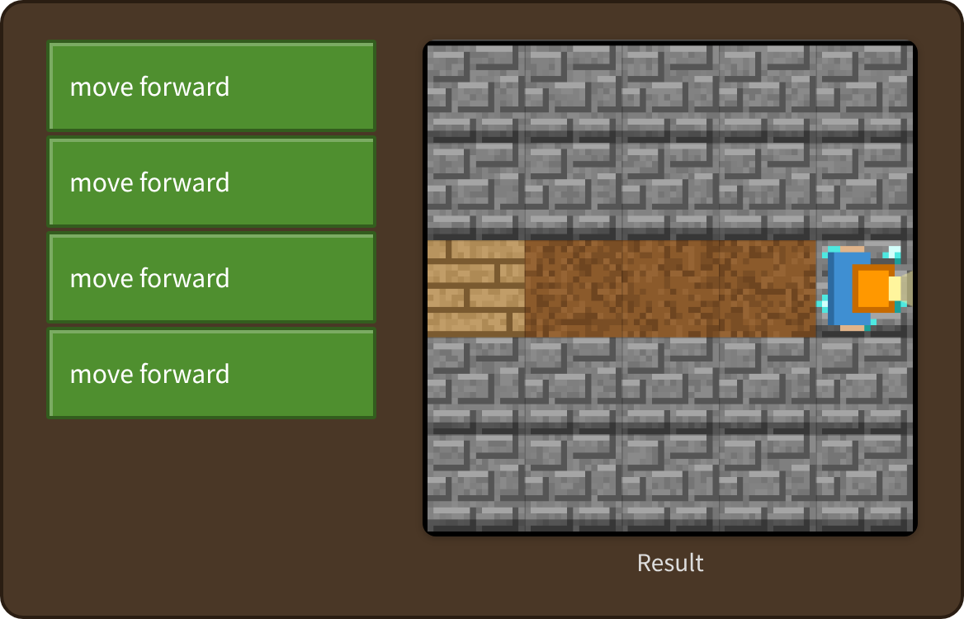
Stage 1: Go straight Answer
✨ Key point
Commands run in order from top to bottom. You stacked four “move forward” blocks.
⚠ Watch out
Blocks that are not connected do not run.
Notes:
[Key point] Commands run in order from top to bottom. You stacked four “move forward” blocks.
[Common mistake] Blocks that are not connected do not run.
[Video] videos/en/maze-01.mp4 (also on the videos page, videos.html)
[Check in the app] Open maze.html?sensei, choose stage 1, then “📖 Answer” → “▶ Run”.

Slide 7
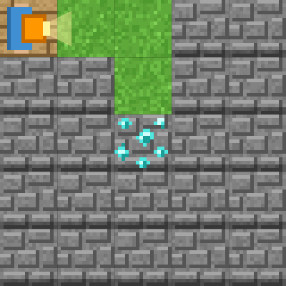
Stage 2: Let's turn
🎯 Goal
Think about direction
📝 Task
You turn on the way. "Forward" is where the explorer's light (yellow beam) is shining.
Notes:
[Goal] Think about direction
[Concepts] Sequence / Direction
[How to start]
Look at the board and trace the path to the goal with a finger. The explorer’s light shows “front”.
[Task] You turn on the way. "Forward" is where the explorer's light (yellow beam) is shining.

Slide 8
Stage 2: Let's turn Hint
💡
How to think
After 2 squares, "turn right". Turning does not move you to another square.
Notes:
[Questions to ask]
- “Which way is it facing at the start?”
- “Is there a set of moves that repeats?”
- “Run it and see where it stops.”
[Common mistake]
Turning alone does not move you. Add “move forward” after turning.

Slide 9
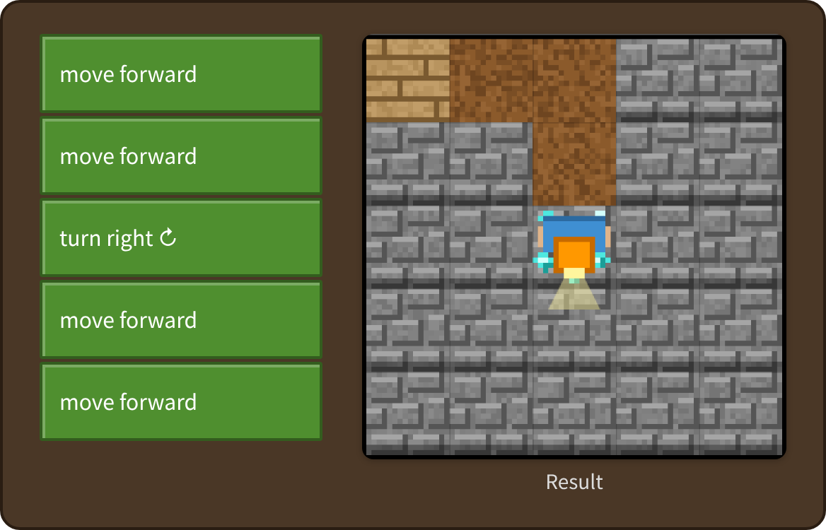
Stage 2: Let's turn Answer
✨ Key point
“Turn” only changes the direction. The explorer stays on the same square.
⚠ Watch out
Turning alone does not move you. Add “move forward” after turning.
Notes:
[Key point] “Turn” only changes the direction. The explorer stays on the same square.
[Common mistake] Turning alone does not move you. Add “move forward” after turning.
[Video] videos/en/maze-02.mp4 (also on the videos page, videos.html)
[Check in the app] Open maze.html?sensei, choose stage 2, then “📖 Answer” → “▶ Run”.

Slide 10
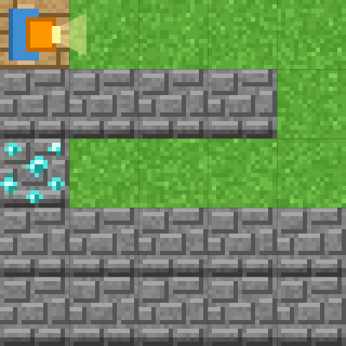
Stage 3: A long path
🎯 Goal
Build a long set of steps
📝 Task
Walk the long path. Pretend you are the explorer and think about which way to turn.
Notes:
[Goal] Build a long set of steps
[Concepts] Sequence / Direction
[How to start]
Look at the board and trace the path to the goal with a finger. The explorer’s light shows “front”.
[Task] Walk the long path. Pretend you are the explorer and think about which way to turn.

Slide 11
Stage 3: A long path Hint
💡
How to think
Forward 4 → turn right → forward 2 → turn right → forward 4
Notes:
[Questions to ask]
- “Which way is it facing at the start?”
- “Is there a set of moves that repeats?”
- “Run it and see where it stops.”
[Common mistake]
It is easy to mix up left and right. Imagine you are the explorer.

Slide 12
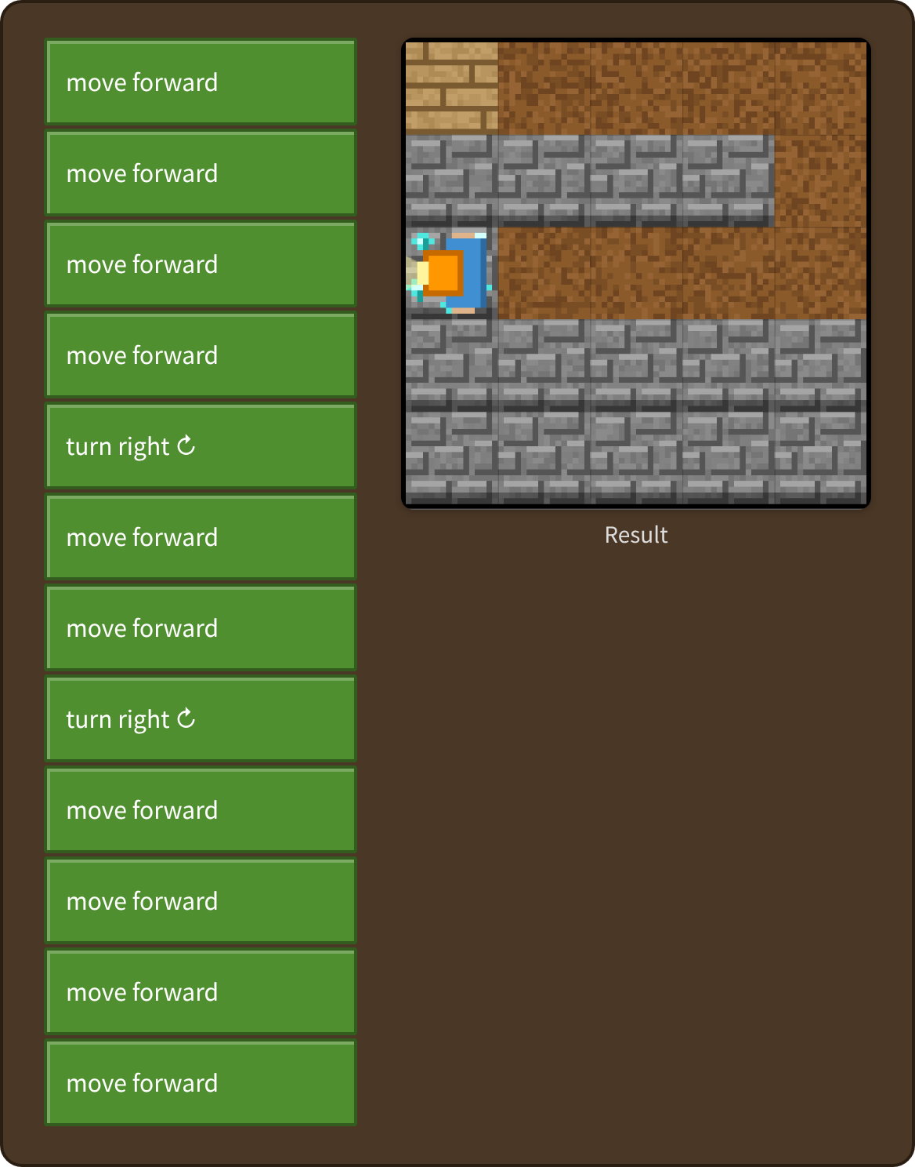
Stage 3: A long path Answer
✨ Key point
That took 12 blocks! Next, you will learn a way to make it shorter.
⚠ Watch out
It is easy to mix up left and right. Imagine you are the explorer.
Notes:
[Key point] That took 12 blocks! Next, you will learn a way to make it shorter.
[Common mistake] It is easy to mix up left and right. Imagine you are the explorer.
[Video] videos/en/maze-03.mp4 (also on the videos page, videos.html)
[Check in the app] Open maze.html?sensei, choose stage 3, then “📖 Answer” → “▶ Run”.

Slide 13
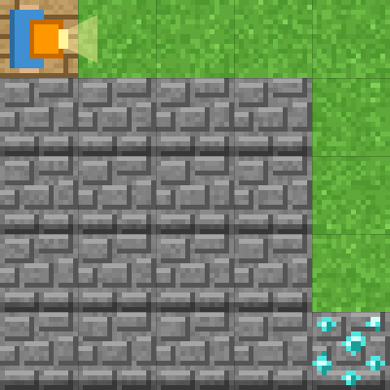
Stage 4: Use a loop
🎯 Goal
Make it shorter with a loop
📝 Task
Stacking the same block again and again is hard work. Put blocks inside "repeat" to repeat them.
Target: 5 blocks or fewer
Notes:
[Goal] Make it shorter with a loop
[Concepts] Loops
[How to start]
Look at the board and trace the path to the goal with a finger. The explorer’s light shows “front”.
The target is 5 blocks or fewer.
[Task] Stacking the same block again and again is hard work. Put blocks inside "repeat" to repeat them.

Slide 14
Stage 4: Use a loop Hint
💡
How to think
"repeat 4 (move forward)" → "turn right" → "repeat 4 (move forward)"
Notes:
[Questions to ask]
- “Which way is it facing at the start?”
- “Is there a set of moves that repeats?”
- “Run it and see where it stops.”
[Common mistake]
Putting “turn right” inside the loop changes the movement.

Slide 15
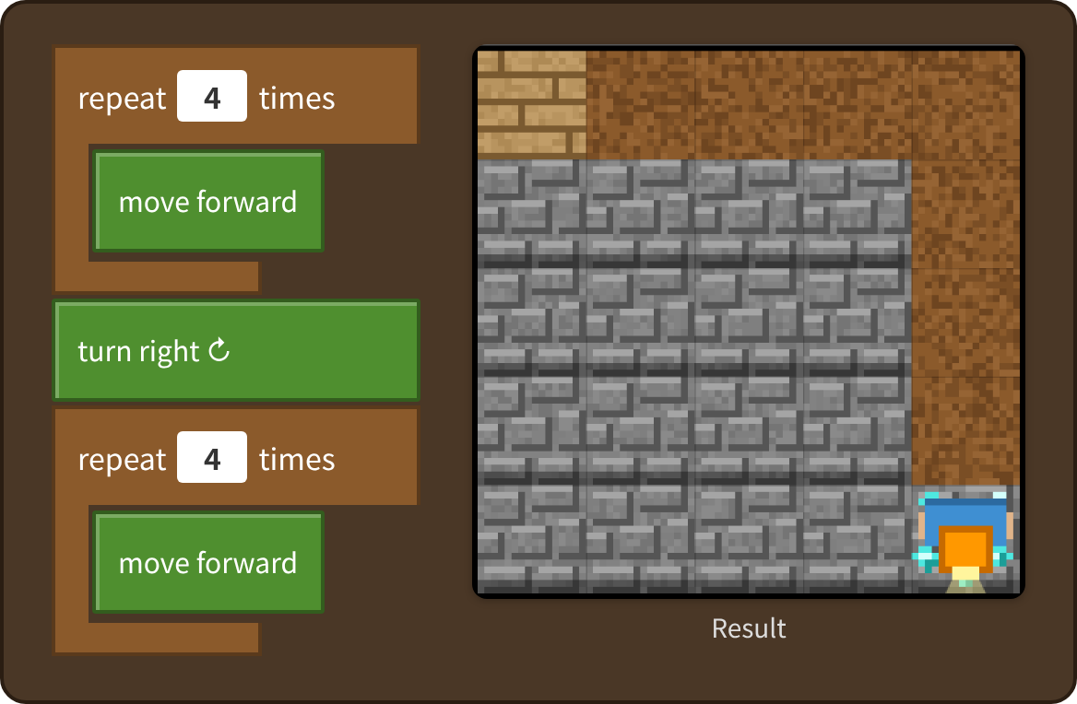
Stage 4: Use a loop Answer
✨ Key point
Repeated blocks can be grouped with “repeat __ times”.
⚠ Watch out
Putting “turn right” inside the loop changes the movement.
Notes:
[Key point] Repeated blocks can be grouped with “repeat __ times”.
[Common mistake] Putting “turn right” inside the loop changes the movement.
[Video] videos/en/maze-04.mp4 (also on the videos page, videos.html)
[Check in the app] Open maze.html?sensei, choose stage 4, then “📖 Answer” → “▶ Run”.

Slide 16
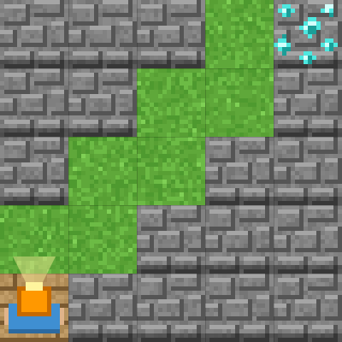
Stage 5: Climb the stairs
🎯 Goal
Find the pattern that repeats
📝 Task
Look closely at the stairs. The same set of moves repeats.
Target: 5 blocks or fewer
Notes:
[Goal] Find the pattern that repeats
[Concepts] Loops / Patterns
[How to start]
Look at the board and trace the path to the goal with a finger. The explorer’s light shows “front”.
The target is 5 blocks or fewer.
[Task] Look closely at the stairs. The same set of moves repeats.

Slide 17
Stage 5: Climb the stairs Hint
💡
How to think
One set is "forward → turn right → forward → turn left". How many times should it repeat?
Notes:
[Questions to ask]
- “Which way is it facing at the start?”
- “Is there a set of moves that repeats?”
- “Run it and see where it stops.”
[Common mistake]
It is easy to get the order of the set wrong (forward → right → forward → left).

Slide 18
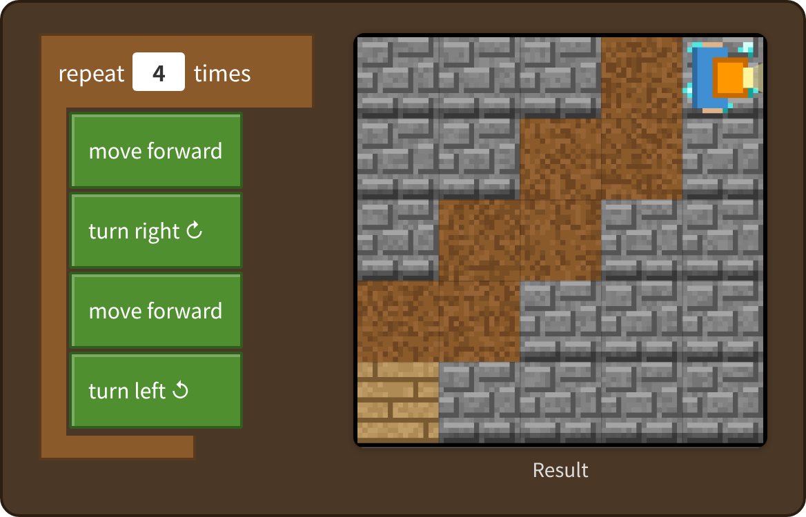
Stage 5: Climb the stairs Answer
✨ Key point
One set is forward, right, forward, left. The program stops when it reaches the goal.
⚠ Watch out
It is easy to get the order of the set wrong (forward → right → forward → left).
Notes:
[Key point] One set is forward, right, forward, left. The program stops when it reaches the goal.
[Common mistake] It is easy to get the order of the set wrong (forward → right → forward → left).
[Video] videos/en/maze-05.mp4 (also on the videos page, videos.html)
[Check in the app] Open maze.html?sensei, choose stage 5, then “📖 Answer” → “▶ Run”.

Slide 19
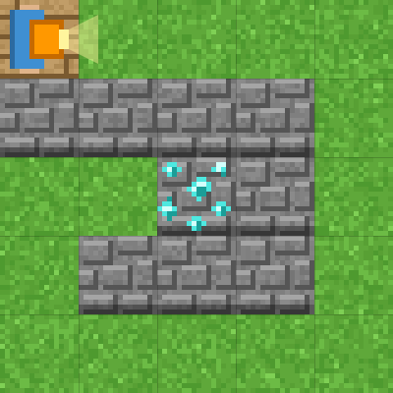
Stage 6: If…
🎯 Goal
Let the explorer decide with “if”
📝 Task
Try "repeat until goal" and "if front is open". The explorer looks ahead and decides to move or turn by itself.
Target: 4 blocks or fewer
Notes:
[Goal] Let the explorer decide with “if”
[Concepts] Conditions / Repeat until
[How to start]
Look at the board and trace the path to the goal with a finger. The explorer’s light shows “front”.
The target is 4 blocks or fewer.
[Task] Try "repeat until goal" and "if front is open". The explorer looks ahead and decides to move or turn by itself.

Slide 20
Stage 6: If… Hint
💡
How to think
Repeat until goal: if front is open "move forward", else "turn right".
Notes:
[Questions to ask]
- “Which way is it facing at the start?”
- “Is there a set of moves that repeats?”
- “Run it and see where it stops.”
[Common mistake]
If the “if” is outside the loop, it only checks once.

Slide 21
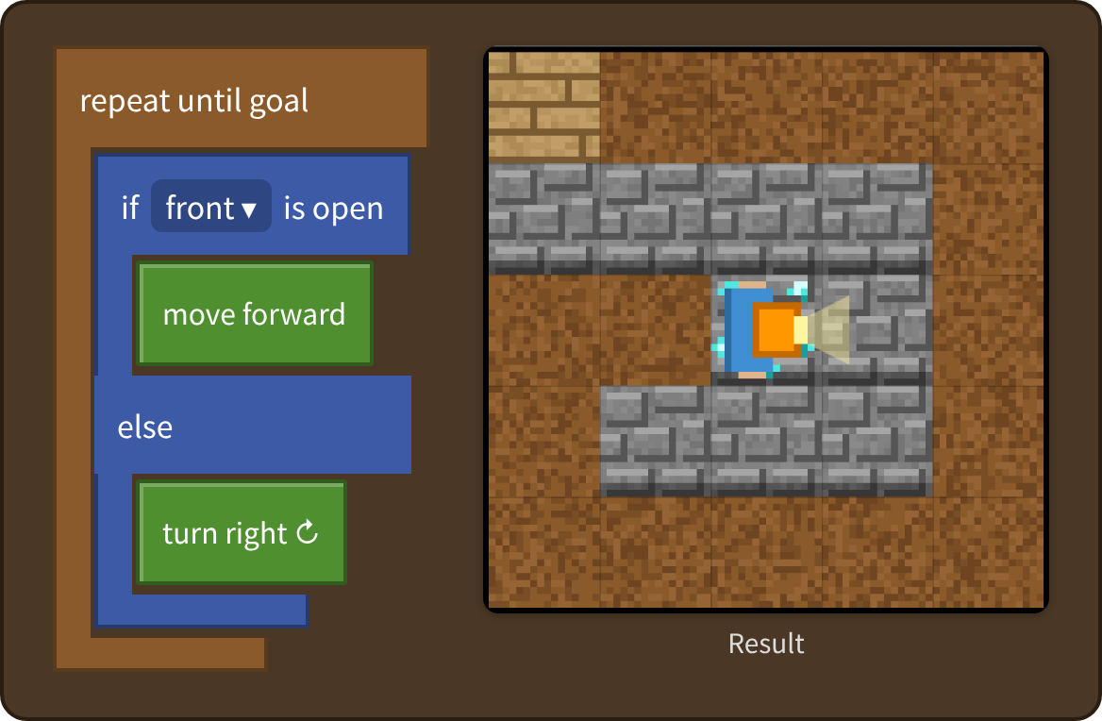
Stage 6: If… Answer
✨ Key point
If the front is open, move. If not, turn right. The explorer decided by itself!
⚠ Watch out
If the “if” is outside the loop, it only checks once.
Notes:
[Key point] If the front is open, move. If not, turn right. The explorer decided by itself!
[Common mistake] If the “if” is outside the loop, it only checks once.
[Video] videos/en/maze-06.mp4 (also on the videos page, videos.html)
[Check in the app] Open maze.html?sensei, choose stage 6, then “📖 Answer” → “▶ Run”.

Slide 22
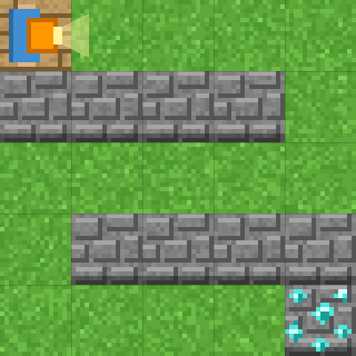
Stage 7: Right? Left?
🎯 Goal
Put an “if” inside an “if”
📝 Task
Now you turn both right and left. If the front is blocked, check the right. If that is blocked too, turn left.
Target: 6 blocks or fewer
Notes:
[Goal] Put an “if” inside an “if”
[Concepts] Conditions / Nesting
[How to start]
Look at the board and trace the path to the goal with a finger. The explorer’s light shows “front”.
The target is 6 blocks or fewer.
[Task] Now you turn both right and left. If the front is blocked, check the right. If that is blocked too, turn left.

Slide 23
Stage 7: Right? Left? Hint
💡
How to think
Put another "if right is open" inside "else".
Notes:
[Questions to ask]
- “Which way is it facing at the start?”
- “Is there a set of moves that repeats?”
- “Run it and see where it stops.”
[Common mistake]
With the Stage 6 program, you hit a dead end after turning.

Slide 24
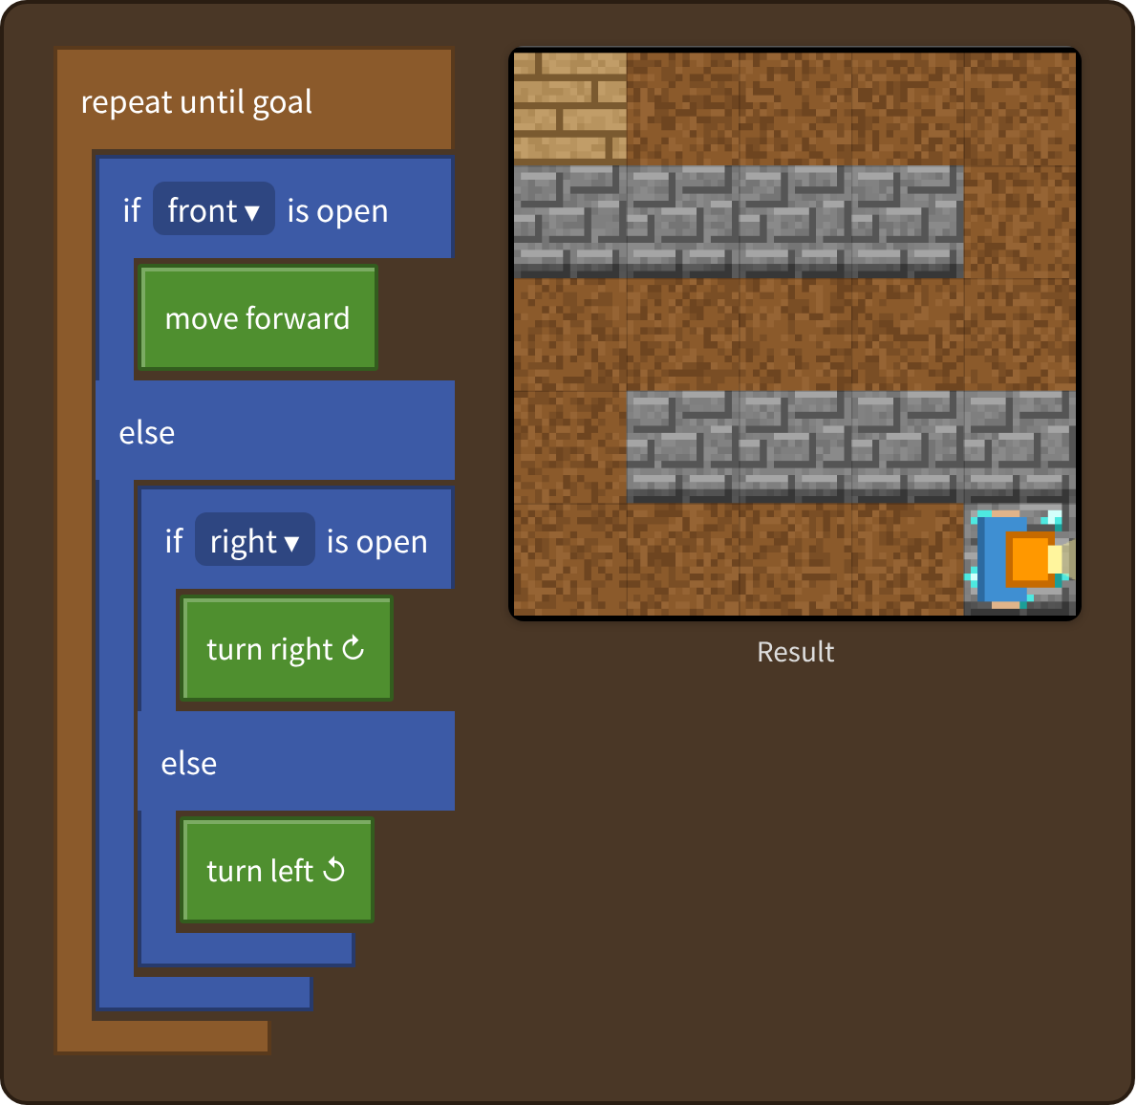
Stage 7: Right? Left? Answer
✨ Key point
Another “if” inside “else” lets it choose right or left.
⚠ Watch out
With the Stage 6 program, you hit a dead end after turning.
Notes:
[Key point] Another “if” inside “else” lets it choose right or left.
[Common mistake] With the Stage 6 program, you hit a dead end after turning.
[Video] videos/en/maze-07.mp4 (also on the videos page, videos.html)
[Check in the app] Open maze.html?sensei, choose stage 7, then “📖 Answer” → “▶ Run”.

Slide 25
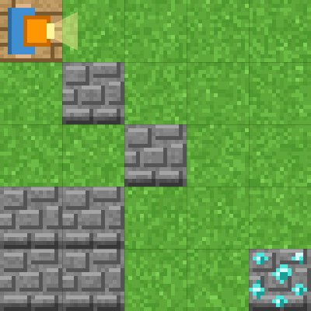
Stage 8: Any maze!
🎯 Goal
A way to solve any maze
📝 Task
Final challenge! Your program is tested on 30 random mazes. Reach the goal in all of them to clear!
Notes:
[Goal] A way to solve any maze
[Concepts] Generalization / Conditions / Repeat until
[How to start]
Look at the board and trace the path to the goal with a finger. The explorer’s light shows “front”.
[Task] Final challenge! Your program is tested on 30 random mazes. Reach the goal in all of them to clear!

Slide 26
Stage 8: Any maze! Hint
💡
How to think
The "right-hand rule": keep your right hand on the wall and you always reach the goal. If the right is open, turn right first, then move.
Notes:
[Questions to ask]
- “Which way is it facing at the start?”
- “Is there a set of moves that repeats?”
- “Run it and see where it stops.”
[Common mistake]
The Stage 7 program can keep going in circles in some mazes.

Slide 27
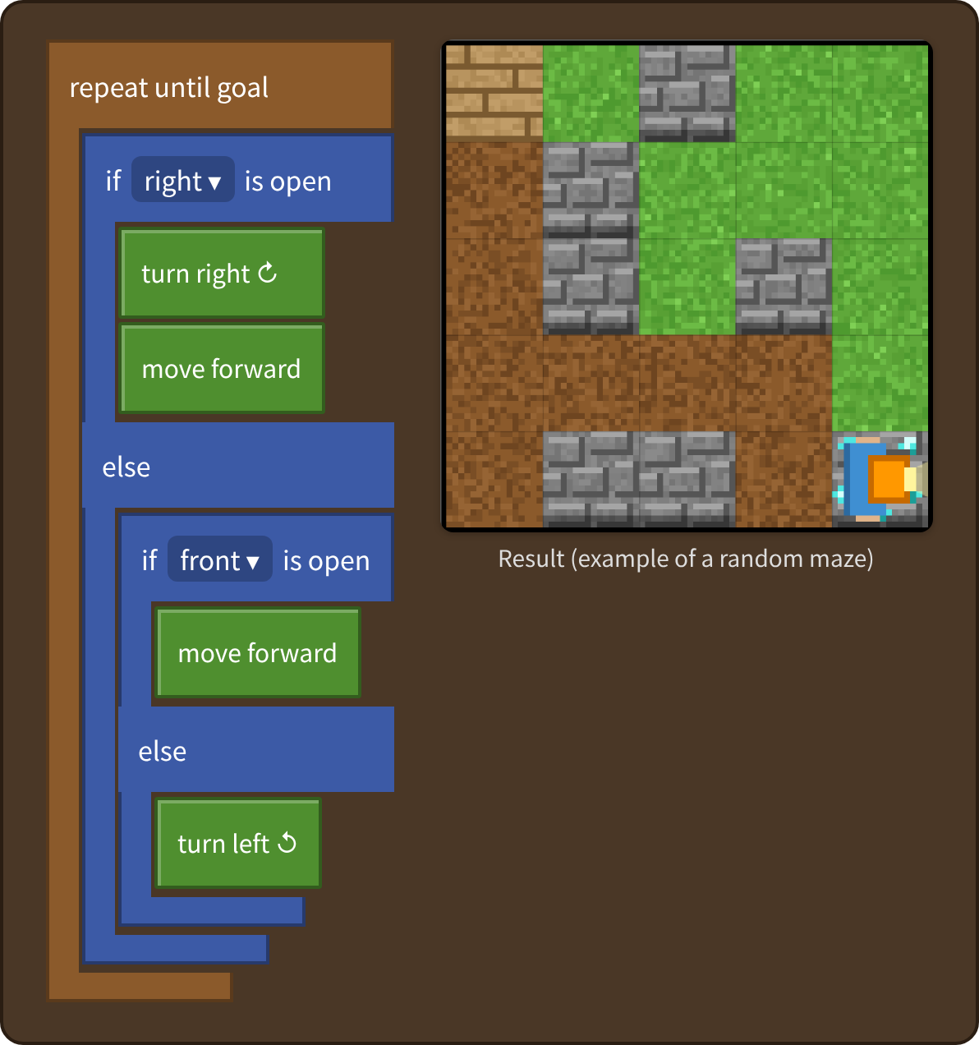
Stage 8: Any maze! Answer
✨ Key point
The “right-hand rule”: keep your right hand on the wall, and you can solve any maze!
⚠ Watch out
The Stage 7 program can keep going in circles in some mazes.
Notes:
[Key point] The “right-hand rule”: keep your right hand on the wall, and you can solve any maze!
[Common mistake] The Stage 7 program can keep going in circles in some mazes.
[Video] videos/en/maze-08.mp4 (also on the videos page, videos.html)
[Check in the app] Open maze.html?sensei, choose stage 8, then “📖 Answer” → “▶ Run”.

Slide 28
Reflection
🤔
🛠
🚀
How did you plan the path to the goal?
What could you do with “if”?
How can you solve any maze?
📜
Clear every stage to get a certificate! Type your name and print it.
Notes:
[Running the reflection]
Discuss one question at a time in pairs or groups, then ask 2–3 students to share with the class.
[Certificate] Clearing every stage shows a certificate (device date; issued by Yasuhito Inoue, NIT Maizuru College). Open it again from “⚙ Settings → 📜”. It prints on A4 landscape.
[Next step] Use “⚙ Settings → 🐍 Switch to Python” to solve the same world with Python.

