Slide 1
🚀 Space Star Hunt
Lesson slides: 7 stages
うちゅうで ほしあつめ
Notes:
[About these slides]
Lesson slides for Space Star Hunt (space.html). Each stage has 3 slides: Task → Hint → Answer.
The slides use simple words for students; notes for teachers are here in the notes area.
Show the Answer slide only after students have tried.

Slide 2
What you will learn
🚀
Sequence
Direction
Stage 1, 2
Stage 2
Pick up every star, then board the rocket. Learn to check first, then act.
Loops
Patterns
Stage 3, 4, 5
Stage 4
Conditions
Repeat until
Stage 5, 6, 7
Stage 6, 7
Notes:
[Lesson aims]
Pick up every star, then board the rocket. Learn to check first, then act.
[Concepts and stages]
・Sequence: Stage 1, 2
・Direction: Stage 2
・Loops: Stage 3, 4, 5
・Patterns: Stage 4
・Conditions: Stage 5, 6, 7
・Repeat until: Stage 6, 7
・Generalization: Stage 7

Slide 3
How to use
🗂
🧩
▶
🔁
1. Choose a stage
2. Connect blocks
3. Run it
4. Fix and try again
Pick a stage from the list at the top right and read the task.
Drag blocks from the left and stack them in order.
Press “▶ Run”. The block that is running lights up.
If it fails, press “↺ Restart”. Stuck? Press “💡 Hint”.
Notes:
[Opening]
Add “space.html” to the end of your published address.
[Teacher mode]
Add “?sensei” to the address to show the “📖 Answer” button and load answers (e.g. space.html?sensei).
[Next player]
When students share a device, press “⚙ Settings → 🔄 Next player” twice to reset the records.

Slide 4
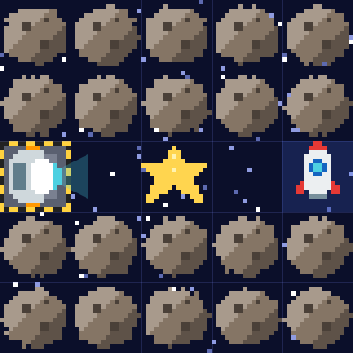
Stage 1: Pick up a star
🎯 Goal
Use “pick up”
📝 Task
Pick up every star ⭐, then board the rocket 🚀! Use "pick up star" on a star square.
Notes:
[Goal] Use “pick up”
[Concepts] Sequence
[How to start]
Look at the board and trace the path to the goal with a finger. The explorer’s light shows “front”.
[Task] Pick up every star ⭐, then board the rocket 🚀! Use "pick up star" on a star square.

Slide 5
Stage 1: Pick up a star Hint
💡
How to think
Forward 2 → pick up star → forward 2
Notes:
[Questions to ask]
- “Which way is it facing at the start?”
- “Is there a set of moves that repeats?”
- “Run it and see where it stops.”
[Common mistake]
Picking up on a square with no star fails. Count where to pick up.

Slide 6
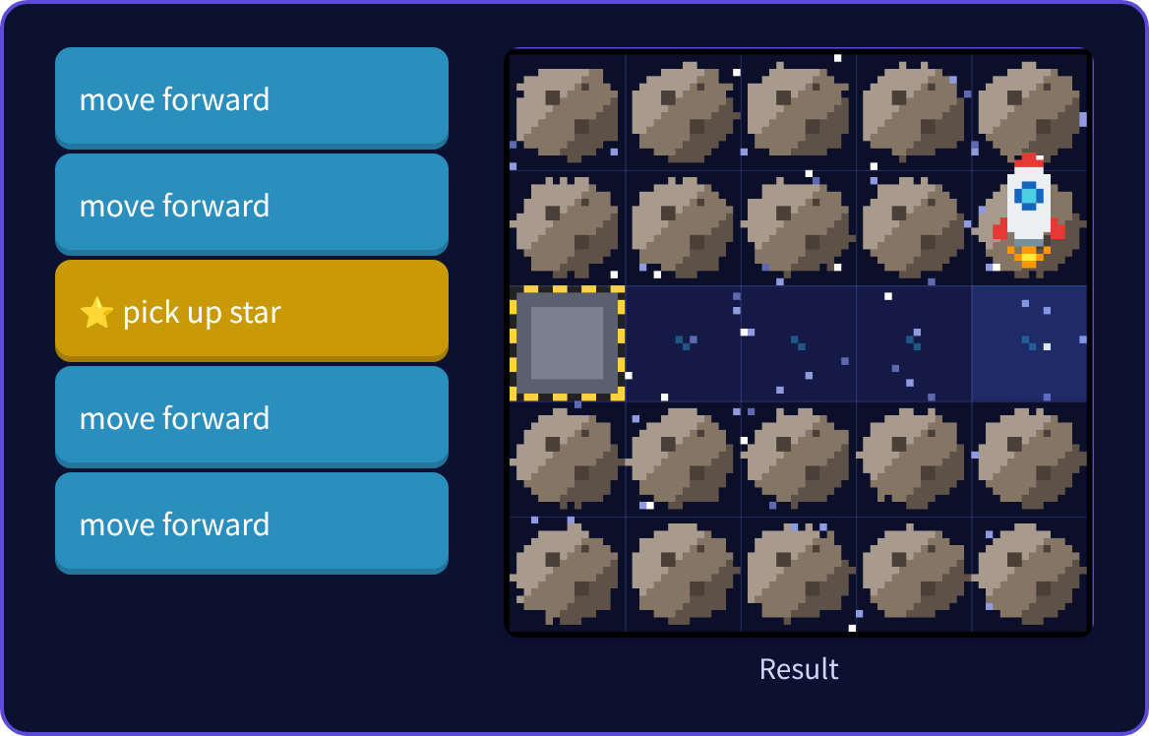
Stage 1: Pick up a star Answer
✨ Key point
Use “pick up” on the star square. Collect them all, then go to the rocket!
⚠ Watch out
Picking up on a square with no star fails. Count where to pick up.
Notes:
[Key point] Use “pick up” on the star square. Collect them all, then go to the rocket!
[Common mistake] Picking up on a square with no star fails. Count where to pick up.
[Video] videos/en/space-01.mp4 (also on the videos page, videos.html)
[Check in the app] Open space.html?sensei, choose stage 1, then “📖 Answer” → “▶ Run”.

Slide 7
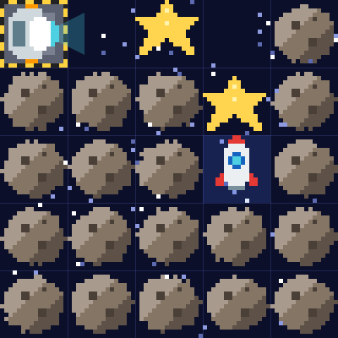
Stage 2: Turn and collect
🎯 Goal
Turn and collect in order
📝 Task
There are 2 stars. Be careful where you turn.
Notes:
[Goal] Turn and collect in order
[Concepts] Sequence / Direction
[How to start]
Look at the board and trace the path to the goal with a finger. The explorer’s light shows “front”.
[Task] There are 2 stars. Be careful where you turn.

Slide 8
Stage 2: Turn and collect Hint
💡
How to think
Forward 2 and pick up → forward 1 → turn right → forward 1 and pick up → forward 1
Notes:
[Questions to ask]
- “Which way is it facing at the start?”
- “Is there a set of moves that repeats?”
- “Run it and see where it stops.”
[Common mistake]
Watch the order: pick up before or after turning?

Slide 9
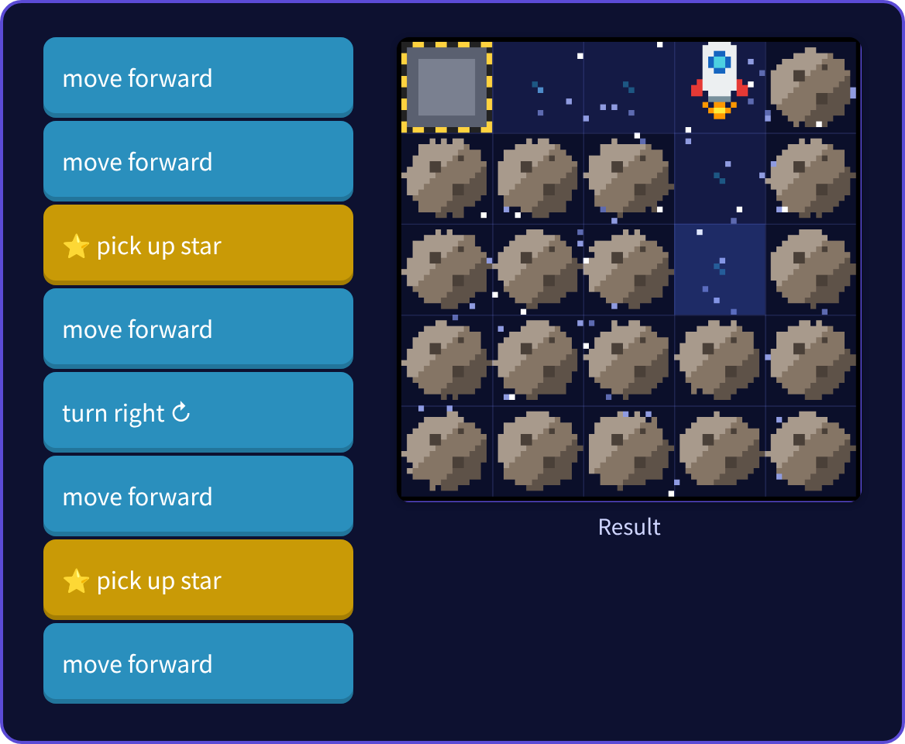
Stage 2: Turn and collect Answer
✨ Key point
The order of turning and picking up is important.
⚠ Watch out
Watch the order: pick up before or after turning?
Notes:
[Key point] The order of turning and picking up is important.
[Common mistake] Watch the order: pick up before or after turning?
[Video] videos/en/space-02.mp4 (also on the videos page, videos.html)
[Check in the app] Open space.html?sensei, choose stage 2, then “📖 Answer” → “▶ Run”.

Slide 10
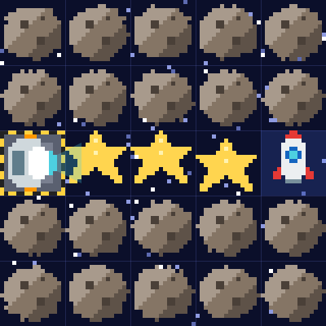
Stage 3: Collect with a loop
🎯 Goal
Collect with a loop
📝 Task
The stars are in a row. Put "move → pick up" into a loop.
Target: 4 blocks or fewer
Notes:
[Goal] Collect with a loop
[Concepts] Loops
[How to start]
Look at the board and trace the path to the goal with a finger. The explorer’s light shows “front”.
The target is 4 blocks or fewer.
[Task] The stars are in a row. Put "move → pick up" into a loop.

Slide 11
Stage 3: Collect with a loop Hint
💡
How to think
"repeat 3 (move forward → pick up star)" → "move forward"
Notes:
[Questions to ask]
- “Which way is it facing at the start?”
- “Is there a set of moves that repeats?”
- “Run it and see where it stops.”
[Common mistake]
Forget the last “move” and you will not reach the rocket.

Slide 12
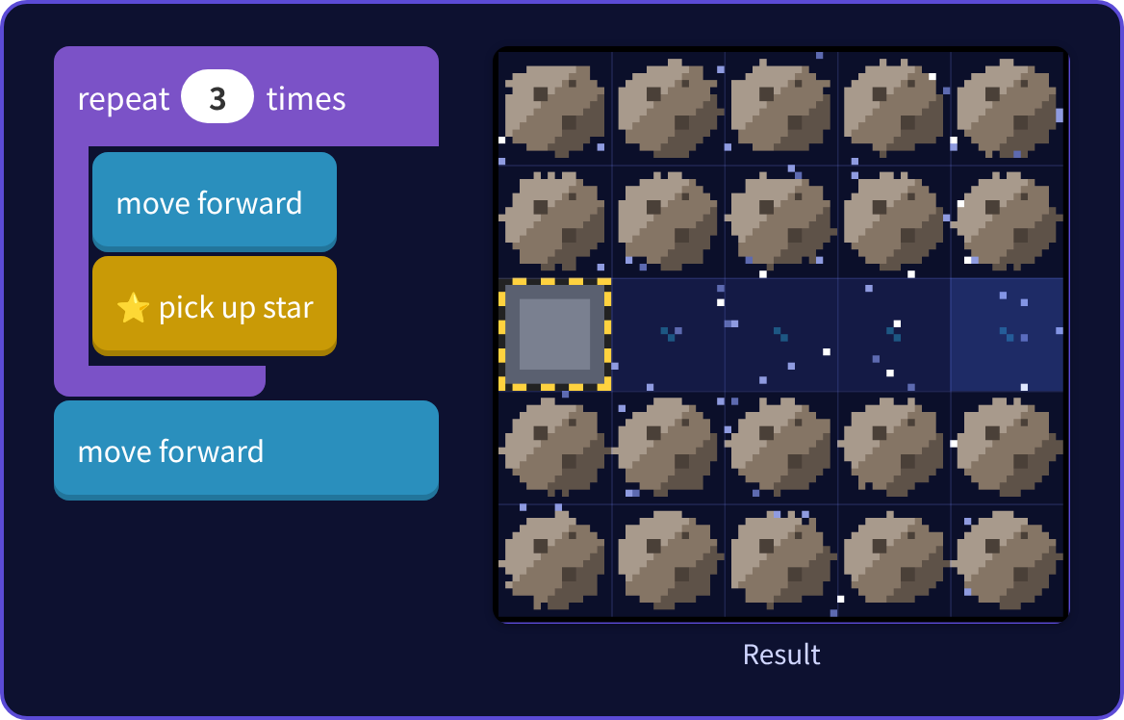
Stage 3: Collect with a loop Answer
✨ Key point
Repeat “move → pick up” 3 times, then move one more square.
⚠ Watch out
Forget the last “move” and you will not reach the rocket.
Notes:
[Key point] Repeat “move → pick up” 3 times, then move one more square.
[Common mistake] Forget the last “move” and you will not reach the rocket.
[Video] videos/en/space-03.mp4 (also on the videos page, videos.html)
[Check in the app] Open space.html?sensei, choose stage 3, then “📖 Answer” → “▶ Run”.

Slide 13
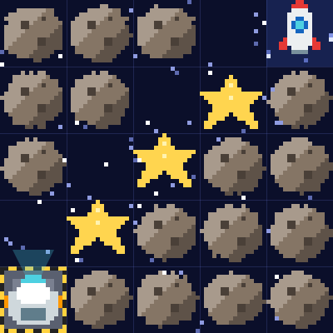
Stage 4: Star stairs
🎯 Goal
Find the pattern and repeat it
📝 Task
There are stars on the stairs. Find the set of moves that repeats.
Target: 6 blocks or fewer
Notes:
[Goal] Find the pattern and repeat it
[Concepts] Loops / Patterns
[How to start]
Look at the board and trace the path to the goal with a finger. The explorer’s light shows “front”.
The target is 6 blocks or fewer.
[Task] There are stars on the stairs. Find the set of moves that repeats.

Slide 14
Stage 4: Star stairs Hint
💡
How to think
Repeat "forward → turn right → forward → pick up → turn left". You finish when you reach the rocket.
Notes:
[Questions to ask]
- “Which way is it facing at the start?”
- “Is there a set of moves that repeats?”
- “Run it and see where it stops.”
[Common mistake]
If “pick up” is in the wrong place, you pick up where there is no star.

Slide 15
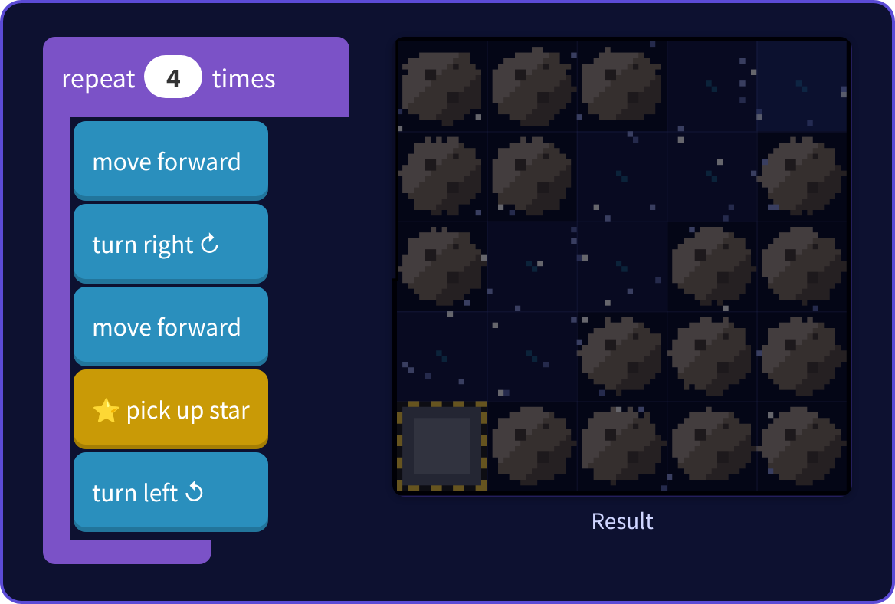
Stage 4: Star stairs Answer
✨ Key point
Each step of the stairs is one set. You reach the rocket during the 4th repeat.
⚠ Watch out
If “pick up” is in the wrong place, you pick up where there is no star.
Notes:
[Key point] Each step of the stairs is one set. You reach the rocket during the 4th repeat.
[Common mistake] If “pick up” is in the wrong place, you pick up where there is no star.
[Video] videos/en/space-04.mp4 (also on the videos page, videos.html)
[Check in the app] Open space.html?sensei, choose stage 4, then “📖 Answer” → “▶ Run”.

Slide 16
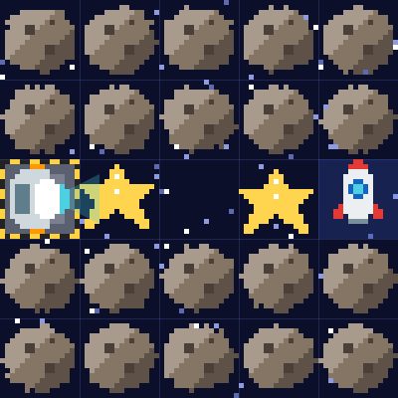
Stage 5: If there is a star
🎯 Goal
Check first, then act (if)
📝 Task
Some squares have stars and some don't. Picking up where there is no star is a mistake! Let the explorer check first.
Target: 4 blocks or fewer
Notes:
[Goal] Check first, then act (if)
[Concepts] Conditions / Loops
[How to start]
Look at the board and trace the path to the goal with a finger. The explorer’s light shows “front”.
The target is 4 blocks or fewer.
[Task] Some squares have stars and some don't. Picking up where there is no star is a mistake! Let the explorer check first.

Slide 17
Stage 5: If there is a star Hint
💡
How to think
"repeat 4: move forward → if there is a star here, pick it up"
Notes:
[Questions to ask]
- “Which way is it facing at the start?”
- “Is there a set of moves that repeats?”
- “Run it and see where it stops.”
[Common mistake]
Picking up every time without “if” fails on empty squares.

Slide 18
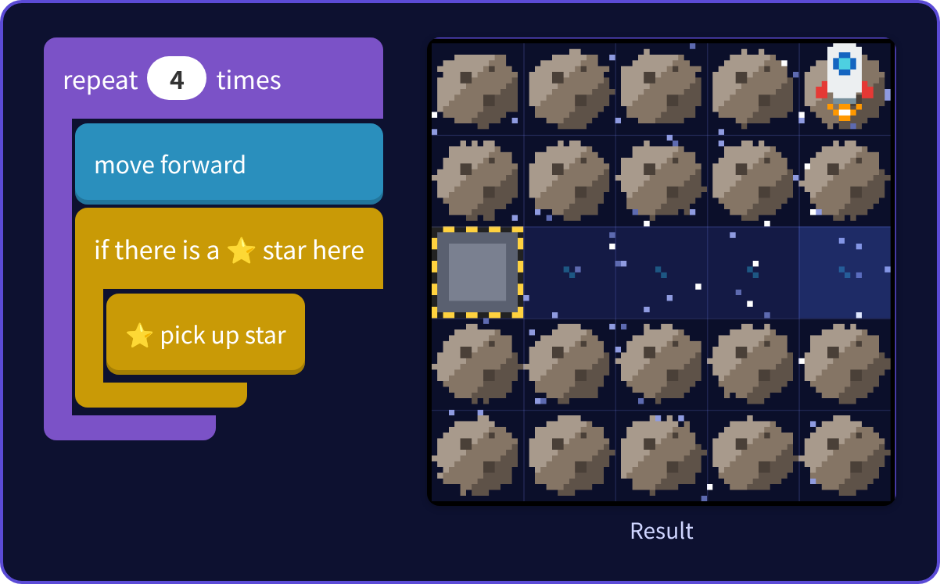
Stage 5: If there is a star Answer
✨ Key point
Pick up only when there is a star. Check with “if” before you act.
⚠ Watch out
Picking up every time without “if” fails on empty squares.
Notes:
[Key point] Pick up only when there is a star. Check with “if” before you act.
[Common mistake] Picking up every time without “if” fails on empty squares.
[Video] videos/en/space-05.mp4 (also on the videos page, videos.html)
[Check in the app] Open space.html?sensei, choose stage 5, then “📖 Answer” → “▶ Run”.

Slide 19
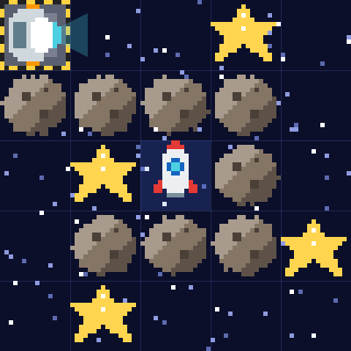
Stage 6: Until mission complete
🎯 Goal
Repeat until the mission is complete
📝 Task
Stars are scattered around a spiral. Use "repeat until mission complete" and check as you go.
Target: 6 blocks or fewer
Notes:
[Goal] Repeat until the mission is complete
[Concepts] Conditions / Repeat until
[How to start]
Look at the board and trace the path to the goal with a finger. The explorer’s light shows “front”.
The target is 6 blocks or fewer.
[Task] Stars are scattered around a spiral. Use "repeat until mission complete" and check as you go.

Slide 20
Stage 6: Until mission complete Hint
💡
How to think
Inside the loop: if there is a star, pick it up → if front is open, move forward, else turn right
Notes:
[Questions to ask]
- “Which way is it facing at the start?”
- “Is there a set of moves that repeats?”
- “Run it and see where it stops.”
[Common mistake]
Forgetting to check at the corners leaves stars behind.

Slide 21
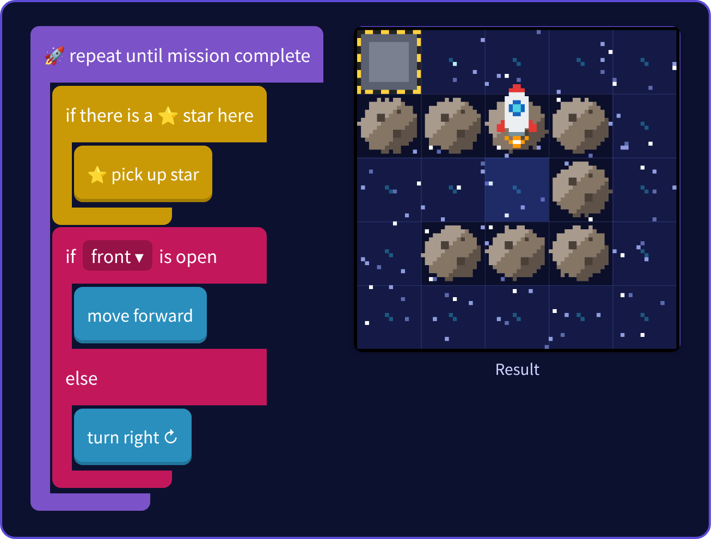
Stage 6: Until mission complete Answer
✨ Key point
Each time, first check under your feet, then move.
⚠ Watch out
Forgetting to check at the corners leaves stars behind.
Notes:
[Key point] Each time, first check under your feet, then move.
[Common mistake] Forgetting to check at the corners leaves stars behind.
[Video] videos/en/space-06.mp4 (also on the videos page, videos.html)
[Check in the app] Open space.html?sensei, choose stage 6, then “📖 Answer” → “▶ Run”.

Slide 22
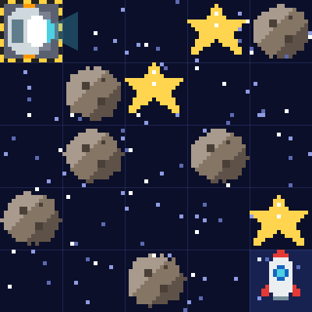
Stage 7: Any space!
🎯 Goal
Clear any space
📝 Task
Final challenge! Your program is tested in 30 random spaces. Collect all the stars and board the rocket to clear!
Notes:
[Goal] Clear any space
[Concepts] Generalization / Conditions / Repeat until
[How to start]
Look at the board and trace the path to the goal with a finger. The explorer’s light shows “front”.
[Task] Final challenge! Your program is tested in 30 random spaces. Collect all the stars and board the rocket to clear!

Slide 23
Stage 7: Any space! Hint
💡
How to think
Use the "right-hand rule" to follow the walls, and pick up stars when you find them. It's OK to pass the rocket — keep walking until you have every star.
Notes:
[Questions to ask]
- “Which way is it facing at the start?”
- “Is there a set of moves that repeats?”
- “Run it and see where it stops.”
[Common mistake]
You may think it stops at the rocket — it keeps going until every star is collected.

Slide 24
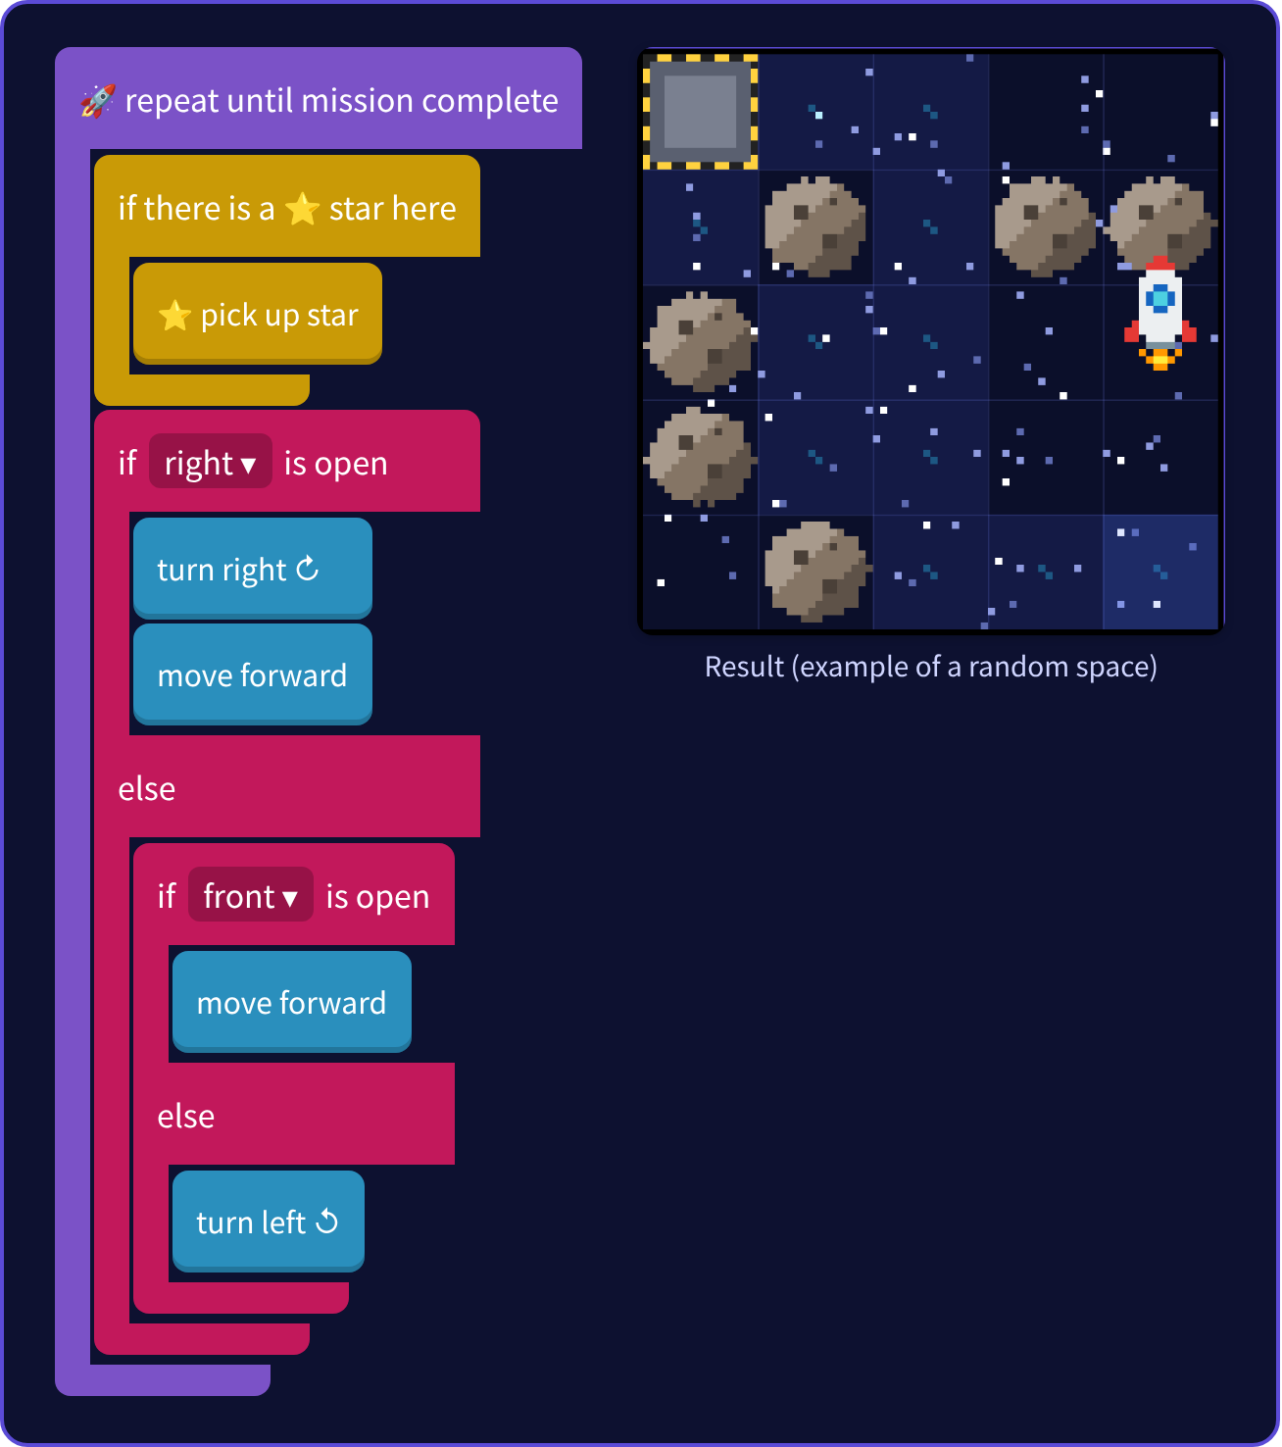
Stage 7: Any space! Answer
✨ Key point
Right-hand rule + pick up stars. It is OK to pass the rocket!
⚠ Watch out
You may think it stops at the rocket — it keeps going until every star is collected.
Notes:
[Key point] Right-hand rule + pick up stars. It is OK to pass the rocket!
[Common mistake] You may think it stops at the rocket — it keeps going until every star is collected.
[Video] videos/en/space-07.mp4 (also on the videos page, videos.html)
[Check in the app] Open space.html?sensei, choose stage 7, then “📖 Answer” → “▶ Run”.

Slide 25
Reflection
🤔
🛠
🚀
How did you decide the order of stars?
Why is “check, then act” useful?
What is good about “repeat until mission complete”?
📜
Clear every stage to get a certificate! Type your name and print it.
Notes:
[Running the reflection]
Discuss one question at a time in pairs or groups, then ask 2–3 students to share with the class.
[Certificate] Clearing every stage shows a certificate (device date; issued by Yasuhito Inoue, NIT Maizuru College). Open it again from “⚙ Settings → 📜”. It prints on A4 landscape.
[Next step] Use “⚙ Settings → 🐍 Switch to Python” to solve the same world with Python.

