Slide 1
🧱 Break & Build Quest
Lesson slides: 7 stages
こわして つくる ぼうけん
Notes:
[About these slides]
Lesson slides for Break & Build Quest (craft.html). Each stage has 3 slides: Task → Hint → Answer.
The slides use simple words for students; notes for teachers are here in the notes area.
Show the Answer slide only after students have tried.

Slide 2
What you will learn
🧱
Sequence
Counting
Stage 1, 2
Stage 2, 4, 6
Break stone to hold blocks, and place them on water to make bridges. Plan while keeping track of how many blocks you have.
Loops
Conditions
Stage 3, 4, 5
Stage 5, 6, 7
Repeat until
Nesting
Stage 7
Stage 7
Notes:
[Lesson aims]
Break stone to hold blocks, and place them on water to make bridges. Plan while keeping track of how many blocks you have.
[Concepts and stages]
・Sequence: Stage 1, 2
・Counting: Stage 2, 4, 6
・Loops: Stage 3, 4, 5
・Conditions: Stage 5, 6, 7
・Repeat until: Stage 7
・Nesting: Stage 7

Slide 3
How to use
🗂
🧩
▶
🔁
1. Choose a stage
2. Connect blocks
3. Run it
4. Fix and try again
Pick a stage from the list at the top right and read the task.
Drag blocks from the left and stack them in order.
Press “▶ Run”. The block that is running lights up.
If it fails, press “↺ Restart”. Stuck? Press “💡 Hint”.
Notes:
[Opening]
Add “craft.html” to the end of your published address.
[Teacher mode]
Add “?sensei” to the address to show the “📖 Answer” button and load answers (e.g. craft.html?sensei).
[Next player]
When students share a device, press “⚙ Settings → 🔄 Next player” twice to reset the records.

Slide 4
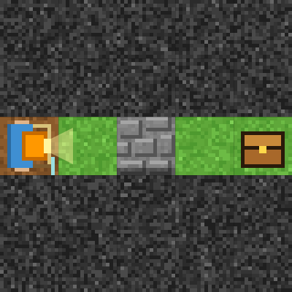
Stage 1: Break and go
🎯 Goal
Use “break”
📝 Task
A stone block is in the way. Break it with "⛏ break the block in front", then go to the treasure chest!
Notes:
[Goal] Use “break”
[Concepts] Sequence
[How to start]
Look at the board and trace the path to the goal with a finger. The explorer’s light shows “front”.
[Task] A stone block is in the way. Break it with "⛏ break the block in front", then go to the treasure chest!

Slide 5
Stage 1: Break and go Hint
💡
How to think
Forward 1 → break → forward 3
Notes:
[Questions to ask]
- “Which way is it facing at the start?”
- “Is there a set of moves that repeats?”
- “Run it and see where it stops.”
[Common mistake]
Moving without breaking bumps into the stone.

Slide 6
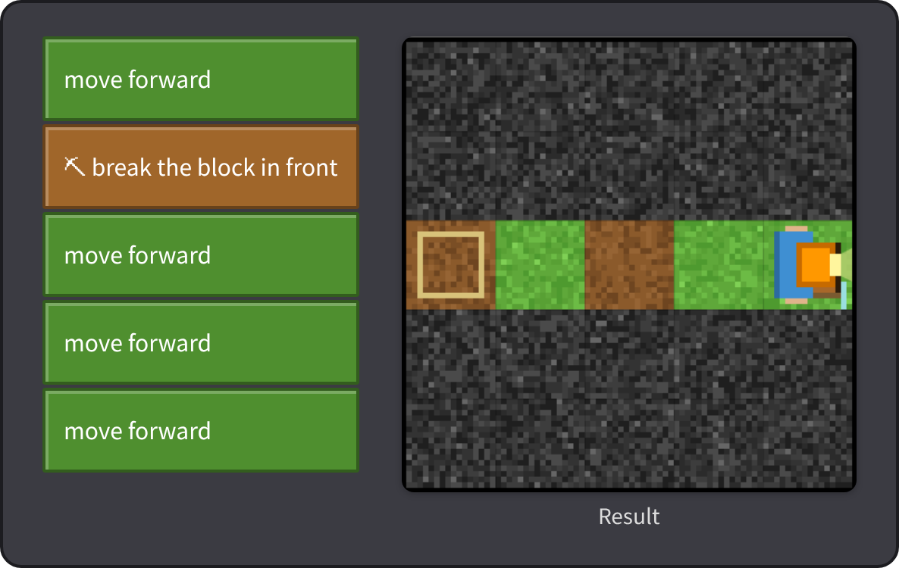
Stage 1: Break and go Answer
✨ Key point
Break the stone in front, and it becomes a path.
⚠ Watch out
Moving without breaking bumps into the stone.
Notes:
[Key point] Break the stone in front, and it becomes a path.
[Common mistake] Moving without breaking bumps into the stone.
[Video] videos/en/craft-01.mp4 (also on the videos page, videos.html)
[Check in the app] Open craft.html?sensei, choose stage 1, then “📖 Answer” → “▶ Run”.

Slide 7
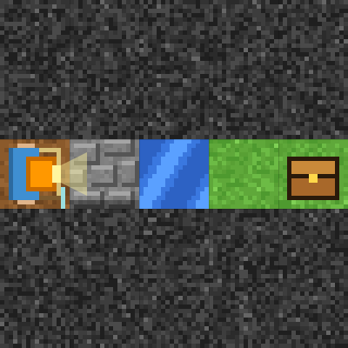
Stage 2: Build a bridge
🎯 Goal
Break → hold → place
📝 Task
There is water ahead. You need a block to make a bridge. Break the stone first — then you will have a block!
Notes:
[Goal] Break → hold → place
[Concepts] Sequence / Counting
[How to start]
Look at the board and trace the path to the goal with a finger. The explorer’s light shows “front”.
[Task] There is water ahead. You need a block to make a bridge. Break the stone first — then you will have a block!

Slide 8
Stage 2: Build a bridge Hint
💡
How to think
Break → forward → place → forward 3
Notes:
[Questions to ask]
- “Which way is it facing at the start?”
- “Is there a set of moves that repeats?”
- “Run it and see where it stops.”
[Common mistake]
Placing first fails because you have no blocks yet.

Slide 9
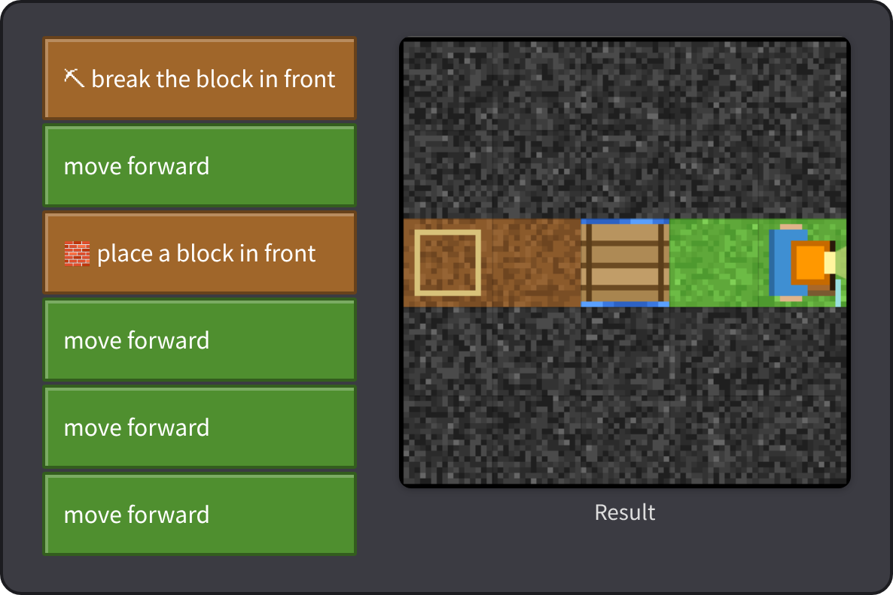
Stage 2: Build a bridge Answer
✨ Key point
You start with no blocks. Break first, then place.
⚠ Watch out
Placing first fails because you have no blocks yet.
Notes:
[Key point] You start with no blocks. Break first, then place.
[Common mistake] Placing first fails because you have no blocks yet.
[Video] videos/en/craft-02.mp4 (also on the videos page, videos.html)
[Check in the app] Open craft.html?sensei, choose stage 2, then “📖 Answer” → “▶ Run”.

Slide 10
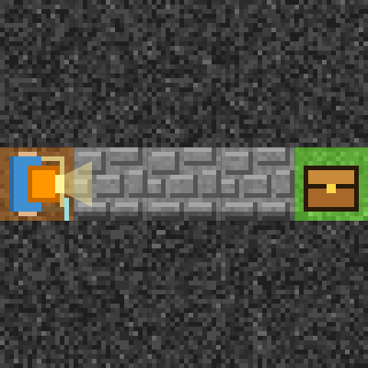
Stage 3: Break with a loop
🎯 Goal
Break with a loop
📝 Task
Stone blocks in a row! Put "break → move" into a loop.
Target: 4 blocks or fewer
Notes:
[Goal] Break with a loop
[Concepts] Loops
[How to start]
Look at the board and trace the path to the goal with a finger. The explorer’s light shows “front”.
The target is 4 blocks or fewer.
[Task] Stone blocks in a row! Put "break → move" into a loop.

Slide 11
Stage 3: Break with a loop Hint
💡
How to think
"repeat 3 (break → move forward)" → "move forward"
Notes:
[Questions to ask]
- “Which way is it facing at the start?”
- “Is there a set of moves that repeats?”
- “Run it and see where it stops.”
[Common mistake]
Moving first bumps into stone. Break first.

Slide 12
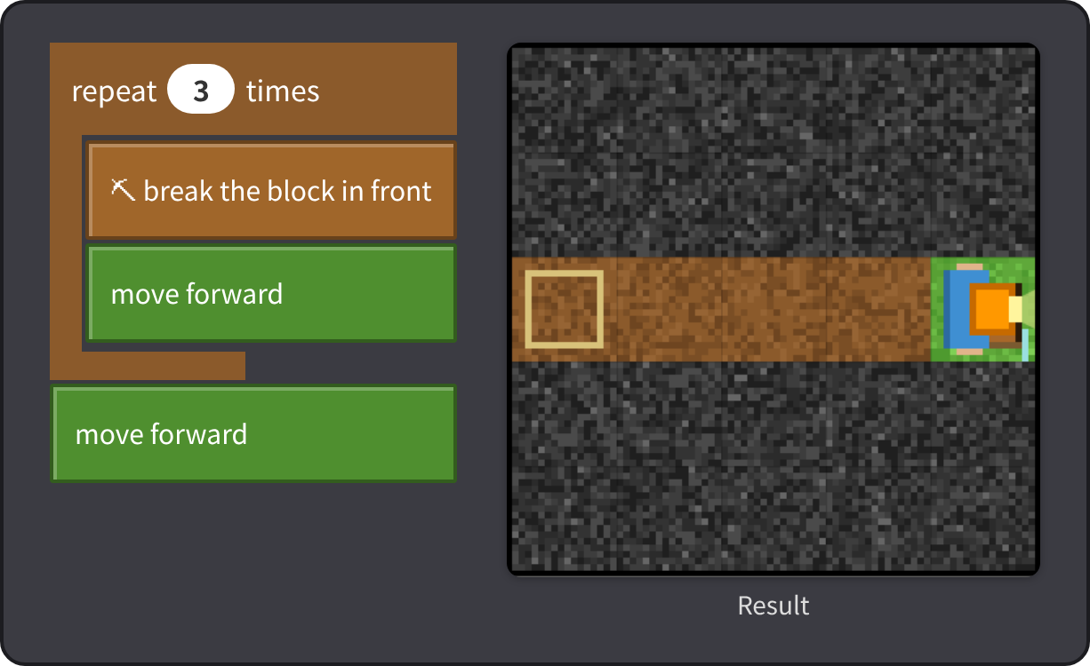
Stage 3: Break with a loop Answer
✨ Key point
You repeated “break → move” 3 times.
⚠ Watch out
Moving first bumps into stone. Break first.
Notes:
[Key point] You repeated “break → move” 3 times.
[Common mistake] Moving first bumps into stone. Break first.
[Video] videos/en/craft-03.mp4 (also on the videos page, videos.html)
[Check in the app] Open craft.html?sensei, choose stage 3, then “📖 Answer” → “▶ Run”.

Slide 13
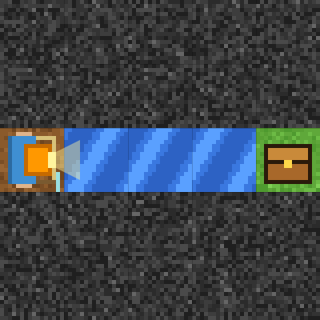
Stage 4: A long bridge
🎯 Goal
Use up the blocks you have
📝 Task
You have 3 blocks. Make a long bridge over the river.
Target: 4 blocks or fewer
Notes:
[Goal] Use up the blocks you have
[Concepts] Loops / Counting
[How to start]
Look at the board and trace the path to the goal with a finger. The explorer’s light shows “front”.
The target is 4 blocks or fewer.
[Task] You have 3 blocks. Make a long bridge over the river.

Slide 14
Stage 4: A long bridge Hint
💡
How to think
"repeat 3 (place → move forward)" → "move forward"
Notes:
[Questions to ask]
- “Which way is it facing at the start?”
- “Is there a set of moves that repeats?”
- “Run it and see where it stops.”
[Common mistake]
Moving before placing drops you into the water.

Slide 15
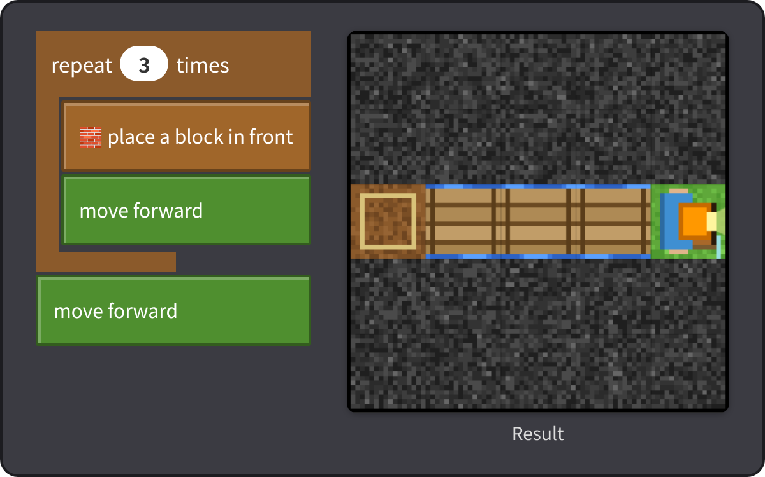
Stage 4: A long bridge Answer
✨ Key point
You had 3 blocks. After placing 3, you have exactly 0.
⚠ Watch out
Moving before placing drops you into the water.
Notes:
[Key point] You had 3 blocks. After placing 3, you have exactly 0.
[Common mistake] Moving before placing drops you into the water.
[Video] videos/en/craft-04.mp4 (also on the videos page, videos.html)
[Check in the app] Open craft.html?sensei, choose stage 4, then “📖 Answer” → “▶ Run”.

Slide 16
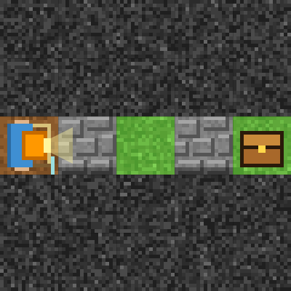
Stage 5: If there is stone
🎯 Goal
Check first, then break (if)
📝 Task
Some squares have stone and some don't. Breaking where there is no stone is a mistake! Use "if" to check first.
Target: 4 blocks or fewer
Notes:
[Goal] Check first, then break (if)
[Concepts] Conditions / Loops
[How to start]
Look at the board and trace the path to the goal with a finger. The explorer’s light shows “front”.
The target is 4 blocks or fewer.
[Task] Some squares have stone and some don't. Breaking where there is no stone is a mistake! Use "if" to check first.

Slide 17
Stage 5: If there is stone Hint
💡
How to think
"repeat 4: if the front is a stone block, break it → move forward"
Notes:
[Questions to ask]
- “Which way is it facing at the start?”
- “Is there a set of moves that repeats?”
- “Run it and see where it stops.”
[Common mistake]
Trying to break when there is no stone fails.

Slide 18
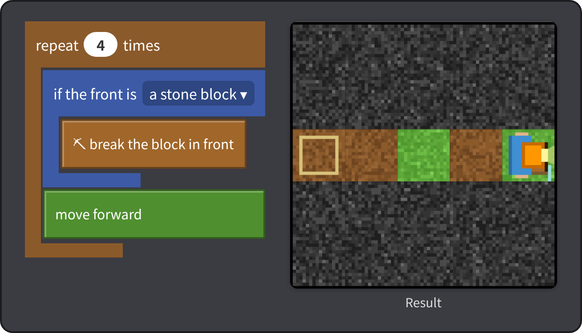
Stage 5: If there is stone Answer
✨ Key point
Break only when there is stone. Breaking where there is none is a mistake!
⚠ Watch out
Trying to break when there is no stone fails.
Notes:
[Key point] Break only when there is stone. Breaking where there is none is a mistake!
[Common mistake] Trying to break when there is no stone fails.
[Video] videos/en/craft-05.mp4 (also on the videos page, videos.html)
[Check in the app] Open craft.html?sensei, choose stage 5, then “📖 Answer” → “▶ Run”.

Slide 19
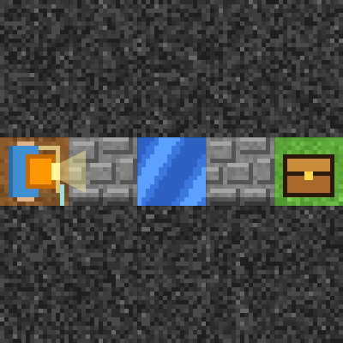
Stage 6: Stone and water
🎯 Goal
Stone and water: two “if”s
📝 Task
Stone and water are mixed. Break stone, bridge water. Breaking stone gives you a block, and placing one uses it up. Watch how many you have!
Target: 6 blocks or fewer
Notes:
[Goal] Stone and water: two “if”s
[Concepts] Conditions / Counting
[How to start]
Look at the board and trace the path to the goal with a finger. The explorer’s light shows “front”.
The target is 6 blocks or fewer.
[Task] Stone and water are mixed. Break stone, bridge water. Breaking stone gives you a block, and placing one uses it up. Watch how many you have!

Slide 20
Stage 6: Stone and water Hint
💡
How to think
Repeat 4 times: if stone → break / if water → place / move forward
Notes:
[Questions to ask]
- “Which way is it facing at the start?”
- “Is there a set of moves that repeats?”
- “Run it and see where it stops.”
[Common mistake]
Forgetting to check for water makes you fall in.

Slide 21
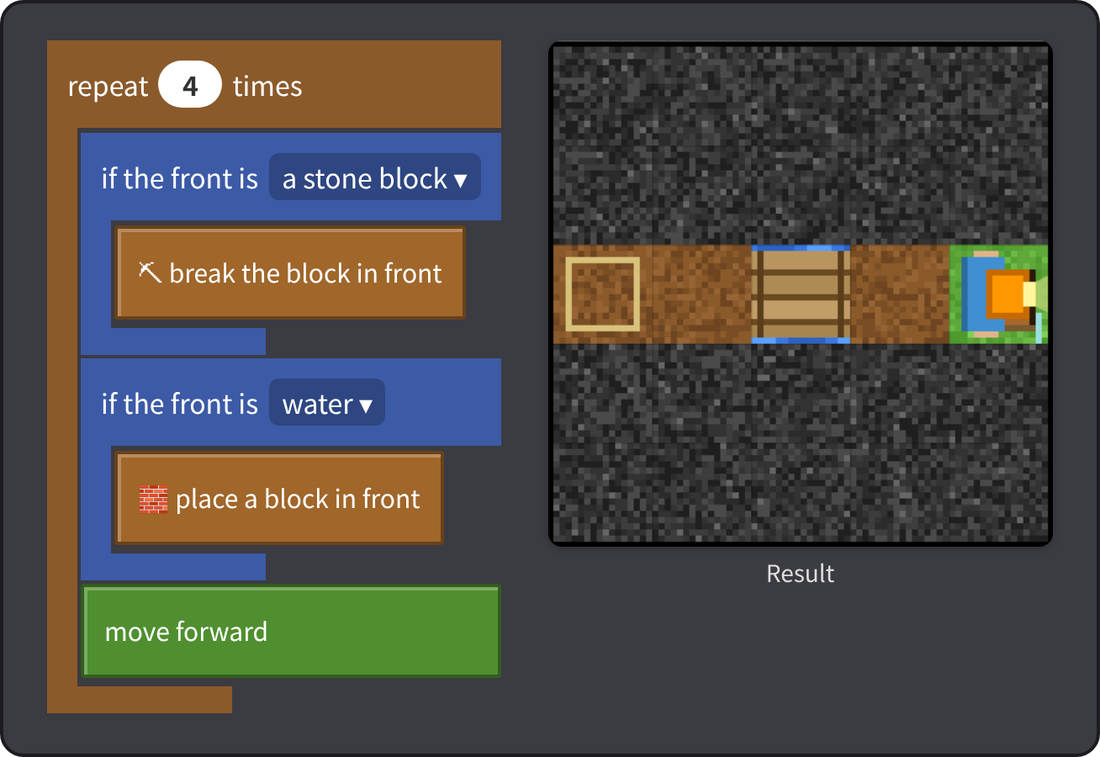
Stage 6: Stone and water Answer
✨ Key point
Breaking adds one, placing uses one: 0 → 1 → 0 → 1.
⚠ Watch out
Forgetting to check for water makes you fall in.
Notes:
[Key point] Breaking adds one, placing uses one: 0 → 1 → 0 → 1.
[Common mistake] Forgetting to check for water makes you fall in.
[Video] videos/en/craft-06.mp4 (also on the videos page, videos.html)
[Check in the app] Open craft.html?sensei, choose stage 6, then “📖 Answer” → “▶ Run”.

Slide 22
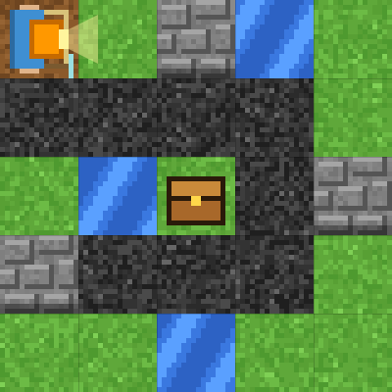
Stage 7: Spiral cave
🎯 Goal
Check the front as you go
📝 Task
A spiral cave full of stone and water. Use "repeat until goal" and decide what to do by checking the front.
Target: 8 blocks or fewer
Notes:
[Goal] Check the front as you go
[Concepts] Conditions / Repeat until / Nesting
[How to start]
Look at the board and trace the path to the goal with a finger. The explorer’s light shows “front”.
The target is 8 blocks or fewer.
[Task] A spiral cave full of stone and water. Use "repeat until goal" and decide what to do by checking the front.

Slide 23
Stage 7: Spiral cave Hint
💡
How to think
Inside the loop: if stone → break / if water → place / if the front is an open path → move, else turn right
Notes:
[Questions to ask]
- “Which way is it facing at the start?”
- “Is there a set of moves that repeats?”
- “Run it and see where it stops.”
[Common mistake]
Hard dark rock cannot be broken. If you cannot move, turn right.

Slide 24
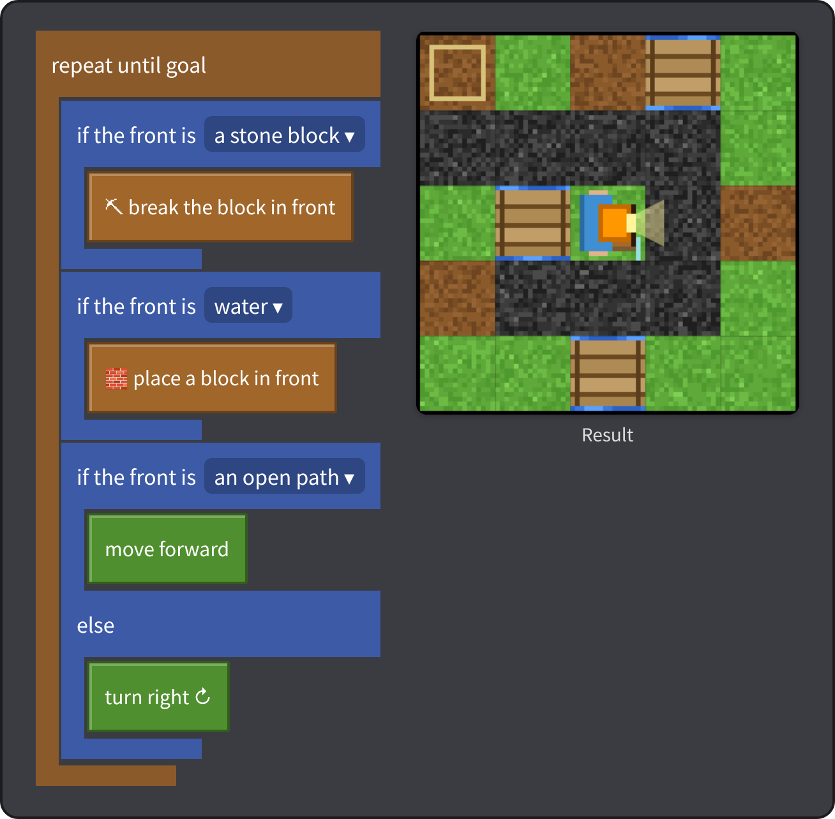
Stage 7: Spiral cave Answer
✨ Key point
Stone? Break. Water? Place. Open? Move. Otherwise, turn right!
⚠ Watch out
Hard dark rock cannot be broken. If you cannot move, turn right.
Notes:
[Key point] Stone? Break. Water? Place. Open? Move. Otherwise, turn right!
[Common mistake] Hard dark rock cannot be broken. If you cannot move, turn right.
[Video] videos/en/craft-07.mp4 (also on the videos page, videos.html)
[Check in the app] Open craft.html?sensei, choose stage 7, then “📖 Answer” → “▶ Run”.

Slide 25
Reflection
🤔
🛠
🚀
What did you watch out for when breaking and placing?
How did the number of blocks you had change?
Why is checking the front useful?
📜
Clear every stage to get a certificate! Type your name and print it.
Notes:
[Running the reflection]
Discuss one question at a time in pairs or groups, then ask 2–3 students to share with the class.
[Certificate] Clearing every stage shows a certificate (device date; issued by Yasuhito Inoue, NIT Maizuru College). Open it again from “⚙ Settings → 📜”. It prints on A4 landscape.
[Next step] Use “⚙ Settings → 🐍 Switch to Python” to solve the same world with Python.

